Slide 1
Preliminary Assessment of Distributed Wind Technical Potential in the Continental U.S.
Mike Gleason
May 6, 2016

Slide 2
Objective and Scope
Objective:
Perform a preliminary assessment of the technical potential for distributed wind technologies in the continental U.S.
Scope:
“Technical Potential” in this analysis is defined as resource potential constrained to areas proximal to end-use electricity demand and constrained by the siting considerations of those areas, but without any consideration of the actual amount of end-use electricity demand
Turbines must be located in areas near buildings and will be sized to maximize annual energy generation under the physical siting constraints of each area, without regard to whether the generated energy could be consumed on-site

Slide 3
Geographic Resolution of Analysis
Census Blocks:
Smallest geographic unit used by U.S. Census Bureau
~11 million blocks in the U.S.
~7 million contain buildings
Average size = 0.9 km² (0.35 mi² or 222 acres)

Slide 4
Siting Constraints: Overview
Focus on siting constraints that are:
Nationally measurable (datasets available)
Commonly applied (supported by review of DSIRE)
Intuitive and non-controversial
Constraints include:
Development limited to Census Blocks containing buildings
Clearance above tree canopy
Affects minimum allowable blade height
Parcel size/setback from property lines
Affects maximum allowable blade height
Power density

Slide 5
Siting Constraints: Tree Canopy – Overview
“A general rule of thumb is to install a wind turbine on a tower with the bottom of the rotor blades at least 30 feet (9 meters) above any obstacle that is within 300 feet (90 meters) of the tower.”
(NREL 2009 - http://www.nrel.gov/docs/fy09osti/45911.pdf)
This is consistent with multiple state guidelines and incentives for distributed wind

Slide 6
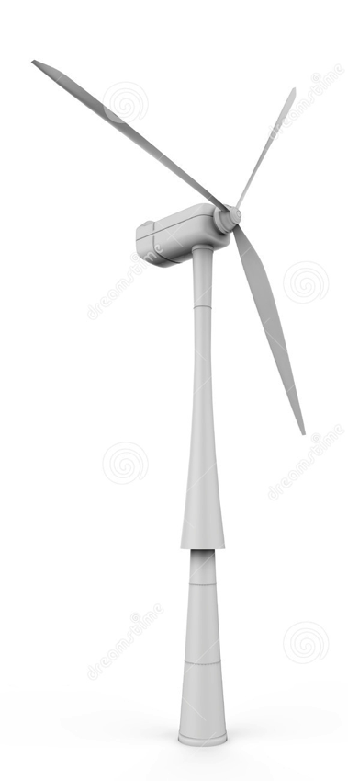





Siting Constraints: Tree Canopy – Implementation
Two datasets to support this constraint:
Percent canopy cover (30 m x 30 m grid) (NLCD 2011)
Average canopy height (30 m x 30 m grid) (NBCD 2000)
Data do not support perfectly replicating “9 meters above obstruction within 300 m”
Instead, approximate as follows:
In Census blocks with non-negligible canopy cover (≥ 10%), the minimum turbine blade height must be a specified clearance (12 m) above the average canopy height
10% canopy is a preliminary, conservative setting based on engineering judgment
Clearance of 12 meters used instead of 9 meters to account for past and future vegetation growth and offset from average (rather than maximum) canopy height
Parcel
≥10% Canopy Cover
12 m

Slide 7
Siting Constraints: Parcel Size/Setbacks – Explained
Parcel Size
Parcel size is commonly used by distributed wind developers as a rule-of-thumb measure for siting various turbine heights
However, existing state legislature rarely considers parcel size (only 3 states)
Minimum parcel size required (~1-2 acres)
Setbacks
Nearly all state guidelines for distributed wind suggest setbacks from property lines of 1, 1.1, or 1.5 times the total turbine height (i.e., blade tip)
Different setback factors (1, 1.1, 1.5) are equally common amongst reviewed legislature

Slide 8
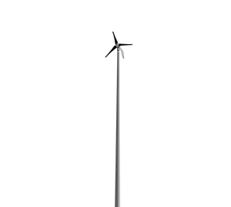

Siting Constraints: Parcel Size/Setbacks – Implementation
Two primary datasets to support this constraint:
Estimated counts of buildings by Census Block (HAZUS General Building Stock 2013)
Land area per Census Block (Census 2010)
Data do not support perfectly replicating “setback from parcel boundaries” because parcel boundaries are not available
Instead, approximate as follows:
Estimate the average parcel size for each block as:
(Note: this calculation assumes one building per parcel)
Based on the average parcel size and blade-tip setback factor of 1.1, calculate the maximum blade height as:
This equation was created by assuming a square area for each turbine setback and solving for the maximum allowable blade height:
The setback factor of 1.1 was selected as a reasonable midpoint based on review of state guidelines for distributed wind siting
22.2 m blade height
Avg. Parcel Size = 2 acres
24.42 m
setback
41 m max blade height
0.58 acres required

Slide 9
Siting Constraints: Overall Implementation
Filter out Census Block with no buildings
Calculate minimum allowable blade height for each Block based on tree canopy
Calculate maximum allowable blade height for each Block based on average parcel size
Identify potential turbine models (hub height and system size) that can be sited in each Block, given blade height constraints and turbine blade heights
From the available models, select a single turbine model for each Block to maximize annual energy production
Annual energy production based on current technology power curves from dWind
Assumed each parcel in the Block installs one turbine (matching the optimal model)
For Blocks with large power densities, cap system counts and capacities to 3 MW/km²

Slide 10
Turbine Specifications
Turbine Size (kw) | Power Curve | Rotor Radius (m) | Hub Heights (m)
2.5 | Small Residential | 2.2 | 20, 30, 40
5 | Small Residential | 3.1 | 30, 40
10 | Small Residential | 4.4 | 30, 40
20 | Small Residential | 6.2 | 30, 40, 50
50 | Small Commercial | 9.8 | 30, 40, 50
100 | Small Commercial | 13.8 | 40, 50
250 | Mid-size | 21.9 | 50
500 | Mid-size | 30.9 | 50, 80
750 | Mid-size | 37.8 | 50, 80
1000 | Large | 43.7 | 50, 80
1500 | Large | 53.5 | 80

Slide 11
Additional Assumptions
No consideration of local or even regional variation in siting regulations or guidelines
Setbacks only apply to property lines, not structures, roads, etc.
No setback is required from structures on the same property as the turbine
Average characteristics of each Census block are representative of all properties in that block
Applies to canopy height, canopy cover, parcel size
Each parcel can only install one turbine, selected to maximize generation
The only constraint applied to account for inter-turbine (e.g., wake) effects is the 3 MW/km² density limit

Slide 12
Results - Summary
Distributed wind technical potential in the continental U.S.:
49.5 million systems
8.1 TW capacity
18,691 TWh generation
Compared to onshore utility scale technical potential from Wind Vision:
10.6 TW
30,950 TWh
Key considerations in comparing these assessments:
Because these were separate assessments, there is likely to be significant “double-counting”, especially in rural areas
The utility wind technical potential analysis considered several additional factors excluded in this preliminary assessment for distributed wind (e.g., setbacks from airports, slope exclusions, wetland exclusions, etc.)

Slide 13
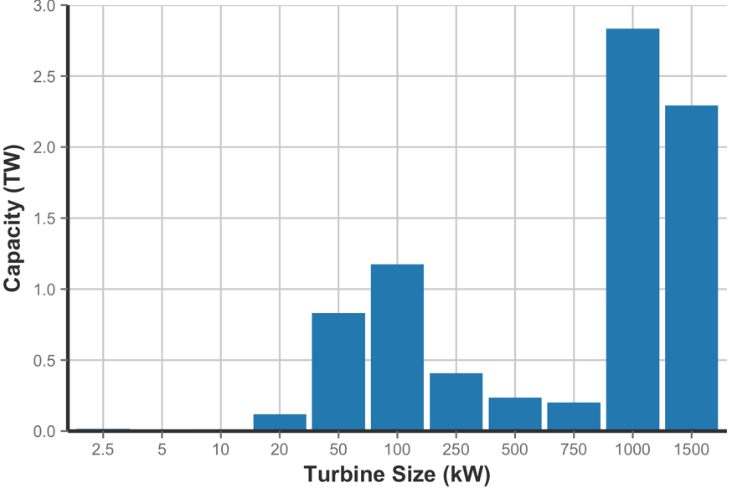
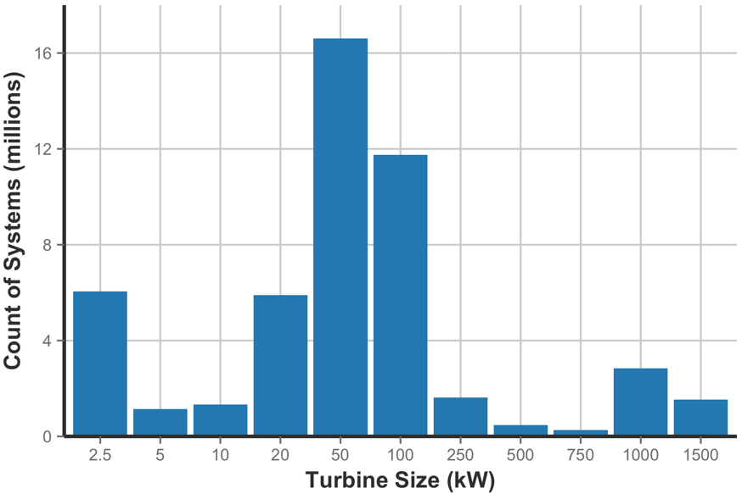
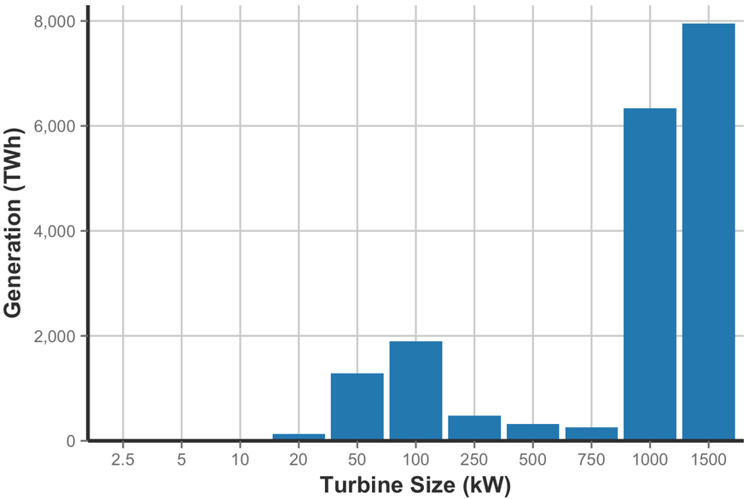
Results – Breakout by Turbine Size
By pure systems count, most systems are small or medium sized (2.5 – 100 kw)
However, in terms of capacity and generation, utility scale systems (1 – 1.5 MW) make up the bulk of the national total

Slide 14
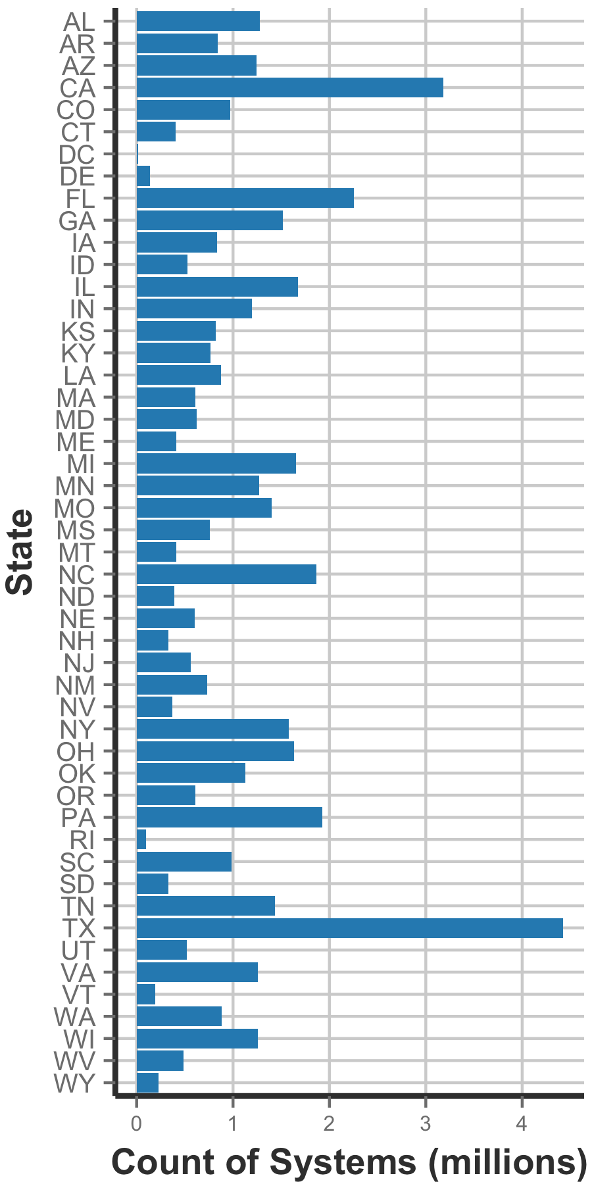
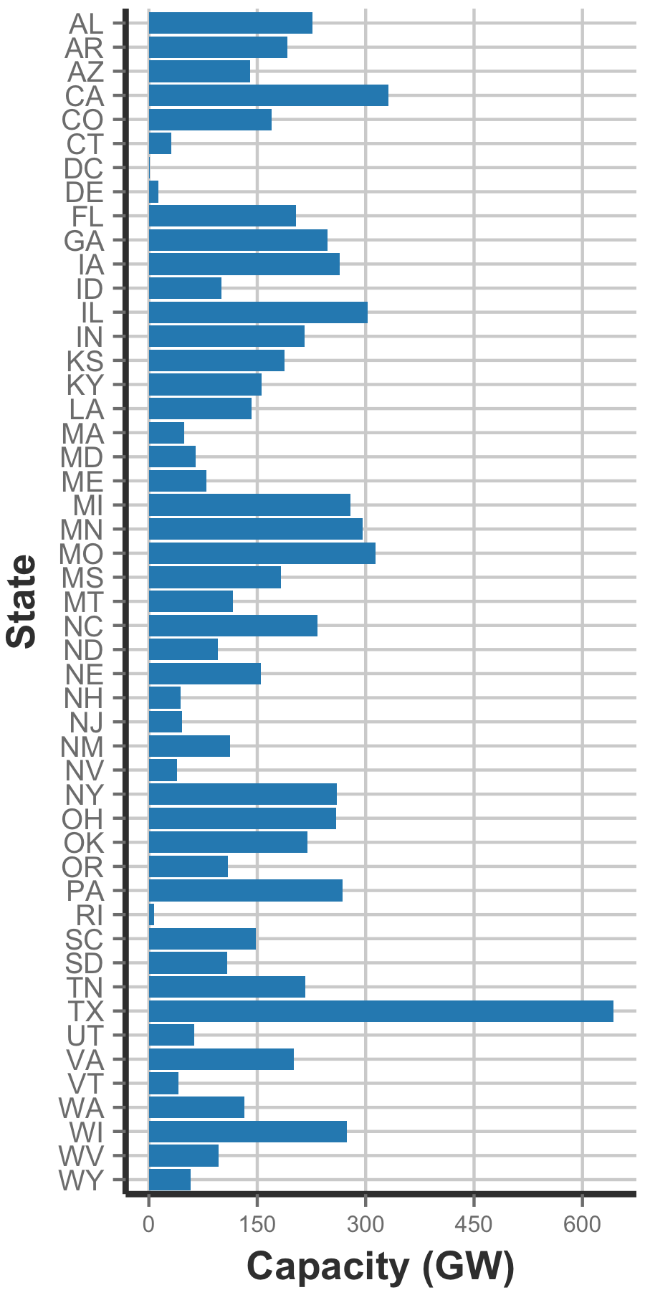
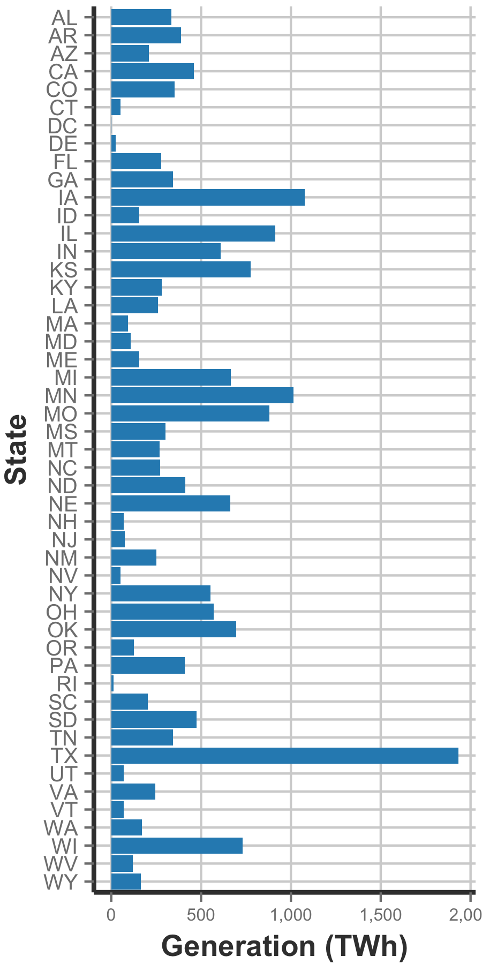
Results – Breakout by State

Slide 15
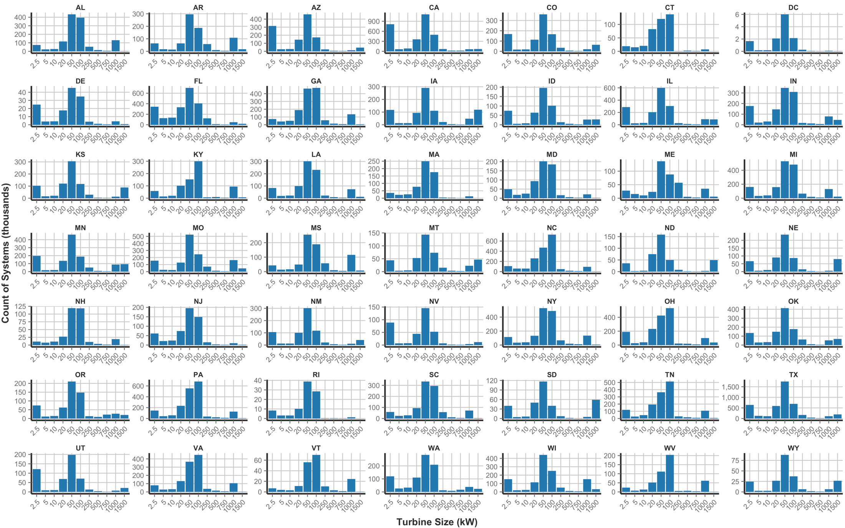
Results – Breakout by Turbine Size and State (Systems)

Slide 16
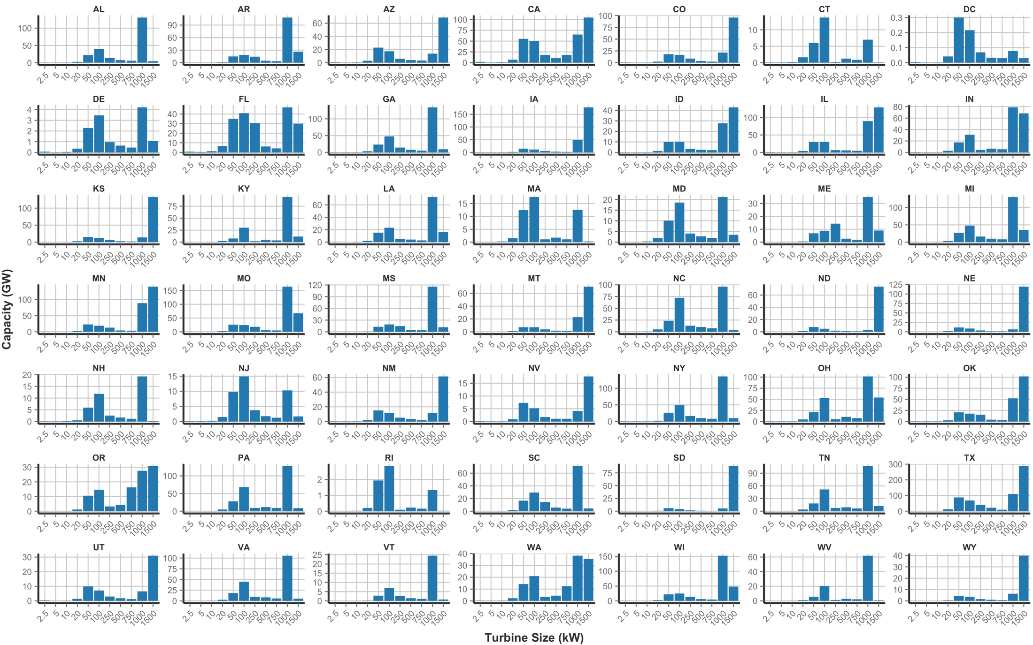
Results – Breakout by Turbine Size and State (Capacity)

Slide 17
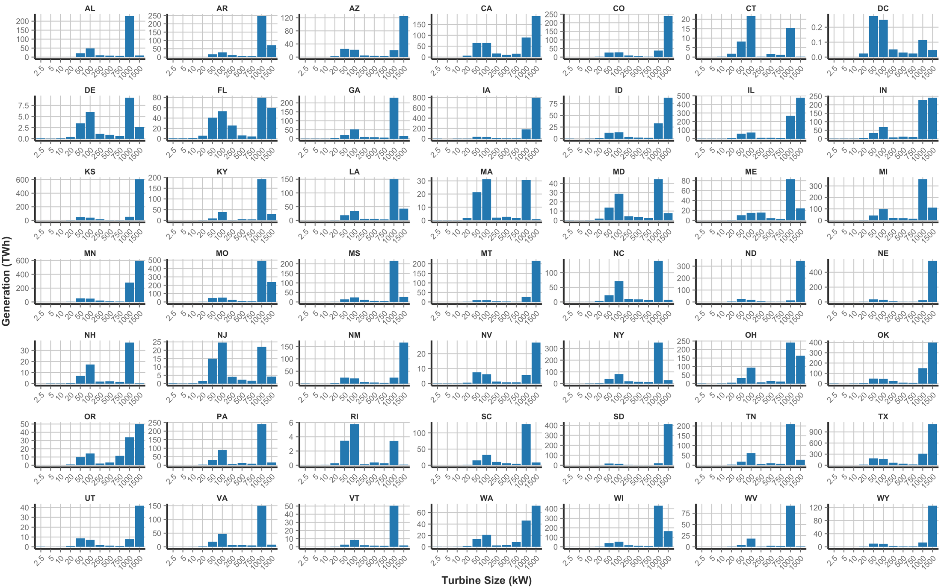
Results – Breakout by Turbine Size and State (Generation)

