Slide 1
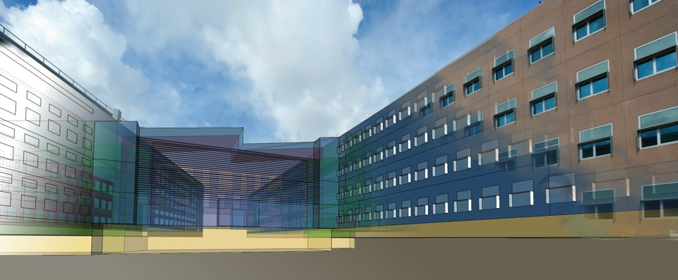
OpenStudio Analysis Framework and the Parametric Analysis Tool Algorithmic Mode
Brian L Ball
June 30, 2023

Slide 2

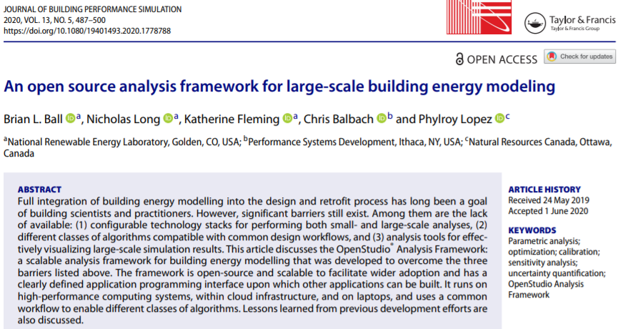

OpenStudio Analysis Framework (OSAF)
NREL’s OpenStudio Analysis Framework is a scalable web-based analysis and distributed computing tool intended to make the creation and analysis of building energy models accessible to architects, engineers, designers and policy makers.
The codebase is open source (https://github.com/NREL/OpenStudio-server) with an API and Command Line Interface (CLI) enabling users and private sector organizations to more easily use and integrate scalable analytic tools into their own solutions.
Many private sector and government organizations have demonstrated success using this analysis platform, either through its existing algorithmic and visualization capabilities or linking the large-scale simulation results to external visualization and analytic tools.
Nicholas Long
Katherine Fleming
Brian Ball
Tim Coleman
Anya Peterson
Ry Horsey

Slide 3
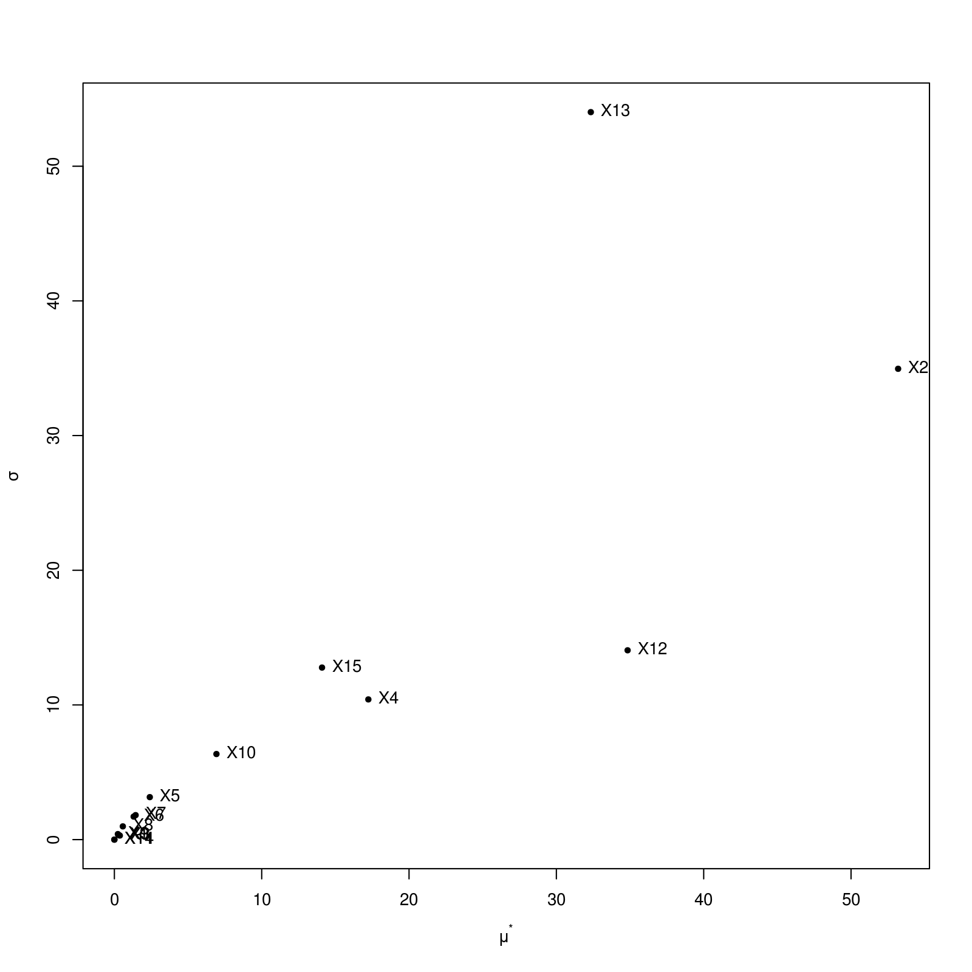
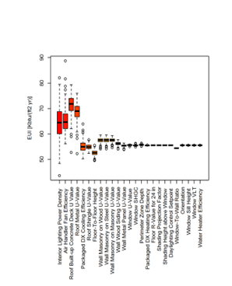
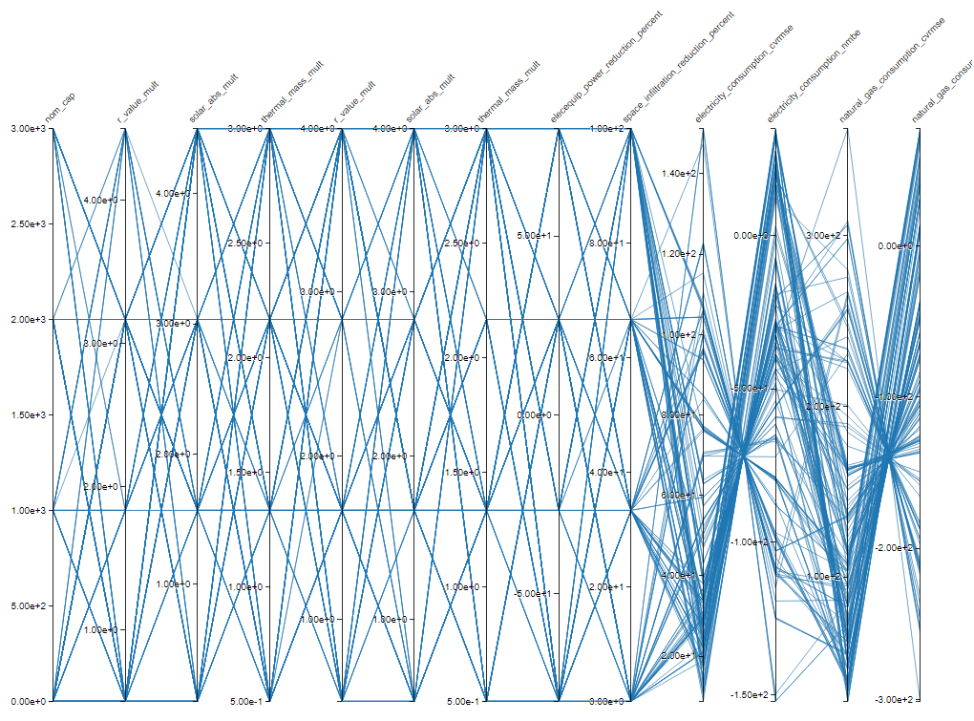
OSAF Sensitivity and Uncertainty Quantification
Sensitivity Analysis and Design of Experiment Methods
Full Factorial Design of Experiments (DOE)
Morris Screening Method
SOBOL (Monte Carlo estimation of the Sobol indices)
FAST99 (Fourier Amplitude Sensitivity Test)

Slide 4
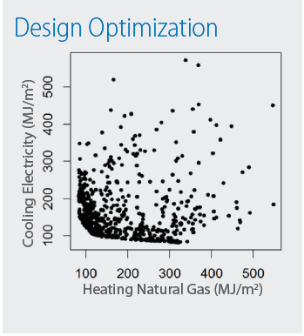
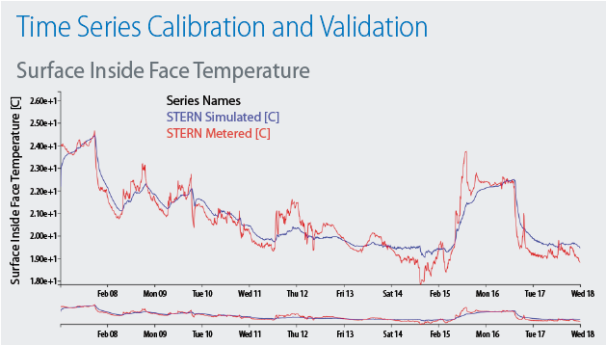
OSAF Optimization Capabilities
Optimize or Calibrate
Multi-Objective Algorithms
NSGA2 (Non-dominated Sorting Genetic Algorithm)
Parallel F evaluations
Mixed Continuous or Discrete variables
SPEA2 (Strength Pareto Evolutionary Algorithm)
Parallel F evaluations
Continuous variables only
Life Cycle Cost
Net Site Energy (MJ/m2)
Single-Objective Algorithms
Rgenoud (GENetic Optimized Using Derivatives)
Parallel F evaluations for genetic search
Parallel gradient calculation for continuous variables
Optim (quasi-Newton method with bounds)
Parallel gradient calculation
Continuous variables only
PSO (Particle Swarm Optimization)
Parallel F evaluations for each iteration
Continuous variables only

Slide 5
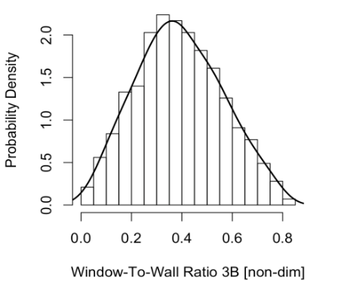
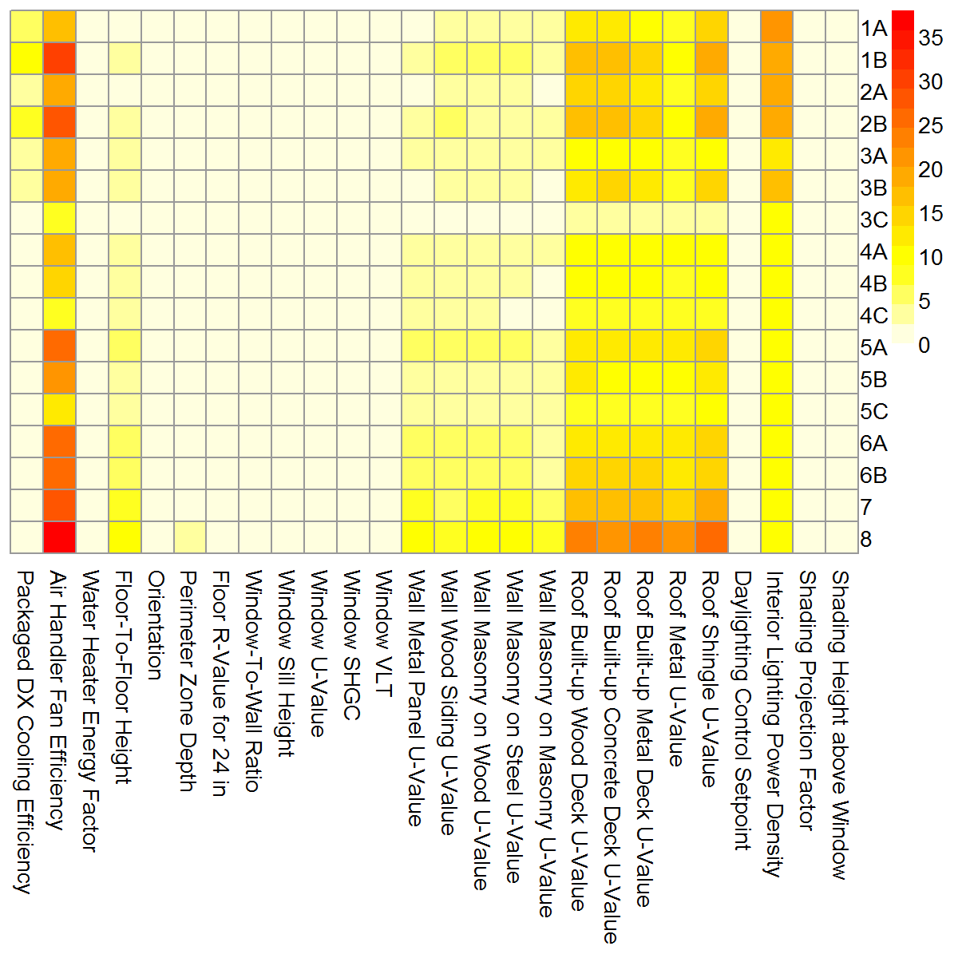
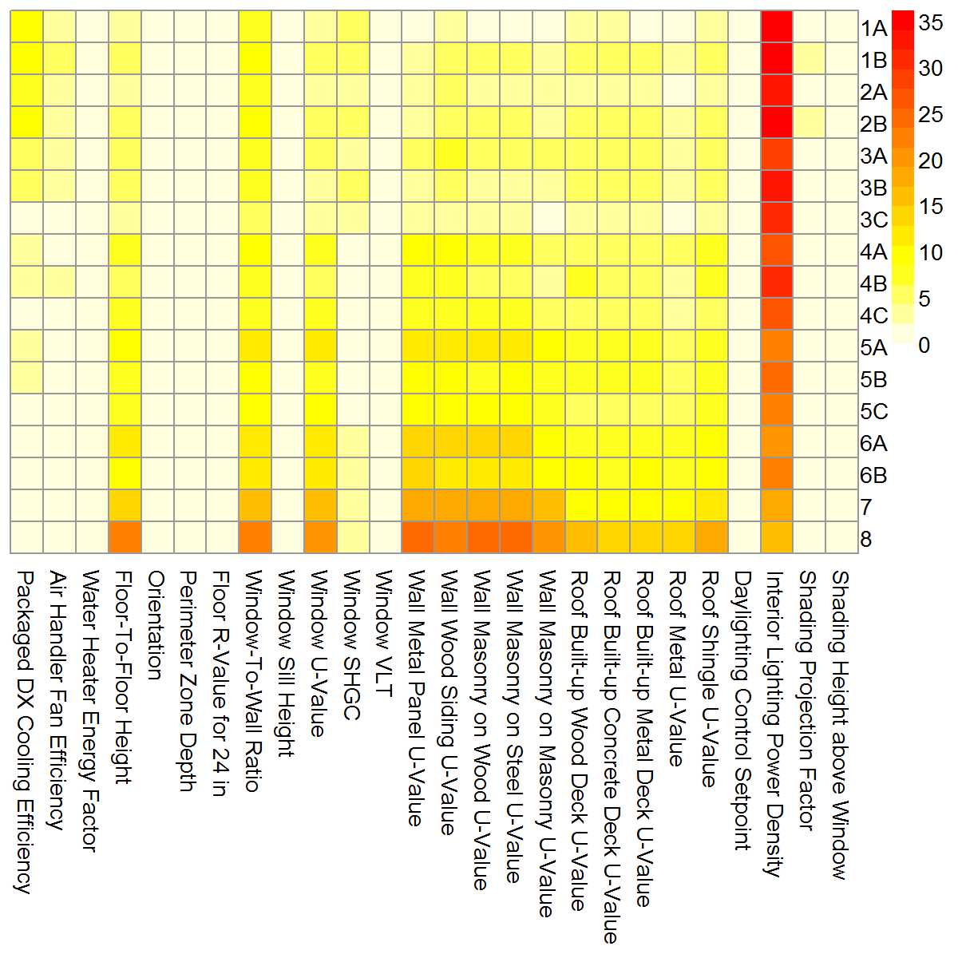
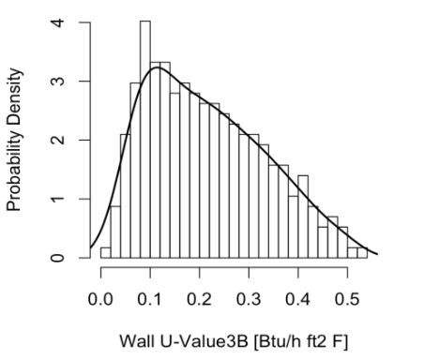
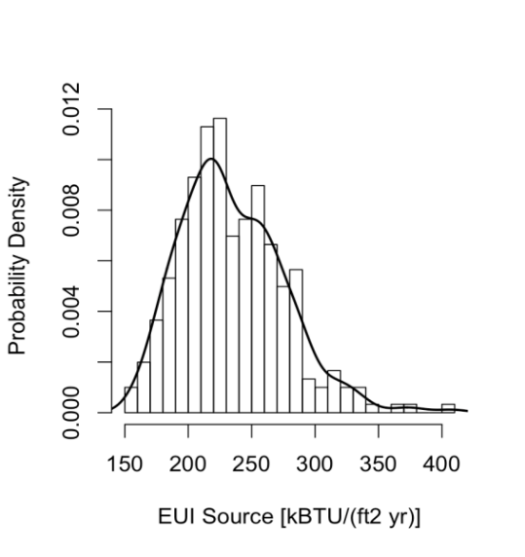
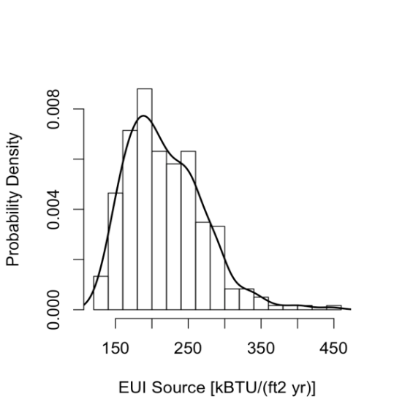
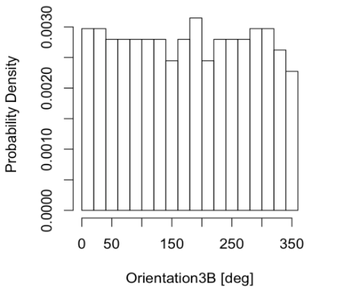
OSAF Sensitivity and Uncertainty Quantification
Sampling-based Uncertainty Quantification
Latin Hypercube Sampling (LHS)
Input Parameters
Warehouse
Medium Office
Impact of each variable across all climate zones
Retail 3B
Retail 5A
Potential range of EUI combing all variables

Slide 6

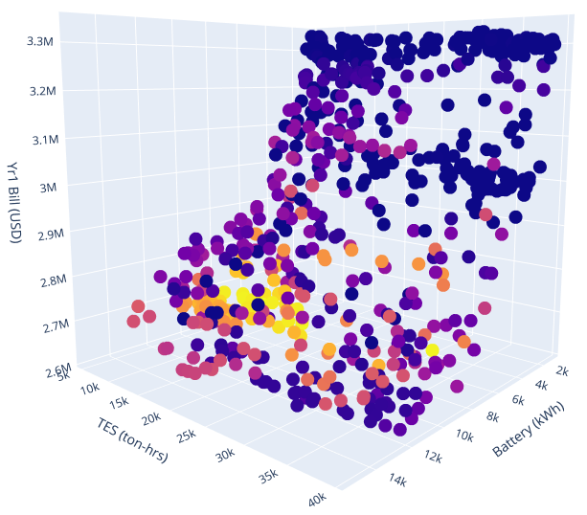
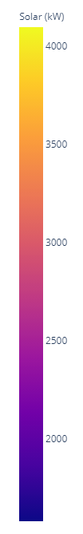



URBANopt / REopt demo example
Mixed use and restaurant features
Central Ice Storage from https://github.com/NREL/openstudio-load-flexibility-measures-gem (Karl Heine)
REopt™ to size battery and PV systems
REopt compute costs/bills from tarrifs
NSGA2 Preliminary example results
10 generations with 60 samples each
inputs Battery installed_cost_us_dollars_per_kw (400-1680 kw) Battery installed_cost_us_dollars_per_kwh (200-840 kwh) Storage Capacity for Ice Tank (5000-40,000 ton-hrs)
chiller_limit (0.1–1.0)
Loop temp setpoint (40-50)
Ice charging setpoint (20-30)
outputs Total electricity_kwh Total natural_gas_kwh Total solar_pv_kw size_kw (battery power rating) size_kwh (battery capacity) year_one_energy_cost_us_dollars year_one_bill_us_dollars
This is just a toy example, but now you can do a real one at scale!

Slide 7
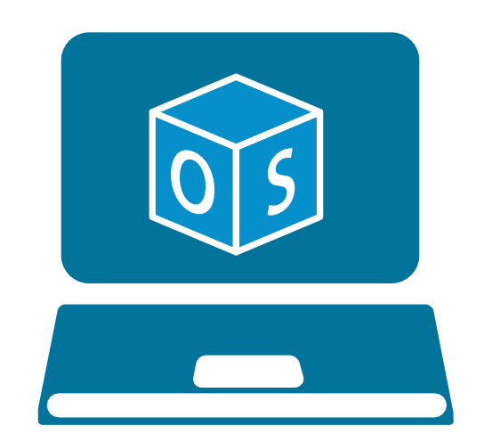
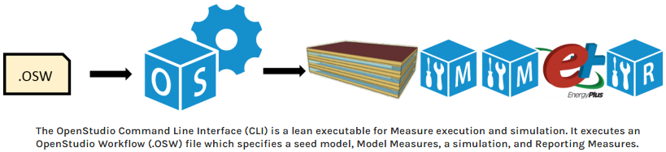
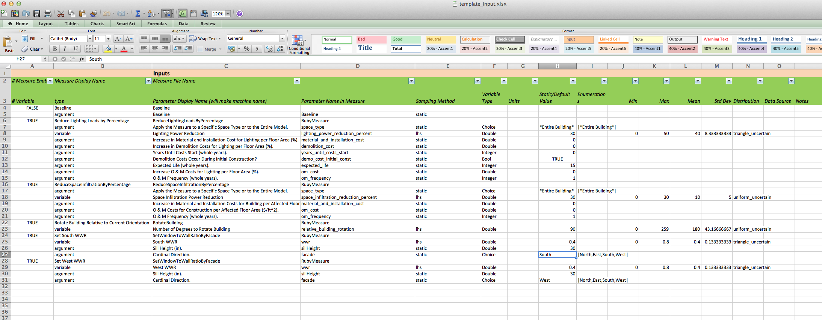
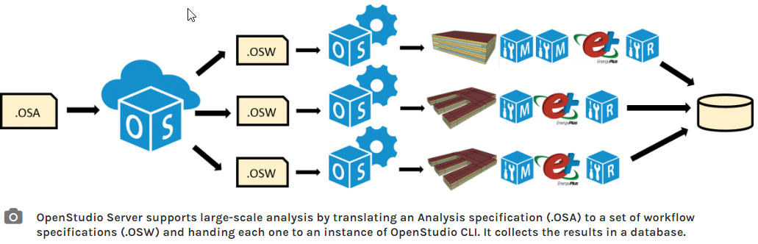


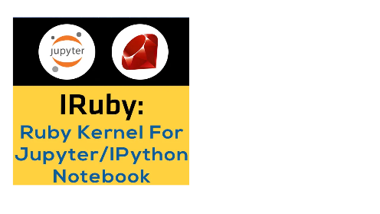
How does it work?
To create an OSW, use the GUI (OS APP) or the SDK
App
SDK
To create an OSA, use the GUI (PAT APP) or the new SDK methods in Analysis-Gem
deprecated
PAT
SDK
https://github.com/NREL/docker-openstudio-jupyter
Images from https://www.energy.gov/eere/buildings/articles/openstudio

Slide 8
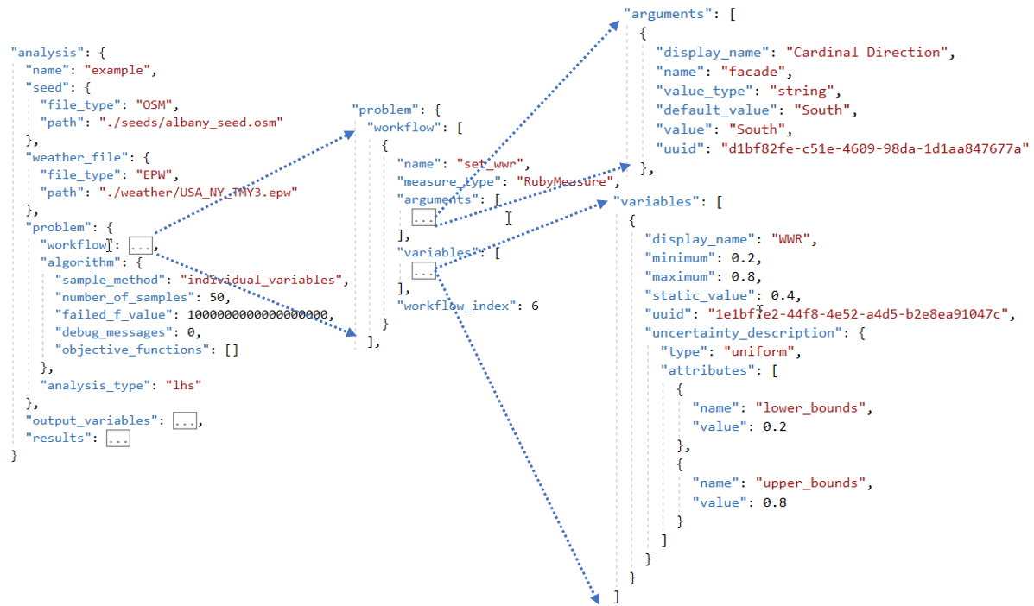
What is an OSA? (OpenStudio Analysis JSON)
workflow
variables
y = f(x)
objective_functions
Variable Definition
The variable values in the OSA are turned into specific arguments in the OSW by the algorithms
OSA -> OSWs (OpenStudio Workflow JSON)

Slide 9
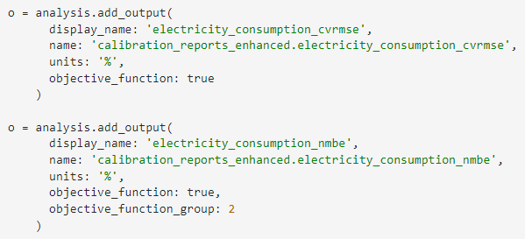


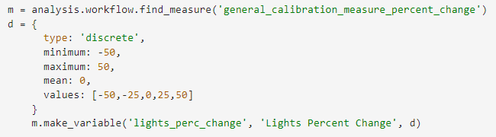
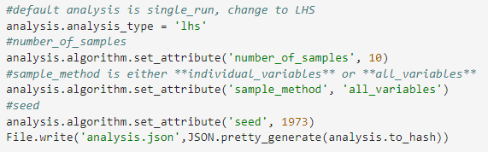
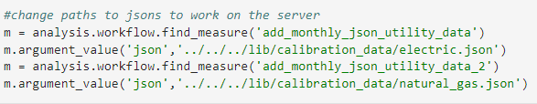

How to use Openstudio-Analysis Gem
Make Objective Functions
Load gem
Create analysis from OSW
Make Variables
Set Algorithm and make analysis.json
Change Measure argument values
Make analysis.zip
Example Notebooks:
https://github.com/NREL/docker-openstudio-jupyter

Slide 10
PAT Algorithmic Mode

Slide 11
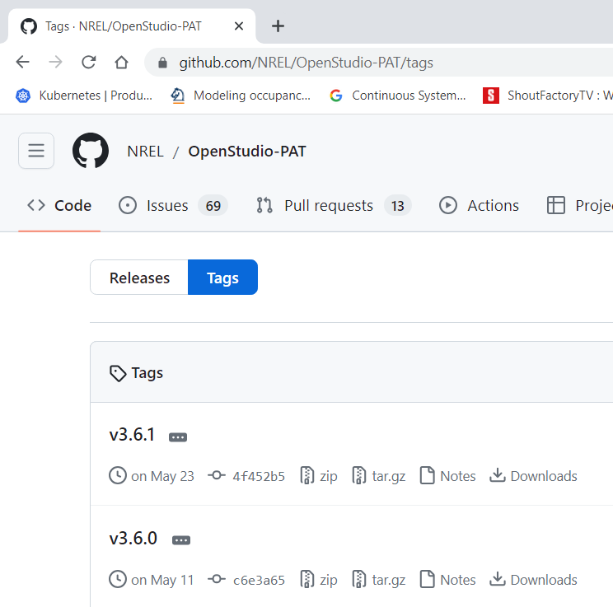
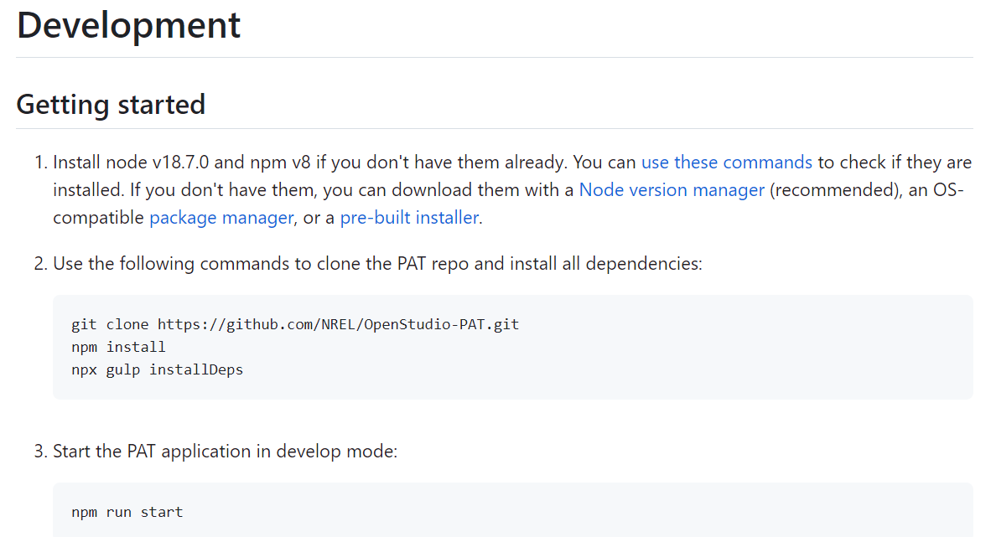
How to download PAT
PAT github page for downloads
PAT version is consistent with OpenStudio version
EnergyPlus and OpenStudio versions:
https://github.com/NREL/OpenStudio/wiki/OpenStudio-SDK-Version-Compatibility-Matrix
Building PAT from the code is very easy:
Install the right version of NodeJS
>npm install
>npx gulp installDeps

Slide 12
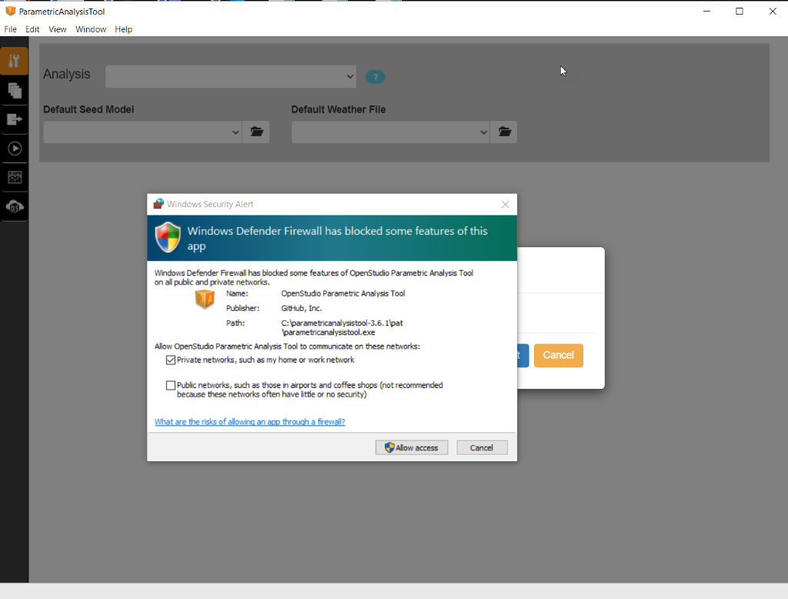
Starting PAT for the first time
PAT has an internal web server which typically runs at http://localhost:8080 and needs a firewall exception in some cases.

Slide 13
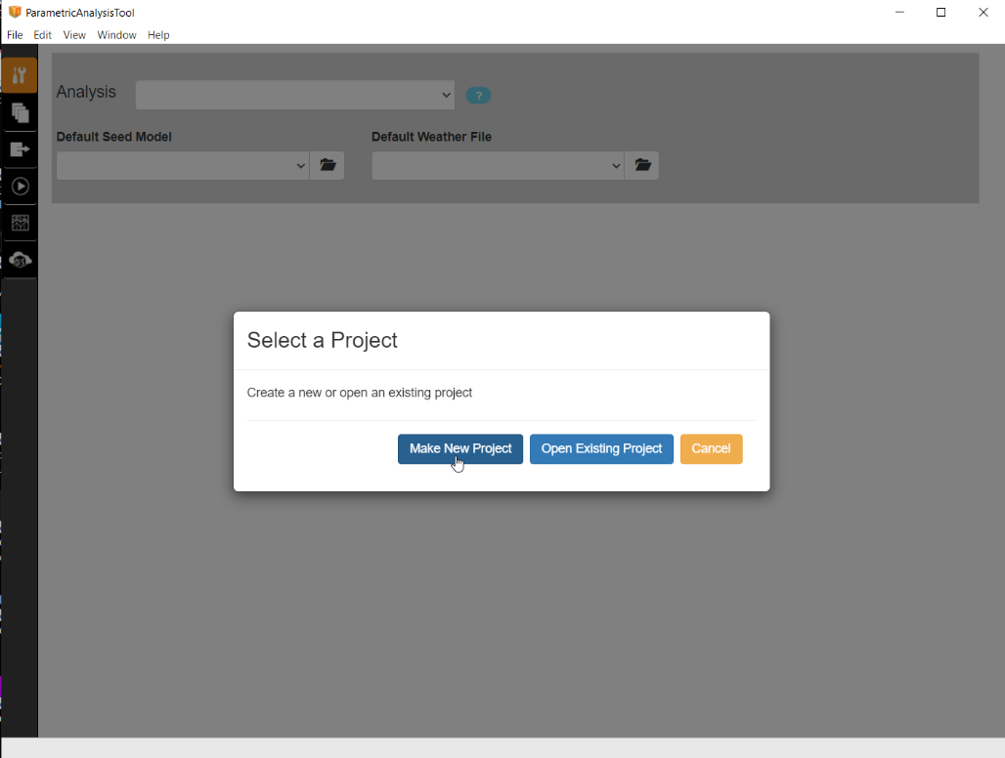
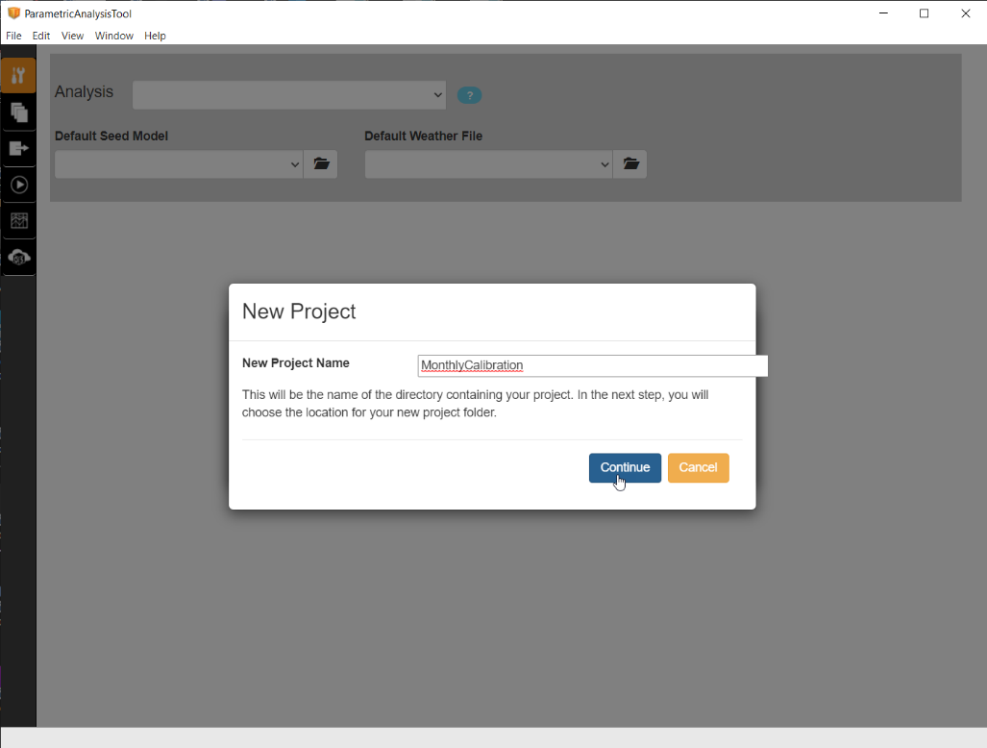
Creating a Project
Make a new project or open an existing one
Name your new project

Slide 14
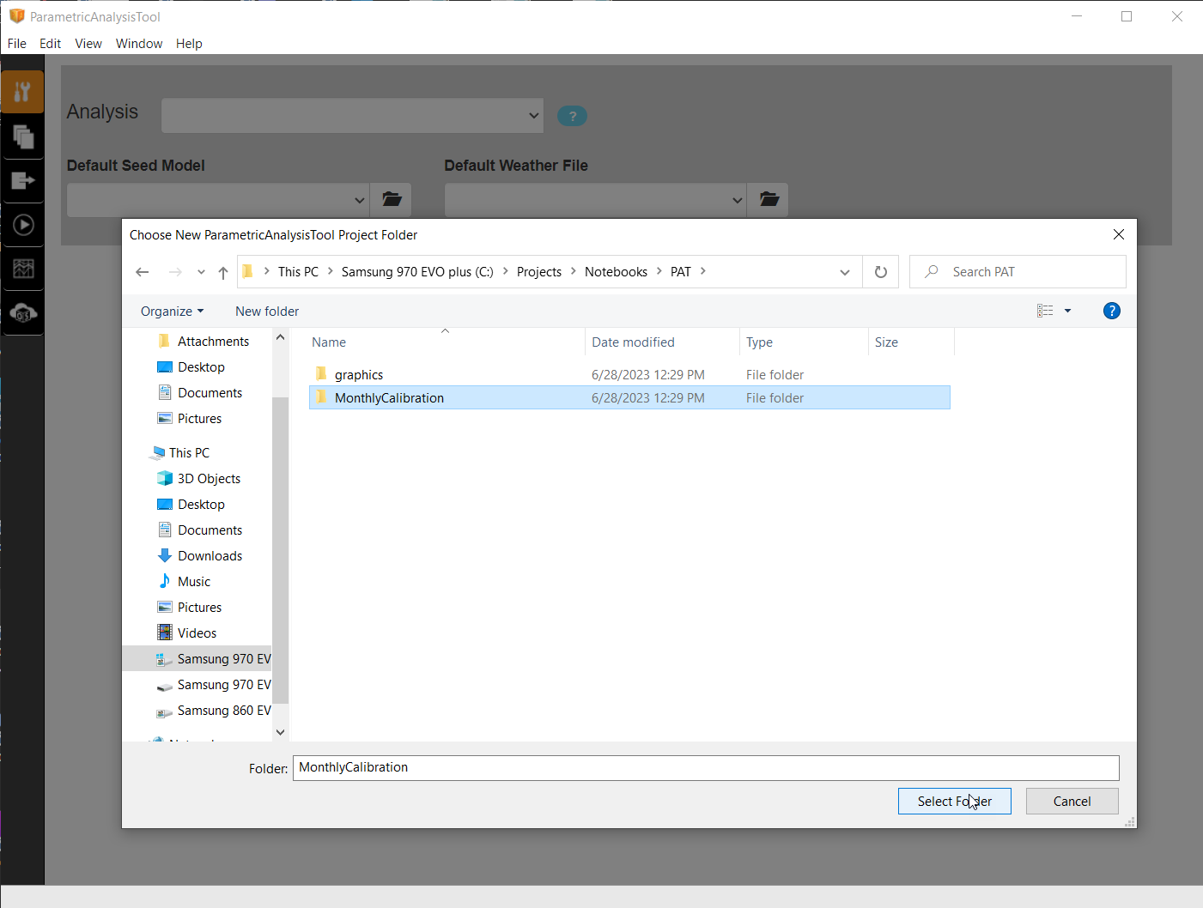
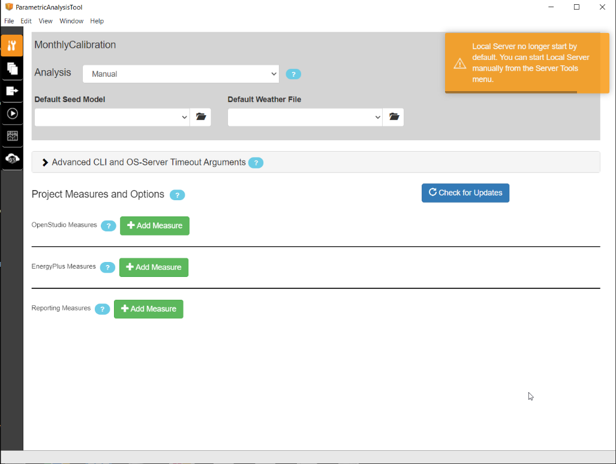
Creating a Project
Choose (create) directory for the Project files
The local server is OFF by default when PAT starts.
The GUI and project files are still available and can be manipulated, however they cannot be RUN until the server is started.
OpenStudio Workflow (OSW) section which defines the:
OpenStudio Measures
EnergyPlus Measures
Reporting Measures
and the order in which they are run.

Slide 15
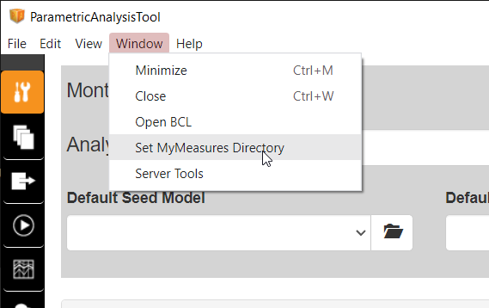
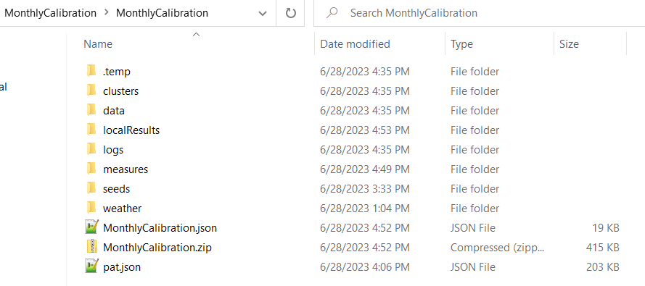
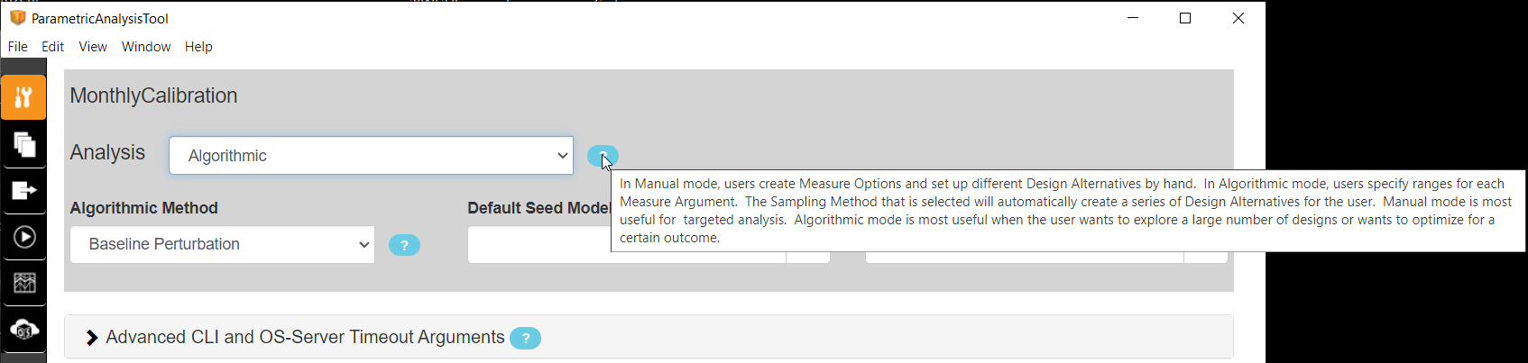
Setup Measures and Algorithmic Mode
Choose the directory where PAT will look to find your Measures. When Measures are added to your PAT project, a copy of them will be added to the Measures directory in the PAT project.
Change from Manual to Algorithmic mode.

Slide 16
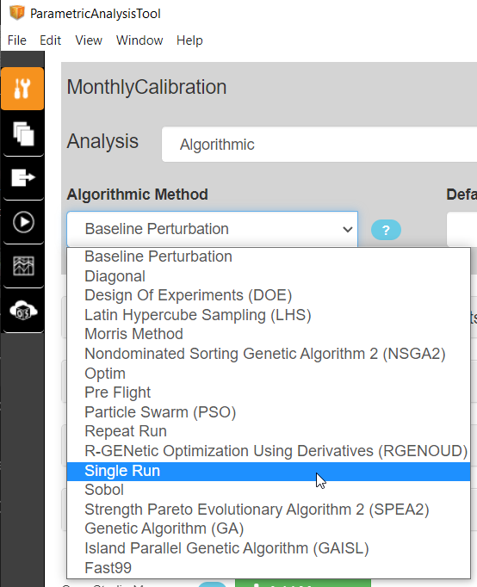
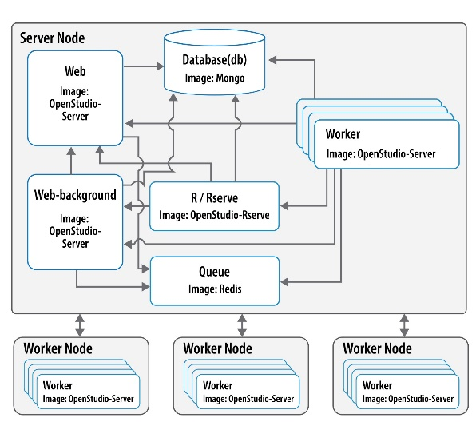
Available Algorithms
These are the Algorithms that will work in OSAF.
‘Single Run’ is the only one that will work with PAT Local Server. All the others will require a remote OSAF cluster. This is because all the algorithms are in the RServe container, which is not packaged with PAT.
Description of the Algorithms and OSAF:
https://www.tandfonline.com/doi/full/10.1080/19401493.2020.1778788
OSAF architecture

Slide 17
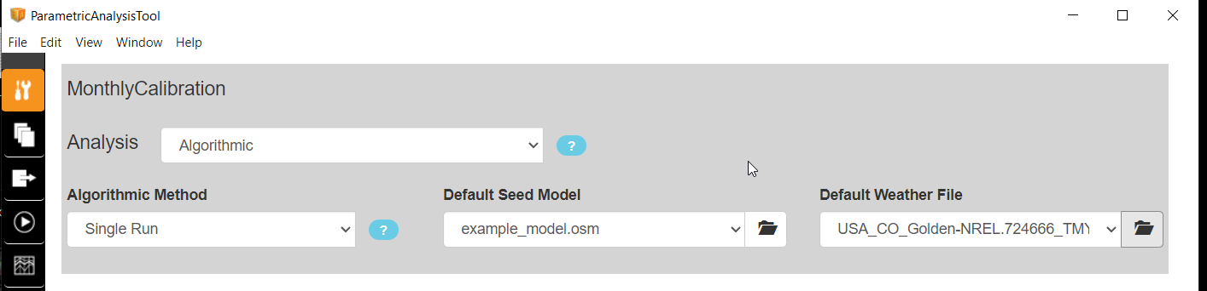
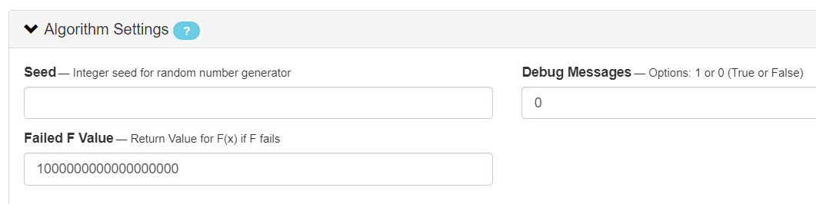
Algorithm Settings
Set Algorithm to ‘Single Run’ Choose base OSM Choose Default Weather File
Algorithm settings for Single Run can be ignored.
Seed is for random number generator in sampling-based methods
Debug Messages are algorithm debug outputs
Failed F Value is the return value if a simulation fails. Optimization typically wants a large value so algo will ignore run. Sensitivity Analysis typically wants ZERO so fails don’t skew results as an outlier

Slide 18
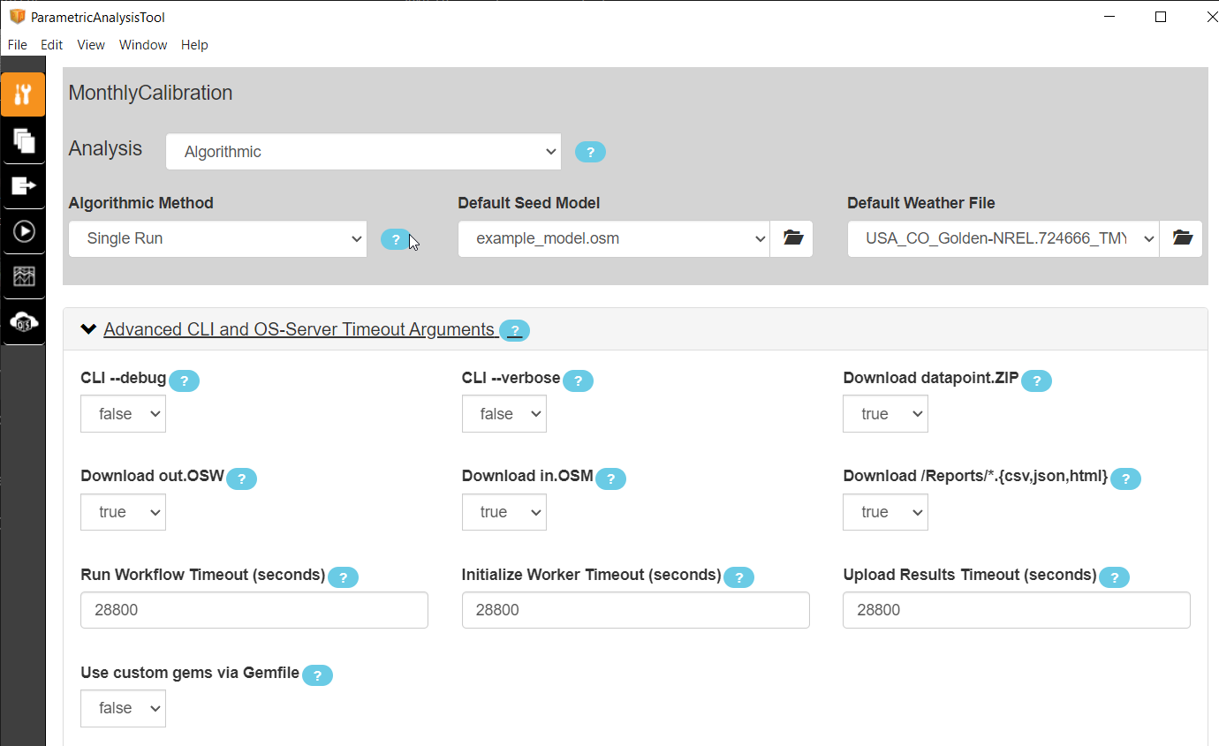
Advanced OpenStudio CLI settings
--debug and --verbose are options that get used in the OpenStudio CLI call at runtime. These can turn off the runnerRegisterInfo() type statements in Measures.
Download .zip, .osw, .osm can turn off the internal rest API transfer of large results files from workers to the web server and increase production runtime performance for large scale problems.
Custom Timeouts for runtime, initialization and uploading results (8 hour default).
Custom gems via Gemfile vs server scripts

Slide 19
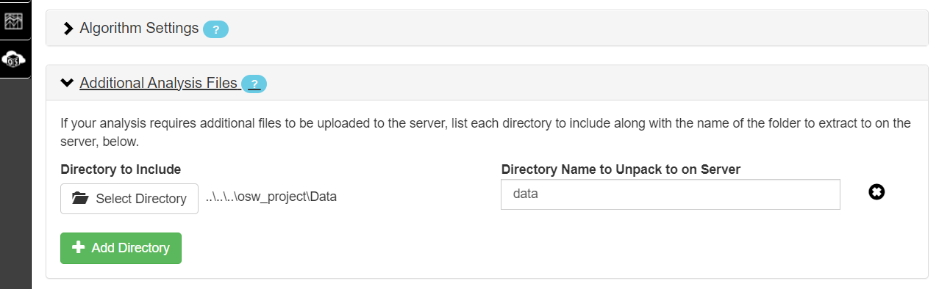
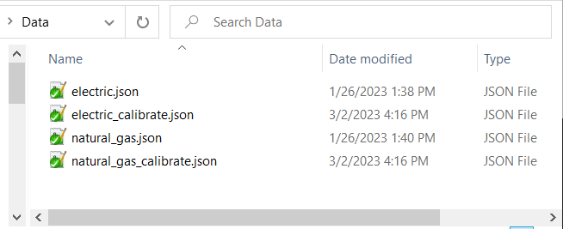
Additional or Supporting Files
Additional or supporting files, like metered data for calibration, weather files for location changes, etc can be added. Select a local directory that has the data and the name you want the directory to be called in the server.
The runtime path, from a measure to that directory in the server, is ‘../../../lib/data/electric_calibrate.json’
As an example, the local ‘Data’ directory contains the ‘electric_calibration.json’ file and gets transferred to the ‘/lib/data’ directory.

Slide 20
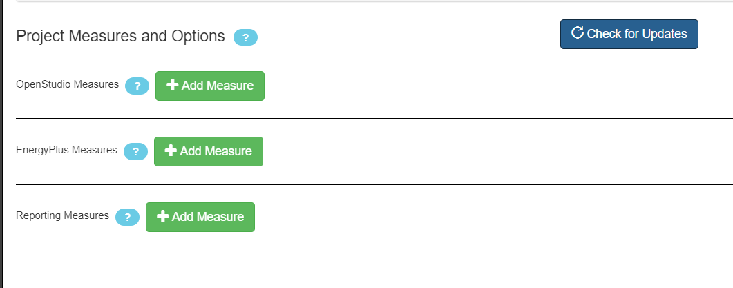
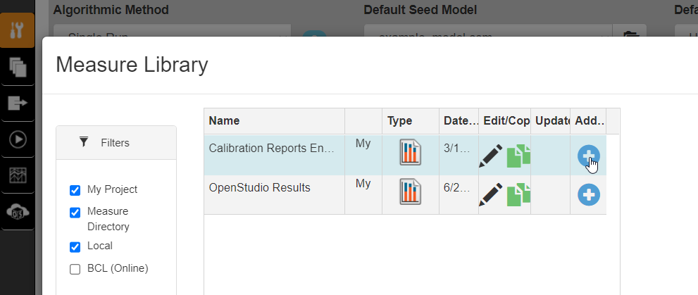
Adding Measures to a Project
Check for updates will compare your local project measures with your MyMeasures folder and look for differences.
Add Measures to the project by clicking the green + Add Measure button
A list of Measures will show and click the Add + symbol to include in the project.

Slide 21
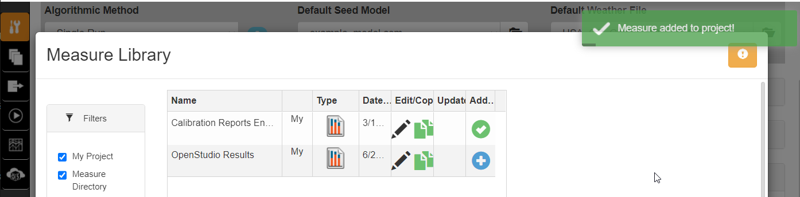
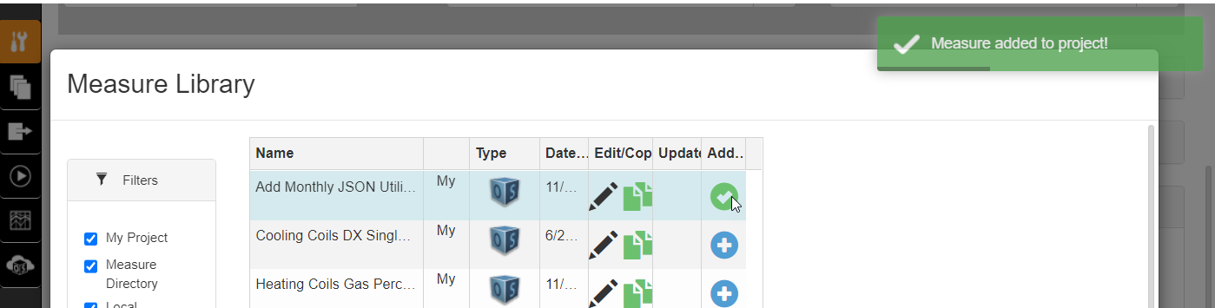
Adding Measures to a Project
A green check mark indicates a successful copy of the measure to your project Measure folder and addition to the PAT.json

Slide 22
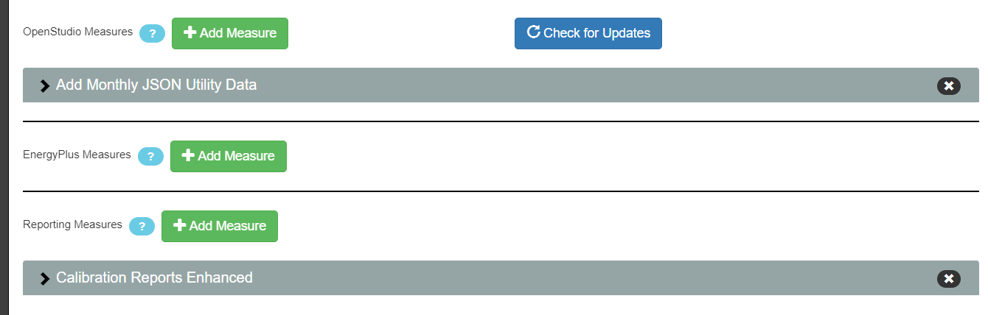
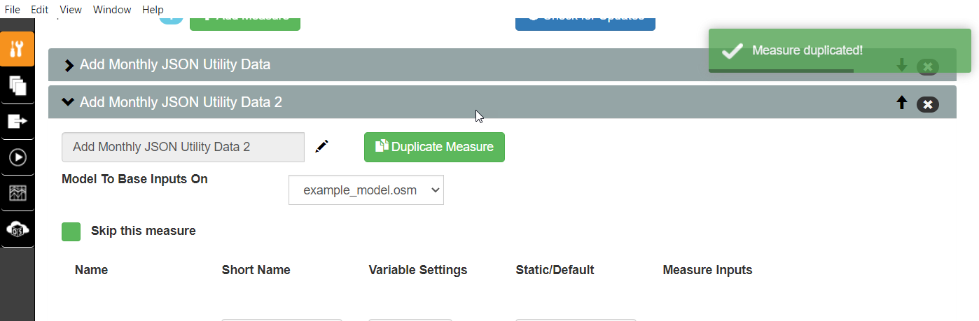
Adding Measures to a Project
The Measures should show up in the project GUI like they are above. Clicking the > for the measure will reveal its arguments and the ‘duplicate Measure’ button to make another copy of the measure in the workflow. We can use this to setup the electric and gas utility data for a calibration example. One measure will setup electric, the other gas.

Slide 23
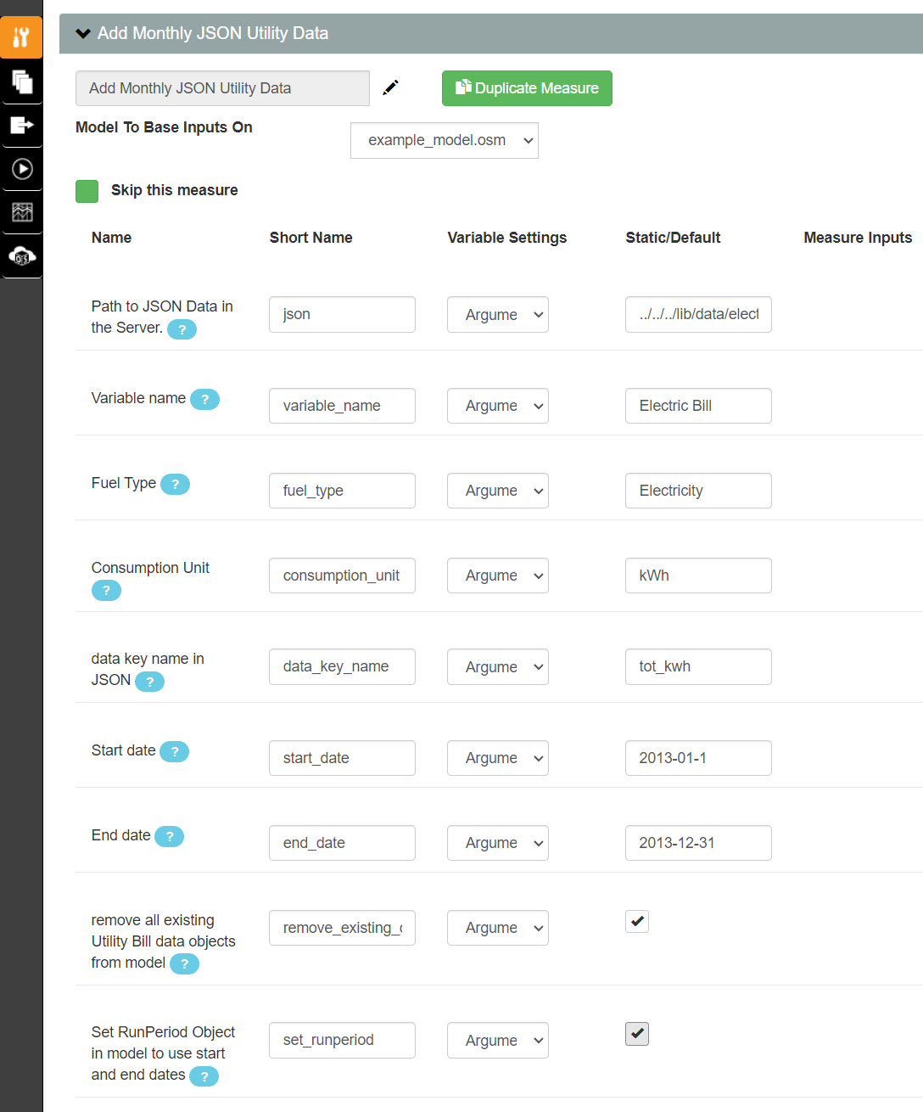
Configuring Measure Arguments
Configure the Measure Arguments for the
‘Add Monthly JSON Utility Data’ measure, which takes json data and makes an OS Utility Bill Object.
The relative path to the metered data from this measure at runtime is: ‘../../../lib/data/electric_calibrate.json’
The first copy of this measure, we want to remove any existing Utility Bill data objects in the model. The second copy we don’t.
Set the RunPeriod object to use the dates in the measure, which correspond to the data

Slide 24


Creating Output Variables
Select the Calibration Report and choose the CVRSME and NMBE for electric and gas.

Slide 25


Creating Output Variables
The Measure and the variables should show up as Outputs now.
Toggle them as Objective Functions
For Multi-objective problems,
You can assign them to different groups. The L2 Norm will be applied to all the outputs in a group.

Slide 26



Starting Local Server
Select Run on Cloud, then use Server Tools to start the local server.
This can take a while, depending on your computer and resources.

Slide 27


Starting Local Server for manual and single run mode
You may need to allow it a firewall exception.
You should also see several Ruby interpreter processes in task manager. These are the server and worker processes.

Slide 28

Using Docker Desktop for local deployment
Install Docker Desktop from https://www.docker.com/products/docker-desktop/
Clone the Git repo https://github.com/NREL/OpenStudio-server/tree/develop locally. The scripts use a local directory at c://Projects//OS-Server-develop//
Run the https://github.com/NREL/OpenStudio-server/blob/develop/local_setup_scripts/win64/nuke.sh with argument of the OS version (ex: >./nuke.sh 3.6.1-3)
When complete, http://localhost:8080 should be available in a web browser
This will remove any existing docker entities, use with caution if you have some you don’t want to lose
This will pull the containers needed from dockerhub
This will create a registry and push the containers to it
Change the path to your local directory
This will deploy the docker swarm
This will scale the number of workers

Slide 29




Running on Cloud locally
Type in ‘http://localhost:8080’ in the Existing Server URL window and hit connect. That value can be found in the ‘local_configuration.json’ file in your project folder. The Server Status icon will turn green when it can connect.
To see the commands that PAT is using to manage the server, use the ‘Toggle Developer Tools’ dropdown and select ‘Console’. In there you can find the ‘start server command’ and ‘run analysis command’ after hitting the Run Entire Workflow button

Slide 30


Run Console and Server Webpage
Click the View Server button and a web browser should pop up and display the OSAF server GUI page.
From there you can click on the Analyses to see the Datapoints in your analysis.

Slide 31

Analysis View
Interactive Visualizations
CSV files of all the Results can be downloaded
Information for each datapoint is available thru the View or clicking the datapoint

Slide 32

Datapoint View
Zip file of all the datapoint results are available which contain the E+ outputs.
Simulate Datapoint Log or sdp_log_file is available for debugging the workflow

Slide 33


Debugging a Failed Datapoint
eplusout.err is useful for debugging E+ errors
The Simulate Datapoint log will show any workflow ERRORs
The DEBUG statements will only show if –debug CLI argument is TRUE

Slide 34



Results from a successful Datapoint
Objective Functions will show on the Analysis page and datapoints can be sorted by their values.
Reports are available in the Results Files section

Slide 35




Creating input Variables
Add the General Calibration Percent Change Measure to the Workflow
Change a Measure Argument to a Variable
Choose distribution type and bounds for continuous Variables
Choose values for discrete variables.
They will have equal weights unless otherwise specified.

Slide 36


Sampling and Screening Algorithms

Slide 37

Single Objective Optimization

Slide 38



Running an Algorithm
Export OSA will save the JSON and ZIP
which can then be run with the openstudio_meta CLI
To debug algorithms:
logs are available thru the ‘Log’ link. This is a good place to debug a submission error.
Also, using the run analysis command in a terminal window with –verbose

Slide 39

Options for OSAF Server deployment
Helm charts for Kubernetes deployment of OpenStudio Server.
https://github.com/NREL/openstudio-server-helm
Google
Amazon
Azure
Local Docker Swarm deployment of OpenStudio Server.
https://github.com/NREL/OpenStudio-server/tree/develop/local_setup_scripts
nuke.sh will setup registry, pull built containers from dockerhub and deploy swarm
(it will also remove all existing docker images and containers so use with caution)
docker-compose.yml has resource allocations in it.

