Slide 1
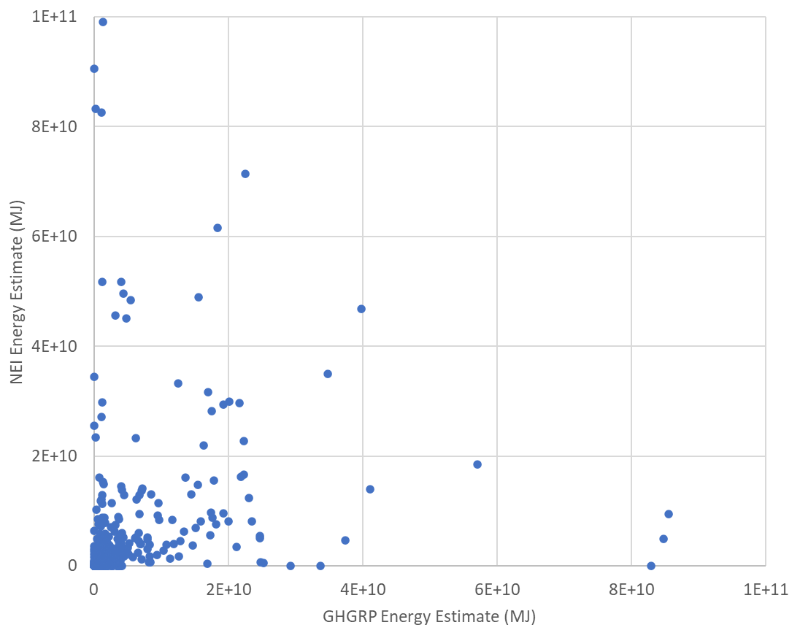

Slide 2
GHGRP: ghgrpID n = 2,270
NEI : eisFacilityID n = 23,093
FRS Data: registryID n = 480,146

