Slide 1
Freestream Wind Direction
LPF
Freestream Wind Magnitude
LUT
Turbine Yaw Offsets
+
-
Turbine Yaw Setpoints
Notes:
LUT

Slide 2
WHOC (Greedy, LUT, or MPC)
Turbine Yaw Setpoints
Hercules
Packaged AMR=Wind Inputs
AMR-Wind
Turbine Wind Dirs., Speeds, Powers
Raw AMR-Wind Outputs
Notes:
LUT

Slide 3

$$Δt_{c}$$
Turbine Wind Directions
LPF
Turbine Yaw Rate
X
Turbine Yaw Setpoints
+ +
+ -
Notes:
greedy

Slide 4





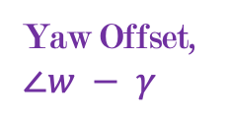
$$y$$
Wind Direction,
$$∠w=\tan^{−1}{\frac{u}{v}}+π$$
Yaw Offset,
$$∠w − γ$$
$$x$$
Yaw Setpoint, $γ$
Notes:
LUT

Slide 5





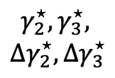


$$y′$$
$$γ_{2}^{⋆},γ_{3}^{⋆},$$
$${Δγ}_{2}^{⋆},{Δγ}_{3}^{⋆}$$
$$y$$
$$γ_{1}^{⋆},{Δγ}_{1}^{⋆}$$
Wind Direction,
$$∠w=\tan^{−1}{\frac{u}{v}}+π$$
$$x′$$
$$x$$
$$γ_{0}^{⋆},{Δγ}_{0}^{⋆}$$
Notes:
LUT

Slide 6
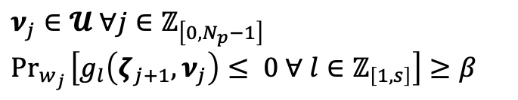

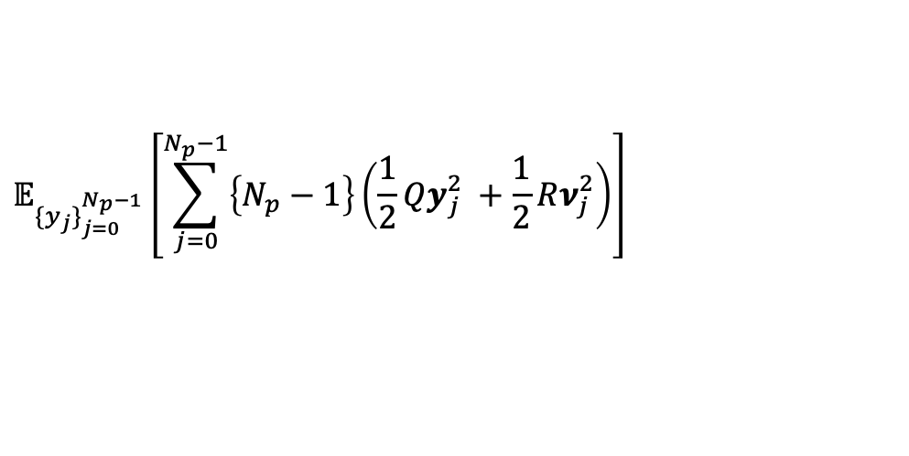
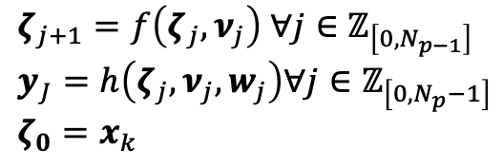
Freestream Wind Magnitude Preview
Freestream Wind Direction Preview
Solver
Turbine Yaw Setpoints
$$w_{j}∼P_{w}∀j∈ℤ_{\left[0, N_{p}−1\right]}$$
Cost Function
Model
Constraints
$$𝔼_{\{y_{j}\}_{j=0}^{N_{p}−1}}\left[\sum_{j=0}^{N_{p}−1}{\left\{N_{p}−1\right\}\left(\frac{1}{2}Qy_{j}^{2} +\frac{1}{2}Rν_{j}^{2}\right)}\right]$$
$ζ_{j+1}=f\left(ζ_{j},ν_{j}\right)$ $∀j∈ℤ_{\left[0, N_{p−1}\right]}$
$$y_{J}=h\left(ζ_{j}, ν_{j},w_{j}\right)∀j∈ℤ_{\left[0, N_{p}−1\right]}$$
$$ζ_{0}=x_{k}$$
$$ν_{j}∈𝓤 ∀j∈ℤ_{\left[0, N_{p}−1\right]}$$
$${\text{Pr}}_{w_{j }}\left[g_{l}\left(ζ_{j+1}, ν_{j}\right)≤ 0 ∀ l∈ℤ_{\left[1, s\right]}\right]≥β$$
Notes:
LUT

