Slide 1
Rollerball: Overview and Requirements Analysis
By Team The Best Team

Slide 2
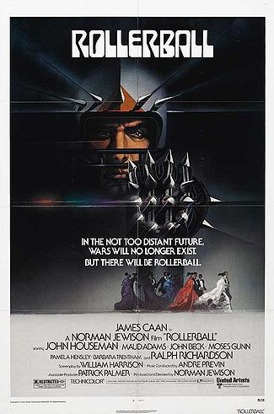
Rollerball: Game Origin
Variant of the game Chess
Invented in 1998 by Jean-Louis Cazaux
Inspired by science fiction movie of the same name
Futuristic and violent sport similar to roller derby

Slide 3
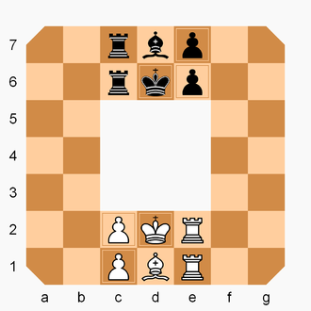
Rollerball: Game Overview
7x7 chess board with 3x3 hole in center
Pieces generally move clockwise
1 king, 1 bishop, 2 rooks, 2 pawns
Pieces move similar to regular chess
Rook and bishop can rebound
Objective:
Checkmate enemy king
Bring own king to enemy king’s starting square

Slide 4
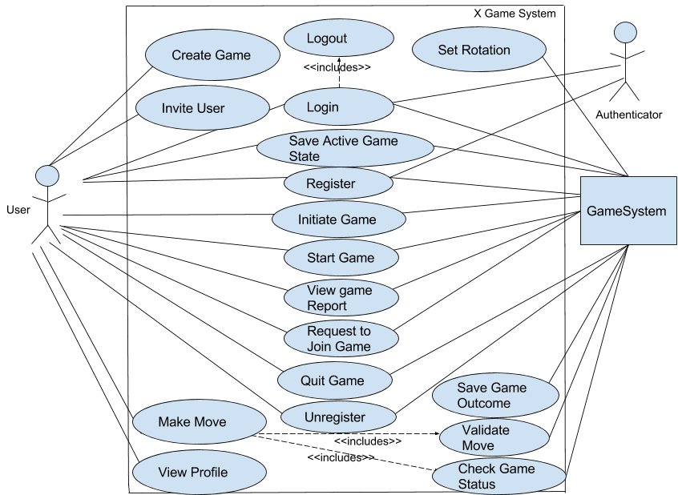
Requirements Analysis: Use Case Model

Slide 5
Project Decisions
Development
Web application
Automated testing
MongoDB
JavaSwing UI
Game
Worst record gets first move
Abandoning game is automatic loss

Slide 6

Questions

