Slide 1
Modeling plasmas with differential equations
Steve Swanekamp
Plasma Physics Division
Naval Research Laboratory

Slide 2
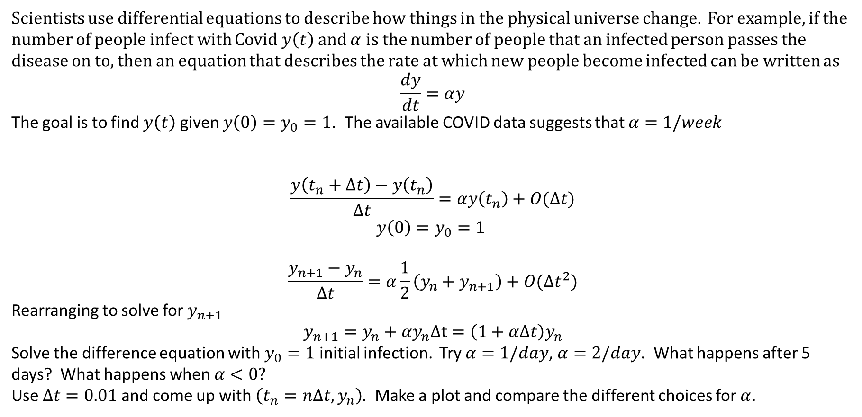
Differential equations
Scientists use differential equations to describe how things in the physical universe change. For example, if the number of people infect with Covid $y\left(t\right)$ and $α$ is the number of people that an infected person passes the disease on to, then an equation that describes the rate at which new people become infected can be written as
$$\frac{dy}{dt}=αy$$
The goal is to find $y\left(t\right)$ given $y\left(0\right)=y_{0}=1$. The available COVID data suggests that $α=1/week$
$$\frac{y\left(t_{n}+Δt\right)−y\left(t_{n}\right)}{Δt}=αy\left(t_{n}\right)+O(Δt)$$
$$y\left(0\right)=y_{0}=1$$
$$\frac{y_{n+1}−y_{n}}{Δt}=α\frac{1}{2}\left(y_{n}+y_{n+1}\right)+O(Δt^{2})$$
Rearranging to solve for $y_{n+1}$
$$y_{n+1}=y_{n}+αy_{n}Δt=\left(1+αΔt\right)y_{n}$$
Solve the difference equation with $y_{0}=1$ initial infection. Try $α=1/day$, $α=2/day$. What happens after 5 days? What happens when $α<0?$
Use $Δt=0.01$ and come up with $\left(t_{n}=nΔt, y_{n}\right)$. Make a plot and compare the different choices for $α$.

Slide 3
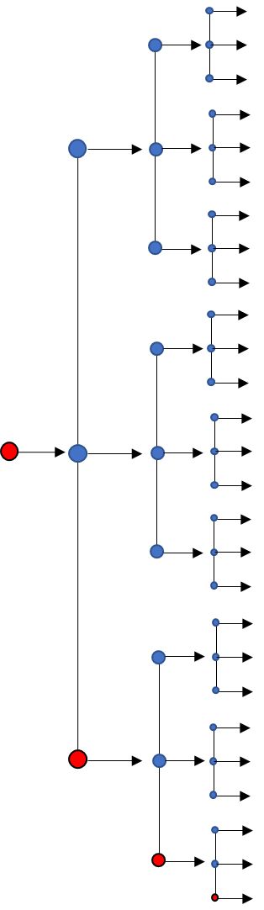
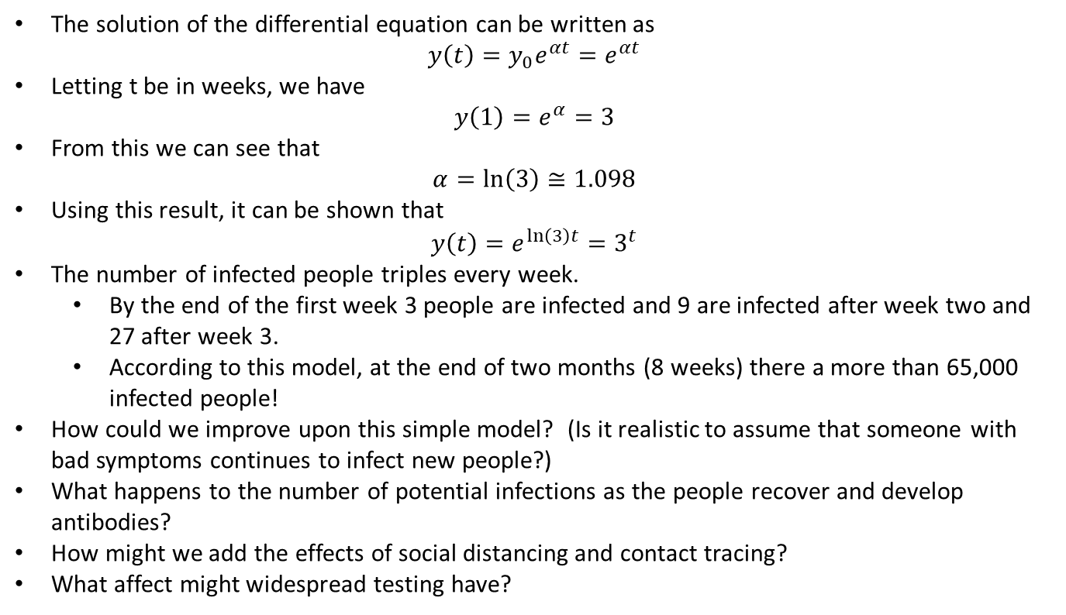
In this simple model a single infected person passes on the disease to 2 new people every two weeks
3
wks
The solution of the differential equation can be written as
$$y\left(t\right)=y_{0}e^{αt}=e^{αt}$$
Letting t be in weeks, we have
$$y\left(1\right)=e^{α}=3$$
From this we can see that
$$α=ln\left(3\right)≅1.098$$
Using this result, it can be shown that
$$y\left(t\right)=e^{\ln\left(3\right)t}=3^{t}$$
The number of infected people triples every week.
By the end of the first week 3 people are infected and 9 are infected after week two and 27 after week 3.
According to this model, at the end of two months (8 weeks) there a more than 65,000 infected people!
How could we improve upon this simple model? (Is it realistic to assume that someone with bad symptoms continues to infect new people?)
What happens to the number of potential infections as the people recover and develop antibodies?
How might we add the effects of social distancing and contact tracing?
What affect might widespread testing have?
2
wks
1
wk

Slide 4
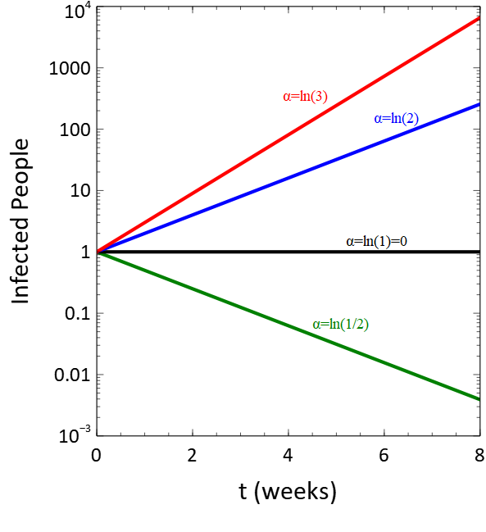
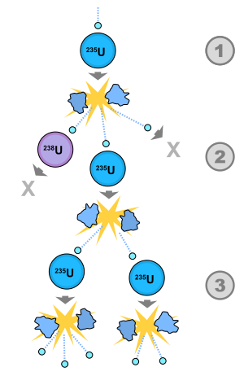

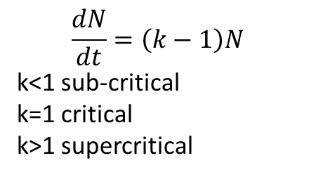
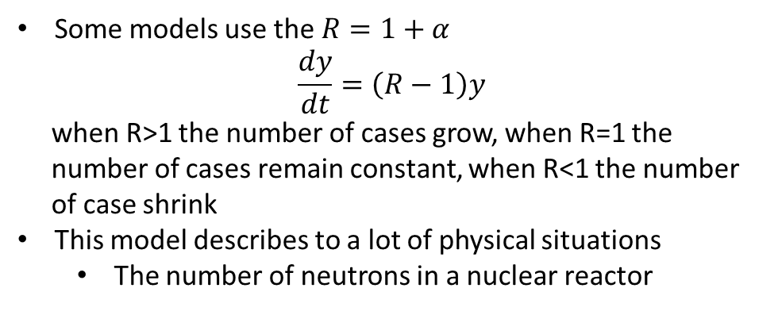
To slow the spread of the infection we need to have $α<0$
Some models use the $R=1+α$
$$\frac{dy}{dt}=\left(R−1\right)y$$
when R>1 the number of cases grow, when R=1 the
number of cases remain constant, when R<1 the number
of case shrink
This model describes to a lot of physical situations
The number of neutrons in a nuclear reactor
$$\frac{dN}{dt}=\left(k−1\right)N$$
k<1 sub-critical
k=1 critical
k>1 supercritical

Slide 5
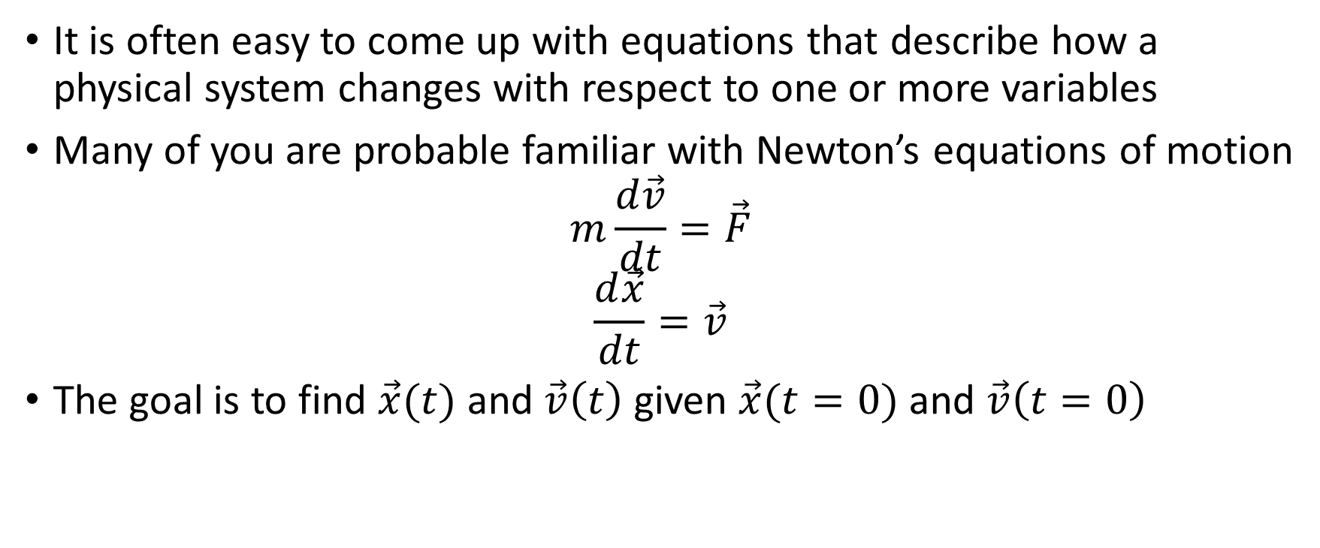
Physicists use differential equations to model physical systems
It is often easy to come up with equations that describe how a physical system changes with respect to one or more variables
Many of you are probable familiar with Newton’s equations of motion
$$m\frac{d\vec{v}}{dt}=\vec{F}$$
$$\frac{d\vec{x}}{dt}=\vec{v}$$
The goal is to find $\vec{x}(t)$ and $\vec{v}\left(t\right)$ given $\vec{x}(t=0)$ and $\vec{v}\left(t=0\right)$

Slide 6


Gravity example: $F=−mg$
The equations of motion are
$$m\frac{dv}{dt}=−mg$$
$$\frac{dx}{dt}=v$$
These equations have the solution
$$v\left(t\right)=v_{0}−gt$$
$$x\left(t\right)=x_{0}+v_{0}t−\frac{1}{2}gt^{2}$$

Slide 7
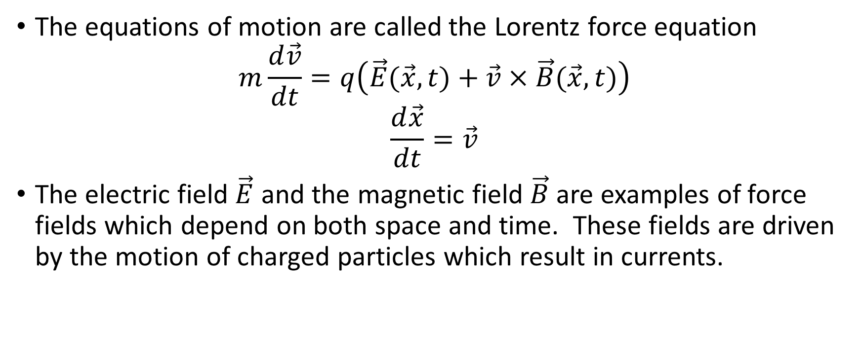
In plasma physics we are concerned with particle motion in an electromagnetic field
The equations of motion are called the Lorentz force equation
$$m\frac{d\vec{v}}{dt}=q\left(\vec{E}(\vec{x},t)+\vec{v}×\vec{B}(\vec{x},t)\right)$$
$$\frac{d\vec{x}}{dt}=\vec{v}$$
The electric field $\vec{E}$ and the magnetic field $\vec{B}$ are examples of force fields which depend on both space and time. These fields are driven by the motion of charged particles which result in currents.

Slide 8
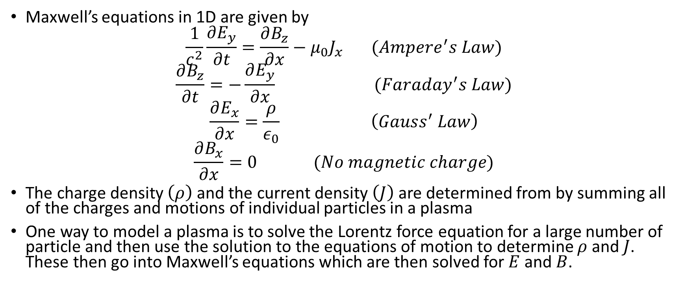
The electromagnetic fields are determined from another set of differential equations called Maxwell’s equations
Maxwell’s equations in 1D are given by
$$\frac{1}{c^{2}}\frac{∂E_{y}}{∂t}=\frac{∂B_{z}}{∂x}−μ_{0}J_{x} (Ampere^{′}s Law)$$
$$\frac{∂B_{z}}{∂t}=−\frac{∂E_{y}}{∂x} (Faraday^{′}s Law)$$
$$\frac{∂E_{x}}{∂x}=\frac{ρ}{ε_{0}} \left(Gauss^{′} Law\right)$$
$$\frac{∂B_{x}}{∂x}=0 (No magnetic charge)$$
The charge density $\left(ρ\right)$ and the current density $\left(J\right)$ are determined from by summing all of the charges and motions of individual particles in a plasma
One way to model a plasma is to solve the Lorentz force equation for a large number of particle and then use the solution to the equations of motion to determine $ρ$ and $J$. These then go into Maxwell’s equations which are then solved for $E$ and $B$.

Slide 9
Plasma can also be modeled as a fluid
In many cases, collisions between plasma particles cause many particles to respond to fields in a similar way. In this case, the motion of individual particles does not need to be followed.
Instead, the motion of fluid elements can give a good description of a plasma.
Fluid elements contain many individual particles which results in a simpler model where only the average motion of the fluid elements need to be followed.
The fluid equations are equations for the density, the fluid velocity, and the mean energy of the fluid.

Slide 10

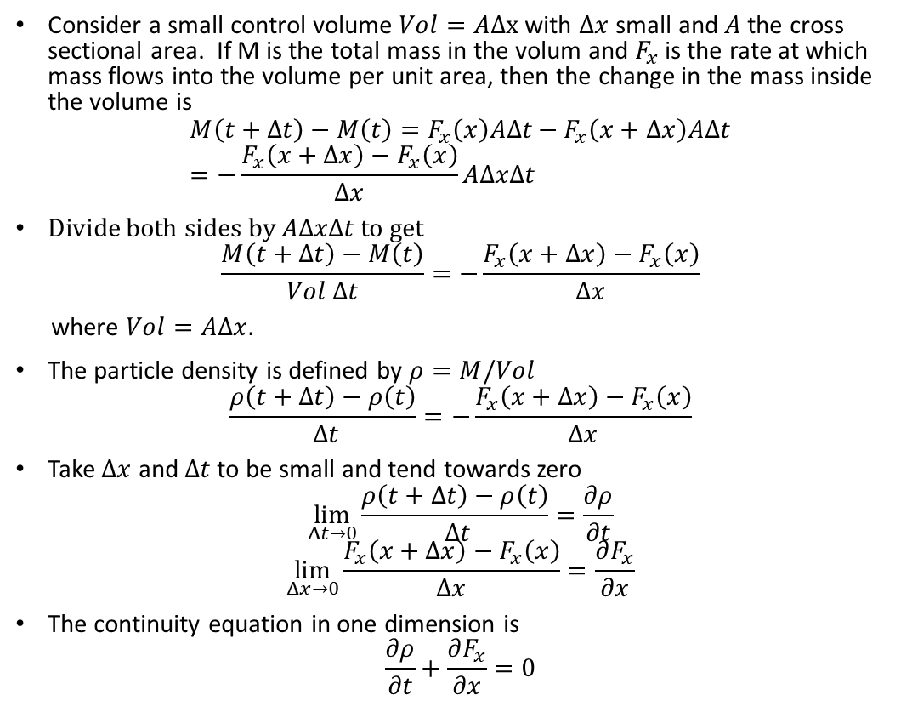

The equation for the density is called the continuity equation which is an statement of the conservation of mass
Consider a small control volume $Vol=AΔx$ with $Δx$ small and $A$ the cross sectional area. If M is the total mass in the volum and $F_{x}$ is the rate at which mass flows into the volume per unit area, then the change in the mass inside the volume is
$$M\left(t+Δt\right)−M\left(t\right)=F_{x}\left(x\right)AΔt−F_{x}\left(x+Δx\right)AΔt=−\frac{F_{x}\left(x+Δx\right)−F_{x}\left(x\right)}{Δx}AΔxΔt$$
Divide both sides by $AΔxΔt$ to get
$$\frac{M\left(t+Δt\right)−M\left(t\right)}{Vol Δt}=−\frac{F_{x}\left(x+Δx\right)−F_{x}\left(x\right)}{Δx}$$
where $Vol=AΔx.$
The particle density is defined by $ρ=M/Vol$
$$\frac{ρ\left(t+Δt\right)−ρ\left(t\right)}{ Δt}=−\frac{F_{x}\left(x+Δx\right)−F_{x}\left(x\right)}{Δx}$$
Take $Δx$ and $Δt$ to be small and tend towards zero
$$\lim_{Δt→0}{\frac{ρ\left(t+Δt\right)−ρ\left(t\right)}{ Δt}=\frac{∂ρ}{∂t}}$$
$$\lim_{Δx→0}\frac{F_{x}\left(x+Δx\right)−F_{x}\left(x\right)}{Δx}=\frac{∂F_{x}}{∂x}$$
The continuity equation in one dimension is
$$\frac{∂ρ}{∂t}+\frac{∂F_{x}}{∂x}=0$$
y
Δy
$$F_{x}(x)$$
$$F_{x}(x+Δx)$$
x
Δz
Δx
z

Slide 11
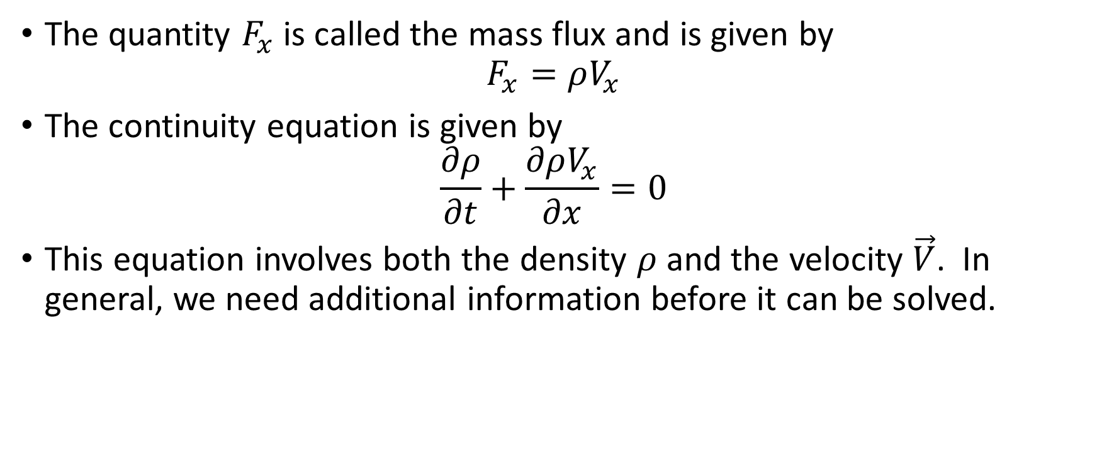
The continuity equation
The quantity $F_{x}$ is called the mass flux and is given by
$$F_{x}=ρV_{x}$$
The continuity equation is given by
$$\frac{∂ρ}{∂t}+\frac{∂ρV_{x}}{∂x}=0$$
This equation involves both the density $ρ$ and the velocity $\vec{V}$. In general, we need additional information before it can be solved.

Slide 12
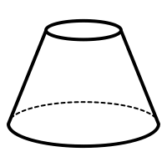


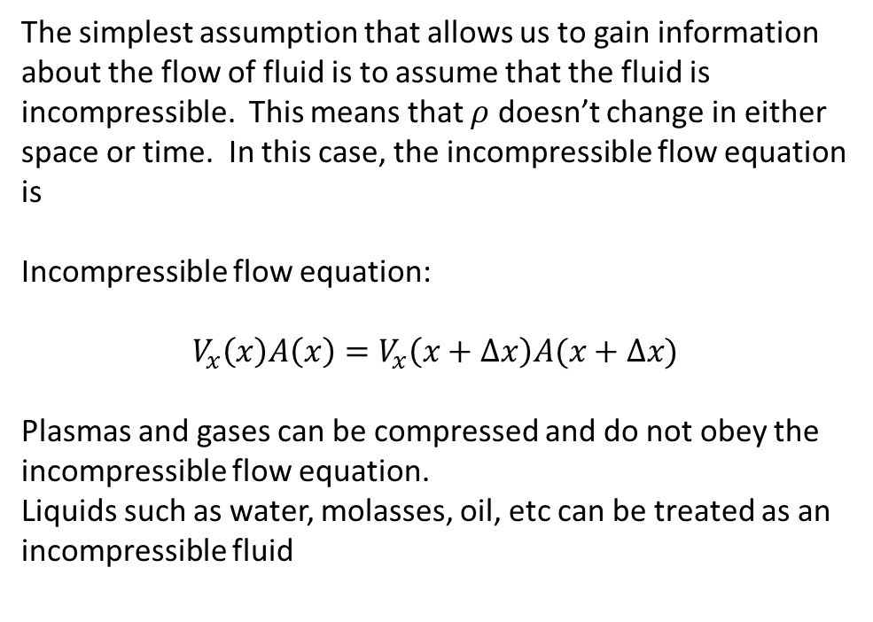



Incompressible flow equation
The simplest assumption that allows us to gain information about the flow of fluid is to assume that the fluid is incompressible. This means that $ρ$ doesn’t change in either space or time. In this case, the incompressible flow equation is
Incompressible flow equation:
$$V_{x}\left(x\right)A\left(x\right)=V_{x}\left(x+Δx\right)A(x+Δx)$$
Plasmas and gases can be compressed and do not obey the incompressible flow equation.
Liquids such as water, molasses, oil, etc can be treated as an incompressible fluid
y
x
$$A\left(x+Δx\right)$$
z
$$F_{x}\left(x\right)$$
$$F_{x}\left(x+Δx\right)$$
$$A\left(x\right)$$
$$Δx$$

Slide 13



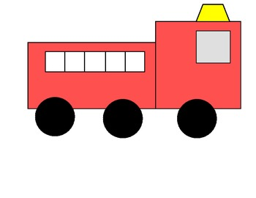
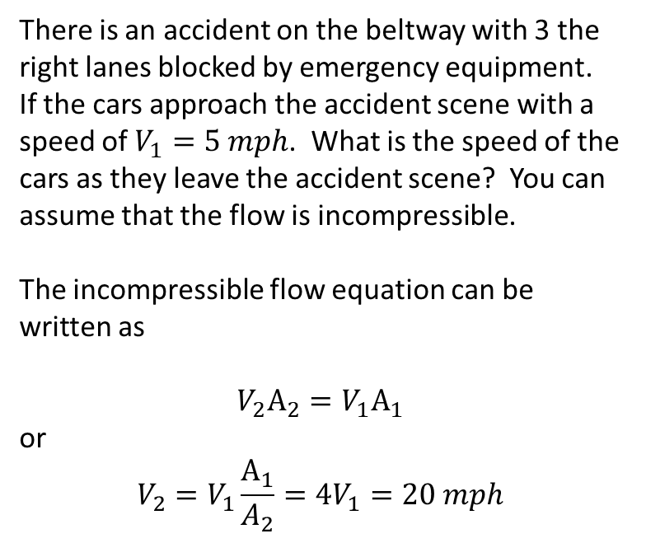


Treating traffic flow like an incompressible fluid
$$V_{1}$$
$$V_{2}$$
There is an accident on the beltway with 3 the right lanes blocked by emergency equipment. If the cars approach the accident scene with a speed of $V_{1}=5 mph$. What is the speed of the cars as they leave the accident scene? You can assume that the flow is incompressible.
The incompressible flow equation can be written as
$$V_{2}A_{2}=V_{1}A_{1}$$
or
$$V_{2}=V_{1}\frac{A_{1}}{A_{2}}=4V_{1}=20 mph$$

Slide 14

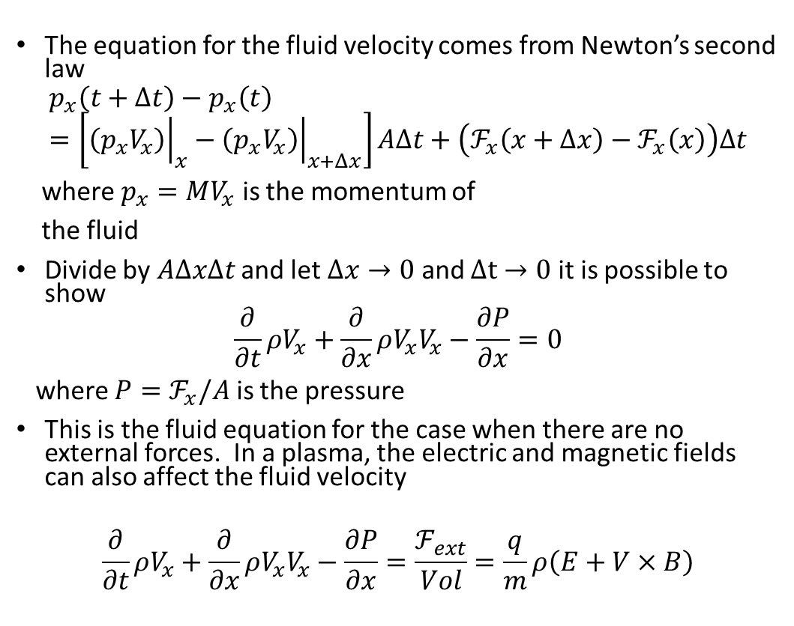

Plasmas are compressible and we need an equation for the fluid velocity
y
The equation for the fluid velocity comes from Newton’s second law
$$p_{x}\left(t+Δt\right)−p_{x}\left(t\right)=\left[{\left.\left(p_{x}V_{x}\right)\right|}_{x}−{\left.\left(p_{x}V_{x}\right)\right|}_{x+Δx}\right]AΔt+\left(ℱ_{x}\left(x+Δx\right)−ℱ_{x}\left(x\right)\right)Δt$$
where $p_{x}=MV_{x}$ is the momentum of
the fluid
Divide by $AΔxΔt$ and let $Δx→0$ and $Δt→0$ it is possible to show
$$\frac{∂}{∂t}ρV_{x}+\frac{∂}{∂x}ρV_{x}V_{x}−\frac{∂P}{∂x}=0$$
where $P=ℱ_{x}/A$ is the pressure
This is the fluid equation for the case when there are no external forces. In a plasma, the electric and magnetic fields can also affect the fluid velocity
$$\frac{∂}{∂t}ρV_{x}+\frac{∂}{∂x}ρV_{x}V_{x}−\frac{∂P}{∂x}=\frac{ℱ_{ext}}{Vol}=\frac{q}{m}ρ\left(E+V×B\right)$$
Δy
$$ℱ_{x}(x)$$
$$ℱ_{x}(x+Δx)$$
x
Δz
Δx
z

Slide 15

The final equation for the energy of the fluid is derived from conservation of energy
The energy equation is derived in the same way as the continuity and force balance equations by considering the flow of energy into and out of the volume and considering the work done as the volume is compressed by pressure forces
$$\frac{∂}{∂t}ρε+\frac{∂}{∂x}\left(ρε+P\right)V_{x}=ρV_{x}E$$

Slide 16
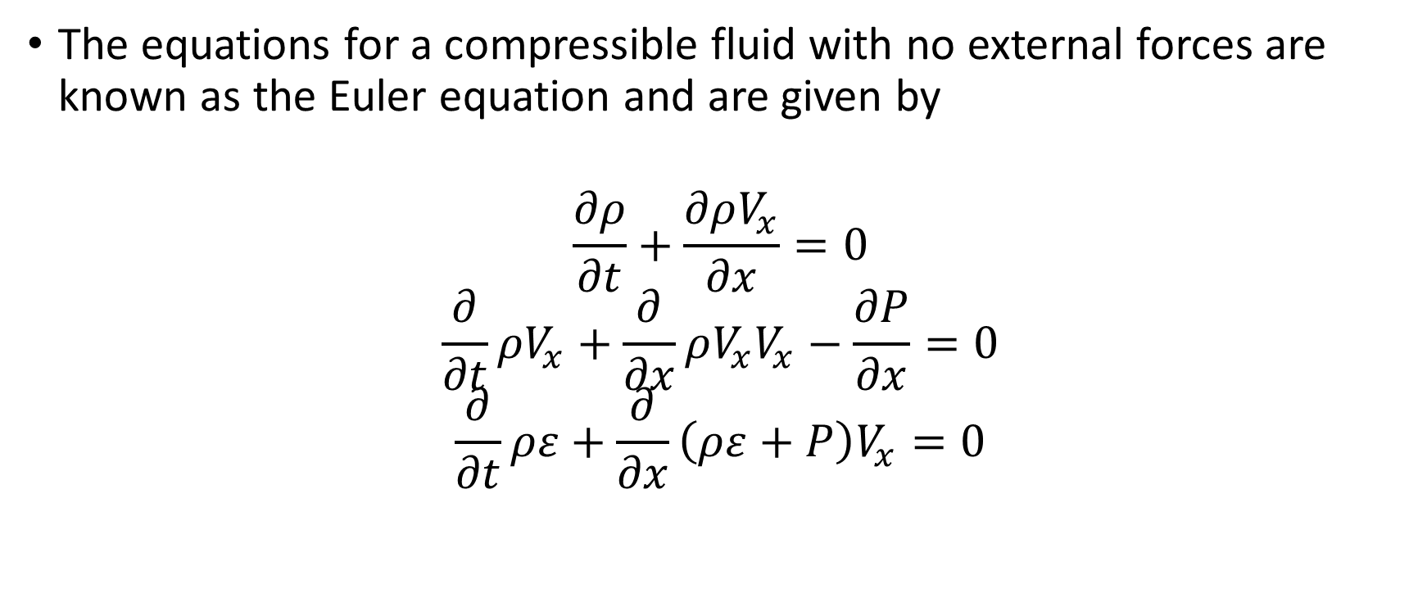
The full set of fluid equations for a compressible fluid are
The equations for a compressible fluid with no external forces are known as the Euler equation and are given by
$$\frac{∂ρ}{∂t}+\frac{∂ρV_{x}}{∂x}=0$$
$$\frac{∂}{∂t}ρV_{x}+\frac{∂}{∂x}ρV_{x}V_{x}−\frac{∂P}{∂x}=0$$
$$\frac{∂}{∂t}ρε+\frac{∂}{∂x}\left(ρε+P\right)V_{x}=0$$

Slide 17

The corresponding set of fluid equations for a plasma are
The plasma fluid equation
$$\frac{∂ρ}{∂t}+\frac{∂ρV_{x}}{∂x}=0$$
$$\frac{∂}{∂t}ρV_{x}+\frac{∂}{∂x}ρV_{x}V_{x}−\frac{∂P}{∂x}=\frac{q}{m}ρ\left(E+V×B\right)$$
$$\frac{∂}{∂t}ρε+\frac{∂}{∂x}\left(ρε+P\right)V_{x}=ρV_{x}E$$

