Slide 1
GeoIPS Workshop 2026: Sectors
Andrew Thorpe
20260721

Slide 2
Overview
Geographic sectors in GeoIPS
Capabilities of sectors in GeoIPS:
Static Sectors
Dynamic Sectors
Sectors and Sectoring backend
Sector Examples:
Static: Vera Cruz Oil spill
Dynamic: Iceberg A23

Slide 3
GeoIPS sectors
YAML defined sectors
Set style helps interchange projection type, size, and resolution
Wide coverage of applications between static and dynamic sectors
Interchangeable; same sector for different products, readers, and data sources
55 static sectors and 23 dynamic sectors
Defined structure and format, see documentation: Extend GeoIPS with a Static Sector

Slide 4
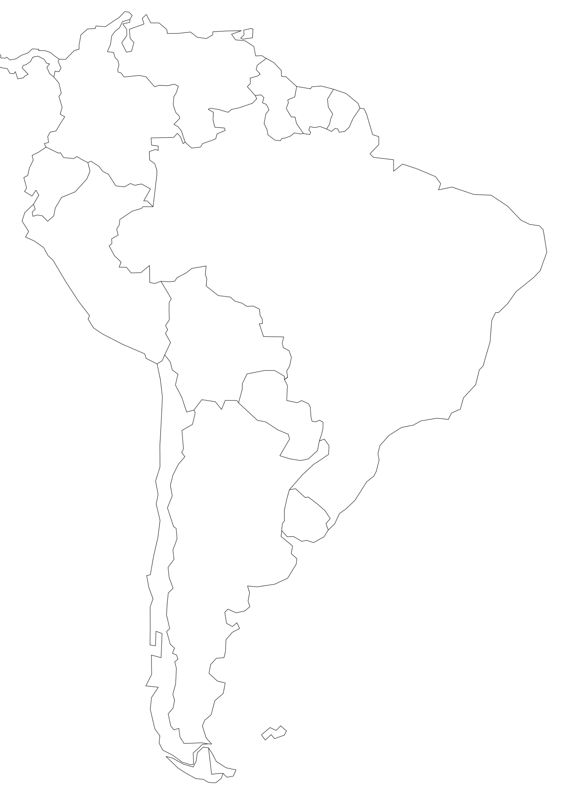
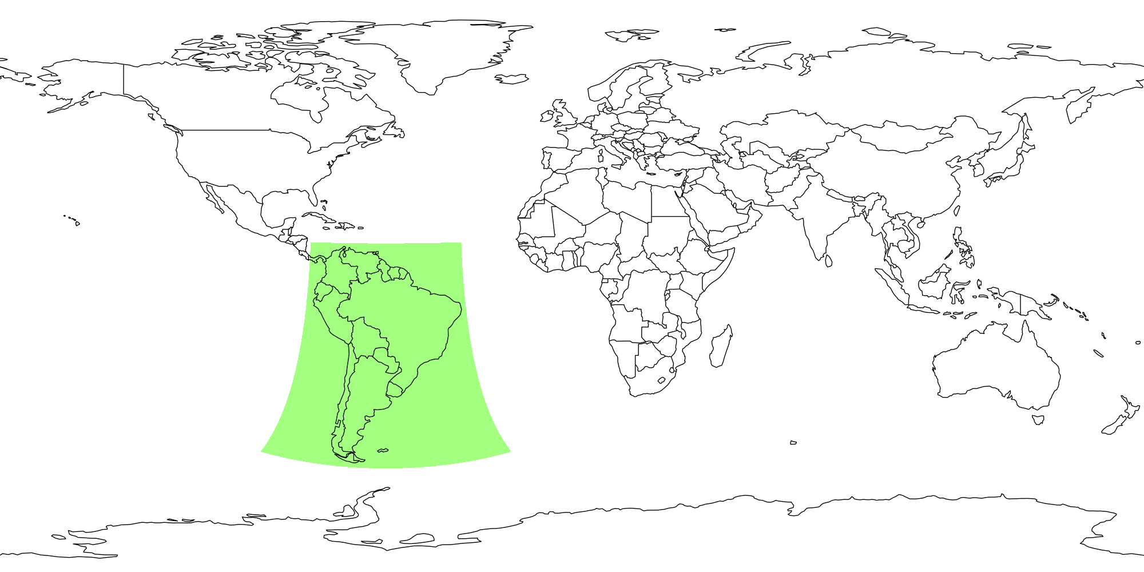
Tools for sectors
Tools to visualize sectors:
geoips test sector <sector_name>
Displays sector in defined projection
geoips test sector <sector_name> --overlay:
Overlays sector onto global equidistant cylindrical projection

Slide 5
Static Example
What if I want to capture a static region on Earth, and use it for any sensor, product, or algorithm?

Slide 6
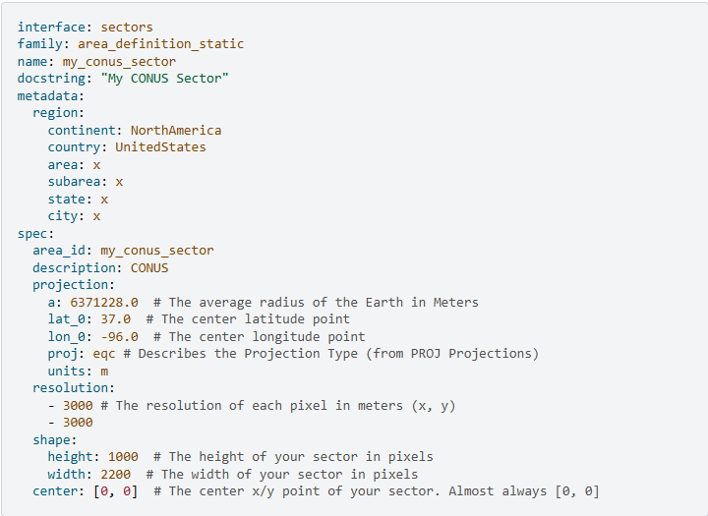
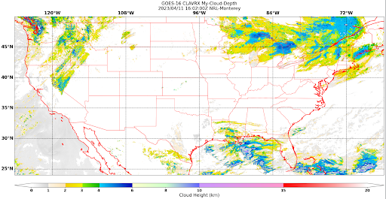
Static Sector Capabilities
Fixed in space and time
Tunable parameters:
Center latitude & longitude
Projection type (EQC)
Units (meters), used in resolution
Resolution of each pixel (in user defined units; km/m)
Shape (height/width in pixels)
Center (almost always 0,0)
Tunable metadata:
Region description; can be used in output metadata and formatting
Continent (EX: NorthAmerica)
Country (EX: USA)
Area (EX: WestCoast)
Subarea (EX: DeathValley)
State (EX: California)
City (EX: Shoshone)
Downsides:
Custom projections are hard to implement

Slide 7
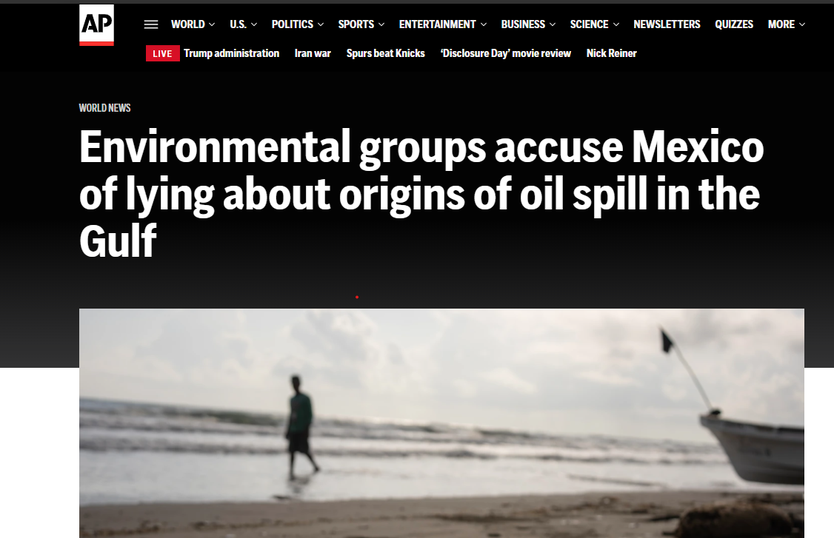
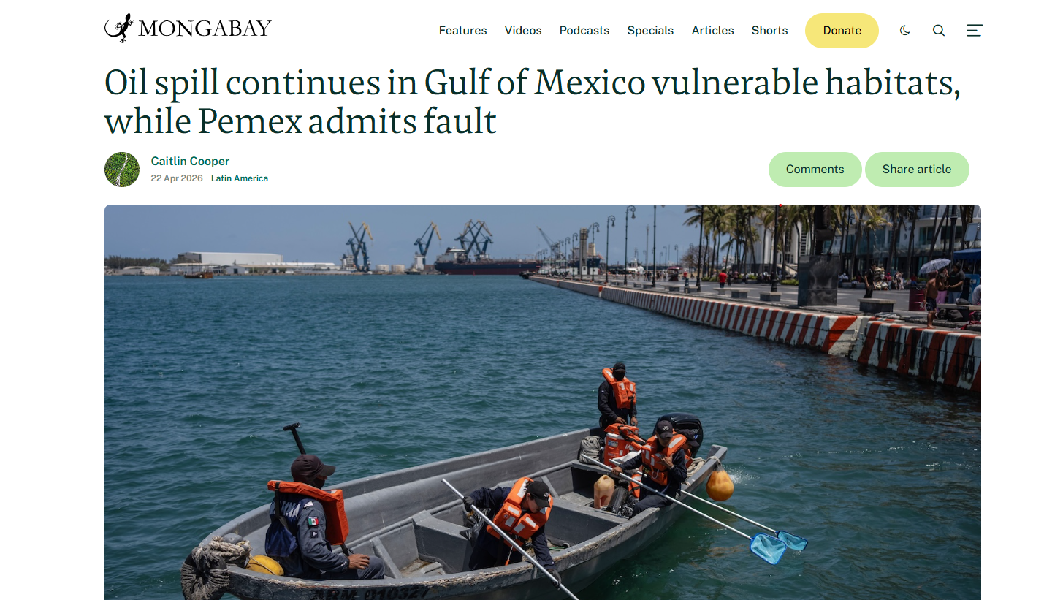
Problem: Oil Spill outside of Veracruz
New coverage of an oil spill in February, March of 2026
Detections of oil spills from beaches, fishing communities, and surrounding habitats
Government owned Pemex initially denied leakage in early cases, but admitted fault in April

Slide 8
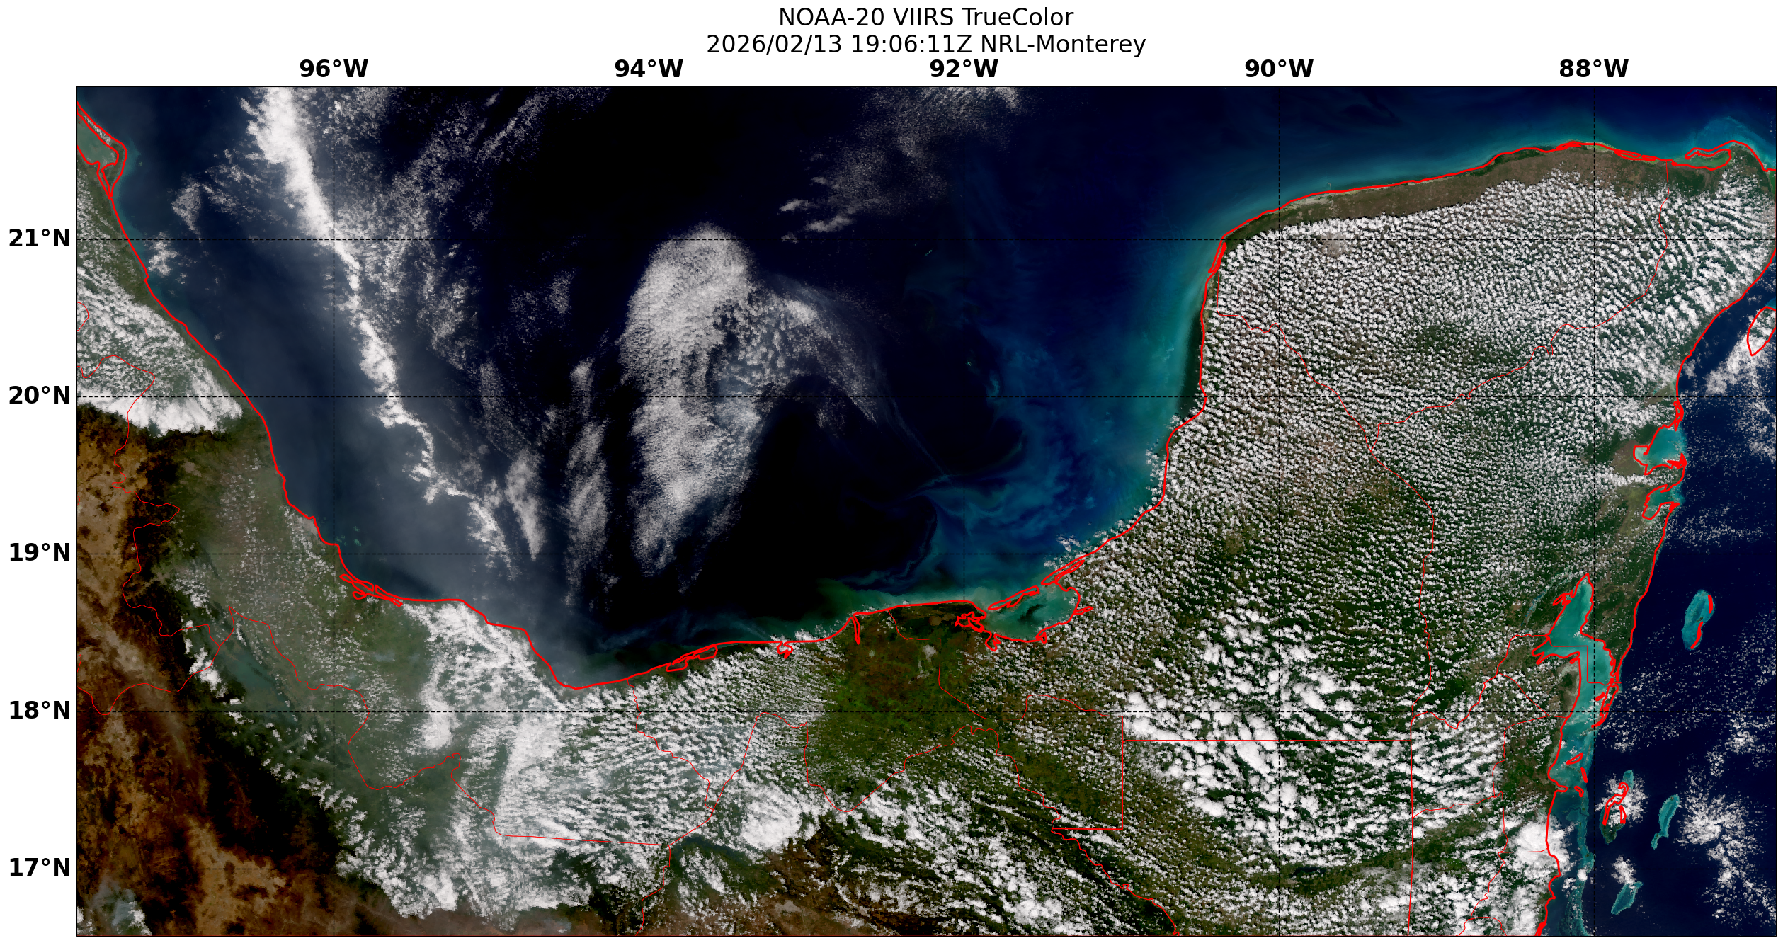
Static Sector Example
First pass failed using VIIRS data to identify a sector or detection
Resolution limited…!
Reached out to AP New’s Will Jarrett, success, but used proprietary data source
Sector derived!

Slide 9
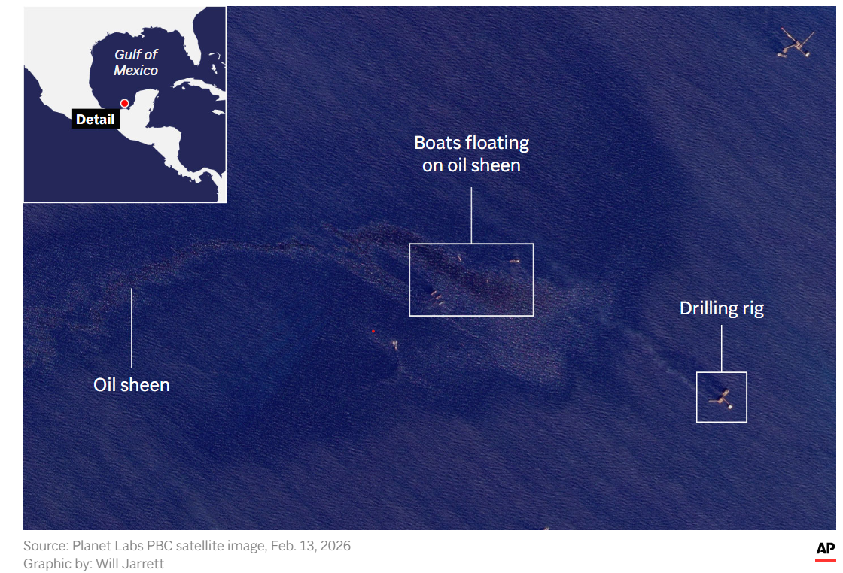
Problem: Oil Spill outside of Veracruz
News sources, and scientists cited using satellite imagery for oil spill identifications
Only AP News displayed imagery with minimal information…..
Goal: Create a static sector to capture oil spills from Pemex oil rigs…?

Slide 10
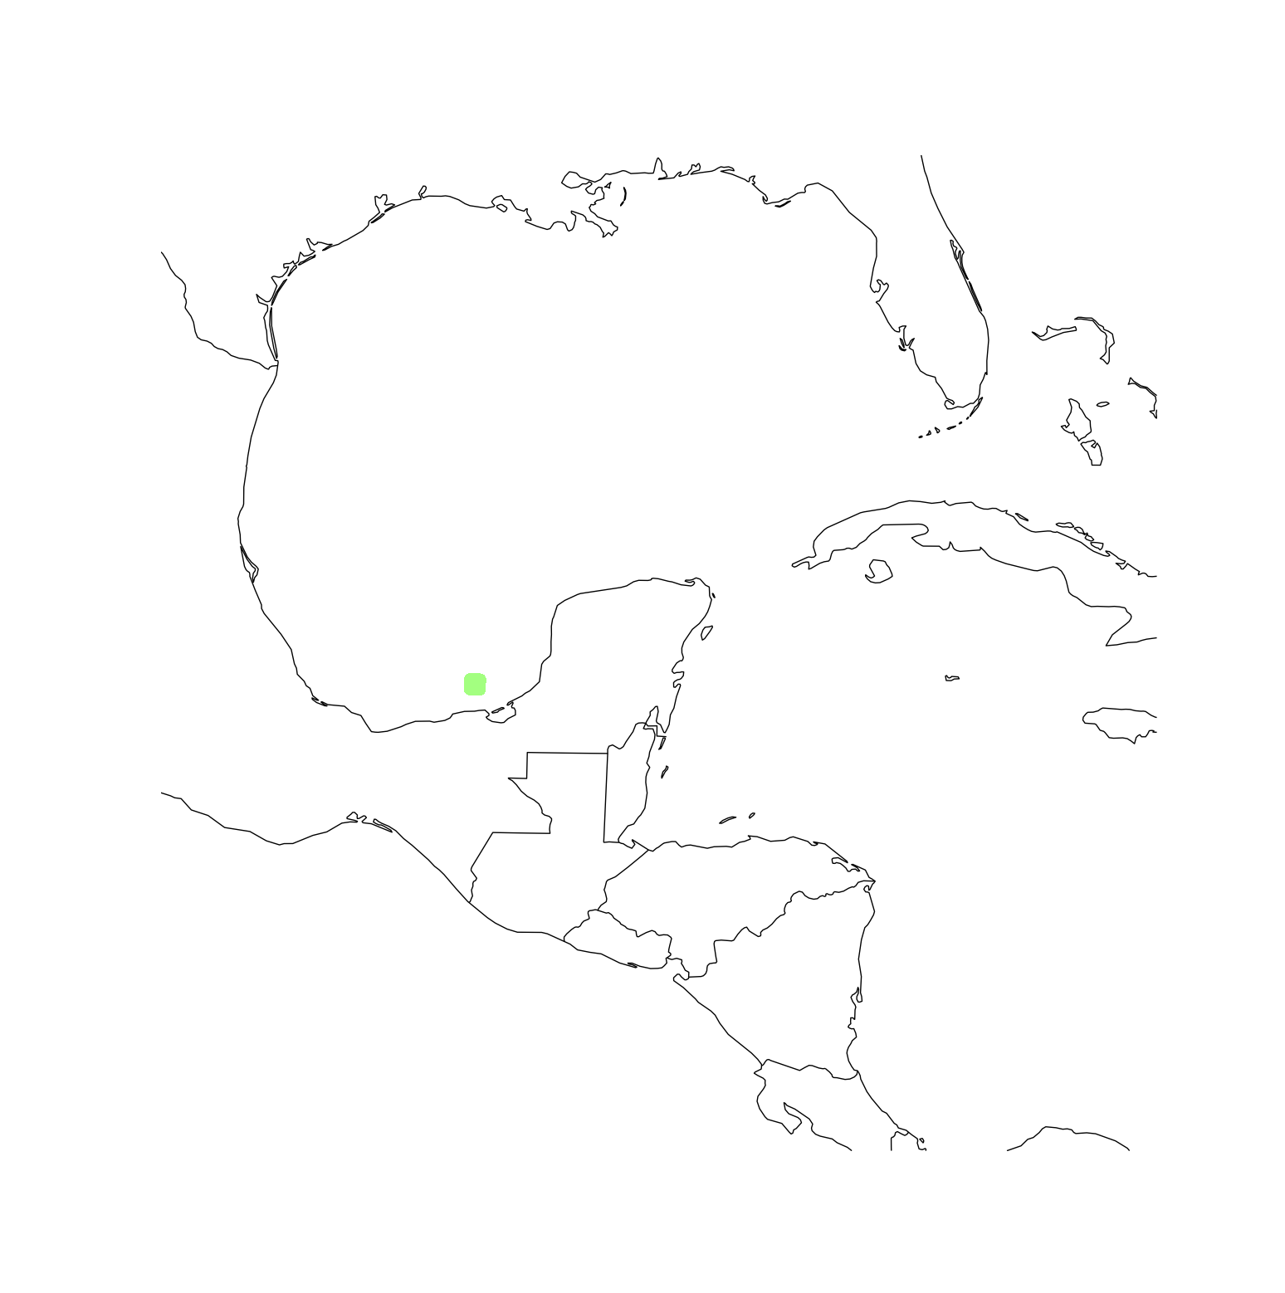
Static Sector Example: Derived Values
Time: 20260213T171453Z
Latitude: 19.27517
Longitude: -92.22473
Resolution: 50 meter
Projection: eqc
Size: 20 km goal diameter, 400 by 400 size

Slide 11
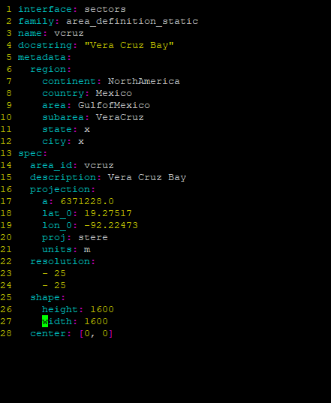
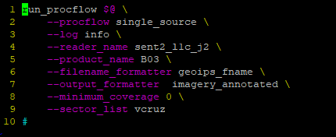
Static Sector: Applied
Derived sector can be applied to any product!

Slide 12
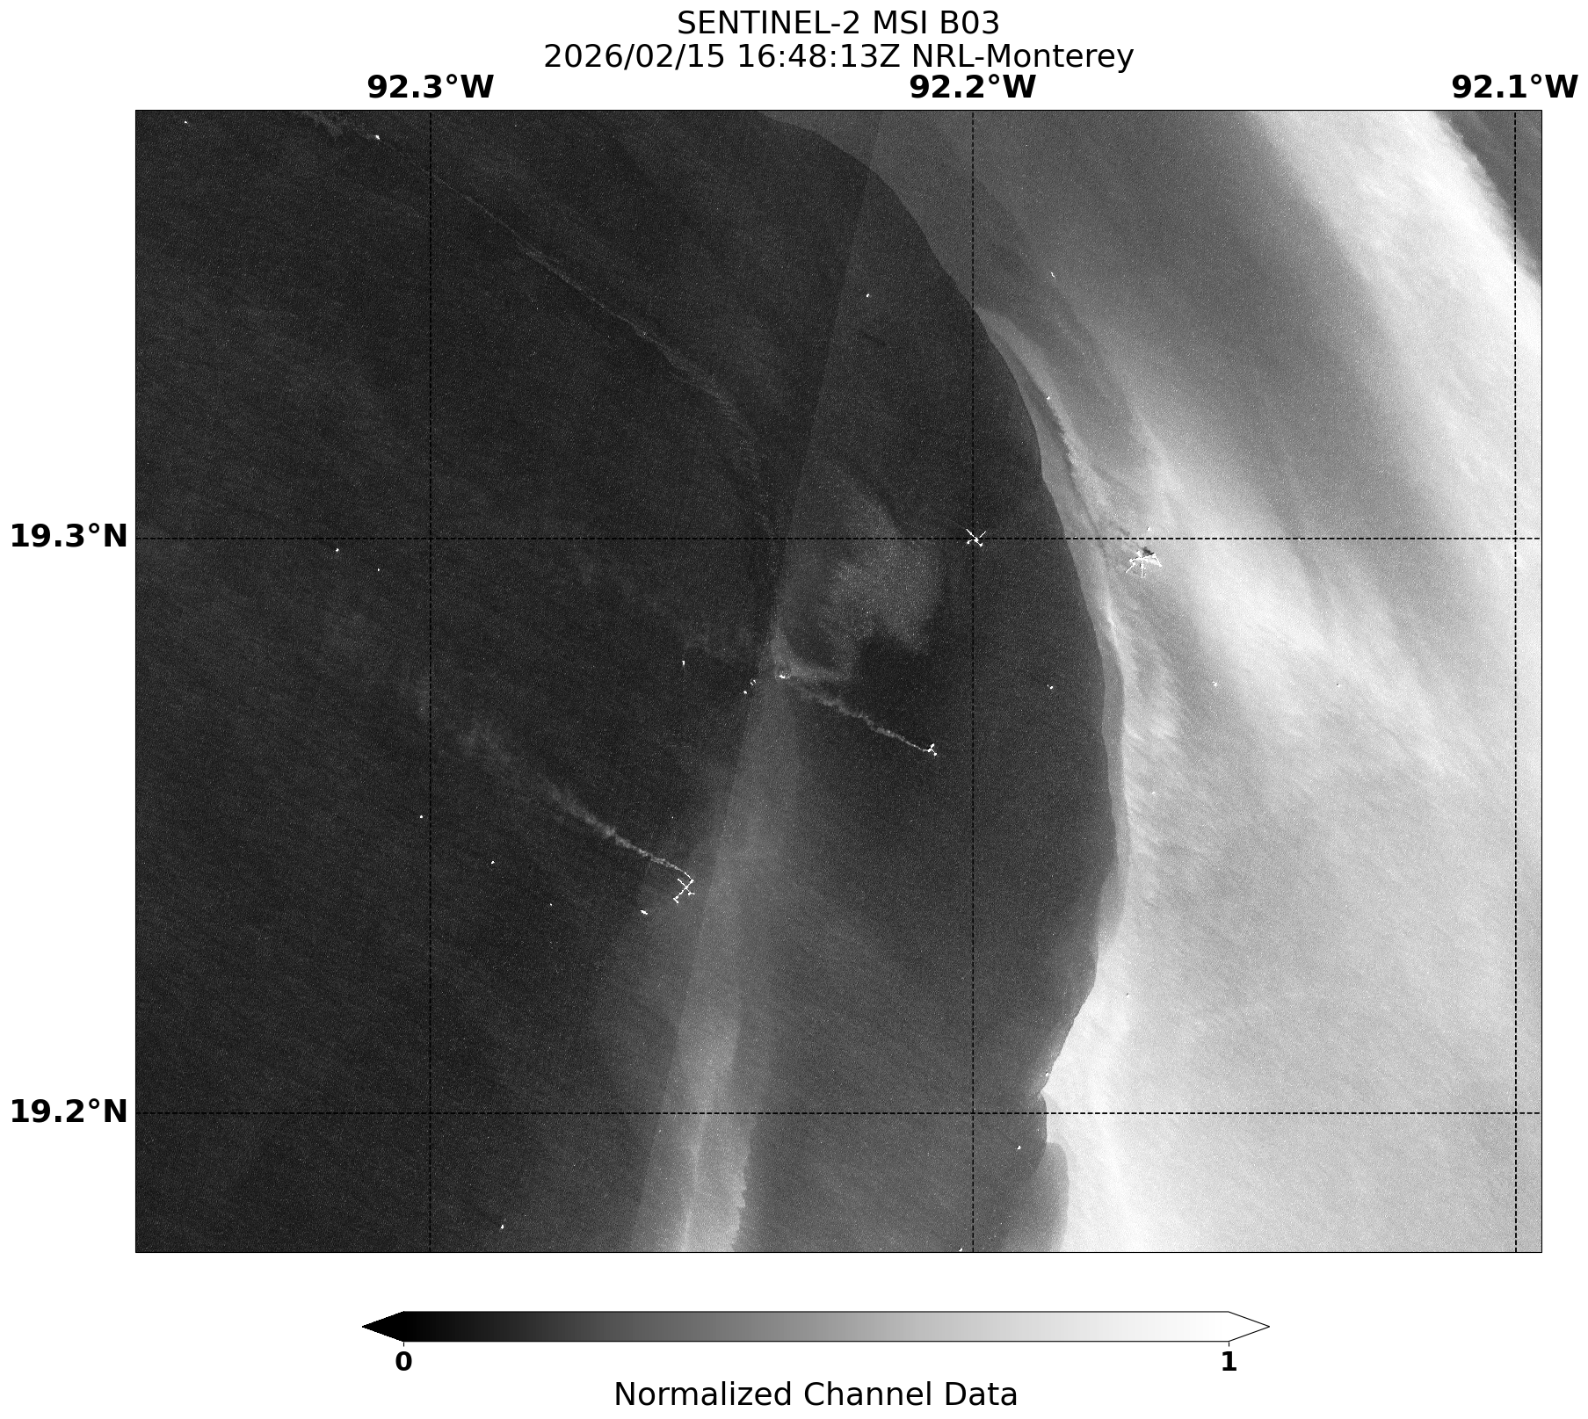

Slide 13
Dynamic Example
What if I want to capture a dynamic region or transient phenomenon on Earth, and use it for any sensor, product, or algorithm?

Slide 14
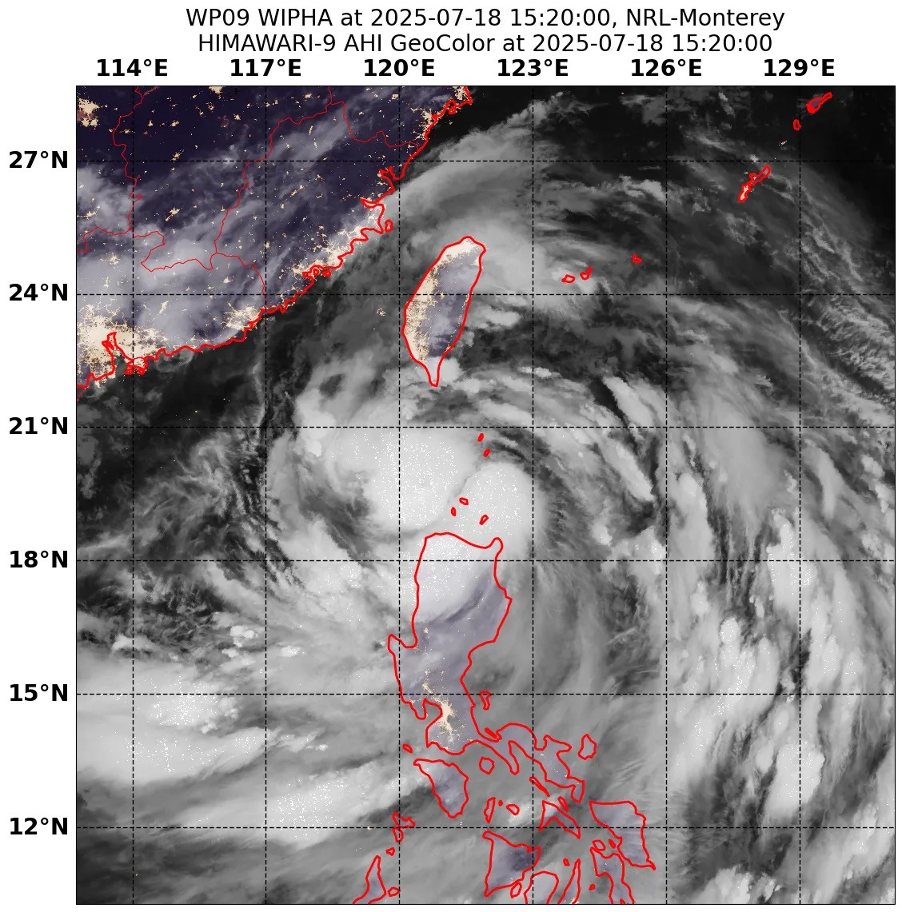
Dynamic Sector Capabilities
Capture transient activity, can be dynamic in space and/or time
Work in conjunction with track files and parsers
Tunable parameters:
Pixel width (meters)
Pixel height (meters)
Number lines (pixels)
Number samples (pixels)
Tunable metadata:
Docstring
Downsides:
Not well documented
GeoIPS utilizes dynamic sectors for Tropical Cyclones
(imagery via TCWeb)

Slide 15

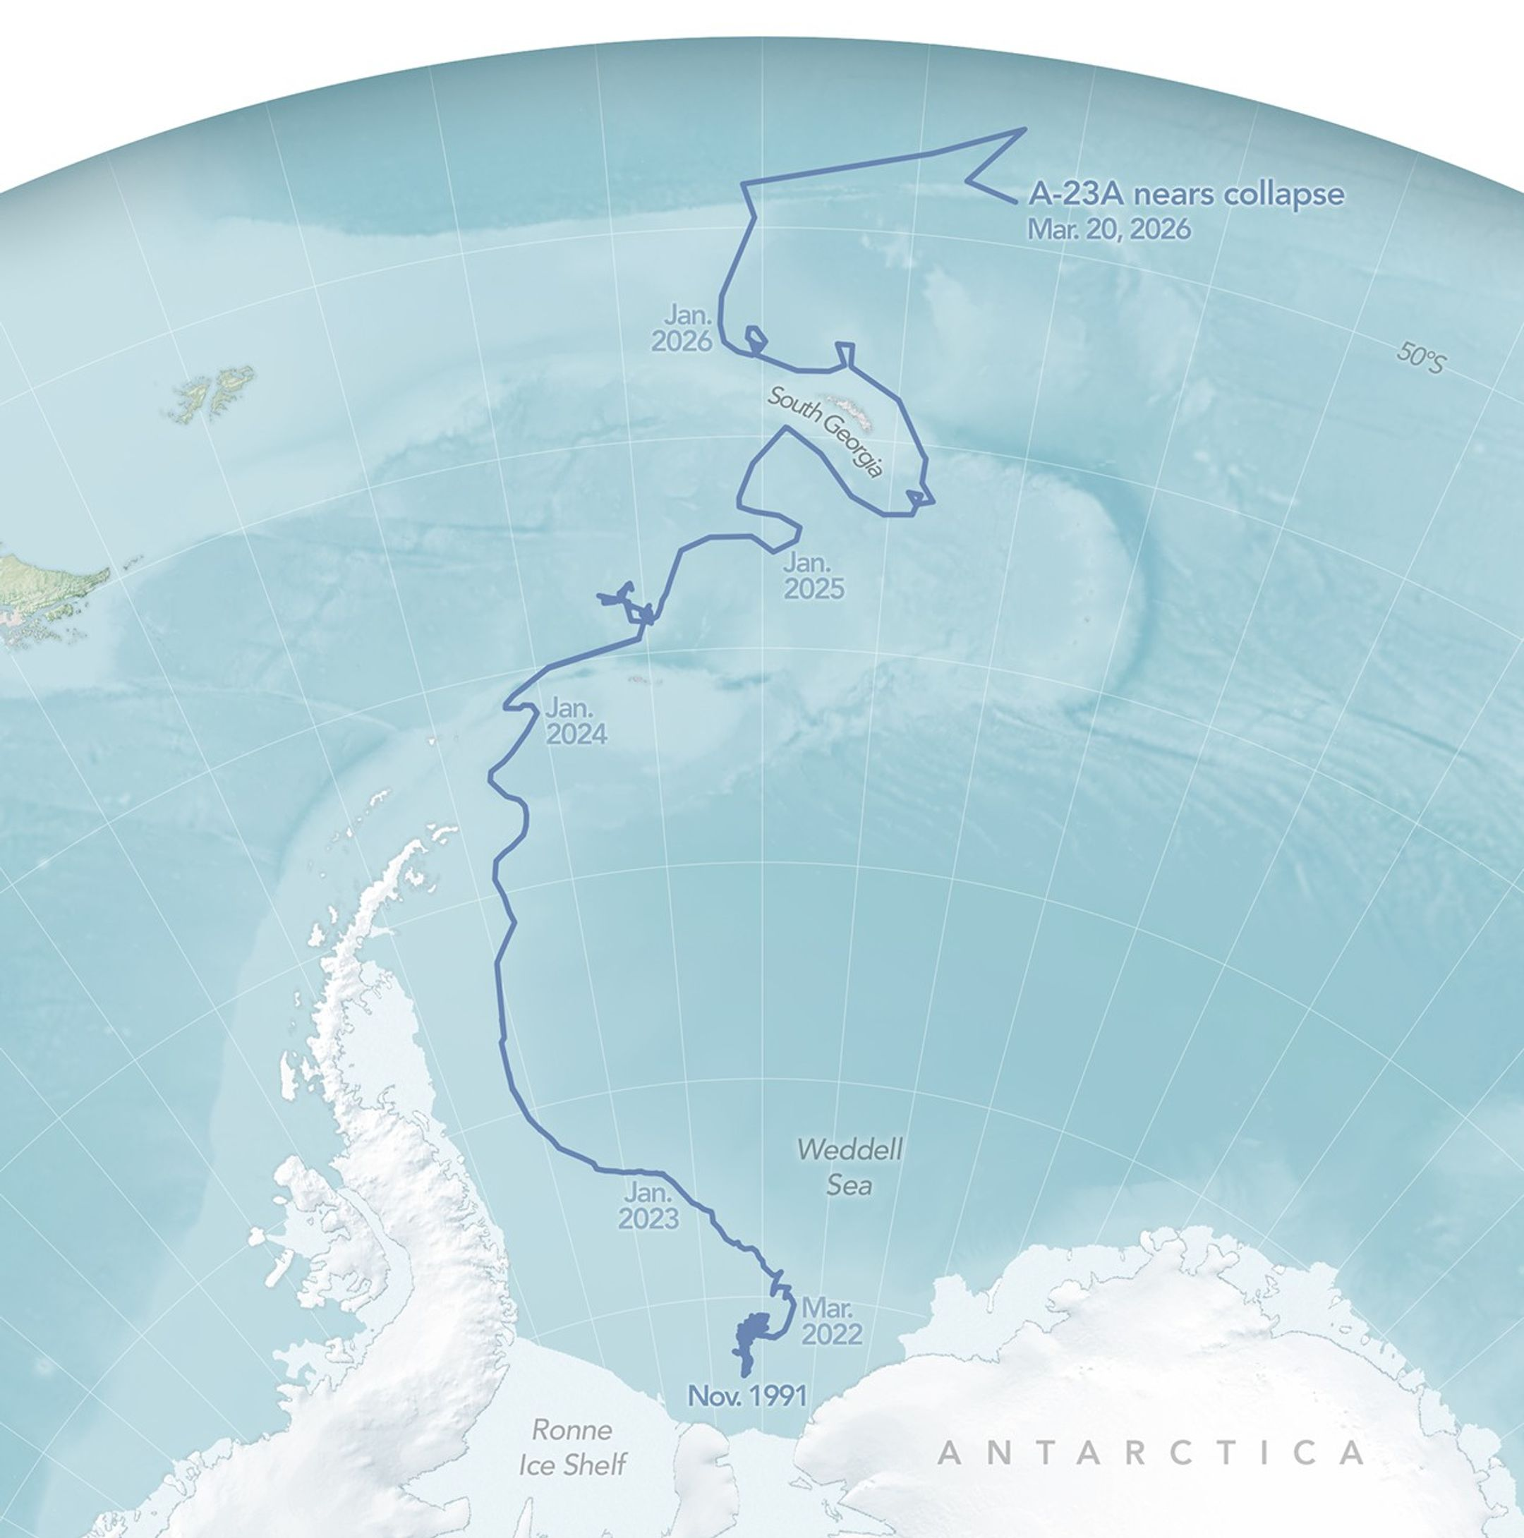
Dynamic Sector Example
Iceberg tracking: A23A, long-living iceberg
Only visible by polar satellites, and transient in time and location
Application: Tracking phytoplankton blooms due to iceberg mineral (iron) deposits

Slide 16
Changes needed for implementation
Created an iceberg dynamic sector file (yaml)
Created a sample iceberg track file (csv)
Created an iceberg dynamic track file parser (csv to list)
Modified sector utilities to create a dynamic AreaDefinition list for icebergs from a parsed track files (list to AreaDefinition)
Modified sector metadata generators class to accept icebergs as an additional parser class

Slide 17
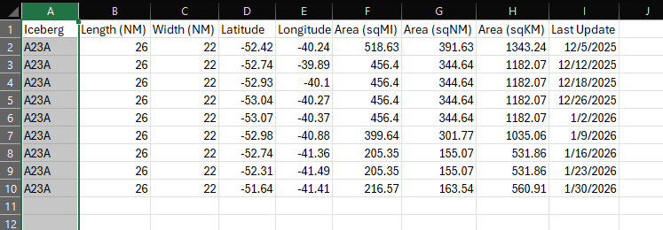
Dynamic Sector Components: TrackFile
Created a multi-time file from daily iceberg reports from the USNIC
Formatted file that contains:
Latitude (required)
Longitude (required)
Time (required)
Relevant metadata

Slide 18
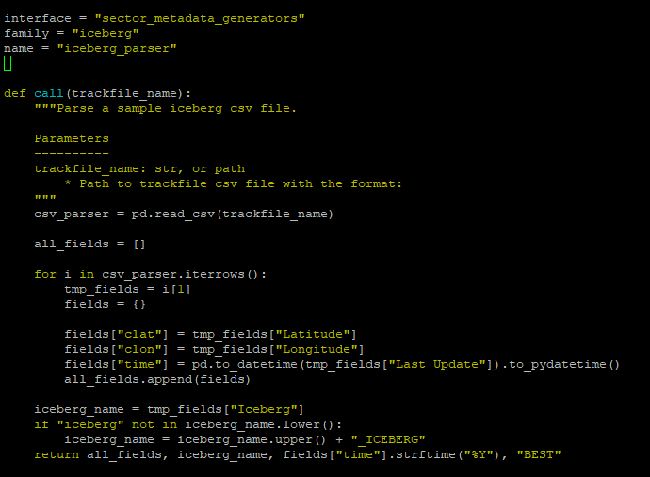
Dynamic Sector Components: Trackfile parser
Translates data from trackfile into a list of dictionaries
Minimum required information:
Latitude
Longitude
Time
Name

Slide 19
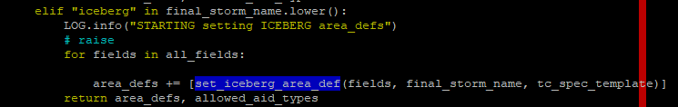
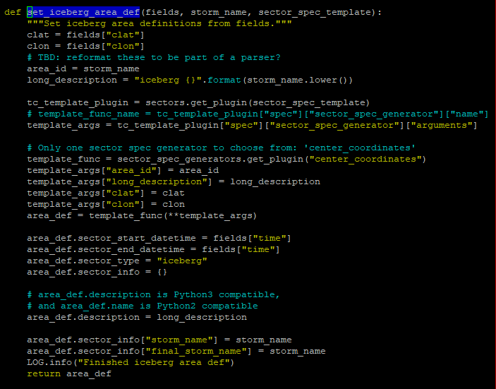
Dynamic Sector Components: Parser to AreaDefinition
Iteratively transforms the iceberg parsed information into area definitions
Set start and end datetimes, which help sector the dataset in the end
Calls the center_coordinate sector spec generator

Slide 20
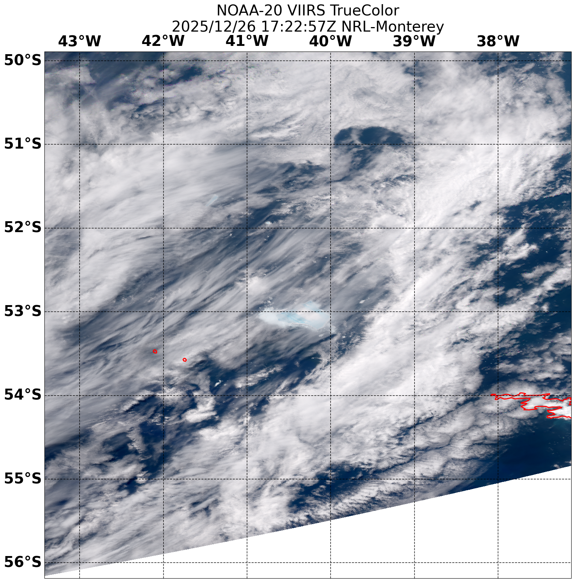
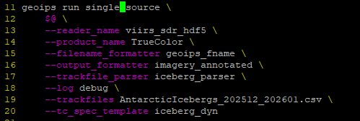
Dynamic Sector Imagery

