Slide 1
3D Texture Mapping
In-depth discovery of Normal Mapping, Bump Mapping, Relief Mapping, and Displacement Mappping

Slide 2
Introduction to Bump Mapping

Slide 3
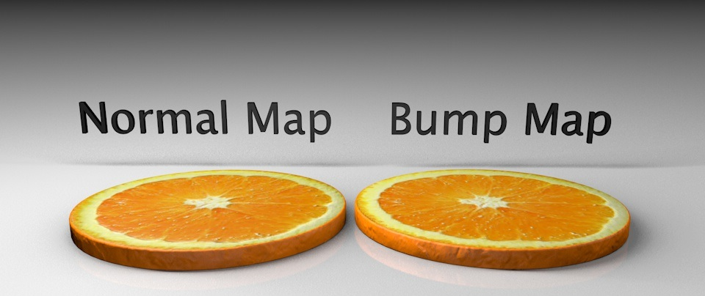
Bump Mapping
A number of different techniques exist for creating bump maps, including normal mapping, displacement mapping, and relief mapping.

Slide 4
Demo

Slide 5
Normal Mapping

Slide 6
Relief Mapping

Slide 7
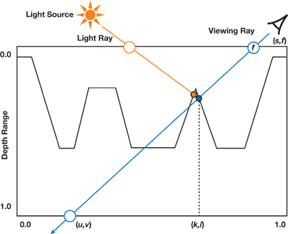
Relief Mapping
Relief mapping simulates the appearance of geometric surface details by shading individual fragments in accordance to some depth and surface normal information that is mapped onto polygonal models. A depth map ^{[1]}(scaled to the [0,1] range) represents geometric details assumed to be under the polygonal surface.
Source

Slide 8
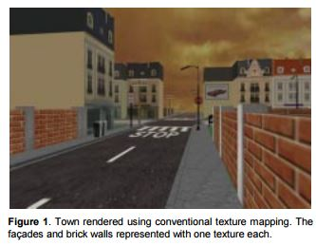
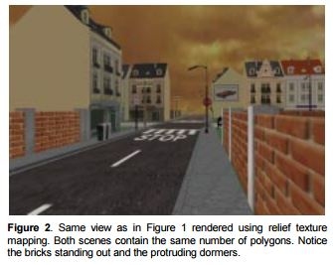
Demo
Conventional Texture Mapping
Relief Texture Mapping
Source

Slide 9
Displacement Mapping

Slide 10
Team Members:
Nicola Frachesen
Natalie Rumak
Xiaoxi Zheng
Richard Li

