Slide 1
CELLS

Slide 2
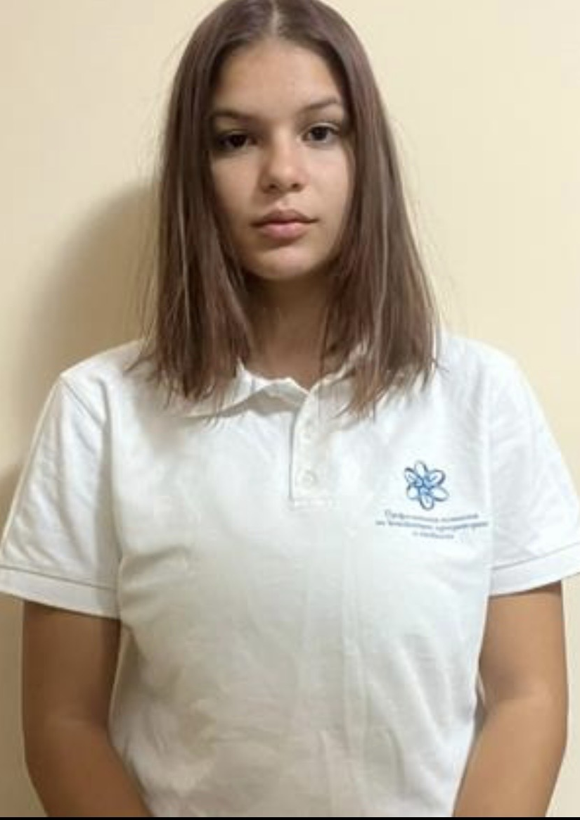
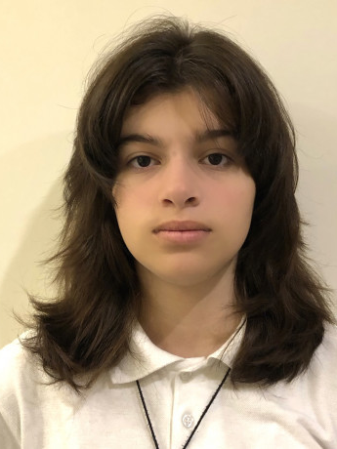
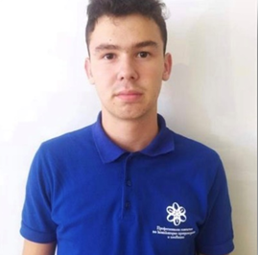
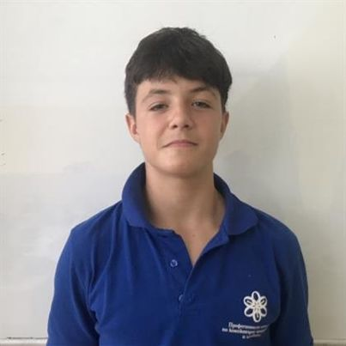
OUR TEAM
SCRUM TRAINER
BACKEND DEVELOPER
BACKEND DEVELOPER
FRONTEND DEVELOPER
Nikoleta Ruseva
Filipa Popova
Kaloyan Georgiev
Steliyan Nikolov

Slide 3





STAGES OF REALIZATION
Choose an idea
Make a design
Make a program
Make documentation

Slide 4







USED TEHNOLOGIES

Slide 5
Let’s get to our repository

