Slide 1
Index | Presentation Core Structure
To adapt
Team Composition
How we worked together
Overview of the entire process and data insights obtained from it
Business action proposals based on findings
1

Slide 2
Group 1 composition & how we worked together
Adapt roles
ADD PROFILE
PICTURE
ADD PROFILE
PICTURE
ADD PROFILE
PICTURE
ADD PROFILE
PICTURE
ADD PROFILE
PICTURE
ADD PROFILE
PICTURE
Sebastián Catalán Fuica
Role
Afp Planvital Chile
Floriane Hernalsteens
Role
Europ Assistance Belgium
Roman Hospodár
Role
Generali Czech Republic
Oliver Manara
Role
Generali Germany
Federico Sportelli
Role
Generali Italy
Lee Thompson
Role
Generali UK
Weekly team meetings (1x or 2x a week)
Teams channel, Github repository & Whatsapp group
Work division according to level of expertise & interest
2

Slide 3

The Use Case
«How to increase the customer retention for a travel agency»
What is the situation?
our group consults an agency which provides school-trips (of various grades/school types & sorts of travel)
our aim is to increase the percentage of trips which are rebooked in the following year by finding insights in historic data & defining applicably actions to increase the customer loyalty
Our Approach
we build a modell using statistical methods to predict the probability of a school booking again a trip based on the behavior of similar clients in the past
assembling on the forecast we figure out the positive and negative key drivers & derive actions to increase the retention
3

Slide 4
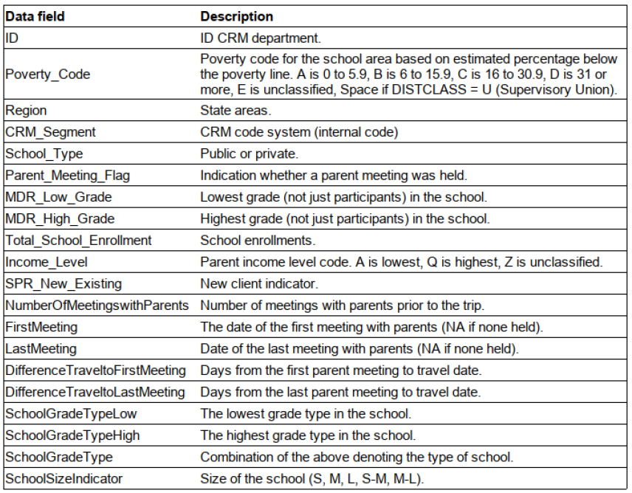
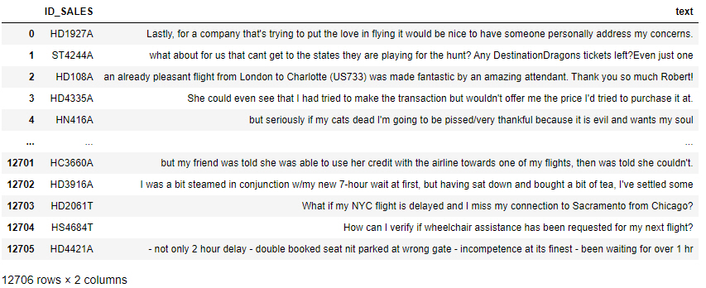
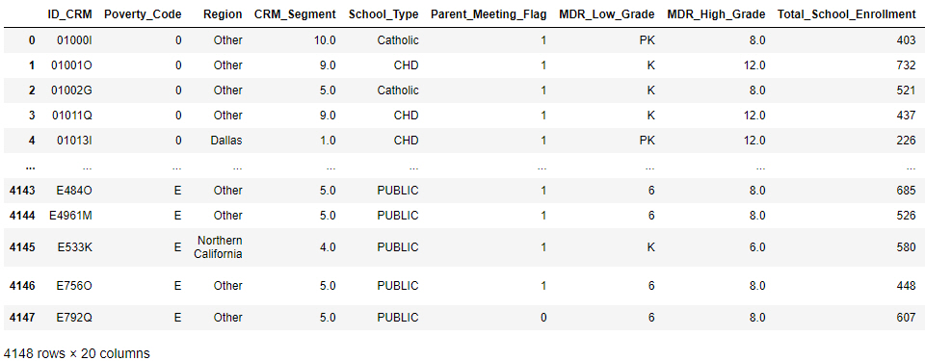
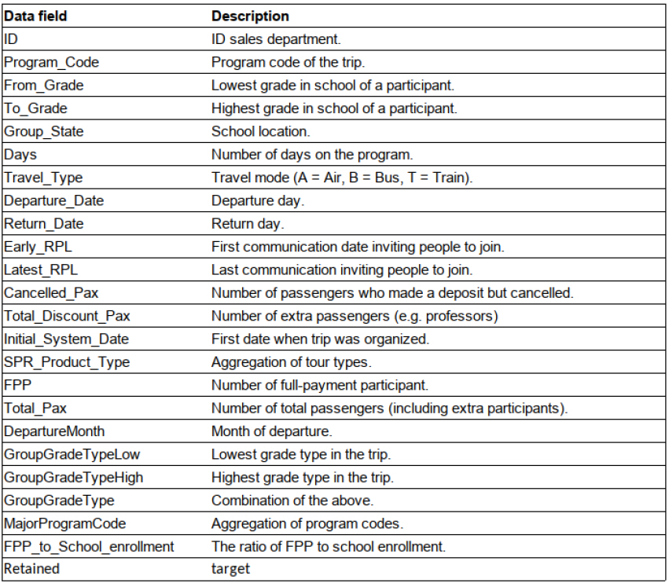
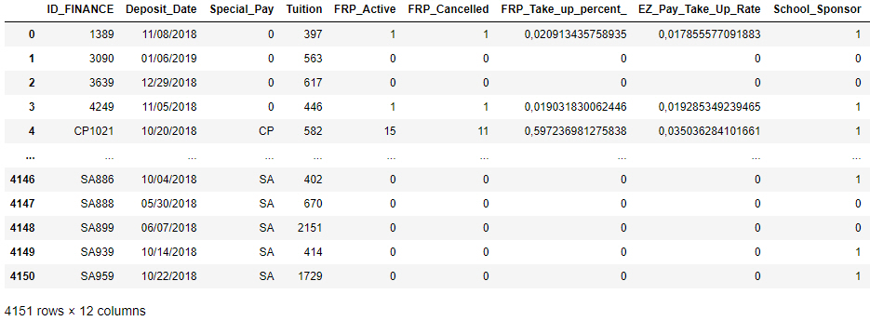
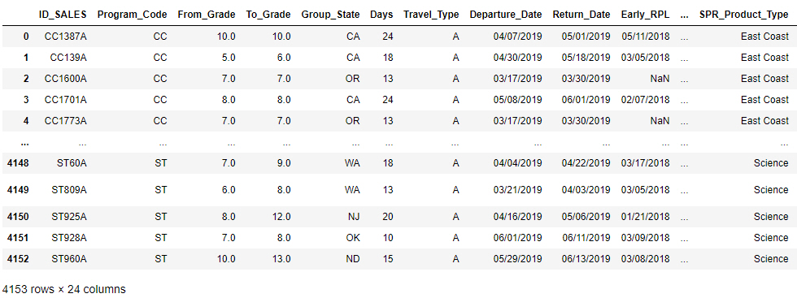
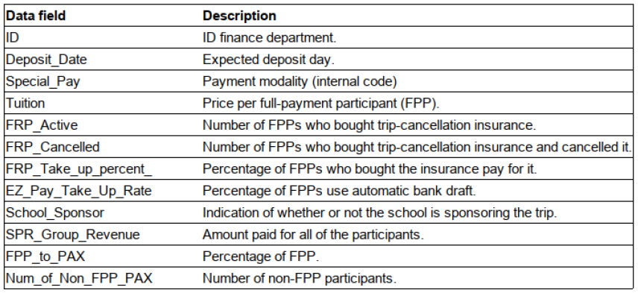
The Use Case four data sources can be analyzed
Tweets of customers refering to trips
CRM Customerdescription based on Customer relationship system
Sales Tripspecification & target variable „Retained“ (1, 0)
Finance Billinginformation
4

Slide 5
Data Cleaning (Lee )

Slide 6
Data Model & assumptions (Federico )

Slide 7
Polarity
It is the measure of the process of analyzing the sentiment of each tweet into negative, neutral or positive. This measure ranges from -1 to 1
Text cleaning
Remove mentions
Remove hashtag
Remove retweet
Remove hyperlink
Remove all distinct to words (ex: emoticons)
How do we calculate the polarity by id?
Calculate sentiment for each tweet using TextBlob
Mean of polarity by id (ID_SALES)
Fill null values with the mean sentiment

Slide 8
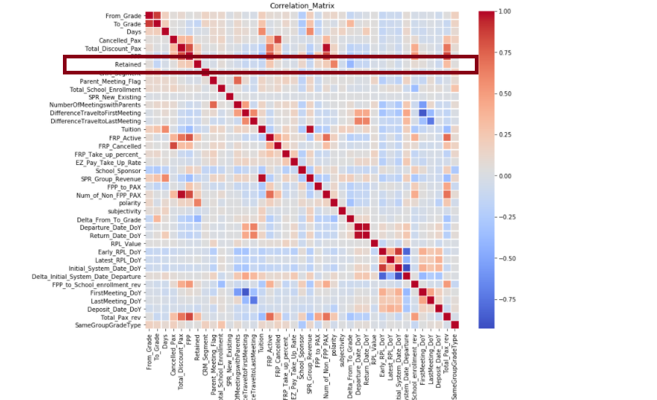
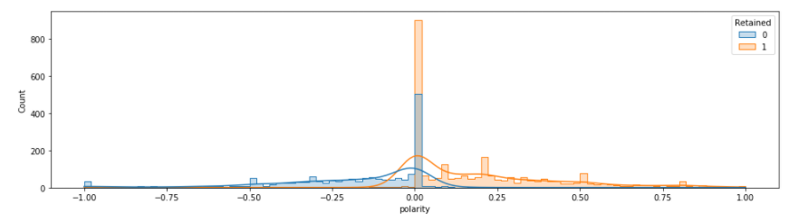
Polarity vs Retention
8

Slide 9
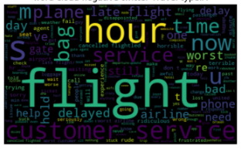
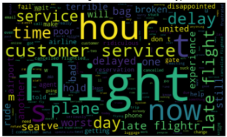
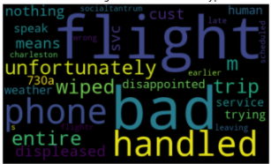
To revise wordcloud?
Polarity
Travel mode: Air
Travel mode: Train
Travel mode: Bus
Late flights
Customer service
Problems with bags
9

Slide 10
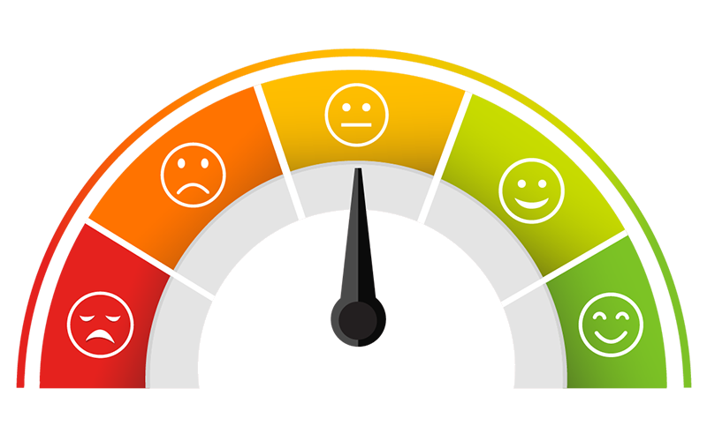

Business action proposals based on findings
Polarity is a key predictor
Word of mouth
Send out a survey (NPS) after each trip to assess customer satisfaction level on different aspects of the trip
Use quantitative (scores) and qualitative (comments) feedback to predict the retention for that trip & school
Set-up a governance to periodically analyze NPS results : identify areas of excellence and improvement and deduct concrete actions
Sponsor „a friend“
The school can invite another school to sign up for a new trip. If it does, they will get a discount of 10% on next subscription
Work with ambassadors
Ask the best scoring NPS if they want to testify about their experience and use it on your website

Slide 11

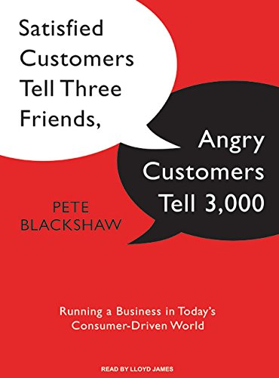
Business action proposals based on findings
Area for improvements
Feedback collection pitfalls
„Close the loop“ for the detractors by calling all low scores to voice out their experience in order to gain more insight and for the customer to feel heard (phone number should be a mandatory field at subscription)
Feedback on flights
Audit the different airlines in portfolio - with a focus on flight punctuality, flight cancellation, luggage management & customer service excellence
Only partner with best ones
In case of long waiting times in airport, always have a playful (group) activity prepared, that is adapted to the age group
In real life, tweets cannot easily be linked to a specific trip
GDPR and data privacy
NPS survey is linked to specific trip and not anonymous

Slide 12
Delta from to grade (Roman)

Slide 13
Total pax rev (Lee & Oliver)

Slide 14
'SPR_Product_Type_East Coast(Lee & Oliver)

Slide 15
Key take aways

