Slide 1

Reminders
Request access to the box with the recordings today, we will not have the time to grant access a few months down the line. You’ll have access to these forever!
Please, please, please, please take the final feedback survey seriously. We have external evaluators for the training grant that need this information. We also use this for teaching reviews!
There will be a drawing for a $50 dollar giftcard!
https://data2insight.az1.qualtrics.com/jfe/form/SV_d9Wg89tEgE2pGtw

Slide 2
Transitioning Out of This Course
And into the real world!

Slide 3
Overview of What We Learned
Data types
for loops
if/else statements
Functions
numpy
matplotlib and general plotting knowledge
pandas
Basic statistics and data analysis with python
Seaborn + SciPy
Maps
gifs
.py and .sh
Putting all our knowledge together

Slide 4
How to find help
Google all of your errors, questions, and goals
Search on Stackoverflow - usually only try answers with a green check next to it or lots of upvotes
If your question can’t be found on google or stackoverflow, submit a stackoverflow question yourself!
Search github for libraries and code that you need and you feel other people might have already developed
Matplotlib and seaborn examples galleries
Go back to the class notebooks and recordings
Ask other grad students and postdocs in your research group!
Notes:
Stack overflow, google, documentation, matplotlib image base, coding 2 resources and videos
Do a demo for each resource

Slide 5
Best Practices
(or, Amanda’s grumpy old man rant)
Import libraries, load in datasets, and define global variables at the top of your code so that people reading your code know the requirements right off the bat
Comment excessively
Explain all variables, especially if they don’t have intuitive names
Provide explanations for all of the analysis steps you do
Make docstrings for each function
Do everything in functions when reasonable
If you find yourself copying and pasting your own code, consider turning that code into a function!
Play around, learn, and explore in notebooks. Put finished products in .py files
Notes:
Tidy dataframes, dont put your data on github

Slide 6
Best Practices
(or, Amanda’s grumpy old man rant)
Commit often to git: I commit every few hours or every time I make a significant change, whichever comes first
Open source code is the new scientific paper: Your code should be readable and understandable by someone who is trying to reproduce exactly what you did and understand all steps of your analysis - future you falls into that category so have sympathy!
Get in the habit of publishing your code publicly (like on github) whenever you publish a paper, and include a link to that code in your paper
Don’t be scared! Don’t be scared of trying to solve a new coding problem, don’t be freaked out by errors, don’t be scared of asking for help. Computers are great because you can mess around until it works

Slide 7
Katie’s words of wisdom
Practice now while all of this stuff is fresh in your mind!
Use cheat sheets! Just google images search “bash cheat sheet” or “pandas cheat sheet”
Take care of your mental and physical health in grad school- treat yourself like a tamagotchi, take vitamin D, be kind to yourself
Join the Chicago Public Library
Free books, audiobooks, kindle books. Take a break from reading for research and read for fun!
Request financial assistance from UChicago Medicine in your mychart account BEFORE you have an expense! I had an unexpected surgery and saved $$$$$$ this way.

Slide 8
Maria’s words of wisdom
It’s ok to mess up, if you learn from those errors you will have new skills!
Come to Life During Graduate School panelist series, which will be happening in mid-October (so much wisdom is shared!)
Be grateful for past you, be nice to future you (aka commenting your code and writing blocks of code in functions)
There’s 100 ways of doing something, you just need one that works
Good luck!! You got this!!

Slide 9
Amanda’s words of wisdom
It is always worth it to make your code more readable, efficient, and clean. It will save you time in the long run, it will make you look impressive in front of others, and it will make your code more transferable to other projects.
Don’t be scared!
Don’t be scared of trying to solve a new coding problem, don’t be freaked out by errors, don’t be scared of asking for help. Computers are great because you can mess around until it works

Slide 10
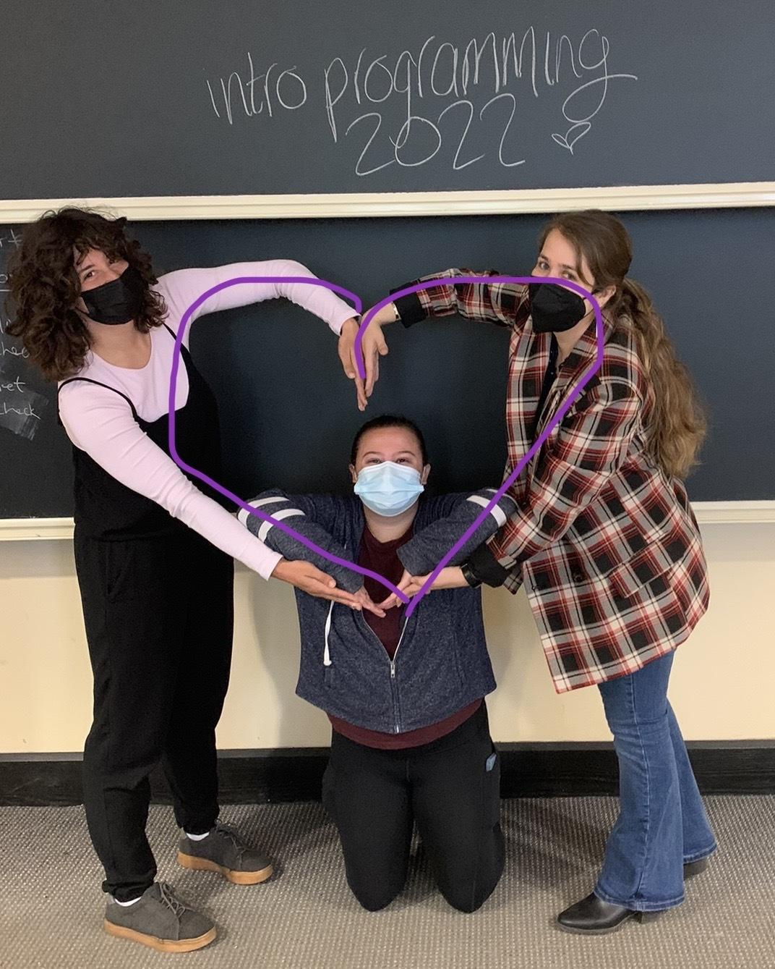
Have fun in the real world!

