Slide 1
E-Commerce Website EDA & Purchase Prediction
Nate Reedel
GitHub https://github.com/NReedel/OESON/tree/main/Project_3-4

Slide 2

Data Analysis
Data Inspection
- Look at columns of data used.
Summary Statistics
- Stats(mean, median, mode) of data.
Data Clean Up
- Missing values, outliers, and feature scaling.

Slide 3
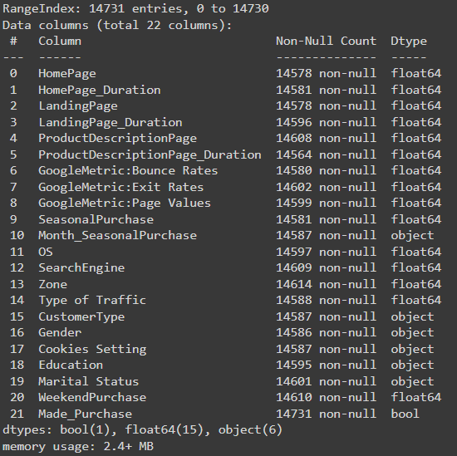
Data Inspection
Total of 22 data columns.
Concise summary of the dataset, including column names, non-null counts, and data types.
Most data fields are floats or rather numeric decimal values.

Slide 4
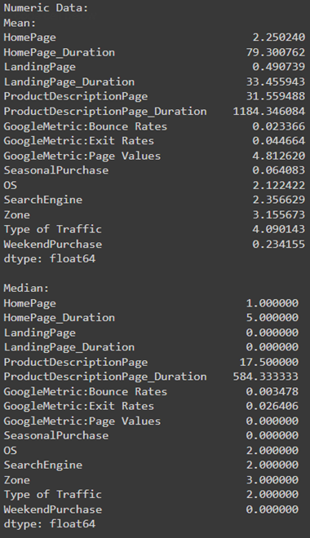
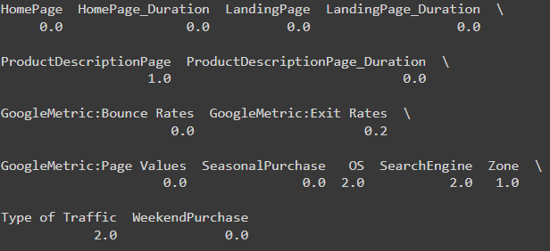
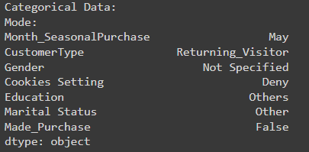
Summary Statistics
Quick look at stats….
ProductDescriptionPage data is an outlier as it is higher than the other numeric mean & median data.
Mode of categories suggests the following:
May has the most seasonal purchases & data entries.
Most web users for the e-commerce page block cookies & don’t make purchases.

Slide 5
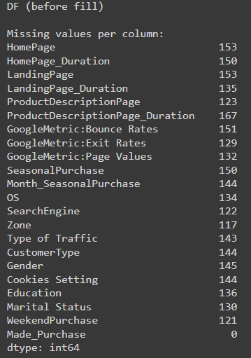

Data Clean Up
Missing Values
Over 100 null values in nearly each set of data.
A forward fill will be used to the replace the missing data.
Outliers
z-scores helped fix outliers of the fields of website data. The process varied depending on whether categorical or numeric data was used.
3. Feature Scaling
I used normalization to scale the numeric feature of the data frame to a range of values between 0 and 1, thus making them consistent and easier to interpret.

Slide 6
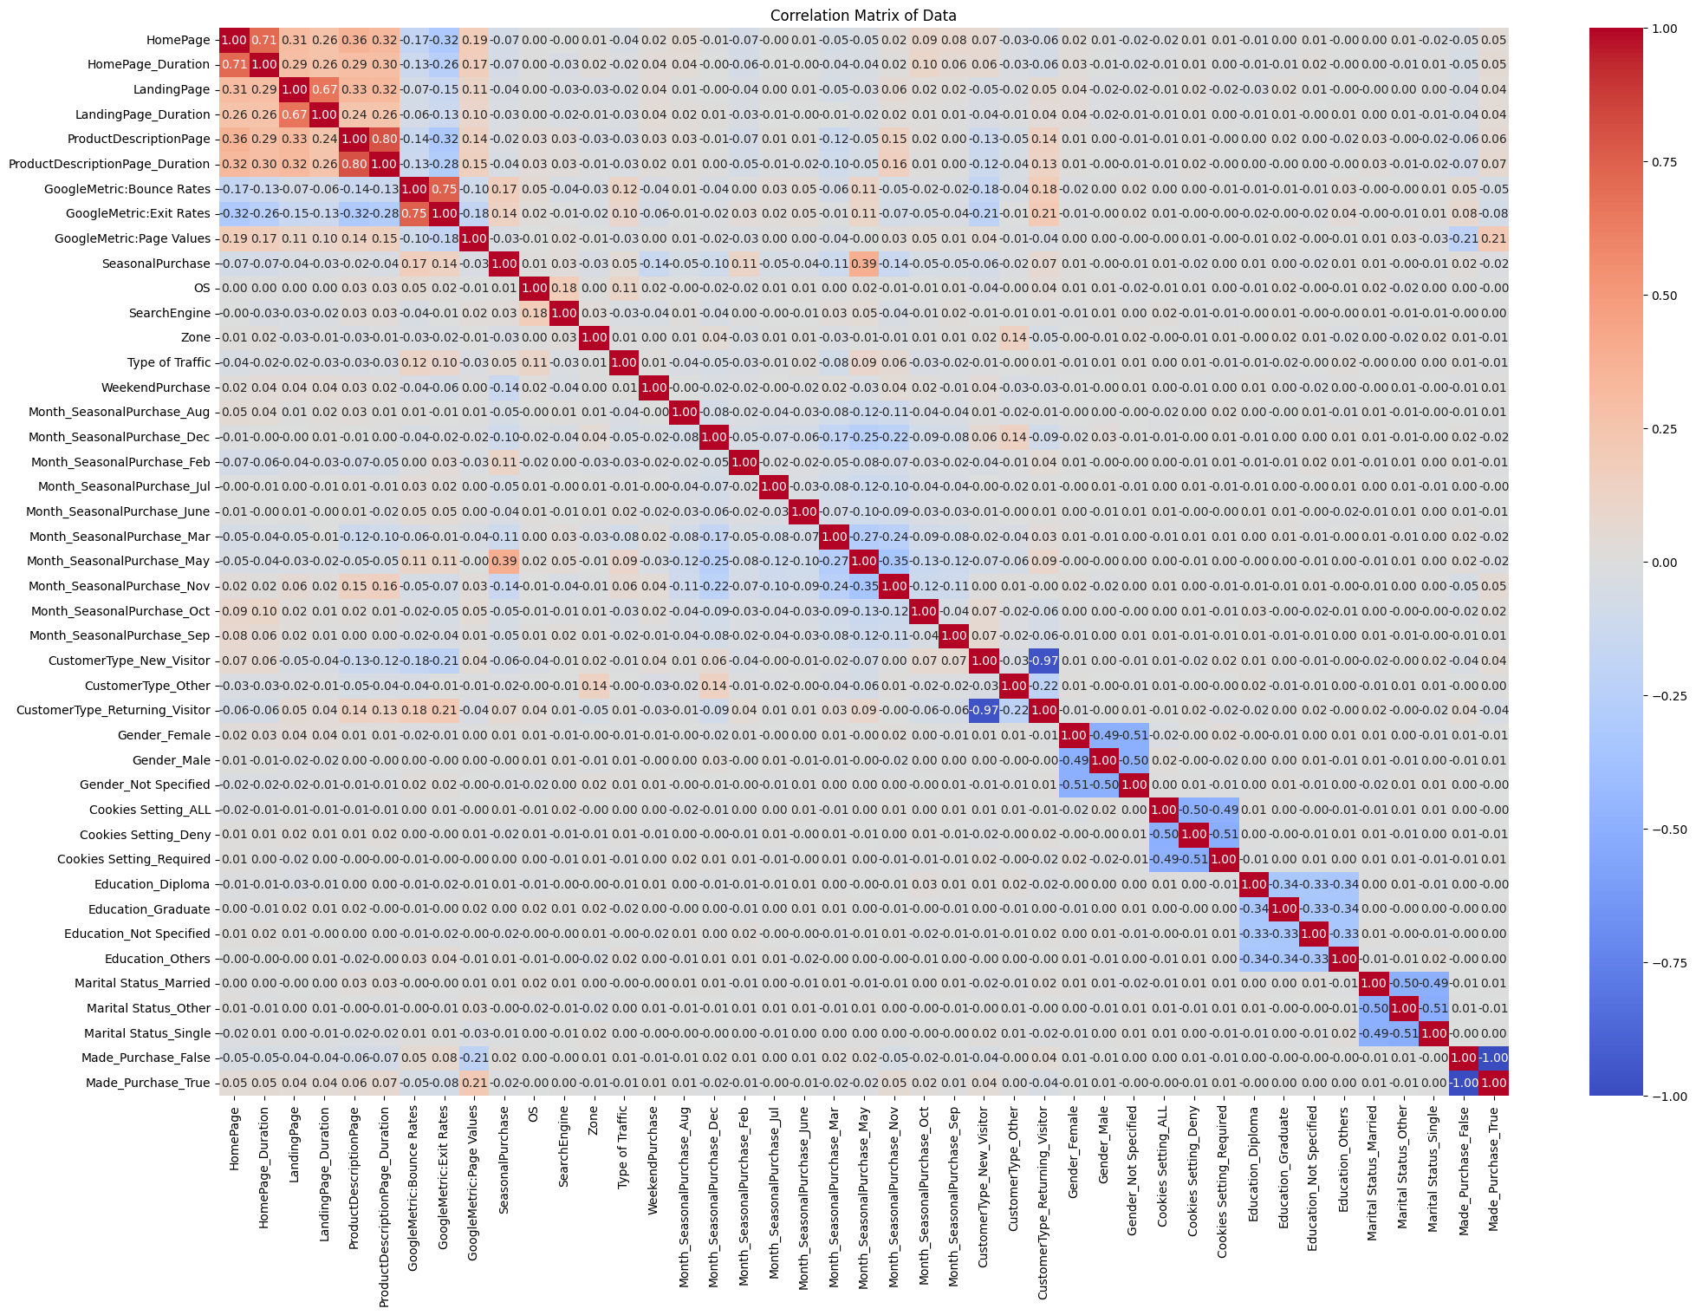
Correlation Matrix
Multivariate Analysis for full frame of website data (post clean up)
Cleaning has helped clarify linear correlations in the normalized data frame.
This graph clearly shows which pairs of data have a strong & weak correlation.
Data can now be used for proper exploratory analysis.

Slide 7
Online Customer Behavior
Customers' online behavior for product purchase can be considered using related data and predictive models.
The correlation matrix from the page prior suggests a strong correlation between the following:
HomePage & HomPage_Duration
LandingPage & LandingPage_Duration
ProductPage & ProductPage_Duration
Since they all share similar values per correlation, these will be perfect for a predictive comparative exploratory data analysis.

Slide 8
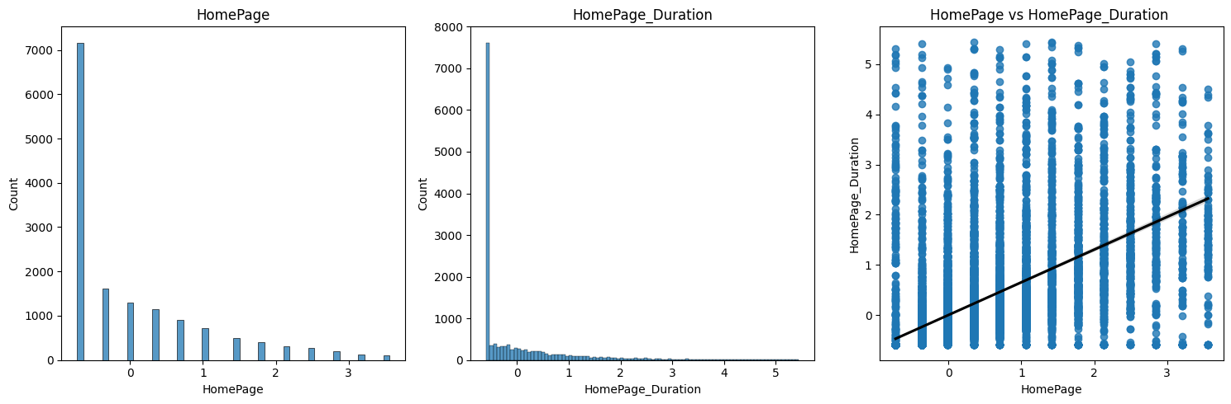
1) HomePage & HomePAge Duration
Univariate Analysis
Both histograms have similar axiom value ranges. This, their similar shape and their titles suggest a strong correlation.
Bivariate Analysis
Though the data is spread from the predicted value, the regression chart between the 2 columns has an upward slope regression line that is almost 1 to 1, supporting the idea of a correlated set of data.

Slide 9
Prediction for HomePage Duration
Predicted next 5 HomePage_Duration values:
0.0469, 0.0469, 0.0469, 0.0469, 0.2362
The predicted time spent suggests that website end users spend very little time at the home page.
The same value is predicted for 4 values, the 5th acts as an outliers.

Slide 10
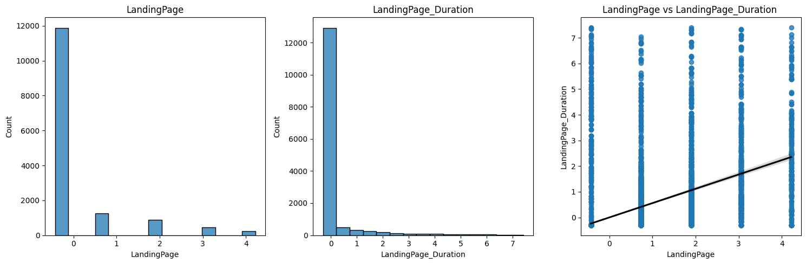
2) LandingPage & LandingPage Duration
Univariate Analysis
Both histograms have similar y axis values and an identical range. LandingPage_Duration has almost twice as many bins and a wider distribution. Their similar shape and their titles suggests a correlation.
Bivariate Analysis
Though the regression lines slope isn’t exactly 1 to 1 the graph suggests its estimation would be, again supporting some correlation.

Slide 11
Prediction for LandingPage Duration
Predicted next 5 LandingPage_Duration values:
0.2381, 0.2381, 0.2381, 0.2381, 0.2381
The predicted time spent suggest the user spend at least some time on the landing page.
The repetitive values suggests the data field has a lot of reoccurring values and users typically mostly spend the same amount of time on the webpage. Another reason may suggest a flaw in the predictive model.

Slide 12
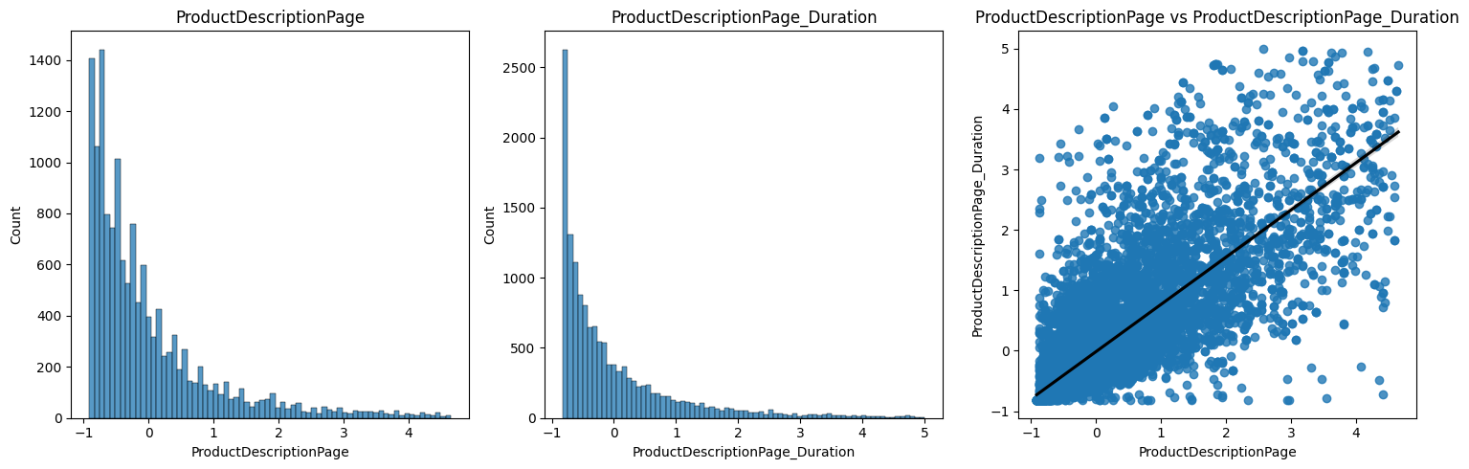
3) ProductPage & productpage Duration
Univariate Analysis
Both histograms are very similar and have a near identical pattern. This suggest a high correlation between the pairs of data.
Bivariate Analysis
The regression lines slope is practically 1 to 1 the graph suggests an almost complete correlation.

Slide 13
Prediction For productpage Duration
Predicted next 5 ProductPage_Duration values:
0.6651, 0.6396, 0.4357, 0.6651, 0.6906
The predicted time suggests that end users spend time on the product page.
The predicted values all vary so its safe to say there is a healthy variance of values in the correlation.

Slide 14

Prediction Summary
The e-commerce website costumers won’t spend much time at the home page.
Instead, users are predicted to spend a more significant amount of time on the landing page and to spend the most time at the product page.

Slide 15

Conclusion
Based on the summary of consumer data, the business should spend energy focusing things like advertising on the product page if they wish to boost their marketing & increase purchases.

