Slide 1

Financial Risk in the Share Market: Stock Price Analysis
(2018-2023)
GitHub https://github.com/NReedel/OESON/tree/main/Project01
Nathanial Reedel

Slide 2

Company Sample Introduction
Microsoft
Technological company that develops and markets software, services, and hardware devices that deliver new opportunities, greater convenience, and enhanced value to people's lives.
Automotive and energy company. It designs, develops, manufactures, sells, and leases electric vehicles, energy generation, and storage systems.
Technological company that designs, manufactures and markets smartphones, personal computers, tablets, wearables and accessories, and sells a variety of related services.
A stock market index that is viewed as a measure of how well the stock market is performing overall. It includes around 500 of the largest U.S. companies.
Tesla
Apple
S&P 500

Slide 3
Microsoft Data Analysis
Open |  | High |  | Low
Mean | 194.4708998 | Mean | 196.522676 | Mean | 192.3018466
Standard Error | 2.076481441 | Standard Error | 2.098027552 | Standard Error | 2.053190255
Median | 203.580002 | Median | 205.1900025 | Median | 201.315002
Mode | 95.139999 | Mode | 107.900002 | Mode | 89.660004
Standard Deviation | 74.23239641 | Standard Deviation | 75.00265102 | Standard Deviation | 73.39975685
Sample Variance | 5510.448676 | Sample Variance | 5625.397659 | Sample Variance | 5387.524306
Kurtosis | -1.287957663 | Kurtosis | -1.297941694 | Kurtosis | -1.283822226
Skewness | 0.149832436 | Skewness | 0.142448052 | Skewness | 0.151653684
Range | 258.559997 | Range | 263.360015 | Range | 258.37001
Minimum | 86.059998 | Minimum | 86.309998 | Minimum | 83.830002
Maximum | 344.619995 | Maximum | 349.670013 | Maximum | 342.200012
Sum | 248533.81 | Sum | 251155.98 | Sum | 245761.7599
Count | 1278 | Count | 1278 | Count | 1278
Close |  | Adj Close |  | Volume
Mean | 194.5105477 | Mean | 190.8267835 | Mean | 30267789.44
Standard Error | 2.076748161 | Standard Error | 2.103222362 | Standard Error | 359366.0121
Median | 203.050003 | Median | 198.8247145 | Median | 27062700
Mode | 92.330002 | Mode | 89.883148 | Mode | 22860700
Standard Deviation | 74.2419314 | Standard Deviation | 75.18836093 | Standard Deviation | 12847020.8
Sample Variance | 5511.864378 | Sample Variance | 5653.28962 | Sample Variance | 1.65046E+14
Kurtosis | -1.290677547 | Kurtosis | -1.310573841 | Kurtosis | 5.754011718
Skewness | 0.147216579 | Skewness | 0.140260764 | Skewness | 2.016413568
Range | 258.099983 | Range | 259.869614 | Range | 102252900
Minimum | 85.010002 | Minimum | 80.055191 | Minimum | 8989200
Maximum | 343.109985 | Maximum | 339.924805 | Maximum | 111242100
Sum | 248584.4799 | Sum | 243876.6293 | Sum | 38682234900
Count | 1278 | Count | 1278 | Count | 1278
MSFT Stock 2018-2023
Mean Open is about equal to Mean Close, showing stability, though adj close is slightly lower.
High Max = 349.67 & Low Min = 83.83, so the absolute range is $265.84 which shows a big difference between the lowest and highest price of the stock opening over 5 recent years, a signifier of price change.
The range of volume Min is low in comparison to the mean. This likely indicates that there where few times with slow trade. The Max value by comparison is significantly higher than the mean. A characteristic of rapid trade a price difference.
The kurtosis values for all price-based analysis indicate a mesokurtic or a normal distribution. This indicates stability over time.

Slide 4
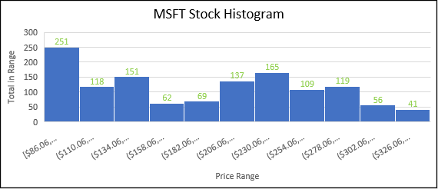
Microsoft Graphical Representation
Description
Price
On average, the price has steadily increased with little variance from the predicted value though more so toward the later years toward the right.
Histogram
The most common price range is the lowest, between $86.06 – $110.05, indicating the least amount of change over time.
The least common price range is the highest, $326.06 & over, indicating fast price changes at this range.

Slide 5
Microsoft Beta Analysis
a
Analysis for MS%chng vs SP%chng
Beta is 1.21 which is only a 21% variation from the over all economic indicator. It shows a strong similarity o the standard market value.
R squared is .6033 indicating the predictive linear model mostly reflects the literal with 39% deviation.

Slide 6
Tesla Data Analysis
Open |  | High |  | Low
Mean | 131.8952112 | Mean | 134.9584057 | Mean | 128.5118299
Standard Error | 3.27746698 | Standard Error | 3.351604169 | Standard Error | 3.192735721
Median | 96.573334 | Median | 100.3216665 | Median | 94.2669985
Mode | 24 | Mode | 21.496 | Mode | 21.766666
Standard Deviation | 117.1665796 | Standard Deviation | 119.8169193 | Standard Deviation | 114.1375111
Sample Variance | 13728.00737 | Sample Variance | 14356.09415 | Sample Variance | 13027.37145
Kurtosis | -1.257261138 | Kurtosis | -1.254437249 | Kurtosis | -1.266503256
Skewness | 0.470592085 | Skewness | 0.469633509 | Skewness | 0.469723833
Range | 399.396668 | Range | 402.051341 | Range | 393.867323
Minimum | 12.073333 | Minimum | 12.445333 | Minimum | 11.799333
Maximum | 411.470001 | Maximum | 414.496674 | Maximum | 405.666656
Sum | 168562.0799 | Sum | 172476.8424 | Sum | 164238.1187
Count | 1278 | Count | 1278 | Count | 1278
Close |  | Adj Close |  | Volume
Mean | 131.7902812 | Mean | 131.7902812 | Mean | 133357337.3
Standard Error | 3.272219195 | Standard Error | 3.272219195 | Standard Error | 2515609.407
Median | 97.6400035 | Median | 97.6400035 | Median | 103169550
Mode | 23.620667 | Mode | 23.620667 | Mode | 130173000
Standard Deviation | 116.9789759 | Standard Deviation | 116.9789759 | Standard Deviation | 89930837.32
Sample Variance | 13684.08079 | Sample Variance | 13684.08079 | Sample Variance | 8.08756E+15
Kurtosis | -1.260371058 | Kurtosis | -1.260371058 | Kurtosis | 9.959429269
Skewness | 0.468792298 | Skewness | 0.468792298 | Skewness | 2.460147621
Range | 398.038668 | Range | 398.038668 | Range | 884680200
Minimum | 11.931333 | Minimum | 11.931333 | Minimum | 29401800
Maximum | 409.970001 | Maximum | 409.970001 | Maximum | 914082000
Sum | 168427.9793 | Sum | 168427.9793 | Sum | 1.70431E+11
Count | 1278 | Count | 1278 | Count | 1278
Tesla Stock 2018-2023
High Max = 414.50 & Low Min = 11.80, so the absolute range is $402.70 which shows a significantly large difference between the lowest and highest price of the stock opening over 5 recent years.
The range of volume Min is slightly lower than its mean. This likely indicates that there many times with slow trade and consistent tendency. The high Max value by comparison is significantly higher than average. These fact shows tendency of multiple sharp price variation with steep drops.
The kurtosis values for all price-based analysis proves a normal distribution and overall stable change in value.

Slide 7
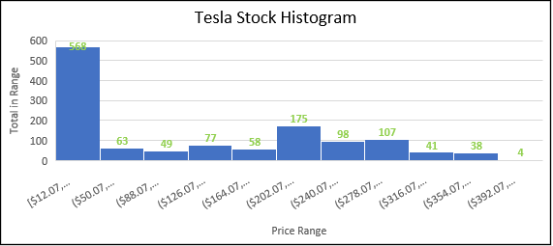
Tesla Graphical Representation
Description
Price
The price has rapidly increased and decreased over time, with large variance from the prediction of the linear regression. However overall, those real values still follow the predicted lines increasing slope.
Histogram
The most common price range is the lowest, between $12.07 – $50.06, indicating the least amount of change over time.
The least common price range is the highest, $392.07 & over, indicating strong price change at this range.
a

Slide 8
Tesla Beta Analysis
a
Analysis for Tesl%chng vs SP%chng
Beta is 1.82 showing a high 82% variation from the specified economic indicator. This is a significant deviation from the standard market value.
R squared is .2309 indicating the predictive linear model mostly deviates from the literal with a 77% deviation.

Slide 9
Apple Data Analysis
Open |  | High |  | Low
Mean | 98.57410424 | Mean | 99.77801653 | Mean | 97.42274246
Standard Error | 1.29167174 | Standard Error | 1.308369051 | Standard Error | 1.274627659
Median | 95.0874975 | Median | 96.307499 | Median | 93.983749
Mode | 127.82 | Mode | 151.570007 | Mode | 133.770004
Standard Deviation | 46.17613562 | Standard Deviation | 46.77304987 | Standard Deviation | 45.5668246
Sample Variance | 2132.235501 | Sample Variance | 2187.718194 | Sample Variance | 2076.335504
Kurtosis | -1.582037477 | Kurtosis | -1.583683904 | Kurtosis | -1.577575598
Skewness | 0.121834092 | Skewness | 0.119586776 | Skewness | 0.124540978
Range | 146.635006 | Range | 146.510002 | Range | 143.619995
Minimum | 35.994999 | Minimum | 36.43 | Minimum | 35.5
Maximum | 182.630005 | Maximum | 182.940002 | Maximum | 179.119995
Sum | 125977.7052 | Sum | 127516.3051 | Sum | 124506.2649
Count | 1278 | Count | 1278 | Count | 1278
Close |  | Adj Close |  | Volume
Mean | 98.64651602 | Mean | 97.38823308 | Mean | 116220544.8
Standard Error | 1.292090365 | Standard Error | 1.302620443 | Standard Error | 1536301.588
Median | 95.6150015 | Median | 94.1483495 | Median | 101699200
Mode | 145.860001 | Mode | 41.246353 | Mode | 118655600
Standard Deviation | 46.19110109 | Standard Deviation | 46.56754217 | Standard Deviation | 54921438.84
Sample Variance | 2133.61782 | Sample Variance | 2168.535984 | Sample Variance | 3.01636E+15
Kurtosis | -1.579983416 | Kurtosis | -1.580637888 | Kurtosis | 5.663382416
Skewness | 0.121783854 | Skewness | 0.123055369 | Skewness | 2.030330727
Range | 146.462494 | Range | 146.650146 | Range | 391314100
Minimum | 35.547501 | Minimum | 34.309586 | Minimum | 35195900
Maximum | 182.009995 | Maximum | 180.959732 | Maximum | 426510000
Sum | 126070.2475 | Sum | 124462.1619 | Sum | 1.4853E+11
Count | 1278 | Count | 1278 | Count | 1278
Apple Stock 2018-2023
High Max = 182.94 & Low Min = 35.5, so the absolute range is $147.44 which shows a difference between the lowest and highest price of the stock opening over 5 recent years, a proof of significant change.
The range of volume Min is about 3 times lower than its mean. This likely indicates that there where a decent number of times with slow trade. The Max value by comparison is about 3 times higher than average showing later times with increased trade. Combined these variations predict consistent linear trade.
The kurtosis values for all price-based analysis once again shows a normal distribution proving more stability through its distribution.

Slide 10
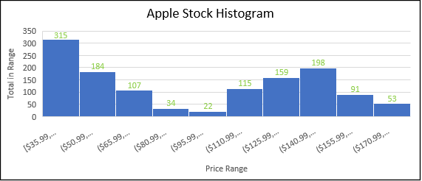
Apple Graphical Representation
Description
Price
The price has steadily increased on average with low variance predicted from the linear regress. Real values follow its increasing slope with relative symmetry.
Histogram
The most common price range is the lowest, between $35.99 – $50.98, indicating the price with least amount of change over time.
The least common price range is the middle, $95.99 - $ 110.98, indicating significant price change at this range.

Slide 11
Apple Beta Analysis
a
Analysis for App%chng vs SP%chng
Beta is 1.32 this shows a lower mid 32% variation from the specified economic indicator. This is a slight deviation from the standard SP market value.
R squared is .5481 indicating the predictive linear model deviates from the literal with 44% deviation.

Slide 12
S&P 500 Analysis
Open |  | High |  | Low
Mean | 3457.034092 | Mean | 3478.394335 | Mean | 3433.64579
Standard Error | 18.64546377 | Standard Error | 18.74513649 | Standard Error | 18.54459646
Median | 3294.67 | Median | 3318.71 | Median | 3280.175
Mode | 2832.41 | Mode | 2761.85 | Mode | 2697.77
Standard Deviation | 666.5590312 | Standard Deviation | 670.1222438 | Standard Deviation | 662.9531131
Sample Variance | 444300.9421 | Sample Variance | 449063.8217 | Sample Variance | 439506.8301
Kurtosis | -1.297242885 | Kurtosis | -1.319303027 | Kurtosis | -1.276323956
Skewness | 0.333240031 | Skewness | 0.333310217 | Skewness | 0.329008918
Range | 2513.8 | Range | 2517.89 | Range | 2588.18
Minimum | 2290.71 | Minimum | 2300.73 | Minimum | 2191.86
Maximum | 4804.51 | Maximum | 4818.62 | Maximum | 4780.04
Sum | 4418089.57 | Sum | 4445387.96 | Sum | 4388199.32
Count | 1278 | Count | 1278 | Count | 1278
Close* |  | Adj Close** |  | Volume
Mean | 3457.230055 | Mean | 3457.230055 | Mean | 4227470023
Standard Error | 18.65160759 | Standard Error | 18.65160759 | Standard Error | 30055826.45
Median | 3298.025 | Median | 3298.025 | Median | 3988600000
Mode | 2783.02 | Mode | 2783.02 | Mode | 3646920000
Standard Deviation | 666.7786672 | Standard Deviation | 666.7786672 | Standard Deviation | 1074469523
Sample Variance | 444593.7911 | Sample Variance | 444593.7911 | Sample Variance | 1.15448E+18
Kurtosis | -1.298909977 | Kurtosis | -1.298909977 | Kurtosis | 3.742636258
Skewness | 0.33118575 | Skewness | 0.33118575 | Skewness | 1.572566435
Range | 2559.16 | Range | 2559.16 | Range | 8679990000
Minimum | 2237.4 | Minimum | 2237.4 | Minimum | 1296530000
Maximum | 4796.56 | Maximum | 4796.56 | Maximum | 9976520000
Sum | 4418340.01 | Sum | 4418340.01 | Sum | 5.40271E+12
Count | 1278 | Count | 1278 | Count | 1278
S&P 500 Stock 2018-2023
Mean Open is equal to Mean Close showing stability in all stocks overall value and trade.
High Max = 4796.56 & Low Min = 2191.86, so the absolute range is $2604.7 more than double showing a massive change in price values overall
Volume Min is about 3 times lower than its mean. This likely indicates that there where times with slow trade and recessive tendency. The Max value by comparison is a little more than twice as high than average. Though slightly lower than the Min, their similarities indicates consistent trade and a very linear pattern.
The kurtosis values for all price-based analysis once again shows a normal distribution proving linear stability.

Slide 13
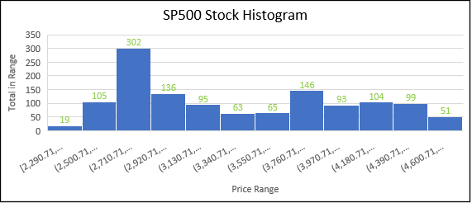
S&P 500 Graphical Representation
Description
Price
The price has very slowly increased on average with low variance compared to the linear regress. Real values follow its somewhat small slope with symmetry and a low increase in variation from it as it progresses.
Histogram
The most common price range is at just under a quarter of the range, between $2710.71 – $2920.70 which is the price range with least amount of change over time overall.
The least common price range is the lowest, $2290.71-$2500.70, indicating significant price flux at this range

Slide 14
Comparative Study
Company | Beta | Conclusion
MSFT | 1.21 | Low variation from overall market value
Tesla | 1.82 | High variation from overall market value
Apple | 1.32 | Some variation from overall market value

Slide 15
Study Conclusion
What does this study mean for investors?
High beta value shown by Tesla is for investors how like high-risk high reward options.
People who looking for stable investments at the price of slower returns should be more interested instead in choosing a company such as Apple or Microsoft, even more so, if they want minimum risk.

Slide 16
Close
This analysis was a valuable tool for deriving information using data analytics.
Such statistic models help with predictions in the future of economic activity as well as give a healthy understanding of the current financial meta.

