Slide 1

Swift Programming
By: Noah Renella
&
Louis Guan

Slide 2

What is swift? The History
Its creator is Chris Lattner – Apple’s Senior Director of the Developer Tools Department at the time of its development
He is currently working at Google as the Senior Director and Distinguished Engineer for TensorFlow(Programming Software) Infrastructure and Technologies
He started designing it in 2010 with a few others joining late 2011 before it became a focus for the Apple Developer group in July 2013
Swift started off as a side project of Chris but as development grew, so did his interest in the language
It was made as a replacement to Objective-C, another iOS Development Language, to make it more streamlined and efficient than its predecessor

Slide 3
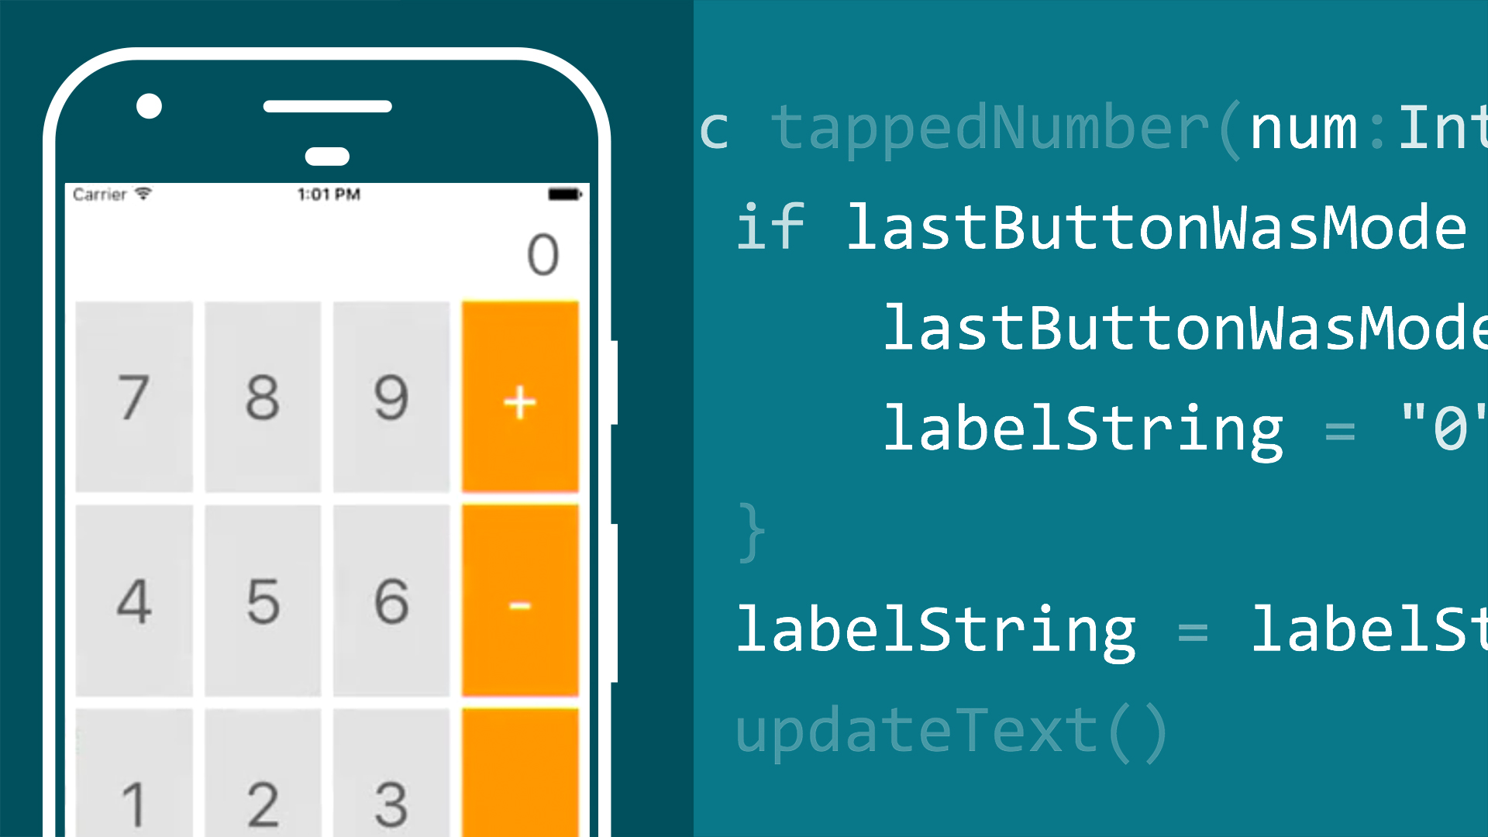
The History continued…
It was officially released in 2014 and by 2015 the language became open source with a huge community backing it
It would go on to get many new versions
Today Swift is widely used for iOS development.
The Lyft app which consisted of 75,000 lines of code was recreated using Swift
the original app took more than a month and multiple engineers to complete while the swift version was completed within a week with only one engineer

Slide 4
Swift Language
Swift is a general purpose Multi-Paradigm, compiled programming language
Functional | Imperative | Object-oriented | Protocol | Block Structured
The Programming language takes ideas from many other languages like Objective-C, rust, Haskell, Ruby, Python, C#, CLU and many others
The language it self is very concise, usually requiring a lot less lines of code to preform the same task
Many Features set it apart from other languages.

Slide 5
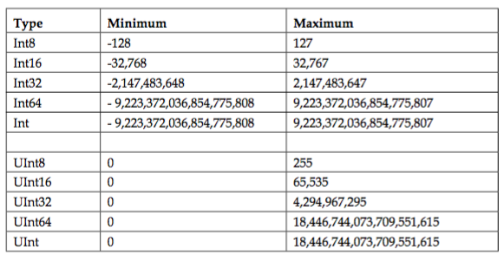
Data Types
The data types in the Swift Language are as follows
Int | Float | Double | Bool | String | Character
One of Key Swifts Features is its “var” keyword
Ex) var str = “Hello, world”
With Swift you variables you initialize are all generic until a value is assigned to them. In the example str became a String when “Hello World” was bound to it
Despite this Swift is a very Strongly typed language with every variable being bound to what ever type it was initialized as and never changing through out the program

Slide 6
Control Structures
Similar to C, Swift has 4 main control structures
For and for-in loops
While and do-while loops
If statements
Switch statements
Differences from C is that the parenthesis is optional, braces are mandatory, and relies heavily on Protocols.
Ex : if integerValue != 0 { // Perform an action if not zero }
Ex : for i in 1...10 { ... }. This improves readability and there is less chance of off-by-one errors.
This improves readability and there is less chance of off-by-one errors.

Slide 7
Program Units
A program unit in Swift is known as Access Control
Based off of the concepts of modules and source files
Built and shipped from a single unit that can as a single unit and that can be imported by another module with Swift’s import keyword.
Provides 5 different levels
Open access and public access
Internal access
File-private access
Private access
Open access is least restrictive and private access is most restrictive

Slide 8
Functions
Functions are self-contained chunks of code that perform a specific task
Swift’s unified function syntax to express anything from a simple C-style function with no parameter names to a complex Objective-C-style method with names and argument labels for each parameter.
Function parameters and return values are extremely flexible in Swift. You can define anything from a simple utility function with a single unnamed parameter to a complex function with expressive parameter names and different parameter options.
Ex: func sayHelloWorld() -> String {
return "hello, world"
}
print(sayHelloWorld())
// Prints "hello, world"

Slide 9
Object-oriented Features
Another one of Swifts key feature is its conciseness when it comes to object oriented programming
Swift provides the user access to classes, they can create structures with methods and protocols which act like interfaces
The language also supports inheritance in the same way Java does inheritance
With Swift all packages are available globally in a file

Slide 10
Exception Handling
Known as Error Handling in Swift. It is the process of responding to and recovering from error conditions in your program.
In Swift, errors are represented by values of types that conform to the Error protocol.
There are 4 ways to handle an error.
Do-catch
Propagate the error from a function
Error as an optional value
Assert that the error will not occur
Ex: func canThrowErrors() throws -> String, func cannotThrowErrors() -> String

Slide 11
Readability, Reliability, and Writability
Swift is considered to be good in readability because the syntax encourages us to write clean and consistent code which may feel strict at times. Provides safeguards to prevent errors and improve readability.
Swift is easy to write very efficiently but unreadable when written badly
The easiness comes from reusing existing code within apps
Apple has such a closed ecosystem, so therefore it is for them to fix bugs that we encounter through swift.
Therefore it is easy for developers to write and maintain code for such a smaller array of system specifications rather than writing code that will fit thousands of devices.

Slide 12
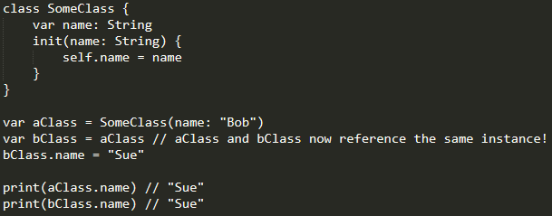
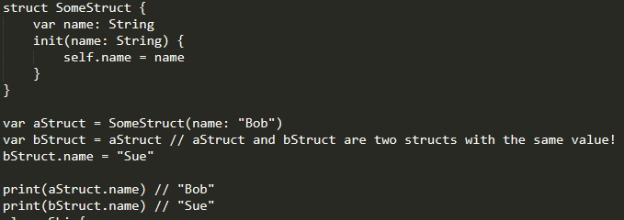
Structs vs Classes in Swift
Both Structs and Classes allow methods in them
Structs are value types in Swift while Classes are reference types
This feature is important for abstracting data
Struct is more useful for bits of related data you want to copy around and modify while Classes are more useful for complex entities.
Ex. (from teamTreeHouse.com)

Slide 13
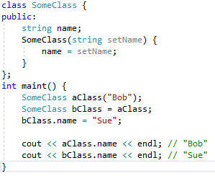
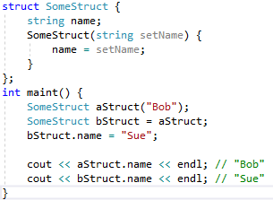
Same Example in C++

Slide 14
Our Application
We decide to try to remake the important parts of a C++ project
In this project we had to create a Ship class and from that class create a Cruise Ship, and a Cargo Ship Subclass
The purpose of the original project was to see how super class arrays work with subclass objects
The purpose of this was to see how inheriting deferrers in Swift from other programs and how overloading / overriding works as well

Slide 15
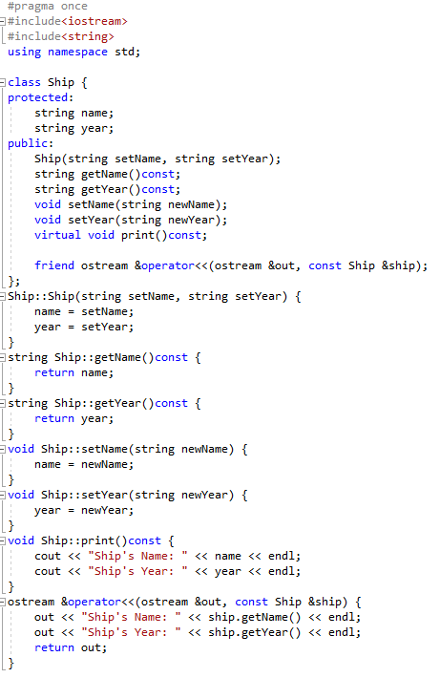
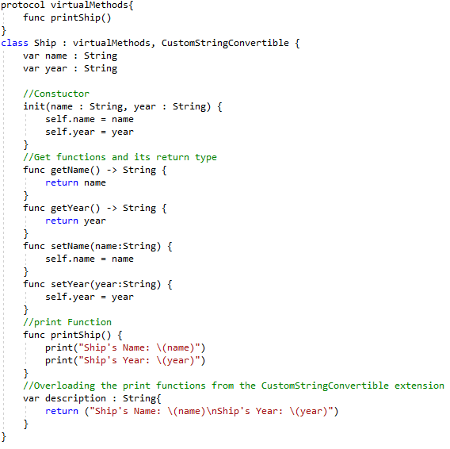
C++ vs Swift Code Ship Class

Slide 16
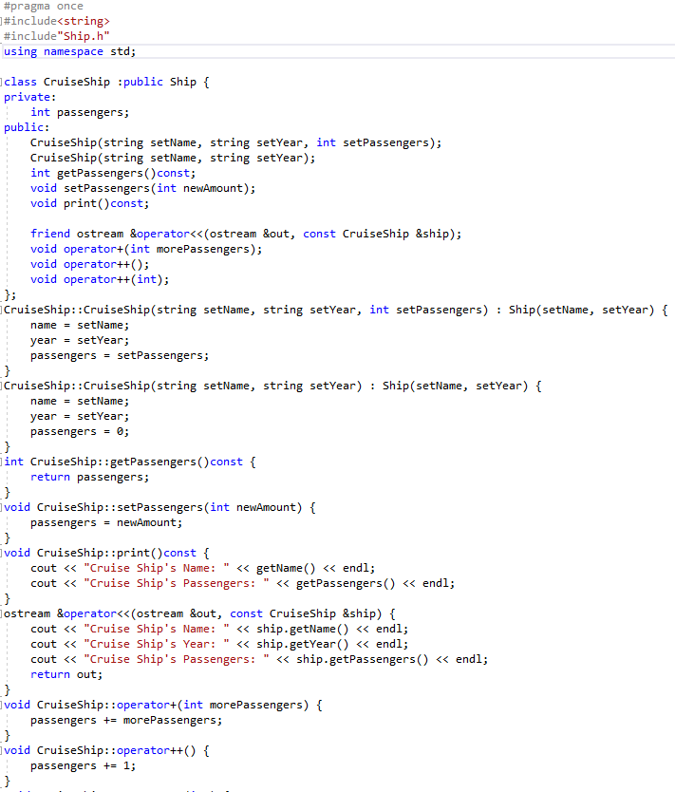
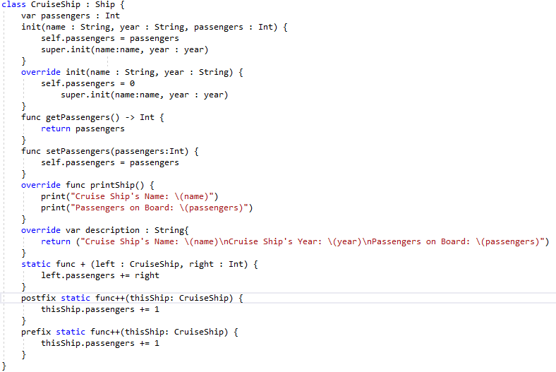
C++ vs Swift Code Cruise Ship

Slide 17
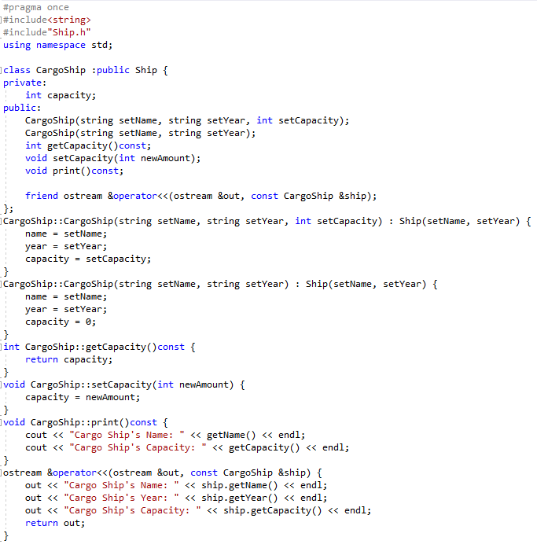
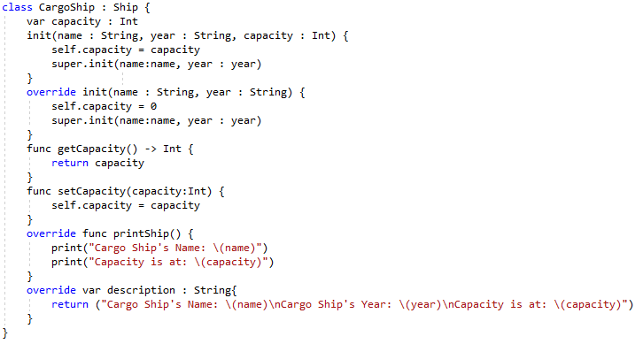
C++ vs Swift Code Cargo Ship

Slide 18
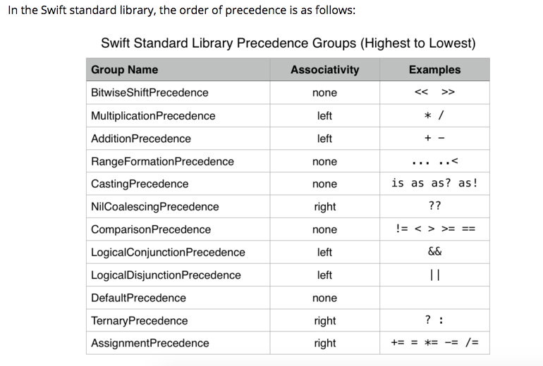
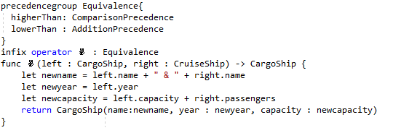
Another Swift Feature
Custom operators
Operator for when a cargo ship has to take passengers

Slide 19
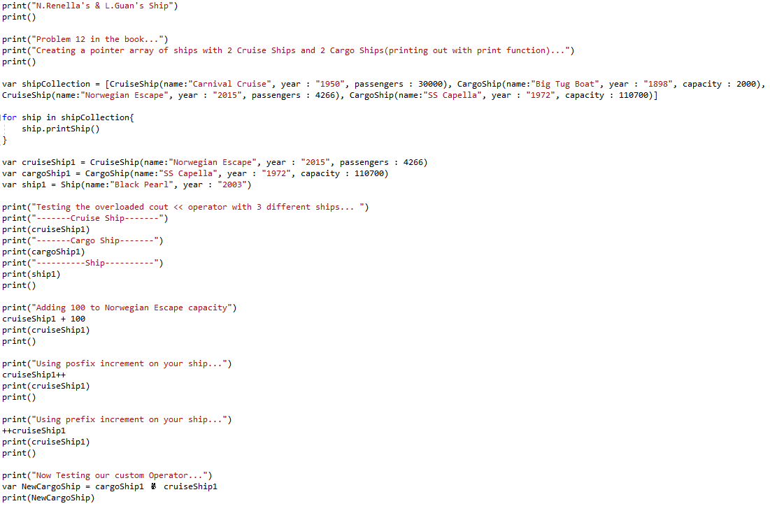
Driver

Slide 20
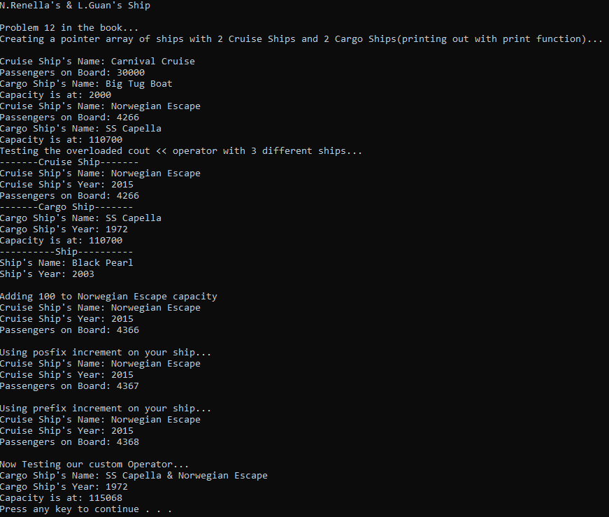
Output

Slide 21
What changes between the Code?
The code is a lot more concise which leads to better readability
To create an array of ship items in C++ you have to create a pointer while in swift you can do it with a normal array
The labels with every item in swift makes telling where each value is going more readable

