Slide 1
SkyTrap-MTD
management of Scanning techniques

Slide 2
Make use of…
Mininet to create a realistic virtual network.
An SDN controller written using the Ryu framework used to manage the Flow Tables of the OpenFlow switches/gateways in the network.

Slide 3
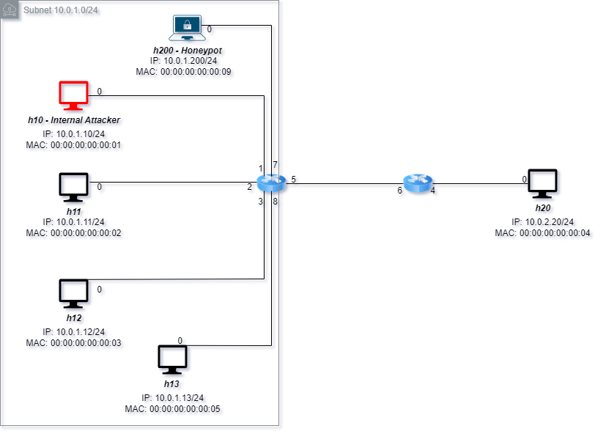
REAL NETWORK TOPOLOGY generated through Mininet environment

Slide 4
ACTIONS IMPLEMENTED on OpenFlow switch through the Ryu Controller
DROP
PERMIT
REDIRECT TO HONEYPOT
CHANGE SOURCE
For Layer 2,3,4 of the stack TCP/IP.
With a focus on these protocols: ARP, ICMP, TCP/UDP.
IN THIS WAY AN «OVERLAY TOPOLOGY» CAN BE CREATED AD MANAGED

Slide 5
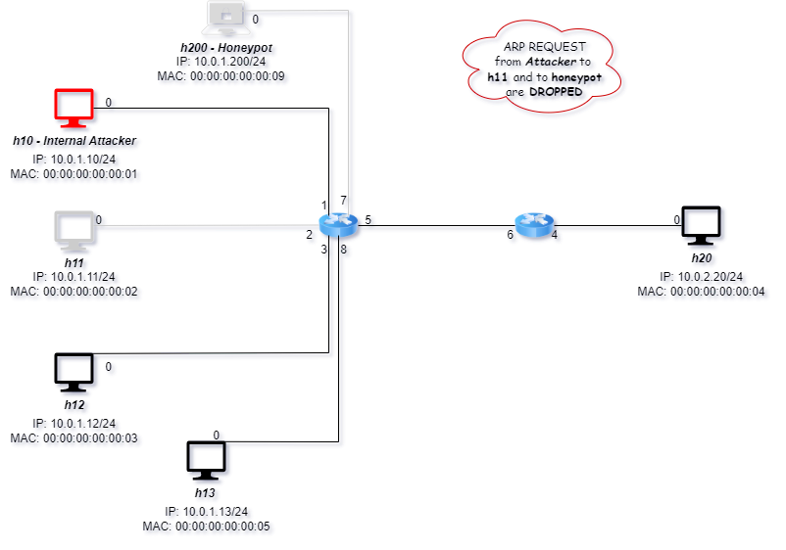
OVERLAY TOPOLOGY from Attacker’s perspective

Slide 6
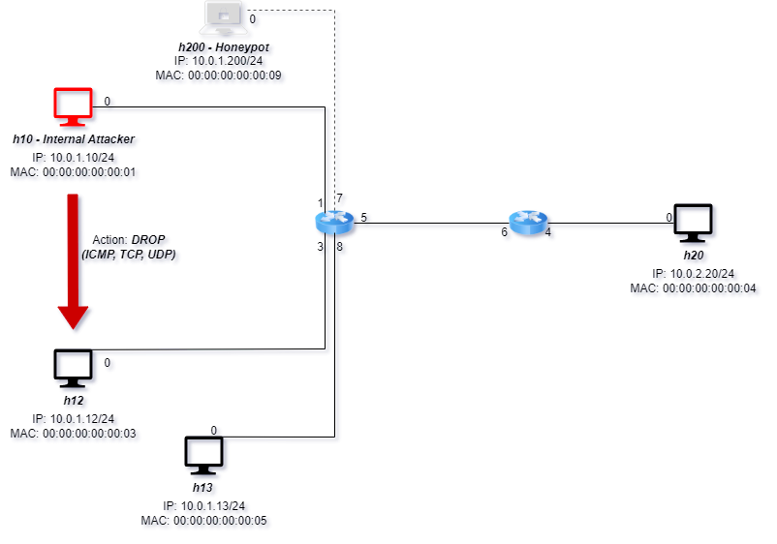
INTERACTIONS: Drop Action from Attacker’s perspective

Slide 7
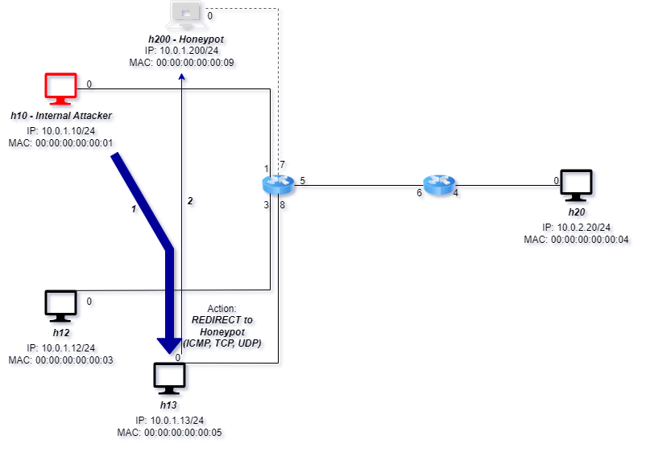
INTERACTIONS: Redirect Action from Attacker’s perspective

Slide 8
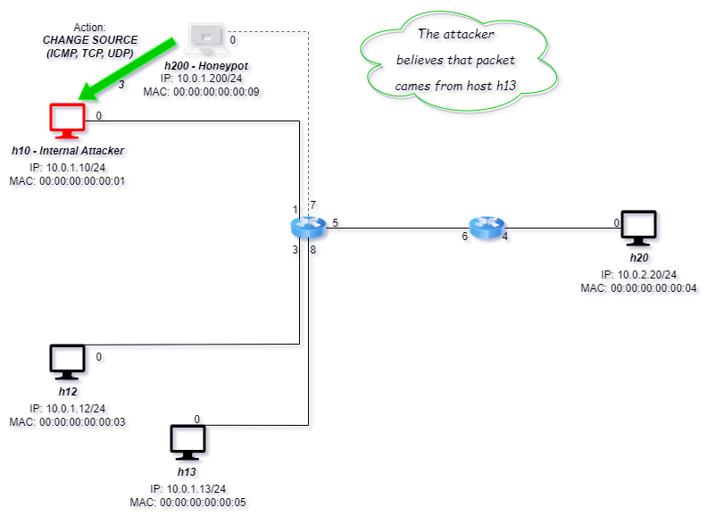
INTERACTIONS: Change Source Action from Attacker’s perspective

Slide 9
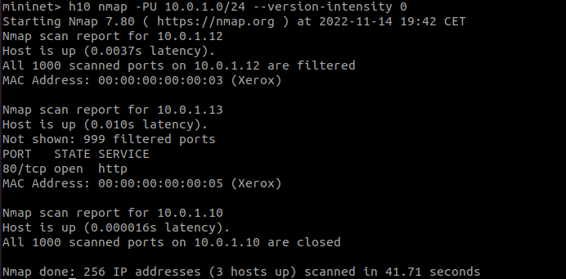
ARP SCAN: Level 2
arp-scan – l
PING SCAN: Level 3
nmap – PE/- PP/- PM 10.0.1.0/24 (ip_attacker_subnet/netmask)
TCP SCAN: Level 4
nmap – PS/- PA 10.0.1.0/24
UDP SCAN: Level 4
nmap –PU 10.0.1.0/24 --version-intensity 0

Slide 10
NEXT STEPS
Management of overlay network in the Ryu controller through python Object and Classes.
Bring the topology from Mininet to OpenStack (MicroStack).
Definition of an algorithm that is able to decide when to apply the Moving Target Defense techniques against one or more potentially malicious hosts.

