Slide 2
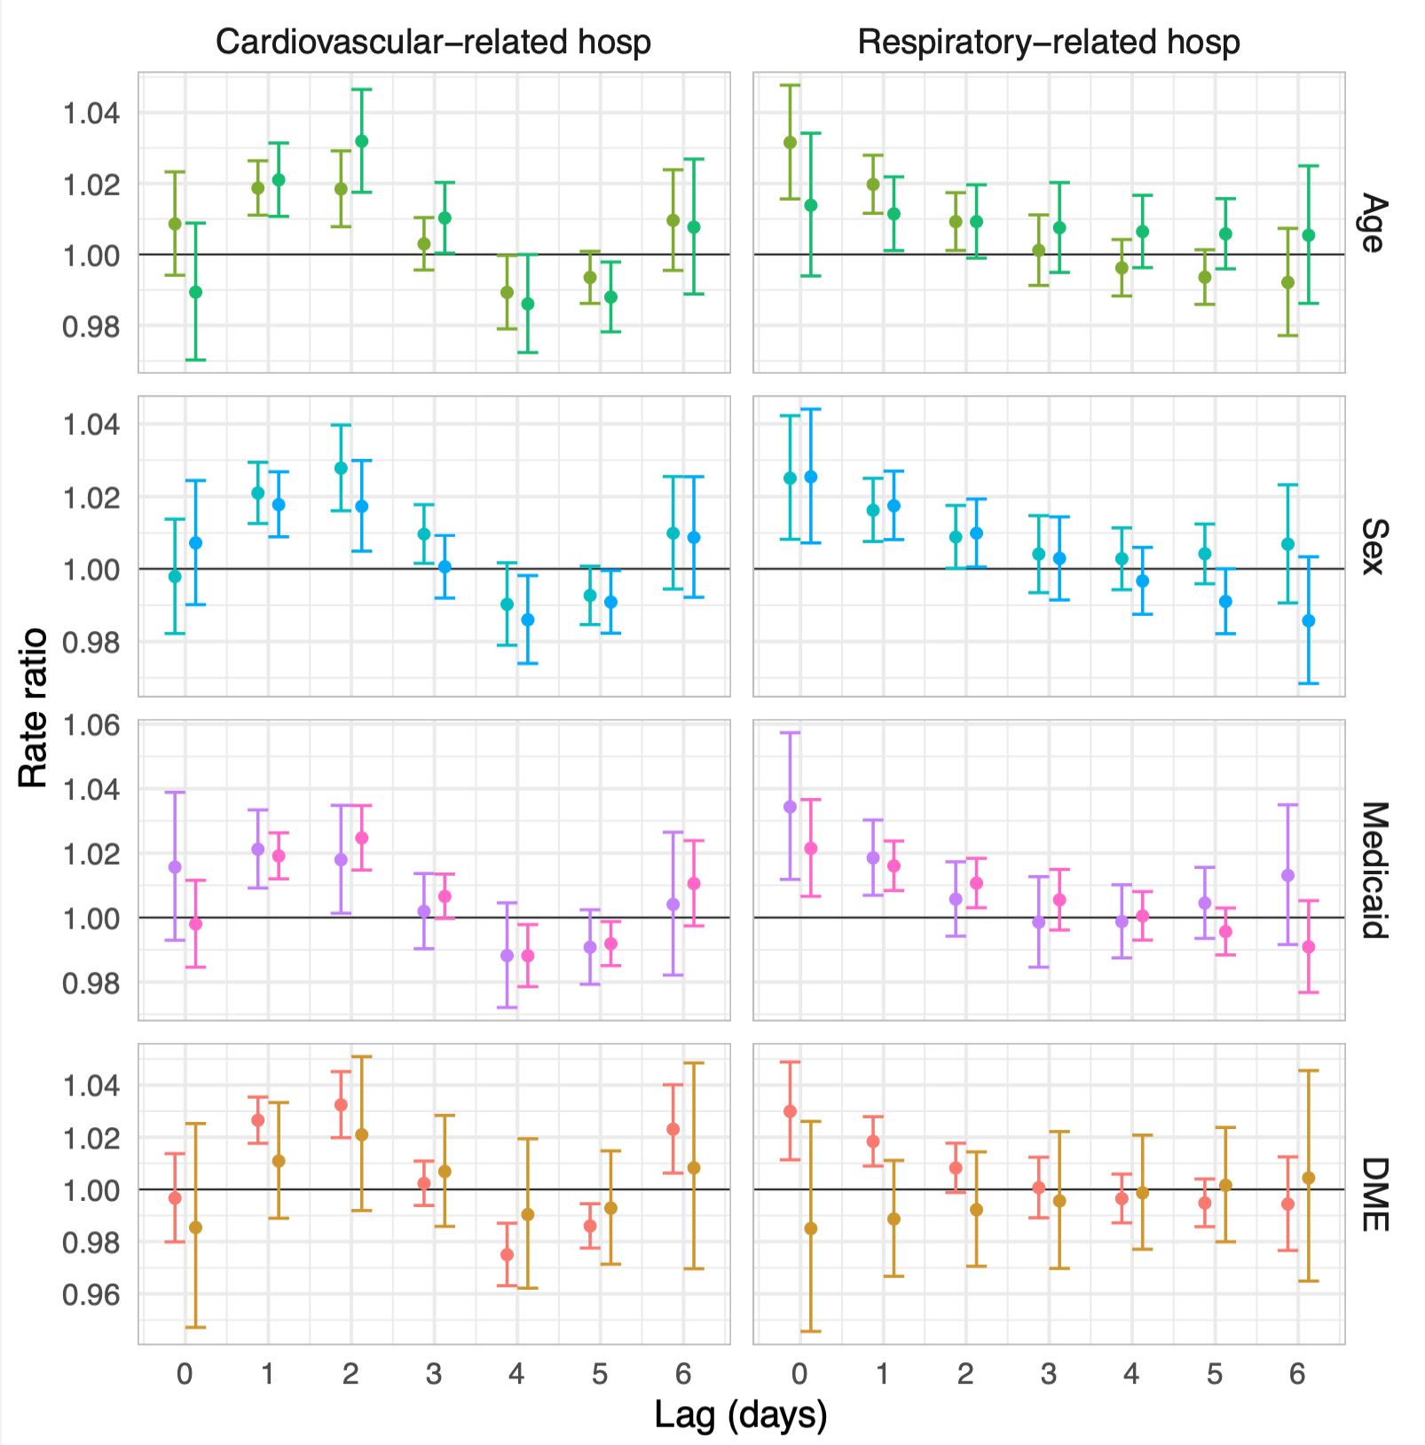
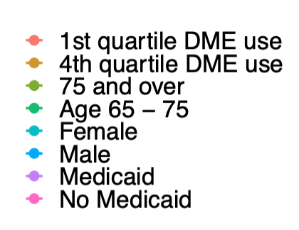
Age 65– 75
75 and older
Female
Male
Medicaid
No Medicaid
1st quartile DME use
4th quartile DME use

