Slide 1

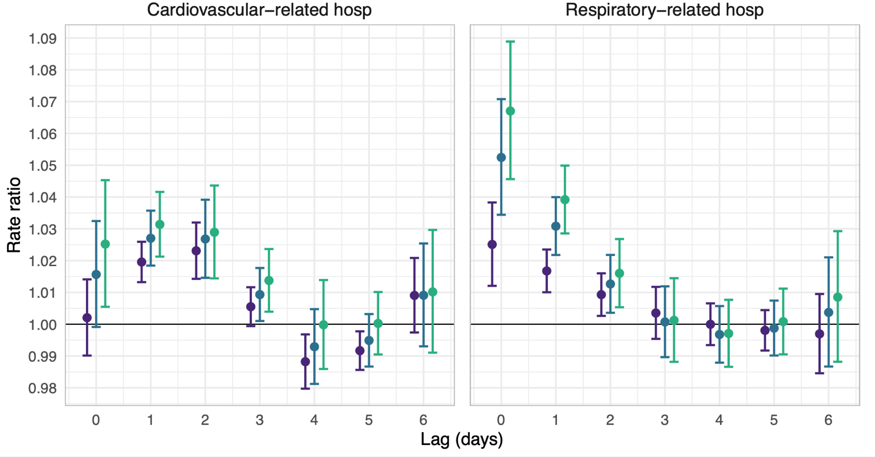
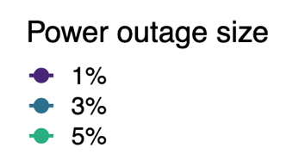

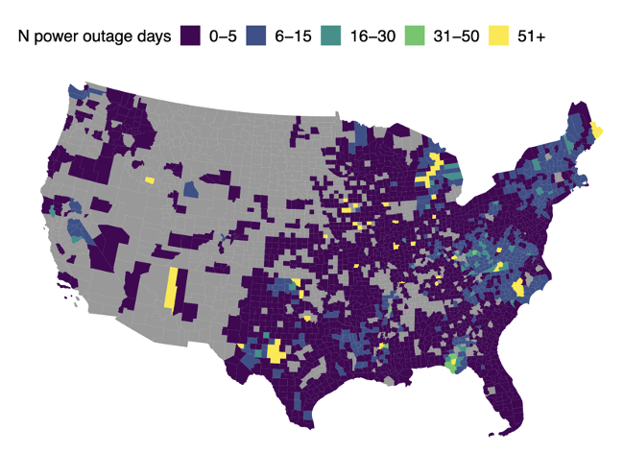
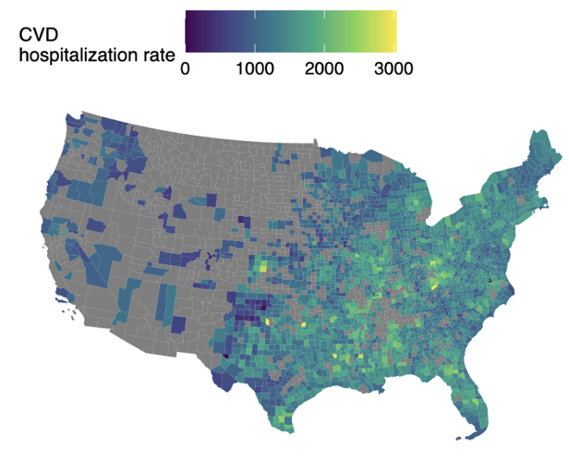
POWER OUTAGE AND CARDIORESPIRATORY HOSPITALIZATIONS AMONG OLDER ADULTS IN THE UNITED STATES
HEATHER MCBRIEN, DANIEL MORK, VIVIAN DO, MARIANTHI-ANNA KIOMOURTZOGLOU AND JOAN A. CASEY
INTRODUCTION
Power outages are becoming more common with climate-related severe weather, wildfires, heat, electrification, and grid expansion for artificial intelligence
Danger to health is underappreciated and understudied in vulnerable groups such as older adults and electricity-dependent medical device users
METHODS
Case-crossover study using conditional Poisson model
Daily power outage daily hospitalization rates
Estimated lagged association up to 1 week
Controlled for daily temperature, wind speed, and precipitation (GridMET)
QUESTION
Do power outages cause cardiorespiratory-related hospitalizations in older adults 65+?
DATA
New national dataset of hourly county-level power outage exposure for 2018 and daily cardiorespiratory hospitalizations for 23 million Medicare beneficiaries 65+
≥ 1%
≥ 3%
≥ 5%

Slide 2

Power outage and cardiorespiratory hospitalizations among older adults in the United States

Slide 3
Power outage and cardiorespiratory hospitalizations among older adults in the United States
≥ 1%
≥ 3%
≥ 5%

Slide 4


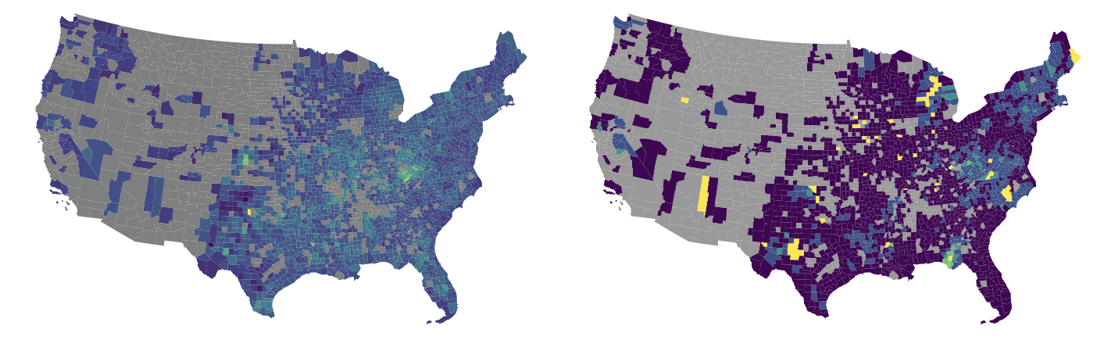
POWER OUTAGE AND CARDIORESPIRATORY HOSPITALIZATIONS AMONG OLDER ADULTS IN THE UNITED STATES
HEATHER MCBRIEN, DANIEL MORK, VIVIAN DO, MARIANTHI-ANNA KIOMOURTZOGLOU AND JOAN A. CASEY
INTRODUCTION
Power outages are becoming more common with climate-related severe weather, wildfires, heat, electrification, and grid expansion for artificial intelligence
Danger to health is underappreciated and understudied in vulnerable groups such as older adults and electricity-dependent medical device users
METHODS
Case-crossover study using conditional Poisson model
Association of daily power outage with daily cardiorespiratory hospitalization rates for days in 2018
Estimated lagged association up to 1 week
Controlled for daily temperature, wind speed, and precipitation (GridMET)
County-level confounders automatically controlled for by design
QUESTION
Do power outages cause cardiorespiratory-related hospitalizations in older adults 65+?
RESULTS
DATA
New dataset of hourly county-level power outage exposure for continental US in 2018 and daily cardiorespiratory hospitalizations for 23 million Medicare beneficiaries 65+
CONCLUSION
Results support community knowledge that power outages are dangerous for vulnerable populations. Health effects of power outage should be taken into consideration during public safety shutoffs and grid planning.

Slide 5
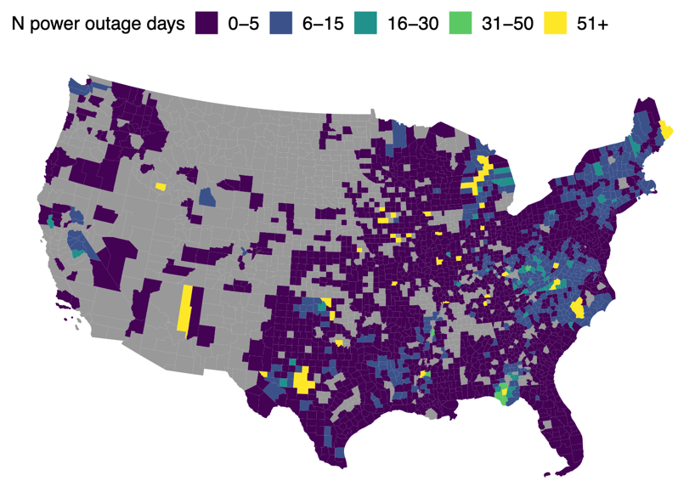
POWER OUTAGE AND CARDIORESPIRATORY HOSPITALIZATIONS AMONG OLDER ADULTS IN THE UNITED STATES
HEATHER MCBRIEN, DANIEL MORK, VIVIAN DO, MARIANTHI-ANNA KIOMOURTZOGLOU AND JOAN A. CASEY
INTRODUCTION
METHODS
Power outages are becoming more common with climate-related severe weather, wildfires, heat, electrification, and grid expansion for artificial intelligence
Danger to health is underappreciated and understudied in vulnerable groups such as older adults and electricity-dependent medical device users
Case-crossover study using conditional Poisson model
Estimated association of daily power outage with daily cardiorespiratory hospitalization rates for days in 2018
Estimated lagged association up to 1 week
Controlled for daily temperature, wind speed, and precipitation (GridMET)
County-level confounders automatically controlled for by design
QUESTION
RESULTS
Do power outages cause cardiorespiratory-related hospitalizations in US older adults 65+?
Rate ratios and 95% confidence intervals for the association between county-level 8+ hour power outage exposure and cardiovascular- and respiratory-related affecting ≥1%, ≥3%, and ≥5% of county electrical customers.
DATA
New exposure dataset of hourly county-level power outage exposure for continental US in 2018 and daily cardiorespiratory hospitalizations for 23 million Medicare beneficiaries 65+.
Number of county-level 8+ hour power outages in 2018 according to the PowerOutages.us dataset.
CONCLUSION
Results support community knowledge that power outages are dangerous for vulnerable populations. Health effects of power outage should be taken into consideration during public safety shutoffs and grid planning.
This work was supported by: National Institute on Aging grant R01 AG071024 (JAC) National Institute of Environmental Health Sciences P30 ES007033 (JAC) National Institutes of Health R01 ES034021 (DM) National Institutes of Health R01 AG066793 (DM) National Institute on Aging P20 AG093975 (MAK) National Institute of Environmental Health Sciences P30 ES009089 (MAK) Canadian Institutes of Health Research Doctoral Foreign Study Award (HM) National Heart, Lung, and Blood Institute F31 HL172608 (VD)

