Slide 1


Statistical Arbitrage of
Equity Index Volatility
A Machine Learning Approach to Dispersion Trading
MSc Risk Management & Financial Engineering | Applied Project | Quantitative Analysis
Nathan SEBBAG | Imperial College Business School | May 2026

Slide 2
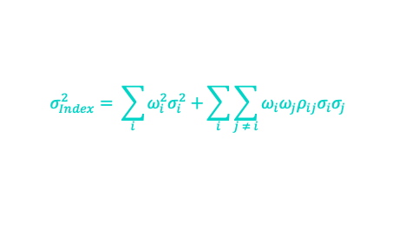
Research Question
Project
Overview
Can Random Matrix Theory-filtered correlation matrices and Deep Learning regime prediction improve the risk-adjusted performance of a systematic Dispersion strategy on the S&P 500?
What is Dispersion Trading?
①
②
③
The variance of an index is NOT the simple sum of component variances, it depends on their correlations.
The Trade
The Edge
The Innovation
Long vol on SPX components · Short vol on SPX index · Delta & Vega neutral portfolio
Market systematically overprices implied correlation · Exploitable Correlation Risk Premium (Driessen et al., 2009)
Random Matrix Theory to clean 50×50 correlation matrices · LSTM/XGBoost to predict regime shifts
$$σ_{Index}^{2}= \sum_{i}{ω_{i}^{2}σ_{i}^{2}}+\sum_{i}{\sum_{j ≠ i}{ω_{i}ω_{j}ρ_{ij}σ_{i}σ_{j}}}$$
Nathan SEBBAG | May 2026

Slide 3
Methodology & Literature
01
Baseline Strategy
Key Literature
SPX Index vs. 50 Components Straddles
Delta-neutral rebalancing (Bloomberg API)
FOUNDATIONS
— Driessen, Maenhout & Vilkov (2009) — Price of Correlation Risk
02
RMT Filtering
Noise isolation via Marchenko-Pastur law
Eigenvalue clipping on Σ₅₀ₓ₅₀
STOCHASTIC MODELS
— Bergomi (2015) — Stochastic Volatility Modeling
03
ML Signal Layer
LSTM: Predict implied vs. realized correlation spread
K-Means: Market regime clustering
RMT & MATRICES
— Bouchaud & Potters — Financial Applications of RMT
04
Backtest Engine
ML IN FINANCE
Custom Python environment
Includes transaction costs & P&L attribution
— Gu, Kelly & Xiu (2020) — Asset Pricing via ML
Nathan SEBBAG | May 2026

Slide 4
Timeline & Expected Contribution
MAY – JUNE
JUNE – JULY
JULY
JULY – AUG
Phase 1
Phase 2
Phase 3
Phase 4
Foundations
RMT Layer
ML Signal
Write-up
Bloomberg data extraction · Maths derivation (Itô P&L) · Baseline backtest
Marchenko-Pastur filtering · Clean Σ matrix · Performance comparison
LSTM training · XGBoost features · Regime clustering (K-Means)
Full backtest · Risk attribution · Report submission (Aug 12)
Expected Contribution
Systematic alpha generation framework for correlation risk premium
Novel RMT-ML pipeline for volatility regime prediction
Practical tool for Vol desks at multi-strategy hedge funds
Nathan SEBBAG | May 2026

