Slide 1
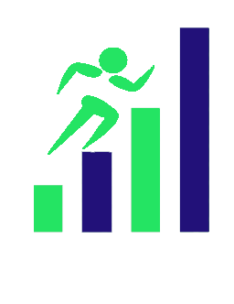

Get fit while improving health in the Bronx
Product Overview
Confidential - November 2016

Slide 2
Product
A user-friendly mobile app that collects user’s body metrics and demographics to coach and unlock the achievements of pre-determined goals. Once goals are met and verified by a health club you receive points that can be contributed to healthcare related charities in the Bronx.

Slide 3
Alarming statistics:
For the seventh consecutive year, Bronx County came in 62nd among all New York counties, branding the area as the most unhealthy
A recent study found that the % of those with access to exercise opportunities in the Bronx and Manhattan were nearly identical, yet the % of obesity in the Bronx was double that of Manhattan

Slide 4
Features:
Calculates BMI: Determines if one is above, below, or at the exact weight they should be
Calculates BMR: Tells you how many calories you have to burn to attain or maintain a specific weight
Connected to gadgets: Gain digital coins used at participating health clubs for membership; as well as gain coins for purchasing healthy foods from meal delivery apps like Blue Apron

Slide 5
Benefits:
Get coins by achieving milestones either at the gym, going for walks, or eating healthy meals.
Coins gained not only go to the individual for personal use but also to charities as well. Which will help fund and promote healthy living in the community

Slide 6
Donate to healthcare related charities/non-profits in the Bronx
For example:
The Bronx Health Link: Connects Bronx residents/ organizations to health providers, researchers, and policy makers, in an effort to achieve health equality.
The Bronx Family Center: Provides integrated health, foster care and preventive services that meet children’s needs from infancy to young adult hood.

Slide 7
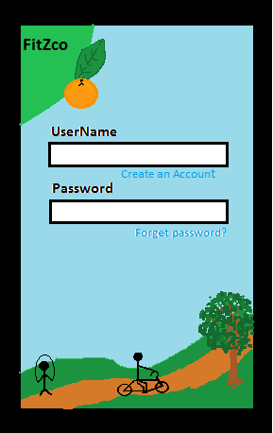
User Interface
Eye catching, sleek design
Friendly user interface
UX is an extension of the core mission of FitZco
Unique and easy to use for diverse users
Implements actual images of sights and landmarks in the Bronx
Embodies a sense of physical activity and health through carefully crafted design
Also is in Spanish

Slide 8
Target Market:
FitZco is a product that targets individuals, men and women(25-45),young working class families, and groups that are highly active in the Bronx but would prefer incentivized physical activity by funding charitable causes in the Bronx. They have gym memberships and what to impact healthy outcomes in the community.

