Slide 1
Panel P17 Leaderboard: Oct , 2016

Slide 2
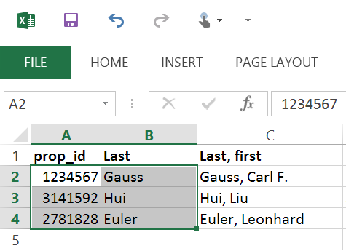
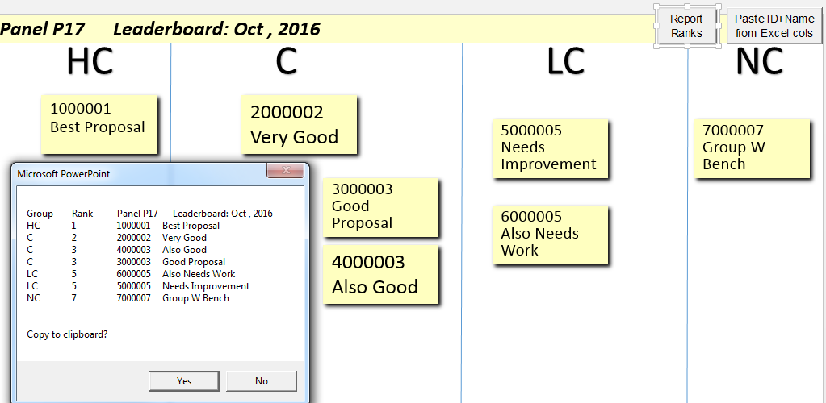
1234567
Gauss
This template makes “Post-its” from Excel column(s) of proposal IDs, PI names.
PC install: Enable content. Edit slide master to change background.
Save as Leaderboard.potm with your Custom Office Templates to allow New from Personal templates; it will save as Presentation1.ppt, discarding macros.
PC Use Instructions:
Copy columns with IDs and/or Names
Start slide show and click the button
“Paste ID+Name from Excel cols” in upper right
Will show list to be pasted, in order.
Esc to exit the show and position Post-its.
Select Post-its to change font or size (I reduce size of long names by hand).
Font changes may make PPT resume spell-checking: if so, select labels and
mark checkbox: Review>Language>Set Proofing Lang>Do not check spelling.
When done, you can restart slide show & click Report Ranks (or run macro) to rank boxes by their left sides. Rank = 1+# boxes starting to the left. (Ties get same rank, but don’t change later ranks.) A new group A,B,... begins when a vertical line can separate a box from its predecessor; be sure boxes in same group can’t be separated. (Customize group names on last slide.)
Jack Snoeyink tested on Windows PP 2010/2013, Mac PP 2011
3141592 Hui
2781828 Euler

Slide 3
1234567
Gauss
This template makes “Post-its” from Excel column(s) of proposal IDs, PI names.
Mac install: Run and accept macros, ignore error about X controls.
Edit slide master to change background. (See next slide on customization.)
Save as Leaderboard.potm with your Templates to allow New from Personal templates;
it will then save as Presentation1.ppt, discarding the macros.
Mac Use Instructions:
Copy columns with IDs and/or Names
Tools>Macros>Macro:
Select Paste_ID_Names_Cols, click Run
Will show list to be pasted, in order.
Last label may have extra characters due to PP bug.
Select Post-its to change font or size (I reduce size of long names by hand).
Font changes may make PPT resume spell-checking: if so, select labels and
mark checkbox: Review>Language>Set Proofing Lang>Do not check spelling.
When done, Tools>Macros>Macro>Select Report_Ranks and Run to rank boxes by their left sides. Rank = 1+# boxes starting to the left. (Ties get same rank, but don’t change later ranks.) A new group A,B,... begins when a vertical line can separate a box from its predecessor; be sure boxes in same group can’t be separated. (Customize group names on last slide.)
Jack Snoeyink tested on Windows PP 2010/2013, Mac PP 2011
3141592 Hui
2781828 Euler

Slide 4
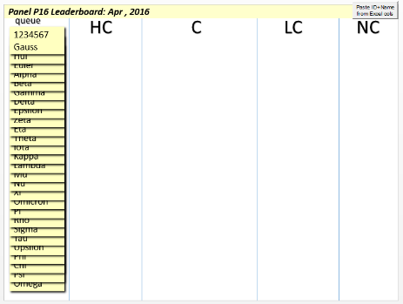
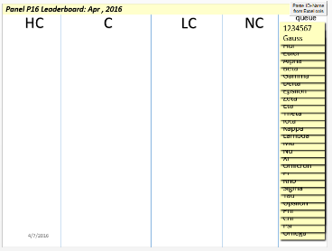
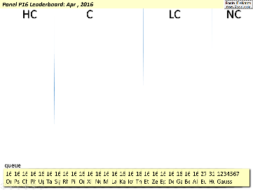
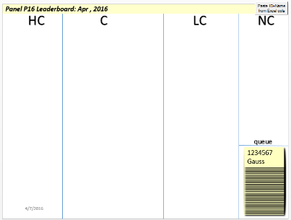
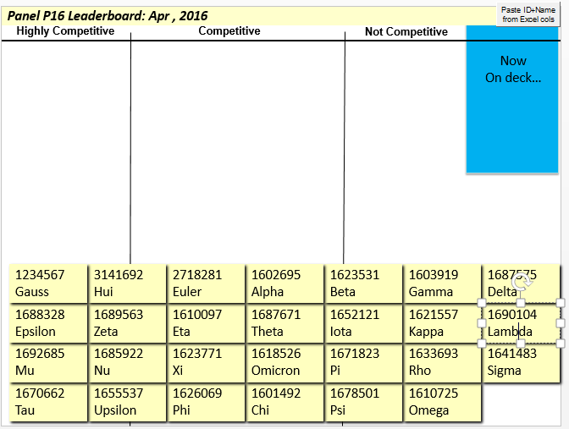
1234567
Gauss
1234567
Gauss
Customization:
Format this label, Box_Exemplar, here (Can set size, color, fonts, shadow). The macro looks here for a textbox named Box_Exemplar; if you delete it, a default is recreated.
Edit panel info at top of slide 1, or delete that textbox.
Use Home > Layout to select a layout for the first slide.
The name of the layout says where the labels are created:
LeftQueue, RightQueue, BottomQueue, CornerQueue are meant to be used when the labels are in discussion order. BottomGrid makes all labels visible (non-overlapping).
View > Slide Master to modify layouts – change categories, etc. (You won’t change where the labels appear unless you edit VBA macros.)
Ranking creates a new “Groups” whenever boxes can be separated by a vertical line. You can enter categories as group names in the table at right or erase them to use A,B,C,...
You can copy/paste extra text columns (e.g, conflicts, discussion time, and/or collab names.) Remember that to project, fonts should be large; I’ll often shrink fonts in the second half of long names.
LeftQueue
Group Names
HC
C
LC
NC
NDP
RightQueue
BottomQueue
CornerQueue
Characters to insert between columns: usually Enter; Right click, Edit Text, and use a Space if you add extra text columns.
BottomGrid

