Slide 1
NSF Integrated Circuits Research, Education, and Workforce Development Workshop
Andrew B. Kahng
UCSD CSE and ECE Departments
abk@ucsd.edu
http://vlsicad.ucsd.edu
Notes:
Hi, everyone!

Slide 2

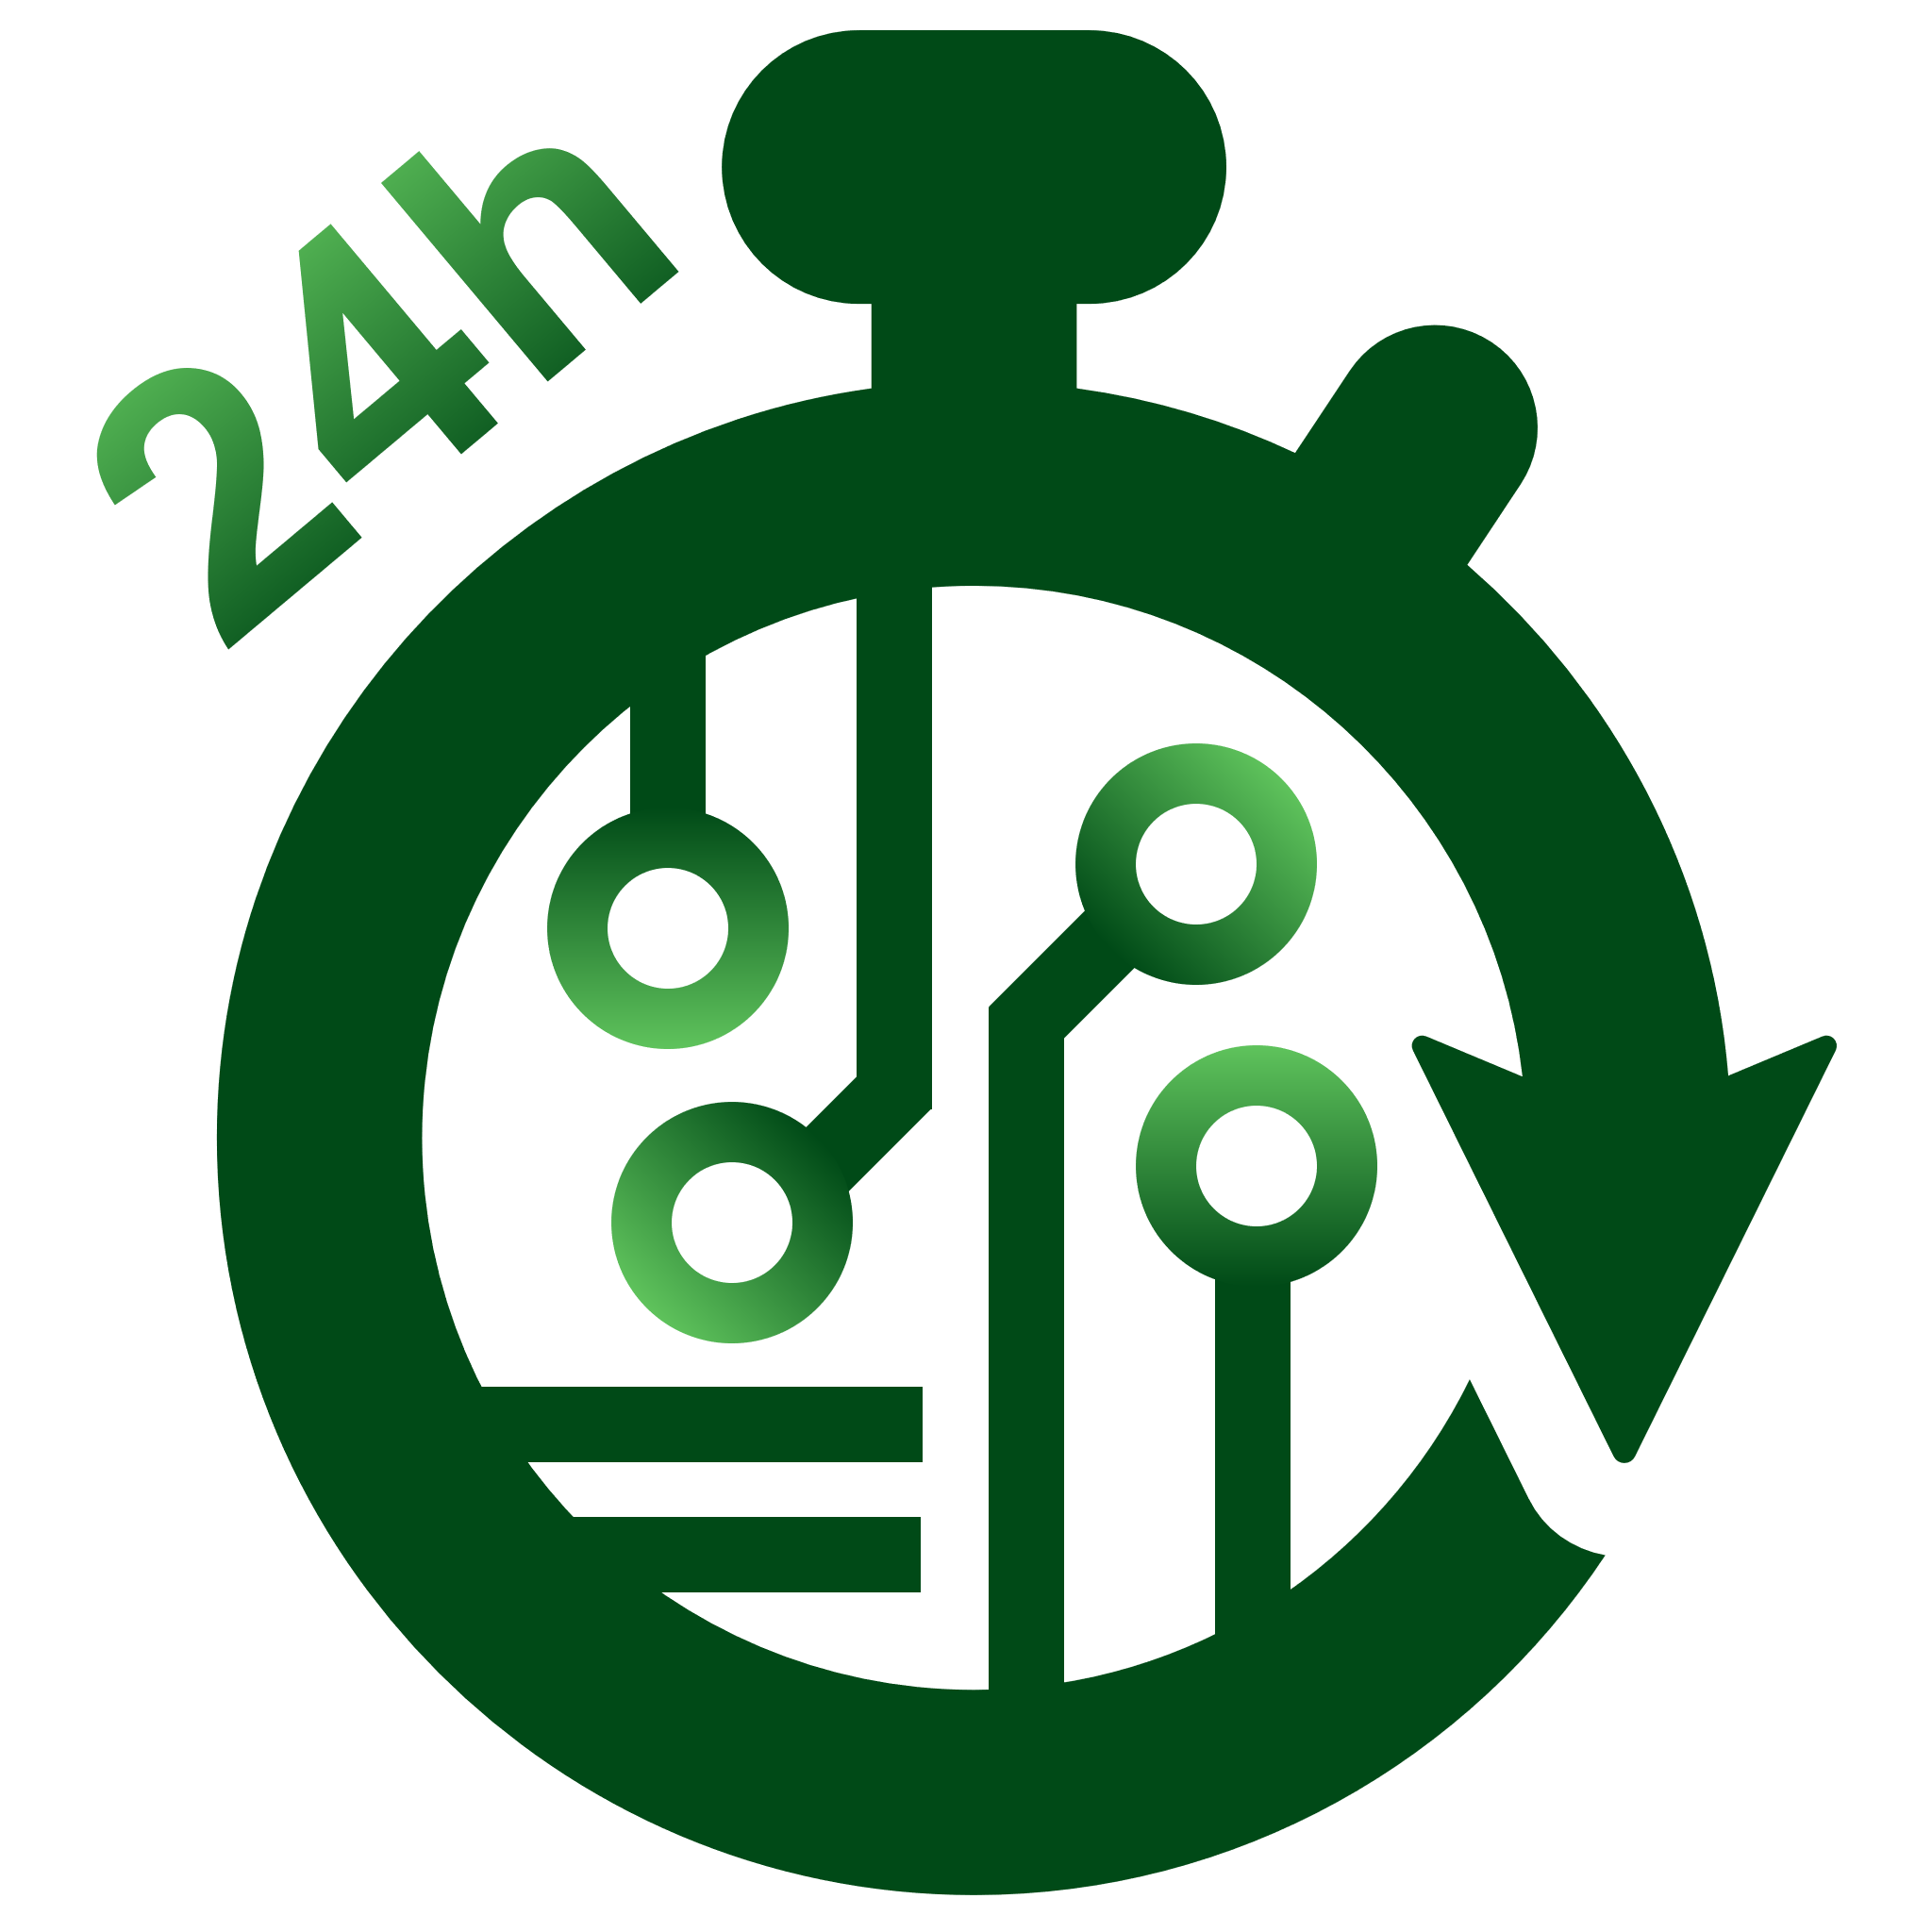
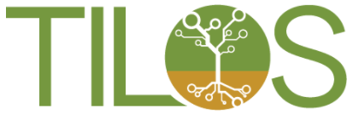
“Who Am I? Why Am I Here?” Adm. James Stockwell, 1992
Who Am I?
“UCSD”
Physical design
Chip implementation (RTL-to-GDS, signoff, PPAC)
Design for manufacturability
Technology roadmapping (ITRS: design technology, system drivers)
Open-source EDA (from the Bookshelf to OpenROAD)
Machine Learning in EDA and IC design (from METRICS to METRICS2.1)
“OpenROAD”
OpenROAD (2018-22)
TILOS NSF AI Institute (partially supported by Intel) (2021-26)
“Startup”
Blaze DFM (2004-07), Cadence (1995-97)
Why Am I Here?
Only Matt knows!
CAD/EDA advocacy: engine of design productivity, equivalent scaling
Learn from and be inspired by others
Notes:
So, who am I / why am I here …
[CLICK] I’ve basically done the same thing for at least 20 to 30 years. Chip implementation, DFM, technology roadmapping.
Open Source – in 1998 it was the Bookshelf of Fundamental CAD Algorithms, today it’s OpenROAD. Machine Learning – from METRICS in the late 90s to METRICS2.1 today.
IC design and design automation are incredibly important to our society and nation – so, for example, “OpenROAD” (and “TILOS”) mentioned here is just trying to re-base and raise foundations – and democratize access – for these domains.
And I’ve spent some time in industry.
[CLICK] Why am I here? (I suppose only Matt knows.) But
[CLICK] seriously – I want to speak up for how EDA tools are a huge part of scaling, VLSI education, and the ability to innovate in hardware. And I’m here to be inspired and motivated by others – which has already been hugely successful.
Let me put on my CAD/EDA hat and talk a bit about challenges.

Slide 3
What are the top 5 CAD research challenges in the next 5 years?
Usual litany =
Reliability and error-tolerance
Embedded software (e.g., for massively multi-core SOC)
Parametric yield and cost optimization
Predictable and high-quality IC implementation
Beyond-CMOS, 3-D, …
Incremental optimizers, successive-approximation optimizers, …
Research productivity
Software reuse
Research infrastructure
Killing problems dead and moving on…
ABK Life Rule #34: You get what you incent
Notes:
In CAD, the top challenges are pretty similar to the top challenges in IC design -- which … makes sense.
[CLICK] Beyond CMOS. 3D. A predictable back-end. Cost. Resilience. Software. This is the usual litany.
Beyond this, let me call out two things:
[CLICK] First: Especially when we have no students and companies don’t support research, research productivity matters. Infrastructure and reuse. And moving forward.
[CLICK] And here’s a life rule for you: You get what you incent.
[CLICK]
Going a bit further, let me suggest the REAL top-5 research challenges. Again: IC design or IC computer-aided design aren’t all that far apart.

Slide 4
What are the top 5 CAD research challenges in the next 5 years?
People
Is EDA attracting the best and the brightest?
Are we here for job security or to solve problems?
Culture
Research and technology agendas “made in our own image”
Pulling punches and hedging bets (non-real problems, watered-down solutions, should this become a startup instead of a paper, …)
Ignoring reality: what is already solved in industry, or only solvable in industry
Clarity of purpose
Strategically differentiating vs. Pre-competitive vs. Post-competitive
This is an industry-wide problem with defining the research agenda
Education
Do students graduate with the ability to comprehend real product challenges and write high-quality software?
Software
Incompatible, stand-alone optimizations
ABK Life Rule #34: You get what you incent
Notes:
I’d say:
[CLICK] People.
[CLICK] Culture.
[CLICK] Clarity of purpose.
[CLICK] Education.
[CLICK] Software.
We’ve certainly talked about People and Education, maybe not the others as much, during the past day.
[CLICK] And there’s that life rule again.

Slide 5
Where will they be attacked with the most success?
People → Culture → Clarity → Education → Software
Open source, commodity components → ideal of snap-on tools
OpenAccess was an excellent ice-breaker
Need really free licensing models
Need correct valuation by universities, 3rd-best EDA companies
Research infrastructure
Cell libraries (all views), DRMs, PDKs
Open-source HW (opencores.org, SPARC, etc.)
Up-to-date, pluggable implementation flows and methodologies
Problem definitions that come with data and solution evaluators
Education
Develop people who are optimized for 21st-century EDA R&D
Notes:
[CLICK] To call out some specifics of where these challenges will be attacked with the most success:
[CLICK] Open source, of course.
And, commoditization is mandatory. It makes no sense for EVERYTHING to be the ultimately strategic crown jewels.
[CLICK] Then there is research infrastructure. We’ve already talked a lot about PDKs and open-source HW – and there’s a bit of can we please benchmark? there as well…
[CLICK] And education: Develop people who are optimized for the 21st century. Remember, the R&D engineer’s average age at a large unnamed EDA company is within two years of my age. So openness, outreach, removing barriers to innovation, democratization – for OpenROAD, we can add “documenting in code the foundations of our field for the next generation” -- I’m sure other speakers will tell us more from the trenches on this.
And, okay – OpenAccess was an ice-breaker? And SPARC and opencores? You’re probably thinking this slide is a bit sketchy …

Slide 6
CAD Research, Pay Now or Pay Later... ICCAD-2006 Monday Evening Panel Andrew B. Kahng Professor, CSE and ECE Departments, UCSD http://vlsicad.ucsd.edu/
Those slides were from 15 years ago …
Notes:
And that’s because it’s 15 years old. [CLICK]
[CLICK]
Which isn’t a matter of “I told you so” – it IS a matter of “So what needs to be different this time around?”

Slide 7
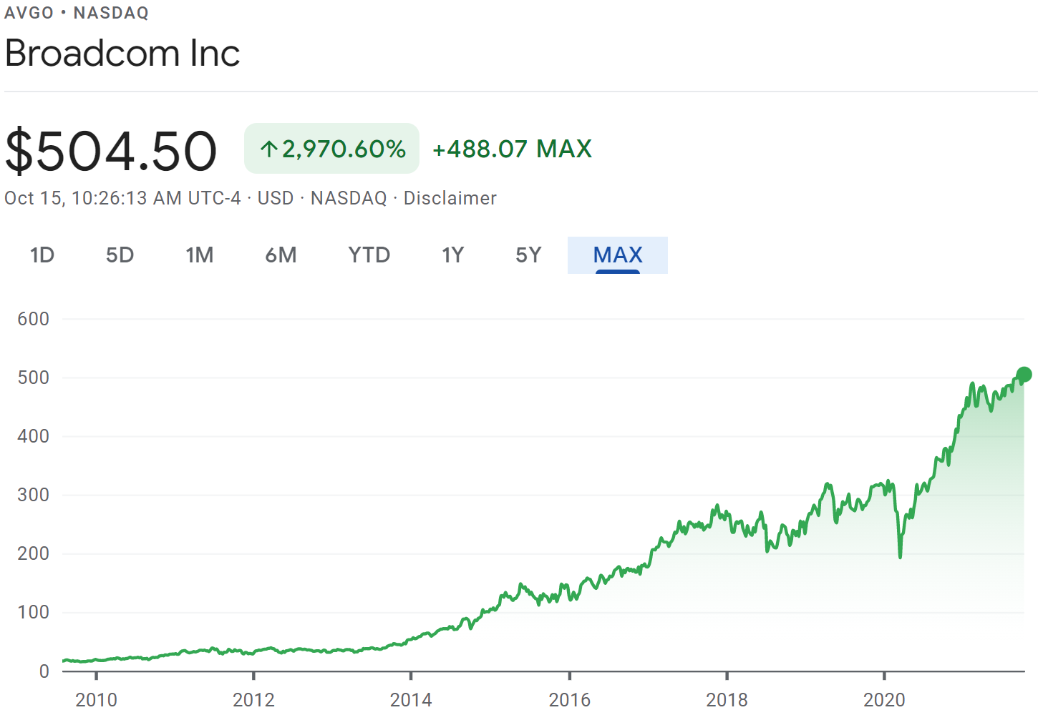
Two More Life Rules …
Learn from history (or be doomed to …)
What works
Being the beacon of opportunity for talent and innovation !!!
Knowing it’s a marathon, not a sprint: “long game”
What doesn’t work
Pushing on ropes, short attention spans, throwing $$$ without fixing root causes
Remember the Serenity Prayer
Accept what we cannot change
Companies, students, faculty all behave rationally in their reward systems
Semi: consolidate, outsource, offshore, spin off, drop off leading edge, …
EDA: EULA terms, IP assertion, price/limits of University Program, #SolvNet logins for Michael, …
Change what we can
Hierarchy of importance don’t boil the ocean; have lifeboat tests
Work backward from the end always be on a feasible path
Culture change is powerful academic credit/value assignment; tech/org health
Accountability and metrics measure to improve; fool me twice, shame on me
Notes:
Two more Life Rules.
[CLICK] Learn from history or be doomed etcetera.
[CLICK] What HAS worked for the U.S. is being the world’s beacon of opportunity for talent and innovation. Can this be sustained?
That fifth paragraph of the Needs Statement sets out a long struggle. My one stay in China was 17 years ago, on a trip arranged by Synopsys for nine CAD professors (from MIT, CMU, Princeton, Stanford, Michigan, and so on) to give lectures to a bunch of young faculty in the EDA field. And even 17 years ago we were told that all these young faculty came to Hangzhou to listen to us because China needed to train 50,000 VLSI designers a year. So wherever this is going, it will be absolutely a marathon – a very long game.
[CLICK] And what doesn’t work is pushing on ropes or changing direction after four years. When the discussion includes economic and national security, I would be petrified about shifting goal posts and declaring victory – which sometimes happens.
[CLICK] There there’s the Serenity Prayer – which saves a lot of time and energy.
[CLICK] Accept what you can’t change – and understand that companies, students and faculty are all rational entities. If you’re a Broadcom stockholder or employee, you’re probably pretty happy.
[CLICK] On the other hand, you change what you can --- GENERICALLY, in priority order, working back from the end goal. A big problem for us in academia is that credit and value assignments drive us away from collaboration and sharing. And long-term technical or organizational health is very rare. Which is an opportunity – low-hanging fruit.
And last, be accountable (especially if we’re talking taxpayer dollars). Measure to improve.
Again, these are GENERIC rules.

Slide 8
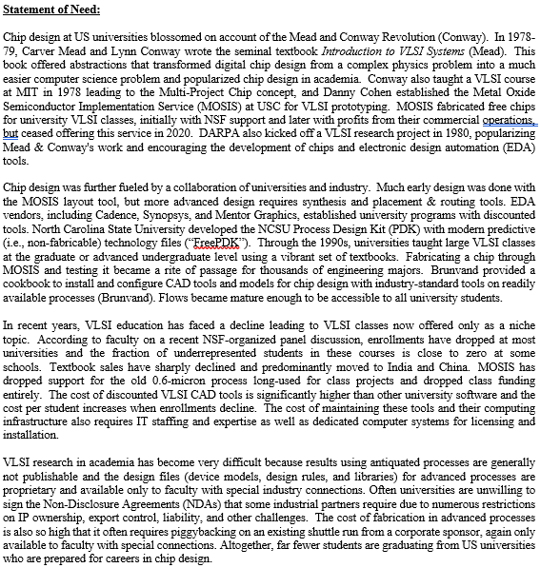
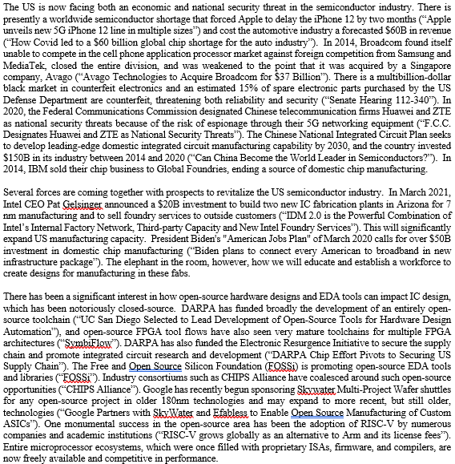
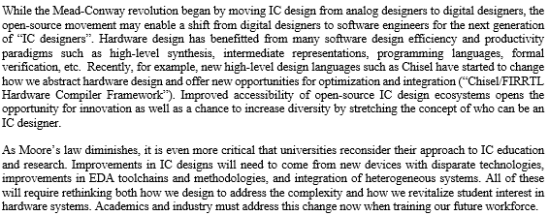
Q: Do Goals Need Clarification?
Example: In which organizations do we need to build the “workforce to create designs for manufacturing in these fabs”?
Should we clarify needs first, then goals?
Notes:
So, I actually spent an embarrassingly long time studying the Google Doc with the directions on position statements, and the Statement of Need.
[CLICK] Fewer chip designers graduating.
[CLICK] Economic and national security threats.
[CLICK] The elephant in the room is training a workforce to fill the new Intel fabs.
[CLICK] Linkage between open-source, democratization, innovation and diversity.
[CLICK] And improvements to IC design will come from multiple technologies – devices to EDA to integration. Which comes full circle to the need to raise student interest.
[CLICK] In my personal opinion, it would be great to clarify what needs are pulled from this context, and how they map to goals.

Slide 9
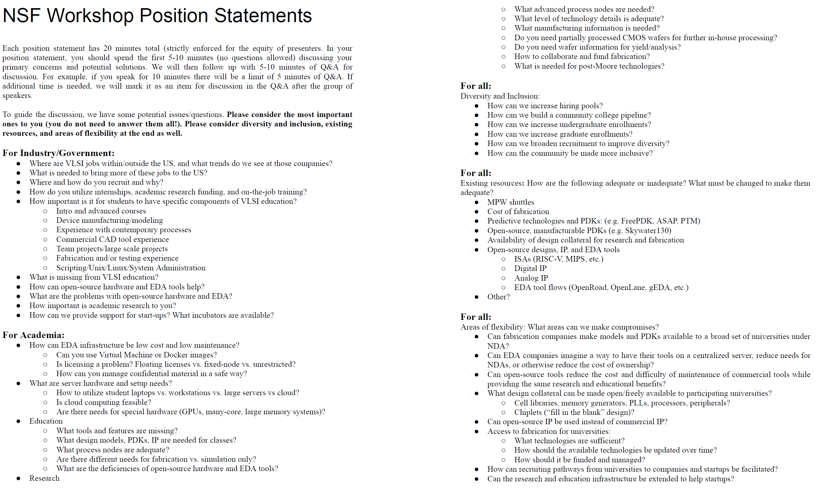
Q: Can We Separate Concerns, Foci?
How will progress be measured? (KPIs)
How can we replicate and scale known successes?
Yes to cloud, containers!
Solution exists: just add $$
“Not a hill to die on”
Flexibility of skills, learning how to learn, curiosity for a lifetime …?
“your primary concerns and potential solutions” → maybe collect offline?
Notes:
Then for the position statements – MAN, there were a lot of bullets and questions here. So
[CLICK] my first concern was whether this requires a lot more time and thought.
[CLICK] Then: could we triage some easy ones? (these labels are just “for example…”)
[CLICK] Some might need clarification.
[CLICK] And some may bring difficult concerns that need to be addressed.

Slide 10
Would Like To See
1. Don’t lose “north star” = what led to U.S. success
Attract the best talent, provide the best opportunities for innovators
(learn from leading programs, exemplars)
2. Do better
Faculty
Share solutions, precedents and existence proofs (NDA/LUL terms, course infrastructure, COVID-19, …) Slack ☺
Share education technology (MSE 2.0)
Share best practices for sharing ☺
Rise above that (#*&!(*!) bean-counting → do the right thing (open-source, share, …)
BTW: EDA companies are great here: training courses, RAKs, web portals, cloud offerings, …
Notes:
Some things I hope for in the future.
[CLICK] First, don’t forget that PEOPLE, TALENT and opportunities for INNOVATION were all part of the past successes. Let’s try not to lose this. And obviously there are some leading examples out there which would be great to learn from.
[CLICK] Faculty can do better – share know-how and IP such as labs or runscripts and workarounds. Again, we’re culturally not incented to do this – but at scale this would save many thousands of hours of pain and reinventing wheels. [Even at the level of nitty-gritty NDA edits or managing IP – I feel that we don’t want everyone to rediscover what’s already in Chris Batten’s head, for example.]
And by the way, in my view the EDA companies really deserve a lot of credit for removing blockers and supporting research and teaching missions a lot better.
Just one example …

Slide 11
Shout-Out + Thanks to EDA Vendors …
How CAD research with vendor tools became reproducible after all …
Hi, Andrew – my students want to replicate your studies in paper XXX. We have the ASAP7 but how exactly did you run the YYY tools? Thanks, Bora.
Hi, Bora – No problem. But please send me a note confirming that you and your students are currently licensed users of the YYY tools (e.g., under relevant paid-up subscriptions to vendor University Programs).
Hi, Andrew – Sure thing – here you go: I confirm that I and my group members are all currently-licensed users of the YYY tools via a current subscription to the YYY University Program.
Hi, Bora – Thanks … can you also send me GitHub handles? We’ll give access to a private repo with the relevant runscripts + public testcases. Note from the paper that we used vZZZZ.Z !
// Alternative: explicit sharing of Drive account
// Alternative: .htdocs/.htpasswd at a (transient, dark) URL
Hi, Andrew – got it, we’re good to go.
Comment 1: From O(N) to O(1) sharing effort: EDA vendors can also put your scripts behind their access-controlled portals (pipecleaners in 2018)
Comment 2: Hammer, CADRE, mFlowgen, … (Tcl bytecode?) are bases of other mechanisms
Comment 3: This could be less cumbersome but IMO it’s a solved problem → much happier now
Support of student learning and research
University Programs
Generic PDKs
Real training classes, RAKs, recent tool versions, …
Pandemic “Recognizing that the extraordinary travel and congregation restrictions imposed as a result of the novel coronavirus (COVID-19) calls for extraordinary measures, notwithstanding the terms and conditions of the applicable license agreement, YYY agrees that for 90 days, …”
Notes:
I used to complain that EULAs and copyrights made my research irreproducible by construction. But now I can send my scripts to Bora, once we make some simple steps between us according to the rules of the road that the EDA vendors provide.
[CLICK] And if handling all those requests is too difficult, the EDA vendors will even help out – we pipecleaned this a few years ago. So this is just great.
[CLICK] And the vendors are so much more supportive and streamlined – even with COVID WAN exceptions – than we would have seen in the past.

Slide 12
Would Like To See
1. Don’t lose “north star” = what led to U.S. success
Attract the best talent, provide the best opportunities for innovators
(learn from leading programs, exemplars)
2. Do better
Faculty
Share solutions, precedents and existence proofs (NDA/LUL terms, course infrastructure, COVID-19, …) Slack ☺
Share education technology (MSE 2.0)
Share best practices for sharing ☺
Rise above those #*&!(*! bean-counters → do the right thing (open-source, share, …)
BTW: EDA companies are great here: training courses, RAKs, web portals, cloud offerings, …
Government
Fund long-term, stable infrastructures including supply chain + professional staff
VLSI design (tooling, expertise) + fabrication + packaging, test (multiple regions do this)
Advanced devices and structures/fabrics, not just mainstream
Define the democratization goal (e.g., open and equal access?)
Fund more “engineering” to build systems, along with translational, innovation efforts (“TIP”?)
Broadly incentivize ($$$) creation and support of high-quality shared infrastructure (IP, labs, …)
3. Accountability
Notes:
And government can obviously help a lot as well – with long-term stable infrastructures (not forgetting the beyond-X fabrics and vectors for future system innovation – 5.5D or GaN or photonics)
Plus again – accountability for succeeding in the nation’s mission and using tax dollars well.

Slide 13
Messages
This is a great workshop – thanks to the organizers
The talks and discussion have been wonderful
Harness energy, good will, sense of collective mission
→ Clarify needs, purpose, goals, boundary conditions, …
Don’t lose sight of how VLSI Design in the U.S. had such incredible success
Share successes, lift all boats (vs. “common denominators”)
Flexible skills, fundamental knowledge, …
Beacon to talent worldwide, best environment for innovation
What is different this time around?
If it’s meaningful, it will be a marathon
“How can I help?”
Notes:
Let me wrap up. First, this is a GREAT workshop – thanks to the organizers and sponsors for making it happen. I look forward to this energy and good will being marshaled to address the nation’s needs.
[CLICK] Second, success is about people and culture: lift all boats, grow flexible skills, never stop being the beacon to talent around the world.
[CLICK] And let’s drill down into what’s different this time around, let’s understand that meaningful goals mean marathons, and … then pitch in.

Slide 14
THANK YOU ! (Q&A)

Slide 15
Backup: Misc + Perspective
Company funding tapeout classes at Stanford, Berkeley, CMU is great
Multiple companies are joining this trend !
Gradients are really tough
Best talents (foreign and domestic) want to do other things than hardware
Brain Drain: “biggest threat to EDA is Google” - Igor Markov, 15 years ago (see #5)
Perspectives / Retrospectives
“CAD Research: Pay Me Now or Pay Me Later”, ICCAD 2006 (slides)
“Toward New Synergies Between Academic Research and Commercial EDA”, CDNLive 2016 (slides)
“A ‘Life Cycle’ of Teaching and Research on EDA and IC Implementation Methodology”, CadenceLIVE! 2020 (slides, mp4)
“Open-Source EDA: If We Build It, Who Will Come?”, VLSI-SoC 2020 (slides, mp4)
About brain drains: 2004 EDA Confidential interview

Slide 16
Misc: Flows (CadenceLIVE, August 2020)
Industry
Faculty
EDA
Tools, Problems
Research
$$
Semiconductor
Training
Teaching
Full-Time
Advising
Teaching
ABKGroup Ph.Ds
~40% → CDNS
~20% → QCOM
Intern
Lab
Course
Students

