Slide 1
Maatritva (OpenCHS)
Job aid & decision Support tool – Public Healthcare Domain

Slide 2
What is the problem?
55,000
Pregnant Women die in India
Annually due to pregnancy
related causes

Slide 3
What is the problem?
80%
are Preventable

Slide 4
Key observations
► Delay in Identification of high risk pregnancy
► No proper Tracking and monitoring health status
► No mapping of health facilities for referral
► Information gap on needs during delivery
► Lack of awareness amongst women

Slide 5
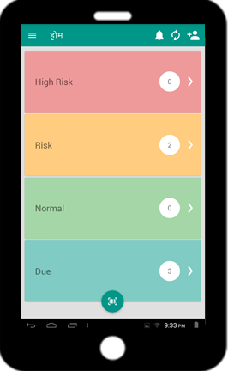
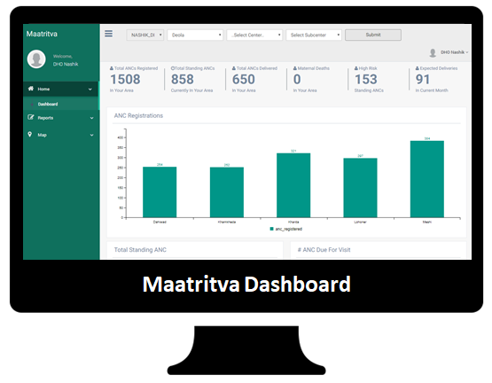
Solution
Mobile Platform
Web Platform

Slide 6
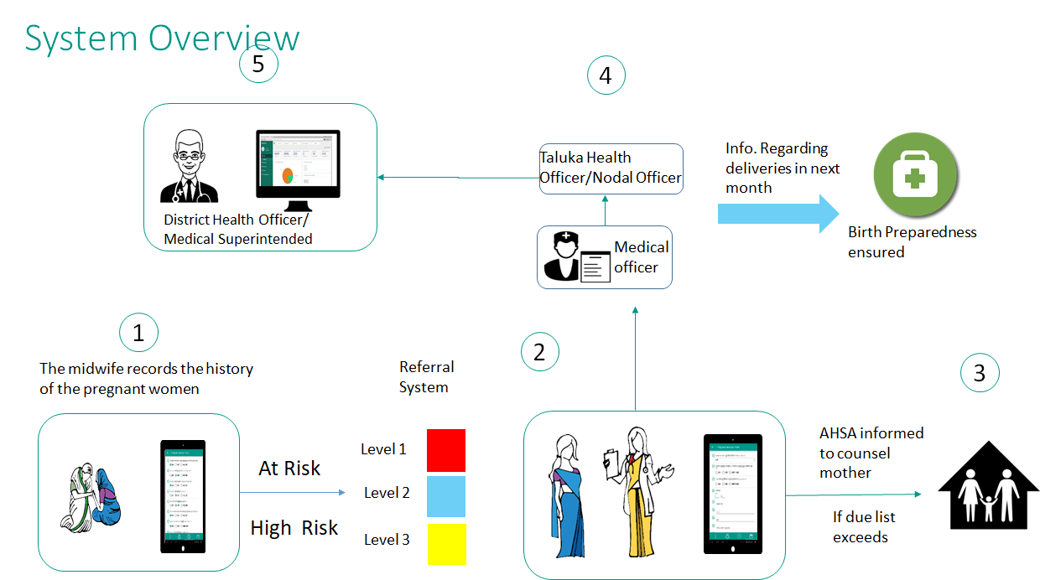
Working of solution - overview/flow

Slide 7
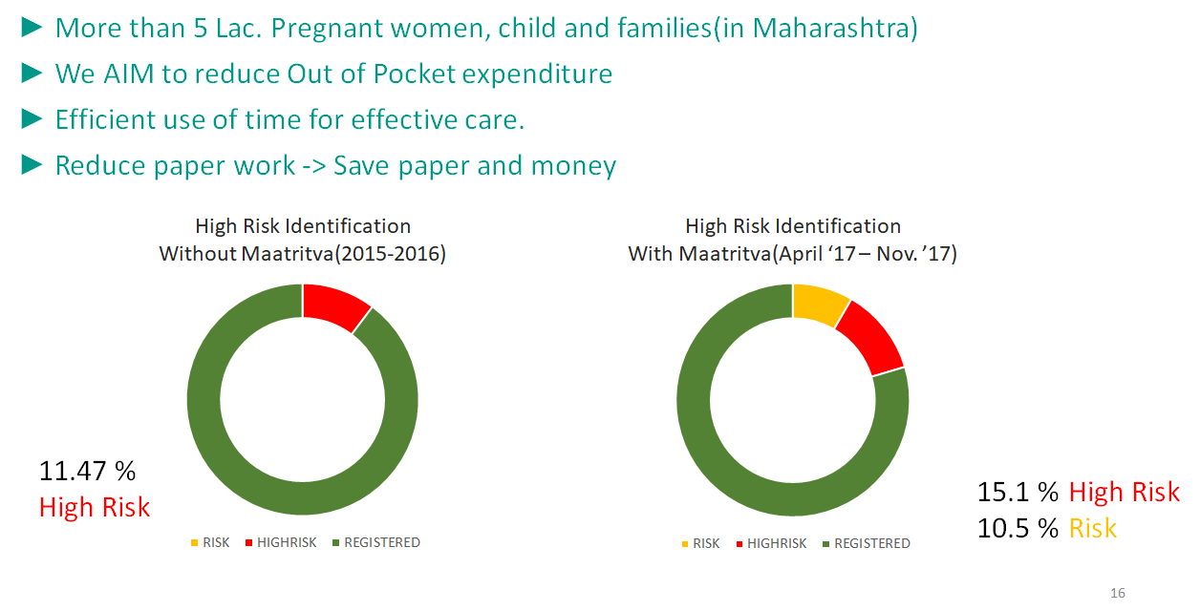
Impact

Slide 8

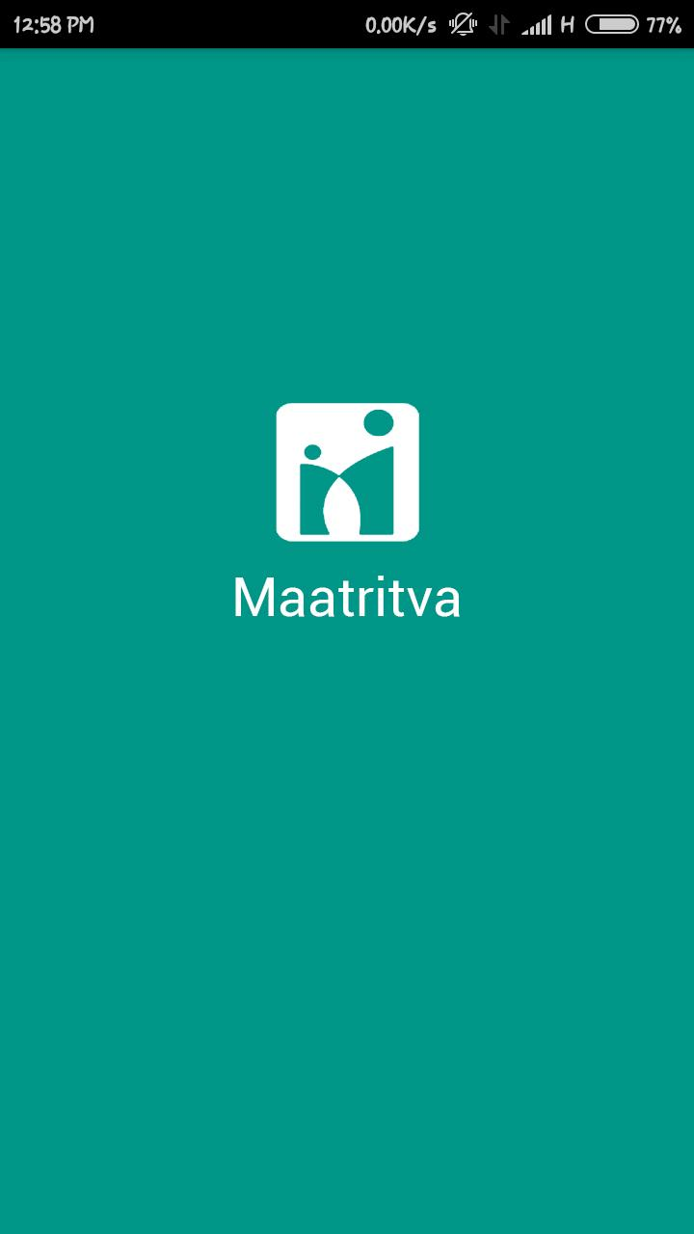
Comprehensive platform
One solution for all types of program
Connected system
Easily configurable : reduce need to retraining
No duplication for multiple programs
Decision support wherever applicable
New guidelines can be updated immediately.
Localization (Hindi, Marathi, English)
Escalation matrix, Reminders/Notifications
Actionable Insights

Slide 9
OpenCHS Health Modules Contains modules for national health programs (as per standard specifications) • Maternal Health (ANC, PNC, Delivery) • High risk identification • Birth preparedness • Child nutrition and growth monitoring • Growth monitoring • Immunisation schedule • Common childhood illness • Adolescent continuum of care (RKSK) • Medicine prescription based on common simple health complaints • Malaria, Cold, Cough, Body ache, etc • More modules to be developed over time (notably NCD)

Slide 10
Continuum of care
Adolescence/pre-pregnancy
05
Other
Adolescent,NCD, Mental Health, TB..etc
01
04
Childhood
Pregnancy
02
03
Birth/Newborn postnatal

Slide 11
Timeline for Implementation
Weeks
4
3
4
24
~
Initial Research
Data Collection
Configuration
Pilot
Scale

Slide 12
Current Customers
01
Nashik District
District health
Nashik Municipal Corporation
Government
02
UNICEF
Lok Biradari Prakalp
Tata Trust
NGO
Sewa Rural
JSS
Ashwini

Slide 13
Future/ Road Ahead
Build
More modules
Scale
To State and Central Level
NCD
MDSR
Sickle Cell
Other
~1 Lac Beneficiaries
~15 Clients
~2000 Users

Slide 14



Business
Implementations Self Sustainable
Grants and Funds
Product Development

Slide 15
Partners
Unltd India
Social alpha
Digital Impact Square

Slide 16
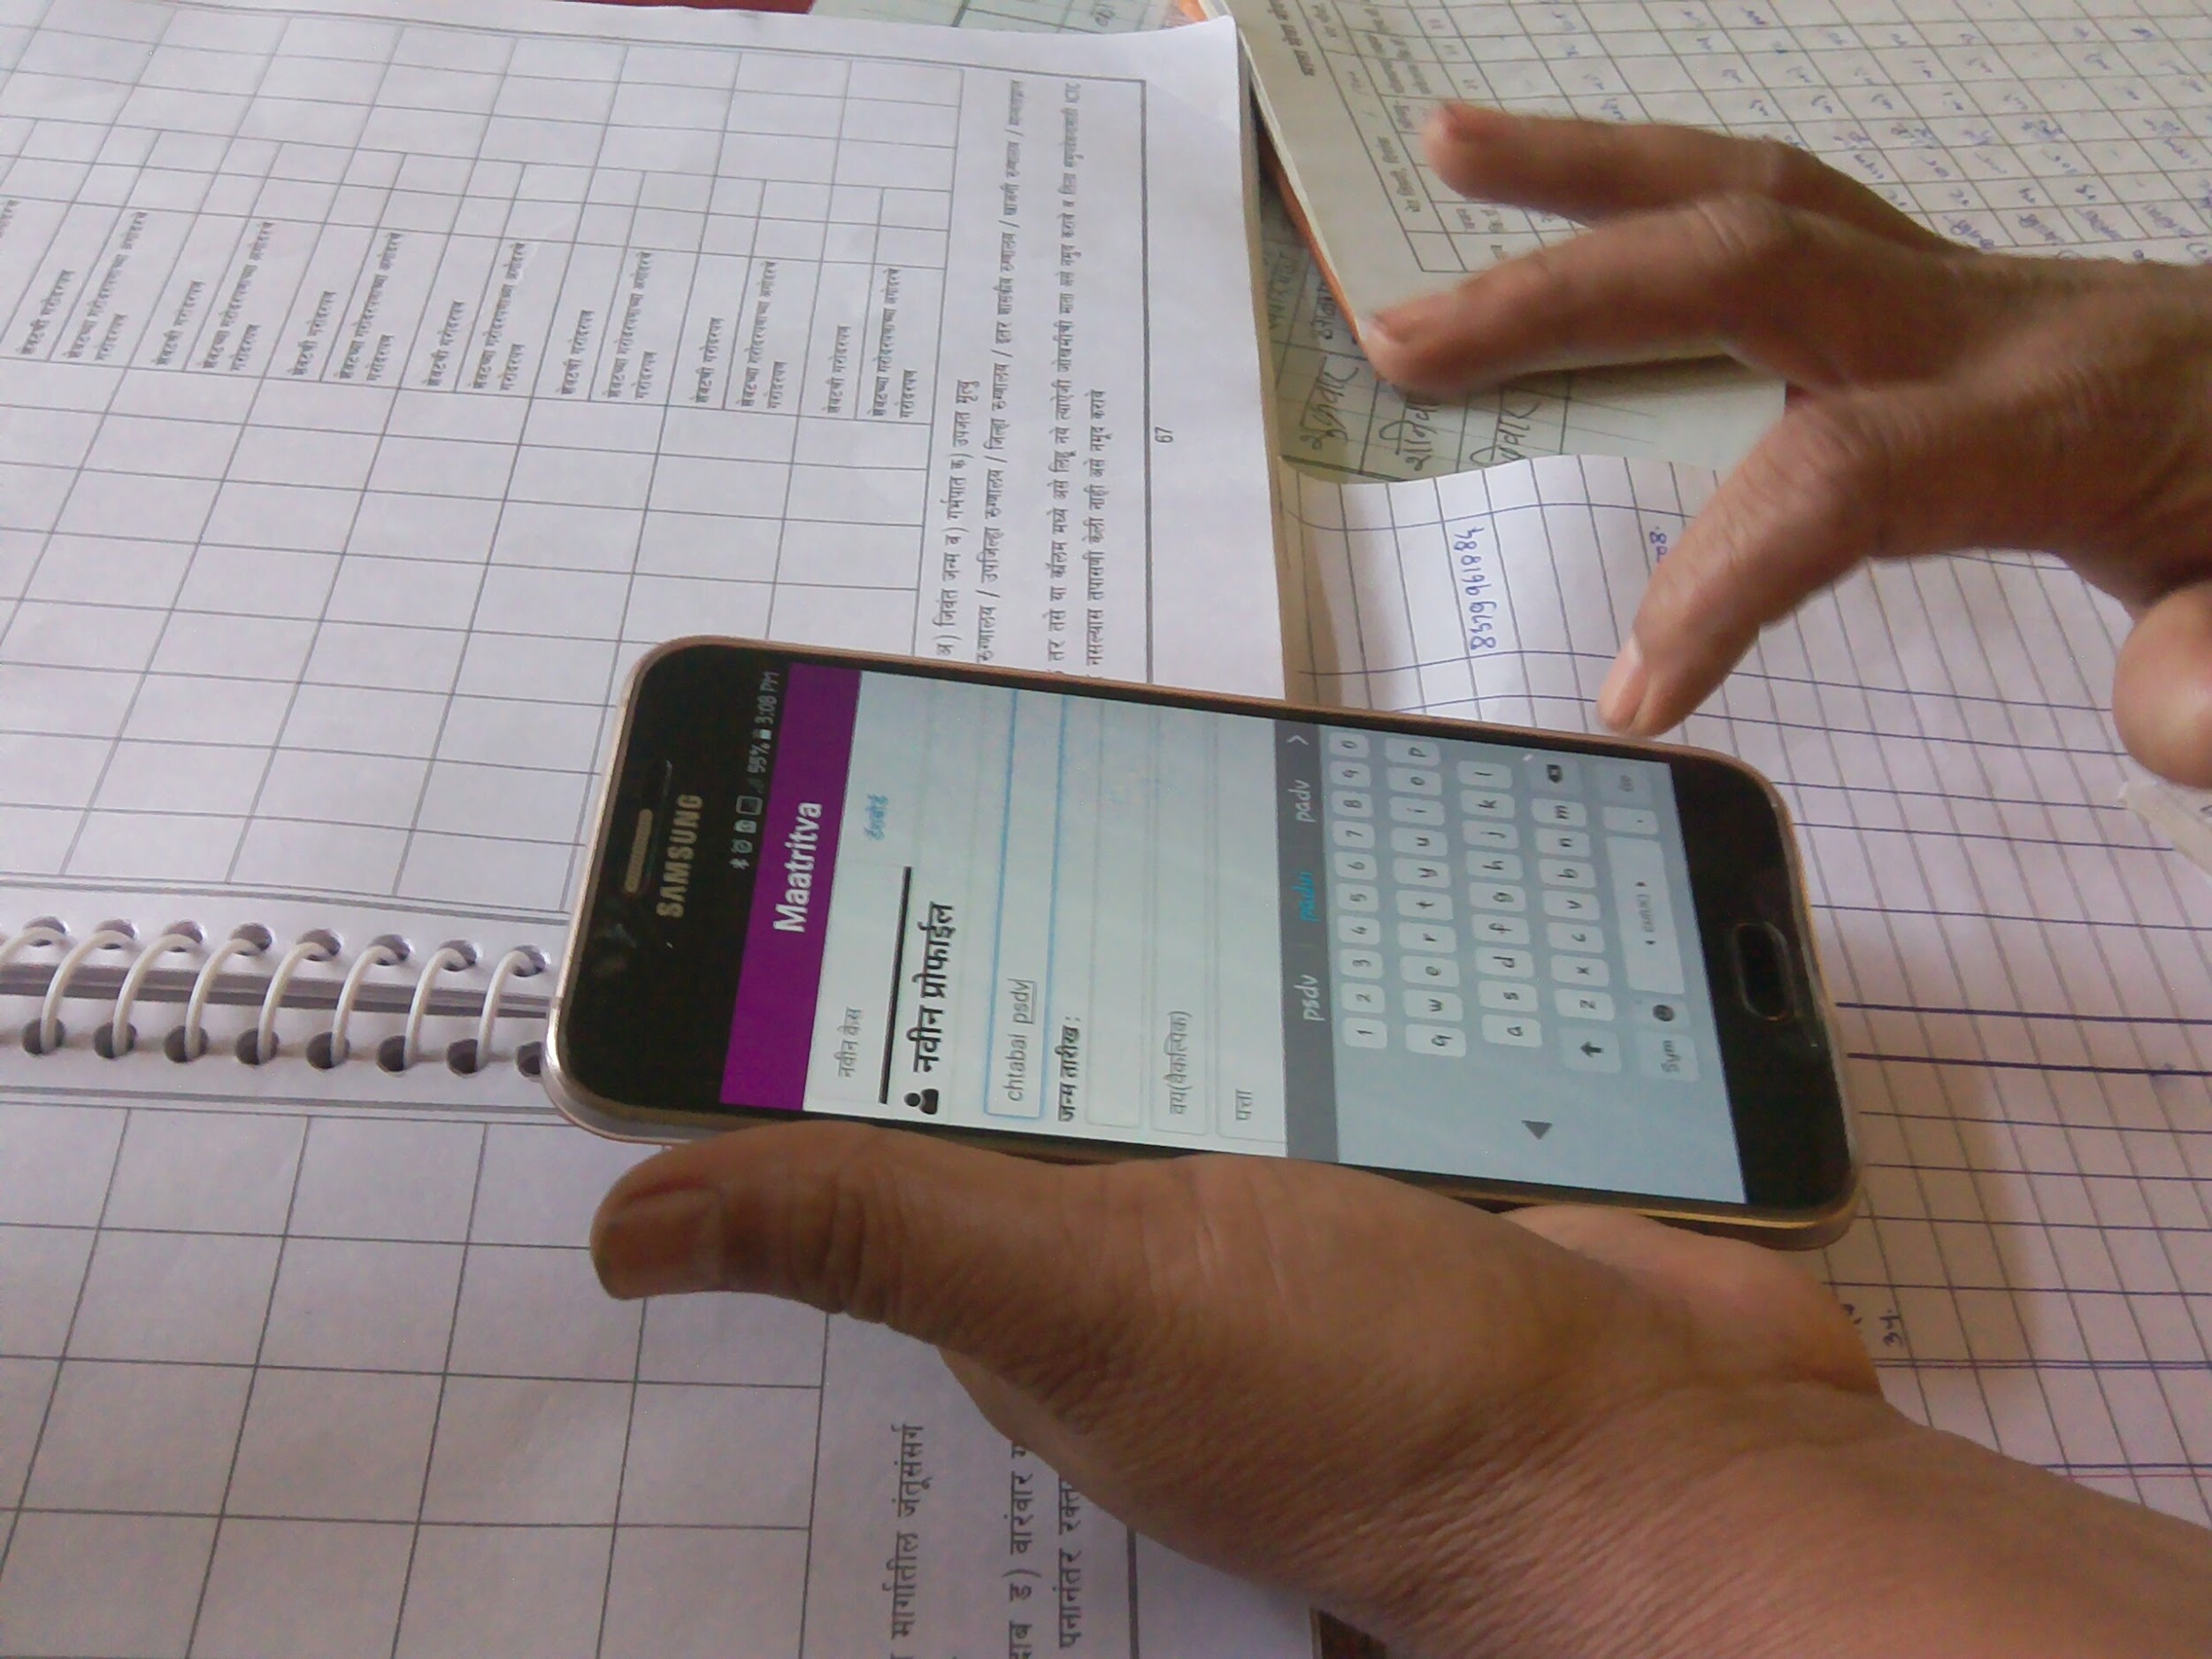

Preleaf Technology
Transforming Health Care
Thank You

