Slide 1


Course Roadmap
Six lectures, from ML vocabulary, data structures/preparation to a worked photometric-redshift pipeline.
1a
LECTURE
1b
LECTURE
2
LECTURE
The Taxonomy of
Machine Learning
Feature Vectors &
Data Modalities
Data
Preparation
AI vs ML · paradigms · problem archetypes · why now
frame the problem · X / y · data scales · EDA · curse of dim
missing values · outliers · scaling · encoding · PCA
3a
LECTURE
3b
LECTURE
4
LECTURE
Splits &
Model Reliability
Decision Trees →
Random Forests
Practical RF +
Photo-z Case Study
train / val / test · K-fold CV · data leakage
Gini · pruning · bagging · feature importance · OOB
sklearn pipeline · pitfalls · 10 000 SDSS galaxies
Theme: Foundations → Data preparation → Reliability & models → Practical case study
Notes:
Use this slide as the opening view of the course. The 2×3 grid mirrors the natural progression: Row 1 sets up the conceptual landscape and prepares the data; Row 2 introduces evaluation, picks the model (Random Forest), and finally applies everything to a real photometric-redshift problem. Each card lists the key topics — students can refer back to this slide between lectures to see how the pieces fit together.

Slide 2
Lecture 1a:
The Taxonomy of Machine Learning
A guided tour of the landscape
Omkar Bait (CosmicAI Fellow)
NRAO, Charlottesville
CosmicAI Summer School
1
Notes:
Welcome to the CosmicAI Summer School. The plan for this lecture is to map out the landscape of AI/ML — vocabulary, paradigms, problem types — so the rest of the course makes sense in context. By the end you should be able to look at any astronomy paper that says 'we used machine learning' and place it on the map.

Slide 3
AI – ML – Deep Learning
Artificial Intelligence
Artificial Intelligence
The broad pursuit of building systems that perform tasks requiring human-level intelligence.
Machine Learning
Machine Learning
A subset of AI focused on statistical algorithms that learn from data — improving with experience.
Deep Learning
Deep Learning
ML using deep neural networks — many layers learn hierarchical features automatically.
Today's lecture and the rest of this course are about the middle ring: classical ML.
CosmicAI Summer School
2
Notes:
Important framing: AI is the goal, ML is the toolbox, DL is one set of (very powerful) tools inside that toolbox. Most of what we'll do in this course is classical ML — the algorithms you can run on a laptop on 10⁴-10⁶ examples. Deep learning enters later when datasets are huge and structure is complex (images, spectra, light curves).

Slide 4
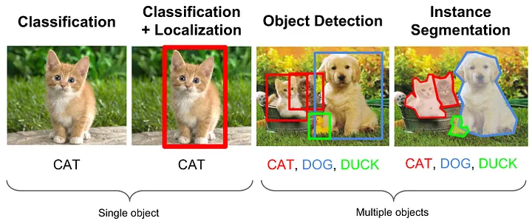

Slide 5
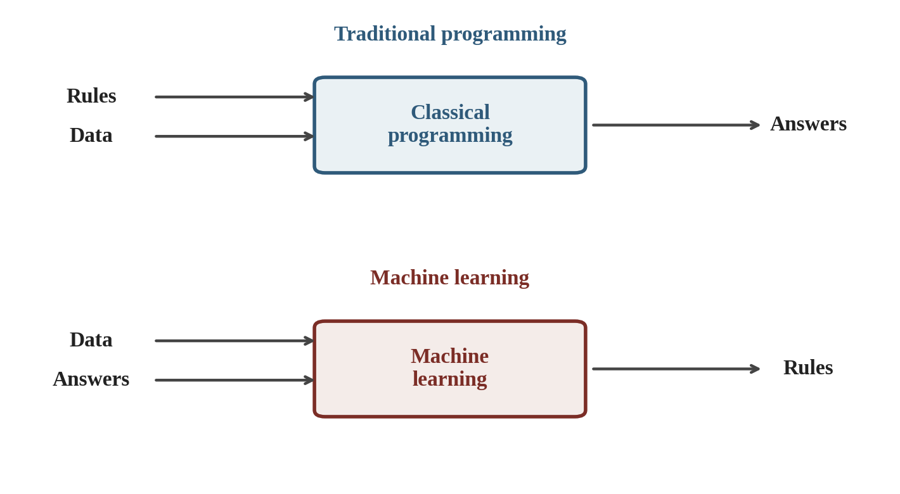
ML vs Traditional Programming
The fundamental flip: in traditional programming we supply the rules and let the computer apply them to data. In ML, we supply data and the answers and ask the computer to discover the rules.
CosmicAI Summer School
3
Notes:
Easy way to remember: traditional programming is rules → answers. ML is examples → rules. This is why ML shines whenever the rules are too complex, too numerous, or unknown — exactly the situation in modern astronomy with multi-band imaging surveys.

Slide 6
The Four Main Pillars
Machine learning is usually classified by what kind of data the model gets to see.
Supervised
Unsupervised
labeled data (X, y)
unlabeled data (X only)
Learn a mapping X → y. Classification, regression.
Discover latent structure: clusters, principal components, anomalies.
Semi- / Self-Supervised
Reinforcement
a little labeled + lots of unlabeled
agent + reward signal
Use the structure in unlabeled data to amplify a small labeled set.
Learn optimal policies via trial and error. (Out of scope for this course.)
Most of this course focuses on supervised learning. The next few slides give each pillar a one-slide tour.
CosmicAI Summer School
4
Notes:
Anchor: the key distinction is what the model SEES during training. Labels = supervised. No labels = unsupervised. Mix = semi/self. Reward signal = reinforcement. Reinforcement learning is conceptually different and we leave it for a future course.

Slide 7
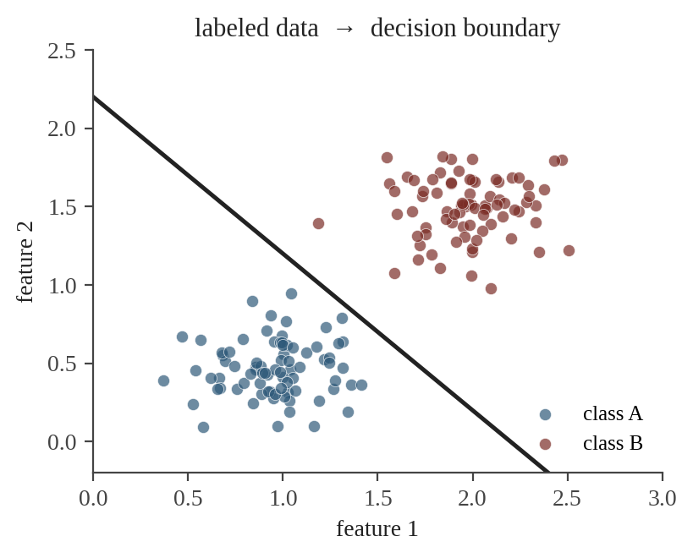
Supervised Learning
Given: training pairs (X, y).
Goal: learn f : X → y that generalizes to new examples.
Two flavors:
y is a category → classification (spiral / elliptical).
y is a number → regression (photo-z).
Astronomy examples
Photo-z (regression) · Galaxy morphology (classification) · Star–galaxy separation (classification) · Stellar parameters from spectra (regression)
CosmicAI Summer School
5
Notes:
This is the meat of the course: lectures 1b through 4 all use the supervised paradigm. The case study in Lec 4 is a regression problem (photo-z from colors). The figure shows the canonical picture: labeled training data → model learns the decision boundary.

Slide 8
Unsupervised Learning
Same data, but no labels — the model has to find structure on its own.
Clustering
Dimensionality reduction
Density estimation
Group similar examples together.
Compress high-D data into a few key axes.
Learn the probability distribution of the data.
Algorithms: K-Means, DBSCAN, Gaussian Mixture. Astro: spectral types, source populations.
Algorithms: PCA, t-SNE, UMAP, autoencoders. Astro: galaxy spectra → eigenspectra.
Algorithms: KDE, GMM, normalizing flows. Astro: cosmological parameter inference.
When to reach for unsupervised: no labels yet, exploring a new dataset, or just curious what's in there.
CosmicAI Summer School
6
Notes:
Tell students: unsupervised methods are often the FIRST thing you do with a new survey. Cluster the spectra, see which groups emerge. Project to 2-D with t-SNE, see if there are anomalous regions. This is exploratory analysis raised to industrial scale.

Slide 9
Semi- & Self-Supervised Learning
The hybrid case: a little labeled data, plus mountains of unlabeled data.
Semi-supervised
Self-supervised
Use unlabeled X to discover useful structure, then exploit it to fit a model on the small labeled (X, y) set.
Astro example:
spectroscopic redshifts exist for ~10⁶ galaxies; photometry for ~10¹⁰.
Manufacture labels from the data itself: predict the next word, fill in the missing pixel, match the augmented view.
Powers modern foundation models (GPT, CLIP, BERT, AstroCLIP).
Why it matters in astro: labels are scarce, raw observations are abundant. Self-supervised pre-training is becoming the standard recipe for survey data.
CosmicAI Summer School
7
Notes:
Briefly tease modern developments: AstroCLIP, AstroFoundation models. We won't cover these in detail in this course, but it's important for students to know the language. Make the point that the photo-z problem is exactly a semi-supervised problem in spirit — small spec-z set, huge photometric set.

Slide 10
Reinforcement Learning (Out of Scope)
An agent interacts with an environment and learns a policy that maximizes long-term reward.
Agent
Action
Environment
state + reward
Famous successes: AlphaGo, AlphaFold's training stage, robotic control, video games.
We will not cover RL further in this course.
CosmicAI Summer School
8
Notes:
RL is fundamentally different: there is no fixed dataset. The agent generates its own data by acting in an environment. It's a fascinating area but deserves its own course. Mention briefly: AlphaGo's policy network is supervised on human games + RL via self-play.

Slide 11
Problem Archetypes — A Map
The same paradigm (e.g. supervised) gives rise to several common problem types.
Classification
Regression
Clustering
spiral / elliptical, star / galaxy
photo-z, stellar mass, luminosity
find groups in unlabeled data
Image analysis
Anomaly detection
Generative
object detection, segmentation
outliers from the norm
synthesize images / spectra / text
The next three slides expand the most important ones.
CosmicAI Summer School
9
Notes:
Hand-wave the tiles. Each is a one-line elevator pitch. We'll spend more time on the top row (classification and regression) because they are the bread and butter of the course. Image analysis (CNNs) and generative models would each deserve their own multi-lecture treatment.

Slide 12
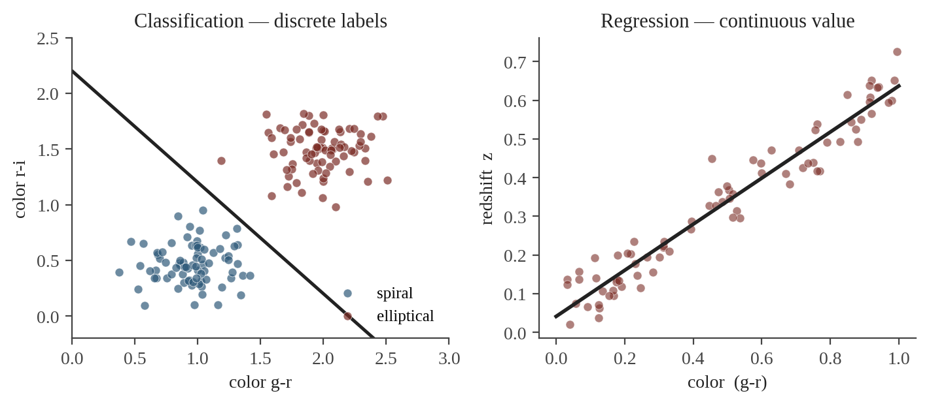
Classification vs Regression
Classification
Regression
Target y is a discrete label.
Binary: 2 classes (lens / no-lens).
Multi-class: many (galaxy morphology).
Target y is a continuous number.
Examples: redshift z, stellar mass, luminosity.
Metric: RMSE, bias.
CosmicAI Summer School
10
Notes:
Concrete examples. Photo-z is regression. Spiral-vs-elliptical is binary classification. Hubble-stage prediction (E, S0, Sa, Sb, Sc, Irr) is multi-class. SAME random-forest algorithm covers both — RandomForestClassifier and RandomForestRegressor in sklearn.

Slide 13
Image Analysis & Generative Tasks
Beyond tabular data — the modern frontier uses pixel-level models.
Object detection
Segmentation
Generation
Find and box objects in an image.
Label every pixel by its class.
Synthesize new examples from learned distribution.
Astro: detect galaxies, transients, lensed arcs in survey images.
Astro: separate galaxy light from cosmic-ray hits, deblending.
Astro: simulate realistic galaxy images, augment training sets, generate spectra.
Typical models: convolutional networks (CNNs) for detection / segmentation; diffusion models & GANs for generation.
CosmicAI Summer School
11
Notes:
Mention but don't go deep: CNNs are the standard for image tasks. Diffusion models are the current state of the art for generation. These all live in 'deep learning' — they would each be a multi-lecture topic on their own.

Slide 14
Anomaly Detection & Clustering
Anomaly detection
Clustering
Goal: find examples that don't match the bulk distribution.
Methods: Isolation Forest, One-Class SVM, autoencoder reconstruction error, Z-score / IQR (Lec 2).
Astronomy: rare transients, gravitational lenses, weird quasars, instrument glitches.
Goal: group similar examples without using any labels.
Methods: K-means, DBSCAN, hierarchical, Gaussian Mixture Models.
Astronomy: spectral type discovery, exoplanet population studies, source clustering for cosmology.
Common thread: both work without labels — they let the data speak for itself.
CosmicAI Summer School
12
Notes:
Story to tell: anomaly detection in astronomy has discovered Boyajian's Star, FRBs, and lots of weird quasar candidates. As surveys get bigger, anomaly-pipelines become essential — you can't manually inspect 10⁹ light curves.

Slide 15
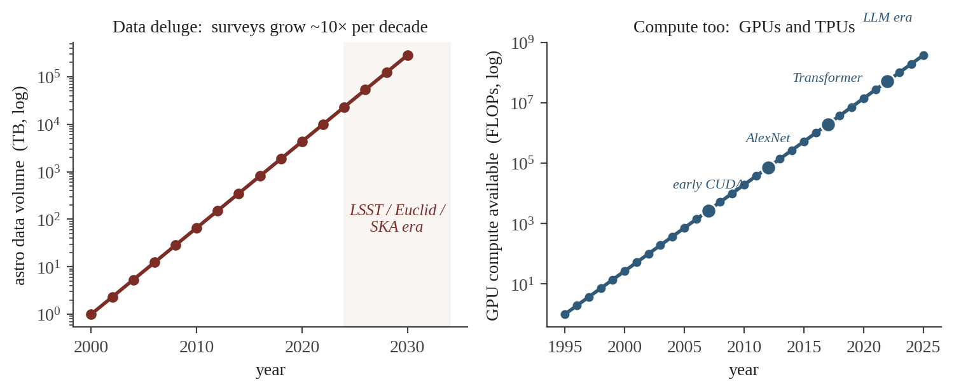
Why AI/ML — Why Now?
Three trends came together in the 2010s and made modern ML inevitable.
1. Data
2. Algorithms
3. Hardware
Surveys grow ~10× per decade — SDSS → DES → LSST → Euclid → SKA. Multi-modal data everywhere.
Modern toolbox: backprop, CNNs, Transformers, diffusion models, foundation models.
Massive parallel compute: NVIDIA GPUs, Google TPUs. CUDA (2007) democratized this.
CosmicAI Summer School
13
Notes:
All three trends are still accelerating. LSST will deliver 20 TB / night for 10 years. Foundation models in 2024 are training on the entire scientific literature. GPU memory doubles roughly every 2 years. The opportunities for astronomy + ML are wide open.

Slide 16
Recap — What You Now Know
1
AI ⊃ ML ⊃ Deep Learning
Nested concepts; the rest of this course lives in classical ML.
2
Four paradigms
Supervised, Unsupervised, Semi-/Self-, Reinforcement (out of scope).
3
Problem archetypes
Classification, regression, clustering, image analysis, anomaly, generative.
4
ML vs traditional
Examples → rules, not the other way around.
5
Why now
Data deluge, modern algorithms, parallel compute.
Next → Lecture 1b: feature vectors, data modalities, framing a problem precisely.
CosmicAI Summer School
14
Notes:
Close the loop: today gave you the vocabulary; the next lecture zooms in on the inputs (features X) and the outputs (targets y). From Lec 1b onward, the course is largely supervised — with photo-z as a running thread.

