Slide 1

Lecture 2: Data Preparation
Cleaning, Scaling, Encoding
Omkar Bait (CosmicAI Fellow)
NRAO, Charlottesville
CosmicAI Summer School
1
Notes:
Lec 1b set up the inputs: features, targets, data types, dimensionality. Now we make those inputs *model-ready*. Three big things today: (1) handle missing data and outliers; (2) put features on a common scale; (3) encode categorical variables. Briefly mention PCA at the end.

Slide 2
Garbage In, Garbage Out
No model — however clever — can rescue badly prepared data.
1. Clean
2. Transform
3. Reduce
Missing values → impute or drop
Outliers → detect & decide
Duplicates → remove
Scale: standardize / min-max
Encode: nominal vs ordinal
Log-transform skewed features
Drop redundant / leaky features
PCA (optional)
Result: a clean X matrix
Punchline: data prep is usually 60–80% of the work in any real ML project. It's also where bugs hide.
CosmicAI Summer School
2
Notes:
Tell the students: every successful ML researcher will tell you that prepping data takes far longer than choosing a model. This isn't an accident — model APIs are stable, but data is messy in many creative ways.

Slide 3
Missing Values — What & Why
Real datasets are full of NaN, blank cells, sentinel values like −99.
Why values go missing (astro examples):
Flavors of missing data
Sensor saturation — too bright for the detector
Below detection limit — too faint to measure
Bad pixels / cosmic rays — masked in pipeline
Human error — a column was never populated
Missing Completely At Random:
unrelated to anything in the data.
Missing At Random:
depends on other observed features.
Systematically Missing:
depends on the missing value itself —
e.g. faint galaxies missing because faint.
First step: always run df.isna().sum(). Decide column-by-column whether to drop, impute, or flag.
CosmicAI Summer School
3
Notes:
The MCAR / MAR / MNAR taxonomy is from Rubin (1976). Astronomy hits MNAR constantly: faint sources are absent because they're faint. This means simple imputation can bias the model. Tell them: at the least, *flag* a missing value with an indicator column.

Slide 4
Imputation — Mean, Median, Mode
Simplest fix: replace the missing value with a typical value from the column.
Mean
Median
Mode
when to use
when to use
when to use
Numeric, roughly symmetric
Numeric, skewed or with outliers
Categorical features
example
example
example
filling missing redshift z
with the dataset mean z̄
filling missing magnitudes
with the column median
filling missing galaxy type
with the most common class
from sklearn.impute import SimpleImputer
imp = SimpleImputer(strategy="median"); X = imp.fit_transform(X)
CosmicAI Summer School
4
Notes:
Warn them: ALL of these reduce variance because every imputed row gets the same value. If you impute 30% of a column with the mean, downstream models will under-estimate the column's true variance. Better strategies exist (KNN, model-based, multiple imputation) — next slide.

Slide 5
Worked Example — Pick the Imputer
WORKED EXAMPLE
Scenario
You have 7 valid r-band magnitudes in a small sub-sample:
[ 18.1, 18.0, 17.9, 18.2, 18.1, 18.0, 25.0 ]
The 25.0 is a suspected outlier (likely near the detection limit). One additional galaxy is missing its r-band measurement.
Compute on paper:
1. The mean of the 7 values.
2. The median of the 7 values.
3. Which would you use to impute the missing galaxy, and why?
Pause and try — then advance.
CosmicAI Summer School
5
Notes:
Give students 60–90 seconds. If anyone struggles with the median, remind them: sort, then pick the middle. Common student trap: forgetting that 25.0 ought to be EXCLUDED from analysis once flagged — but here it's still in the imputation set, which is exactly the messy real-world scenario.

Slide 6
Worked Example — Solution
ANSWER
Step 1 — Mean
Step 2 — Median
sum = 18.1 + 18.0 + 17.9 + 18.2
+ 18.1 + 18.0 + 25.0
= 133.3
mean = 133.3 / 7 = 19.04 mag
sort:
[17.9, 18.0, 18.0,
18.1, 18.1, 18.2, 25.0]
median = 4th value = 18.1 mag
Step 3 — Decision
The outlier 25.0 pulled the mean up to 19.04 — far from any typical galaxy in the sample. The median 18.1 is robust to the outlier. → use the median.
Rule of thumb: median if you suspect outliers or a skewed distribution. Mean only when the data is clean without outliers.
CosmicAI Summer School
6
Notes:
Pedagogical follow-up: ask 'what would mode do here?' (answer: ties between 18.0 and 18.1 — mode is for categorical / discrete values, not really useful for continuous numerics). Tie back to the main slide's choice rules.

Slide 7
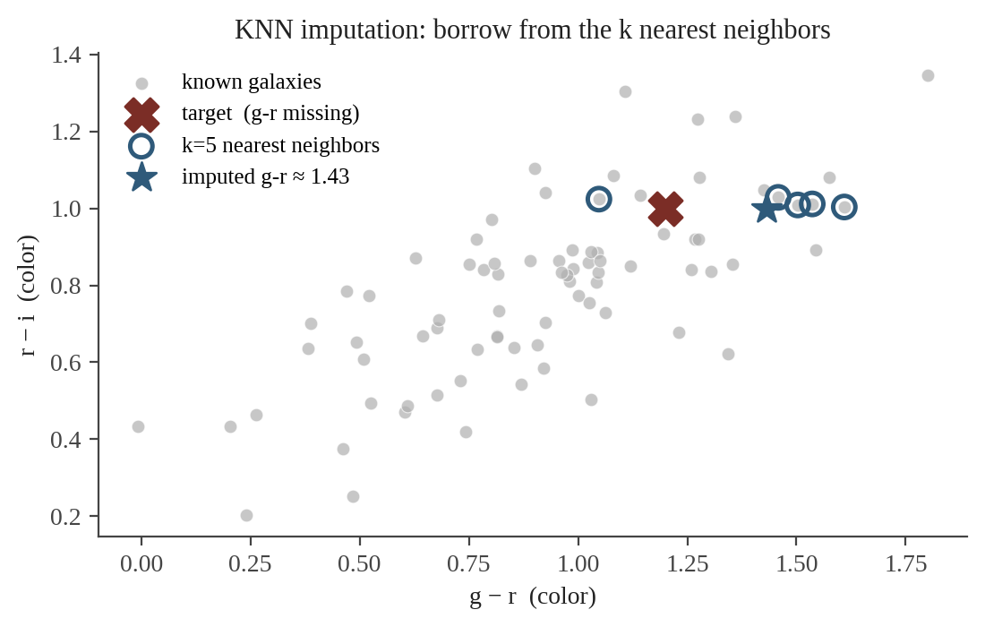
Imputation — KNN
Idea: use the k most similar examples (in the other features) to estimate the missing one.
Steps:
1. Define a distance on the non-missing features.
2. Find the k nearest neighbors.
3. Impute = mean (or median) of their values.
Pros: uses structure in your data, not just one global statistic.
Cons: slow for big datasets; sensitive to feature scaling (do it first!).
from sklearn.impute import KNNImputer
X = KNNImputer(n_neighbors=5).fit_transform(X)
CosmicAI Summer School
7
Notes:
Walk them through the figure: the red X has a missing g-r value. KNN finds galaxies with similar r-i, and averages their g-r. Important: scale your features first, otherwise large-range features dominate the distance metric. This is a recurring theme — preprocessing steps interact.

Slide 8
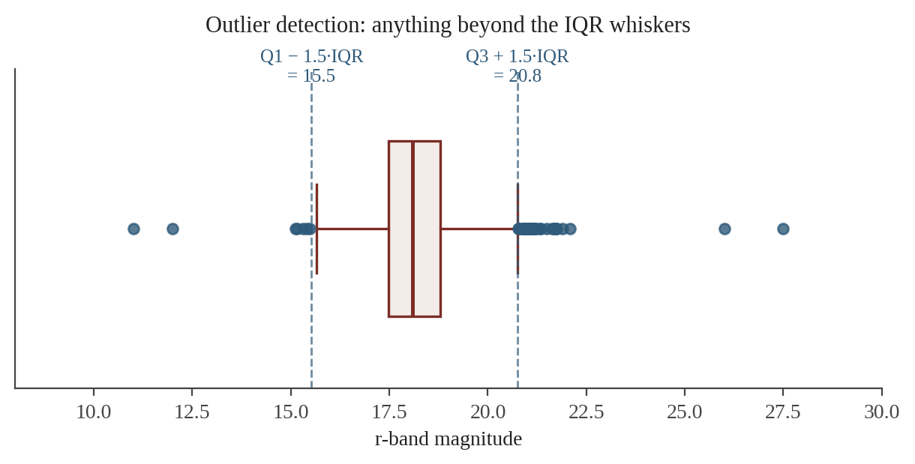
Outlier Detection — Z-score & IQR
Z-score method
IQR method (more robust)
z = (x − μ) / σ
Flag if |z| > 3 (≈ 0.3% of a normal).
Assumes roughly Gaussian.
IQR = Q3 − Q1
Flag x < Q1 − 1.5·IQR or x > Q3 + 1.5·IQR.
No Gaussian assumption.
Flagged ≠ bad. Always investigate before deleting — the outlier might be a quasar, a lens, or a transient.
CosmicAI Summer School
8
Notes:
Critical message: an outlier is *not* automatically bad data. In astronomy, the most scientifically interesting object is often the outlier (quasars, gravitational lenses, transients). Detect them, then decide. Default to flag-and-keep unless you can prove the value is a measurement error.

Slide 9
Worked Example — Z-score Outlier
WORKED EXAMPLE
Scenario
From a clean calibration sample of ~1000 galaxies you have established:
μ_r = 18.0 mag σ_r = 0.5 mag
You measure a new galaxy with r = 19.8 mag.
Compute on paper:
1. The Z-score for the new galaxy.
2. Is it an outlier under the | Z | > 3 rule?
Reminder: Z = ( x − μ ) / σ
Pause and try — then advance.
CosmicAI Summer School
9
Notes:
The key teaching point: μ and σ come from a CLEAN calibration sample. If you compute them on a contaminated set, a single big outlier inflates σ and can mask itself ('the masking problem'). This is why robust statistics (median, IQR) are often preferred — see Lec 2 slide 8.

Slide 10
Worked Example — Solution
ANSWER
Step 1 — Apply the formula
Z = ( x − μ ) / σ
Z = ( 19.8 − 18.0 ) / 0.5
Z = 1.8 / 0.5 = 3.6
Step 2 — Apply the rule
| Z | = 3.6 > 3 → flag as outlier.
Why this trick works:
we used μ and σ from a known-clean sample. If we computed them on the contaminated set including 19.8, σ would inflate and the outlier could mask itself (|Z| < 3). → cross-check with IQR.
CosmicAI Summer School
10
Notes:
This is the 'masking problem' of plain Z-score. Walk through it on the board: if you include the outlier in the μ/σ estimate, σ grows from 0.5 to maybe 0.7, and Z drops from 3.6 to ~2.5 — below the cutoff. Astronomy students will recognize this from the literature on robust estimators.

Slide 11
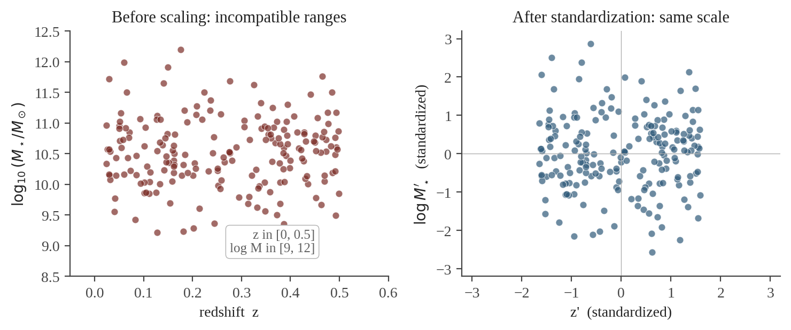
Why Feature Scaling Matters
The problem:
redshift z is in [0, 0.5], stellar mass log M is in [9, 12]. Any distance-based or gradient-based model will let log M dominate the loss.
Models that care:
KNN, K-means, SVM, neural nets, PCA, gradient descent.
Models that don't: decision trees & random forests (next lecture).
CosmicAI Summer School
11
Notes:
Important nuance: NOT every model needs scaling. Tree-based methods split on thresholds and are invariant to monotonic rescalings. But because pipelines mix model types, scaling is a safe default.

Slide 12
Standardization vs Min-Max Scaling
Standardization (Z-score)
Min-Max Scaling
x' = ( x − μ ) / σ
x' = (x − x_min) / (x_max − x_min)
Mean 0, variance 1.
Range is unbounded.
Use when: data is roughly Gaussian,
or you use PCA / linear models / NNs.
sklearn:
from sklearn.preprocessing import
StandardScaler
Output bounded in [0, 1].
Preserves zero-relationships.
Use when: you need a fixed range,
e.g. neural-net image inputs, or PDFs.
sklearn:
from sklearn.preprocessing import
MinMaxScaler
CosmicAI Summer School
12
Notes:
Critical rule: ALWAYS fit the scaler on the TRAINING set only, then apply to test. Otherwise test-set statistics leak into the training. We'll formalize this in Lec 3a. Also: Min-Max is sensitive to outliers (one wild value squashes everyone else). Detect outliers FIRST.

Slide 13
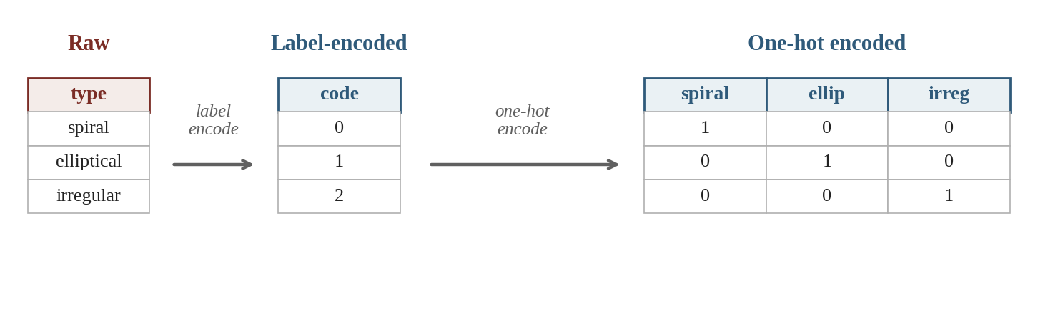
Encoding Categorical Features
Label Encoding
One-Hot Encoding
OK for ordinal data (E→S0→Sa→Sb).
Wrong for nominal — the model will infer that 2 > 1 > 0.
Default for nominal (spiral / ellip / irreg).
Cost: one new column per category — be careful for high-cardinality features.
CosmicAI Summer School
15
Notes:
Tie this back to Lec 1b: nominal vs ordinal vs continuous determines encoding. Mention sklearn: OrdinalEncoder for ordinal, OneHotEncoder for nominal. For very high cardinality (>50 categories), one-hot blows up; mention target encoding briefly.

Slide 14
Quick Check 2
QUIZ
Your dataset has a Hubble morphological stage column with values E → S0 → Sa → Sb → Sc. Which encoding preserves the most physical meaning?
A
One-hot encoding
— five binary columns
B
Label encoding (0,1,2,3,4)
— preserves the order
C
StandardScaler
— center and scale
D
Drop the column
— too tricky to encode
Pick A, B, C, or D — then advance.
CosmicAI Summer School
16
Notes:
Connect back to Lec 1b: Hubble stage is ORDINAL. The order matters. Most common student mistake: picking A (one-hot) because they remember 'one-hot for categorical' from earlier — but that's for NOMINAL data. For ordinal data we want to preserve the order, so label-encode.

Slide 15
Quick Check 2 — Answer
ANSWER
One-hot encoding
Label encoding (0..4)
A
B
✓
Loses the natural order — treats E and Sc as equally different from S0.
Preserves the rank; use OrdinalEncoder in sklearn.
C
StandardScaler
D
Drop the column
Scaling is for numeric data only — not categorical.
Throws away signal — Hubble stage carries real physics.
sklearn one-liner: from sklearn.preprocessing import OrdinalEncoder
OrdinalEncoder(categories=[["E","S0","Sa","Sb","Sc"]]).fit_transform(X)
CosmicAI Summer School
17
Notes:
Show the explicit categories argument — that's how you tell OrdinalEncoder the order. Without it, categories are sorted alphabetically, which gives the WRONG order: 'E','S0','Sa','Sb','Sc' alphabetically is 'E','S0','Sa','Sb','Sc' which is what we want here, but for other orderings (e.g. 'poor', 'OK', 'excellent') alphabet doesn't match physics.

Slide 16
Feature Selection — Pruning Redundancy
Not every feature helps. Some hurt (overfitting, collinearity, leakage).
1. Redundancy
2. Noise features
If u-band and g-band are 95% correlated, you're paying twice for the same information.
Features with no relationship to y just add variance — drop or test with a permutation check.
3. Leakage
4. Curse of dimensionality
A feature that secretly contains the target (e.g., a galaxy ID encoding redshift) must be dropped.
Fewer features → easier to fill feature space with limited data (Lec 1b).
Tools: correlation matrix, mutual information, RandomForest.feature_importances_ (Lec 3b), recursive feature elimination.
CosmicAI Summer School
18
Notes:
Leakage is the most insidious problem in this list. Story: a model that predicted exoplanet detection with 99% accuracy turned out to have the planet's known parameters encoded in a metadata field. Always inspect your features the way a skeptic would.

Slide 17
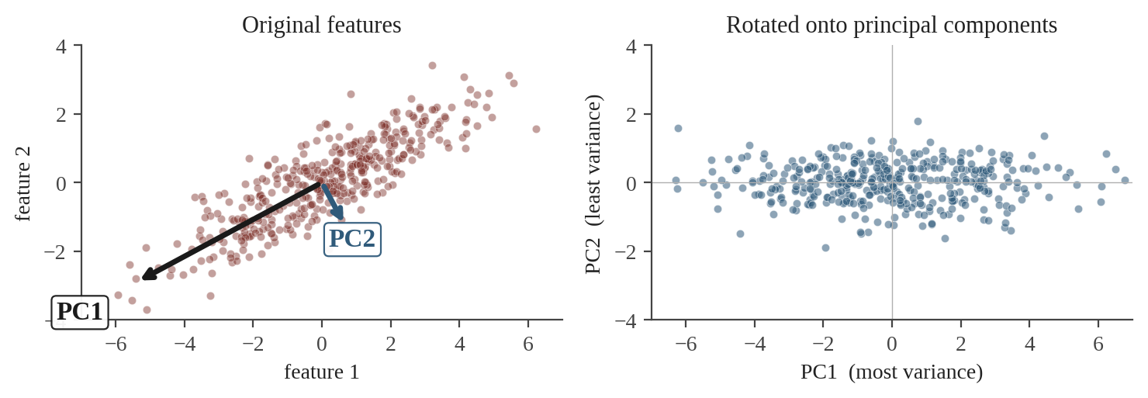
PCA — A First Look
Principal Component Analysis
Find the directions in feature space along which the data varies the most.
Rotate the axes to align with those directions.
Keep only the top k components → dimensionality reduction.
Caveats:
linear only — won't see curved structure.
principal components are mixtures of original features, hard to interpret.
always standardize first!
Astro examples: compressing galaxy SEDs to a few components; finding eigenvectors of stellar spectra.
CosmicAI Summer School
19
Notes:
Brief — this is a foreshadow, not a deep dive. PCA in 1 sentence: variance maximization via eigendecomposition of the covariance matrix. Mention that the spectra-PCA paper by Connolly et al. (1995) is a classic astro application. Recommend `sklearn.decomposition.PCA` for the practical.

Slide 18
Code — A Full sklearn Pipeline
Chain every step into one object so it can't go out of sync.
from sklearn.compose import ColumnTransformer
from sklearn.pipeline import Pipeline
from sklearn.impute import SimpleImputer
from sklearn.preprocessing import StandardScaler, OneHotEncoder
numeric_pipe = Pipeline([
("impute", SimpleImputer(strategy="median")),
("scale", StandardScaler()),
])
preprocess = ColumnTransformer([
("num", numeric_pipe, ["u", "g", "r", "i", "z"]),
("cat", OneHotEncoder(), ["galaxy_type"]),
])
X_train = preprocess.fit_transform(X_train) # fit only on train!
X_test = preprocess.transform(X_test)
CosmicAI Summer School
20
Notes:
Emphasize the `fit_transform` on train and only `transform` on test. This is the FIRST place leakage creeps in. ColumnTransformer applies the right preprocessing to the right columns; Pipeline keeps imputer and scaler in sync. Whole thing serializes with joblib — important for reproducibility.

Slide 19
Recap — The Data-Prep Checklist
1
Inspect for missingness
df.isna().sum() — drop, impute (mean/median/KNN), or flag.
2
Detect outliers
Z-score or IQR. Investigate before deleting; outliers might be the discovery.
3
Scale numeric features
StandardScaler (default) or MinMaxScaler. Fit on TRAIN only.
4
Encode categoricals
OrdinalEncoder for ordinal; OneHotEncoder for nominal.
5
Prune & (optionally) PCA
Drop redundant / leaky features. PCA for compact representations.
Next → Lecture 3a: train / validation / test splits and avoiding data leakage.
CosmicAI Summer School
21
Notes:
End by pointing at this checklist again — it lives at the front of every project. Foreshadow Lec 3a: now that the data is clean, how do we split it so we get an honest performance estimate?

