Slide 1

Lecture 3a: Data Formatting
& Model Reliability
Splits, Cross-Validation, and Leakage
Omkar Bait (CosmicAI Fellow)
NRAO, Charlottesville
CosmicAI Summer School
1
Notes:
Quick recap of Lec 1b & Lec 2. Now: we have a clean X matrix and a target y. How do we know the model we train will work on NEW galaxies, not just the ones we trained on? That is the central question of this lecture: data splits, cross-validation, and a deep dive on data leakage.

Slide 2
Why Split Your Data?
A model that memorizes the training set is worthless on new galaxies.
The trap: training accuracy
Two failure modes
A flexible model can fit any training set perfectly — even pure noise.
Training accuracy says nothing about how the model will perform on tomorrow's data.
We need a held-out sample the model has never seen.
Overfitting: model fits noise as if it were signal.
Symptom: train ≫ test accuracy.
Underfitting: model is too simple to capture the structure.
Symptom: train ≈ test, both bad.
The fix: split the data into Train, Validation, and Test — and use each for one job only.
CosmicAI Summer School
2
Notes:
Get students to internalize: the goal of ML is not to fit data, it is to predict NEW data. Anchor: when we discover a new galaxy, the model hasn't seen it. Its label has never been computed. Train/test split simulates that scenario.

Slide 3
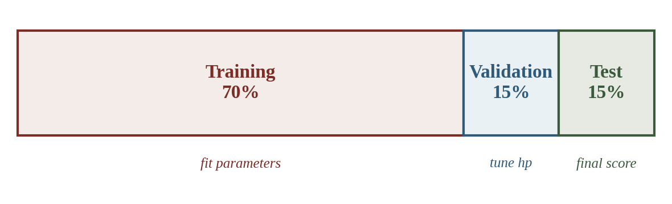
Train / Validation / Test
Training
Validation
Test
~70%
~15%
~15%
Fit the model parameters. Loss is minimized here.
Tune hyperparameters (tree depth, k in KNN). Pick the best model.
Touch only once, at the very end. Reported number = your final score.
Iron rule: the Test set is a one-shot. If you peek and re-tune, it's no longer a test.
CosmicAI Summer School
3
Notes:
Story: many ML papers report a great test score, then someone re-runs on the actual test set (via Kaggle private leaderboard) and the number drops 5–10 points. Why? Because authors test, tune, test again — the test set has been used for tuning. That number is no longer a fair estimate of generalization.

Slide 4
Hold-out Validation
Recipe:
Randomly split into train / val (e.g. 80/20).
Train the model on the train set.
Compute the metric on the validation set.
Repeat for every hyperparameter choice.
Pros: fast — only one train per config.
Cons: the score depends on which random split you got.
from sklearn.model_selection import train_test_split
# stratify=y when classifying
X_train, X_val, y_train, y_val = (
train_test_split(
X, y,
test_size=0.2,
random_state=42,
stratify=y,
)
)
Watch out: one bad split can mislead. Use a fixed random_state for reproducibility, then validate with k-fold (next slide).
CosmicAI Summer School
4
Notes:
Hold-out is the workhorse but it's noisy. For small astro datasets (which are common — spectroscopic confirmation is expensive), a single 80/20 can give wildly different scores depending on which 20 you held out. K-fold averages over this noise.

Slide 5
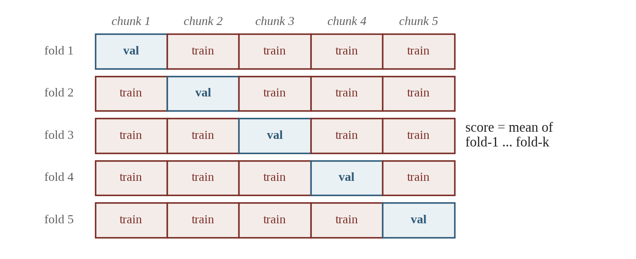
K-Fold Cross-Validation
How it works:
Split data into k equal chunks (typical k = 5 or 10).
Hold one chunk out as validation, train on the rest.
Repeat for every chunk. Average the k scores.
Why bother:
Every example serves as validation exactly once.
More robust estimate (mean ± std across folds).
Especially valuable for small astro samples.
KFold(n_splits=5, shuffle=True, random_state=42)
CosmicAI Summer School
5
Notes:
Trade-off: K-fold takes k× longer than a single split. For neural nets that train for hours, this is expensive — people often use single hold-out. For random forests on tabular astro data, k=5 is cheap and gives much better estimates.

Slide 6
Regression Metrics — Continuous y
When the target is a continuous number, you have a standard toolbox of 4 metrics.
MSE
RMSE
MSE = (1/N) Σ ( yᵢ − ŷᵢ )²
RMSE = √MSE
Squared units. Sensitive to outliers. Mathematically convenient (differentiable).
Same units as y. Default for reporting (interpretable).
MAE
MAE = (1/N) Σ | yᵢ − ŷᵢ |
Same units as y. Robust to outliers (no squaring).
Don't forget BIAS: ⟨ ŷ − y ⟩ — tells you if the model systematically over- or under-predicts. Photo-z (Lec 4): RMSE = 0.025, bias = +0.0001 → accurate and unbiased.
CosmicAI Summer School
6
Notes:
Walk through each card. Anchor RMSE as the default — it's what most papers report. MAE is the right choice when outliers exist (think galaxy size measurements with cosmic-ray contamination). R² is the right choice when you compare a model on dataset A vs dataset B with different y scales.

Slide 7
Classification Metrics — Discrete y
Class labels need a richer toolbox. Start with the confusion matrix.
Confusion matrix
Metrics
 | Predicted YES | Predicted NO
Actual YES | TP | FN
Actual NO | FP | TN
Accuracy
(TP + TN) / total
fraction correct overall
Precision
(Purity)
TP / (TP + FP)
of YES calls, how many right?
Recall
(Completeness)
TP / (TP + FN)
of true YES, how many caught?
F1
2 · P · R / (P + R)
harmonic mean of P & R
ROC-AUC: area under TPR-vs-FPR curve. Threshold-free.
Use F1 or AUC when the rare class is what matters.
CosmicAI Summer School
7
Notes:
Walk through the confusion matrix carefully — TP/FN/FP/TN is the foundation of every classification metric. Then derive accuracy / precision / recall directly from it on the board. The next slide (picking metrics) will reinforce when each is appropriate.

Slide 8
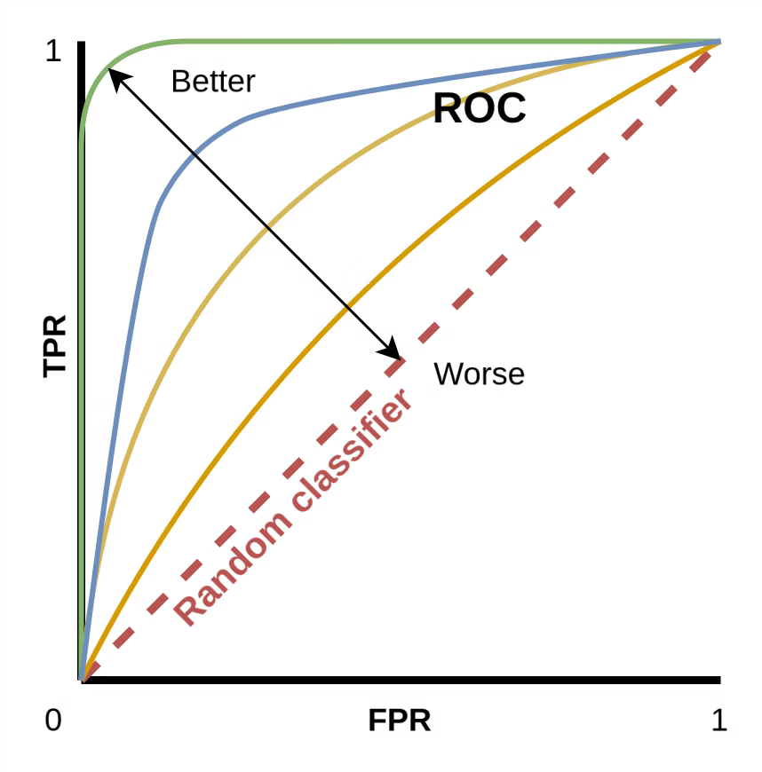
Classification Metrics — Discrete y
Class labels need a richer toolbox. Start with the confusion matrix.
Confusion matrix
Metrics
 | Predicted YES | Predicted NO
Actual YES | TP | FN
Actual NO | FP | TN
Accuracy
(TP + TN) / total
fraction correct overall
Precision
(Purity)
TP / (TP + FP)
of YES calls, how many right?
Recall
(Completeness)
TP / (TP + FN)
of true YES, how many caught?
F1
2 · P · R / (P + R)
harmonic mean of P & R
ROC-AUC: area under TPR-vs-FPR curve. Threshold-free.
Use F1 or AUC when the rare class is what matters.
CosmicAI Summer School
7
Notes:
Walk through the confusion matrix carefully — TP/FN/FP/TN is the foundation of every classification metric. Then derive accuracy / precision / recall directly from it on the board. The next slide (picking metrics) will reinforce when each is appropriate.

Slide 9
Picking the Right Metric
Match the metric to the problem and to what matters scientifically.
What kind of y?
continuous
discrete
Regression
Classes balanced?
Default: RMSE · outliers? MAE
yes
no
Accuracy
F1 · Precision-Recall · AUC
Iron rule: always report 2–3 metrics, never just one. A single number hides important behaviour (bias, recall on the rare class, outlier impact).
CosmicAI Summer School
8
Notes:
Hand-wave through the flowchart in 30 seconds. The real point is the iron rule: NEVER report just one number. Real papers report 3+ metrics. For photo-z: RMSE + bias + outlier fraction. For classification: accuracy + F1 + AUC (or confusion matrix).

Slide 10
Quick Check – Data Preprocessing
QUIZ
Why must scalers (StandardScaler, MinMaxScaler) be fit on the training set only?
It's faster than fitting on all data
Otherwise test-set statistics leak
into the training process
A
B
sklearn requires it for the
API to work
Min and max values from the
test set are unreliable
C
D
Pick A, B, C, or D — then advance.
CosmicAI Summer School
13
Notes:
This is the canonical data-leakage question. Students often pick D (something reasonable about test-set being noisy) but the deep answer is B — fitting on test contaminates the model's view of the world.

Slide 11
Quick Check 1 — Answer
ANSWER
It's faster
Otherwise test stats leak in
A
B
✓
Performance is not the reason — the leak is the reason.
Data leakage: μ and σ from test would influence train.
C
sklearn requires it
D
Min/max unreliable
No — sklearn lets you do anything; YOU enforce hygiene.
True but secondary; leakage is the root reason.
Correct workflow: scaler.fit_transform(X_train) → then scaler.transform(X_test). Inside a Pipeline, this happens automatically inside each CV fold.
CosmicAI Summer School
14
Notes:
Reinforce: this is preview of Lec 3a's leakage discussion. The reason Pipelines are so loved in sklearn is that they prevent this entire class of mistakes by default.

Slide 12
Quick Check
QUIZ
You're classifying gravitational lenses. Only 1% of objects are actually lenses. Your model predicts "NOT a lens" for every example. What is its accuracy?
A
50%
— like a coin flip
B
99%
— but useless
C
1%
— gets all lenses wrong
D
Undefined
— model never said "yes"
Pick A, B, C, or D — then advance.
CosmicAI Summer School
9
Notes:
Show of hands. Most students intuitively go for C ('it got the lenses wrong, so 1%'). The trap is that accuracy includes the TRUE NEGATIVES — the 99% it correctly called 'not a lens.' That high accuracy is exactly why accuracy is the WRONG metric here.

Slide 13
Quick Check — Answer
ANSWER
50%
99% — but useless
A
B
✓
Coin-flip would require 50/50 base rate, not 1/99.
99% of test cases ARE "not a lens" → they're all classified correctly.
C
1%
D
Undefined
Confuses accuracy with recall. Recall on lenses = 0, but accuracy = 99.
Accuracy is always defined as (TP + TN) / total.
Lesson: accuracy looks great here (99%) but the model is scientifically useless. For rare-class detection, look at recall, F1, or AUC — they expose the failure that accuracy hides.
CosmicAI Summer School
10
Notes:
This is the canonical 'class imbalance' lesson. Astronomy is full of these: gravitational lenses are rare, lensed quasars are rare, transients are rare, exoplanets are rare. If your model is for discovery, accuracy is almost never the right metric.

Slide 14
Quick Check 1
QUIZ
You're training a classifier to identify gravitational lenses (a rare class — only ~1% of your sample). Which CV variant should you use?
A
Plain KFold
— random splits
B
StratifiedKFold
— preserves class proportions
C
GroupKFold
— honors example groups
D
TimeSeriesSplit
— train on past only
Pick A, B, C, or D — then advance.
CosmicAI Summer School
14
Notes:
Trigger: 'rare class' is the keyword that should pattern-match to StratifiedKFold. A common wrong answer is C (GroupKFold) — students conflate 'group' with 'class'.

Slide 15
Quick Check 1 — Answer
ANSWER
Plain KFold
StratifiedKFold
A
B
✓
A random split may put 0 lenses in some folds — useless.
Each fold gets ~1% lenses — preserved class proportions.
C
GroupKFold
D
TimeSeriesSplit
'Group' means examples that share an entity (cluster, image).
Use only when temporal ordering matters.
sklearn one-liner: cv = StratifiedKFold(n_splits=5, shuffle=True, random_state=42)
scores = cross_val_score(model, X, y, cv=cv, scoring="f1")
CosmicAI Summer School
15
Notes:
Mnemonic for choosing CV: 'rare class → stratified', 'shared entity → group', 'time matters → time-series'. If none of those apply, plain KFold is fine.

Slide 16
Labels — Ground Truth ≠ Truth
Your labels are estimates too. Garbage labels → garbage model.
Labeled data
Unlabeled data
Noisy labels
Has y. Often expensive — spectroscopic redshift, hand-classified morphology, confirmed transient.
Just X. The bulk of any modern survey (photometric only). Used in semi-/self-supervised settings.
Labels exist but are uncertain — photo-z estimates used as 'truth', crowd-sourced morphology, automated pipelines.
CosmicAI Summer School
16
Notes:
Tie this back to Lec 1b's distribution-shift slide. The spec-z training sample is brighter and rarer than the photometric sample you deploy on. Both labels and features can drift. Mention semi-supervised methods (briefly): use the unlabeled X to help learn structure.

Slide 17
Quick Check 2
QUIZ
Your colleague just ran the model, looked at the test-set RMSE (got 0.025), tweaked some hyperparameters, and re-ran the test. What's the problem?
A
Nothing — running the model
twice is harmless
B
The model is now overfit,
so the new score is worse
C
The test set was used for
tuning → score is biased
D
Hyperparameter tuning is
never allowed for regressors
Pick A, B, C, or D — then advance.
CosmicAI Summer School
18
Notes:
The trap is that this looks innocuous — 'I just looked at the result, what's the harm?' But any decision based on the test score (tweak this knob, switch to a different model) USES the test set to tune. That's the subtle leakage Kaggle private/public leaderboards were designed to catch.

Slide 18
Quick Check 2 — Answer
ANSWER
A
Nothing — harmless
B
Now overfit
Every peek at test contaminates it — even passive peeking counts.
Overfitting is a separate concept — the issue here is leakage.
Test set used for tuning
C
✓
D
Tuning not allowed
The test score is no longer an honest estimate of generalization.
Of course it's allowed — but use the validation set.
The iron rule: the test set is a one-shot. Tune on the validation set (or CV inside the training pool). Touch the test set exactly once, for the final report.
CosmicAI Summer School
19
Notes:
Tell the story: Kaggle has both a public leaderboard (~30% of test rows) and a private leaderboard (the rest). The public board is for tuning; the private one is the honest evaluation. The reason is exactly this question — even passive peeking biases the score.

Slide 19
Worked Example — Spot the Leak
WORKED EXAMPLE
Below is your colleague's photo-z pipeline. Find the leak — there is exactly one.
df = pd.read_csv("photometry.csv")
y = df["z_spec"]
X = df.drop(columns=["z_spec"])
# Standardize features
scaler = StandardScaler()
X_scaled = scaler.fit_transform(X)
# Now split
X_train, X_test, y_train, y_test = train_test_split(
X_scaled, y, test_size=0.2, random_state=42)
rf = RandomForestRegressor(n_estimators=100).fit(X_train, y_train)
print(f"Test RMSE: {rmse(y_test, rf.predict(X_test)):.4f}")
Pause and find the leak — then advance.
CosmicAI Summer School
21
Notes:
Give them 60 seconds. Walk around the room and listen — see who can name it. The students who can spot leakage in code are the ones who will save their advisors months of debugging.

Slide 20
Worked Example — Solution
ANSWER
The leak:
scaler.fit_transform(X) was called on the full dataset before train_test_split. → the test set's μ and σ contributed to the scaling parameters applied to train.
The fix — split FIRST, fit scaler on TRAIN only
X_train, X_test, y_train, y_test = train_test_split(
X, y, test_size=0.2, random_state=42)
scaler = StandardScaler()
X_train = scaler.fit_transform(X_train) # fit on train only
X_test = scaler.transform(X_test) # apply same transform
Even better: wrap it in a Pipeline. The scaler is then automatically refit inside every CV fold — leakage becomes impossible.
CosmicAI Summer School
22
Notes:
Strongest sales pitch for sklearn Pipelines: they make this entire class of bugs impossible. If you can't picture how leakage would sneak into a Pipeline-wrapped workflow, you're already ahead of most ML papers.

Slide 21
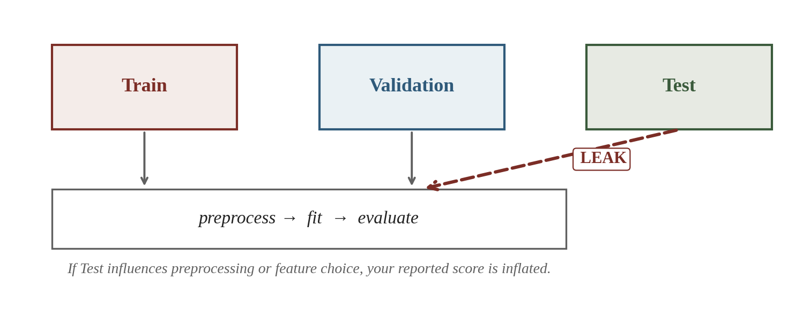
Data Leakage
Definition: any information from the validation or test set that influences the trained model.
Symptom: your test-set score is suspiciously high, but the model flops on real new data.
CosmicAI Summer School
17
Notes:
This is the most insidious failure mode in applied ML. The model APPEARS to work — your collaborators are excited, you submit a paper, and then a reviewer asks the right question and the whole thing collapses. Spend real time on the next slide.

Slide 22
Where Leakage Hides
1. Fitting preprocessing on all data
2. Target leakage in features
StandardScaler mean/std computed on X (train + test) before splitting — test stats leak in.
A feature secretly contains y — e.g. an ID encoding redshift, or a flag built using the answer.
Fix: Fit transformers inside a Pipeline, on TRAIN only.
Fix: Audit features. Drop anything derived from y.
3. Reusing the test set
Look at test → re-tune → 'test' again. Test set has been used for tuning.
Fix: Touch test ONCE. Use validation for tuning.
CosmicAI Summer School
20
Notes:
These four patterns cover ~90% of real leakage cases. Spend time on each. The litmus test at the bottom is the single most useful question to ask of a new feature.

Slide 23
Code — Splitting Done Right
All splitting + preprocessing happens inside a Pipeline; never on raw X.
from sklearn.model_selection import (train_test_split, StratifiedKFold,
GroupKFold, cross_val_score)
# 1. Carve off a final test set that you DO NOT TOUCH until report time
X_pool, X_test, y_pool, y_test = train_test_split(
X, y, test_size=0.15, stratify=y, random_state=42)
# 2. Inside pool: K-fold CV for hyperparameter tuning
cv = StratifiedKFold(n_splits=5, shuffle=True, random_state=42)
scores = cross_val_score(pipeline, X_pool, y_pool, cv=cv, scoring="f1")
print(f"CV F1 = {scores.mean():.3f} ± {scores.std():.3f}")
# 3. Final report: fit on the full pool, evaluate ONCE on test
pipeline.fit(X_pool, y_pool)
test_f1 = f1_score(y_test, pipeline.predict(X_test))
CosmicAI Summer School
23
Notes:
Three commandments visible in this code: (1) test set is split off ONCE at the start, never touched until the very end; (2) all preprocessing lives inside the Pipeline so it gets refit inside each CV fold; (3) stratify=y everywhere if classification. This 25-line template covers 80% of real projects.

Slide 24
Recap — Reliable Evaluation
1
Split into Train / Val / Test
Carve off Test once. Touch only at the very end.
2
Use K-fold on the pool
Average over folds for a robust score; report mean ± std.
3
Stratify, group, time
Match the split structure to the structure of your data.
4
Audit labels
Spec-z vs photo-z; flag noisy or biased labels explicitly.
5
Guard against leakage
Preprocessing in Pipeline, no peeking, drop target-derived features.
Next → Lecture 3b: decision trees, bagging, and random forests.
CosmicAI Summer School
24
Notes:
Close by emphasizing: a reliable evaluation pipeline is more valuable than a fancy model. The next lecture introduces the actual models — but everything we built today (splits, CV, leakage hygiene) wraps around whatever model we choose.

Slide 25
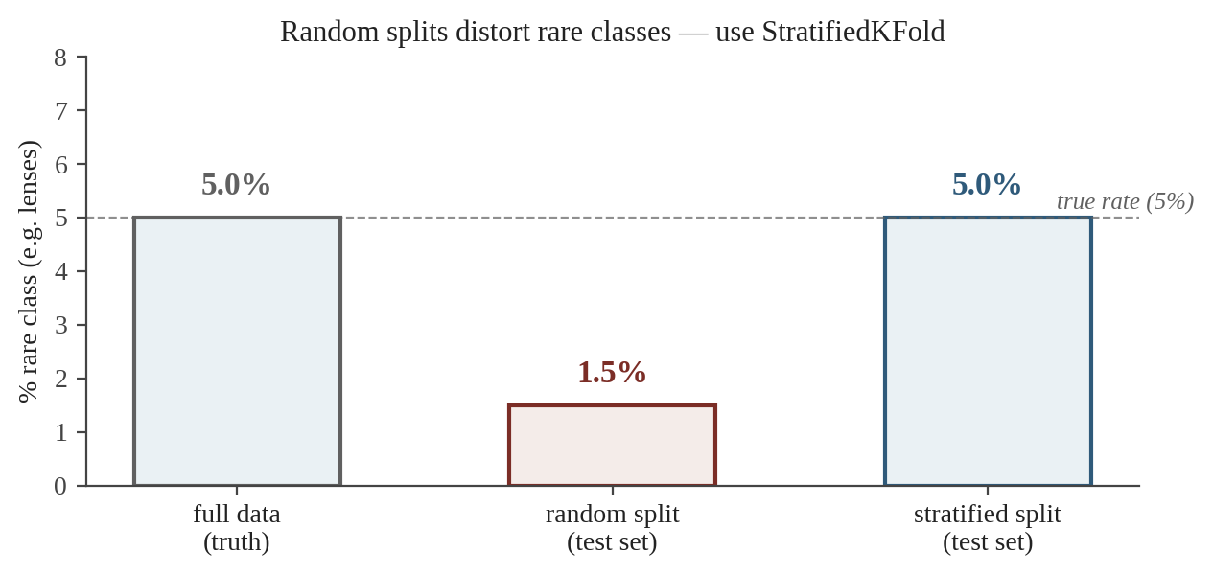
When Plain K-Fold Isn't Enough
Stratified K-Fold
Keep class proportions equal across folds. Use when classes are imbalanced (lenses, quasars).
Group K-Fold
All examples from one group go to one fold. Use when objects share common properties.
Time-series split
Train on the past, validate on the future. Use for transients and time-domain surveys.
Ask of every dataset: rare class → Stratified; grouped → GroupKFold; time matters → TimeSeriesSplit.
CosmicAI Summer School
13
Notes:
Group leakage is a classic astronomy mistake: you have 5 galaxies from the same cluster, you split randomly, 3 go to train and 2 to test. The model has seen cluster-specific features, so it 'cheats' on the test. Always check whether your examples are i.i.d. — they often aren't.

Slide 26
Worked Example — CV Statistics
WORKED EXAMPLE
Scenario
You ran 5-fold cross-validation of a random-forest regressor and recorded the test RMSE per fold:
rmse = [ 0.026, 0.024, 0.027, 0.023, 0.025 ]
Report your model's performance as mean ± σ.
Compute on paper:
1. The mean RMSE across the 5 folds.
2. The standard deviation (use the N − 1 divisor).
3. Report as mean ± σ.
Pause and try — then advance.
CosmicAI Summer School
11
Notes:
Real numbers from a small RF on the photo-z dataset. Walk them through both the arithmetic and the meaning: 'why N-1 not N?' — because the mean was estimated from the same data, you lose one degree of freedom (Bessel's correction).

Slide 27
Worked Example — Solution
ANSWER
Step 1 — Mean
sum = 0.026 + 0.024 + 0.027 + 0.023 + 0.025 = 0.125
mean = 0.125 / 5 = 0.0250
Step 2 — Standard deviation
diffs from mean: +0.001, −0.001, +0.002, −0.002, 0
squared: 1e-6, 1e-6, 4e-6, 4e-6, 0
sum of squares = 10e-6
variance (N − 1) = 10e-6 / 4 = 2.5e-6
σ = √(2.5e-6) ≈ 0.0016
Report: RMSE = 0.0250 ± 0.0016
Why both numbers matter: the mean tells you accuracy. The σ tells you stability across data splits — a big σ signals the score is sensitive to which examples you happened to hold out.
CosmicAI Summer School
12
Notes:
In sklearn: cross_val_score returns the array; you then do scores.mean() and scores.std(). Note the convention: sklearn uses NEGATIVE RMSE in scoring strings ('neg_root_mean_squared_error') because higher is always better — you negate for reporting.

