Slide 1

Lecture 3b:
Decision Trees → Random Forests
Recursive partitioning, ensembles, and feature importance
Omkar Bait (CosmicAI Fellow)
NRAO, Charlottesville
CosmicAI Summer School
1
Notes:
We finally meet a real model. Decision trees are the conceptual root of much of modern ML — gradient boosting, random forests, XGBoost — all are trees underneath. The plan: start with one tree, understand its strengths and weaknesses, then turn it into a forest.

Slide 2
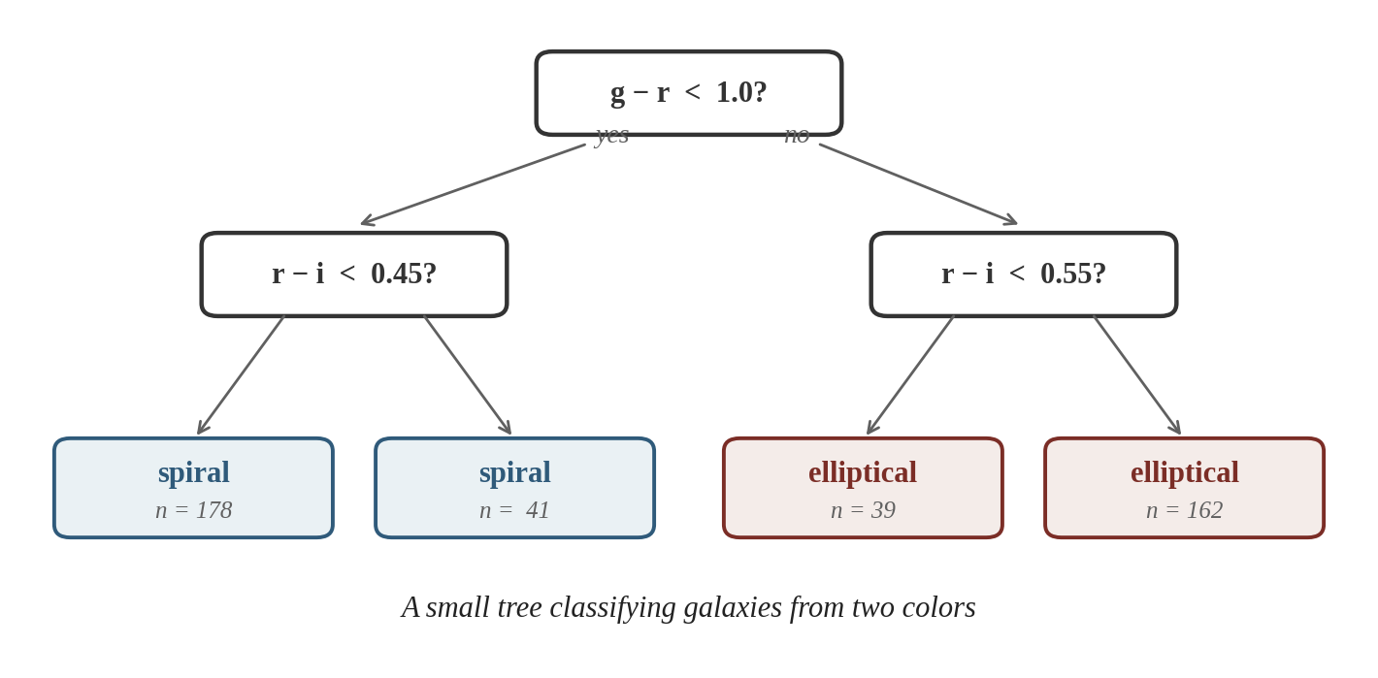
What is a Decision Tree?
A series of yes / no questions that route an input to a prediction.
Each question splits the feature space on a single feature; every example follows exactly one path from root to leaf.
Leaves carry the prediction: a class label, a probability, or a number.
Trees are the easiest model to draw on a whiteboard and explain to a non-expert.
CosmicAI Summer School
2
Notes:
Walk through the small galaxy tree on the right slowly: 'if g-r < 1 then look at r-i; if r-i < 0.45 predict spiral.' Stress that every question uses ONE feature and a threshold — this is the secret of decision trees' interpretability.

Slide 3
Anatomy of a Tree
Vocabulary
Root node — the topmost question.
Internal node — an interior question.
Leaf (terminal node) — a prediction.
Branch / edge — the yes / no answer.
Depth — longest root-to-leaf path.
Prediction rule: route the example down the tree → read off the leaf value. Inference is O(depth) — extremely fast.
CosmicAI Summer School
3
Notes:
Glue point with Lec 1b: the tree partitions the n-dimensional feature space into M non-overlapping regions {R_1, ..., R_M}. Every leaf is one region. The whole machine learning of a tree is choosing those regions cleverly.

Slide 4
Two Flavors — Classification & Regression
Classification tree
Regression tree
y is categorical
y is continuous
Leaf prediction = most frequent class in that region (majority vote).
Also outputs class proportions → probability-like score for each class.
Example: spiral / elliptical / irregular from ugriz colors.
Leaf prediction = mean (or median) of y in that region.
Splits chosen to minimize squared-error within each region.
Example: photometric redshift z from ugriz magnitudes.
Same algorithm, different leaf values. We start with the regression case because the objective is simpler to write down.
CosmicAI Summer School
4
Notes:
Don't let them think these are two different algorithms. The tree-building procedure is identical; only the splitting criterion and the leaf prediction change. That's why scikit-learn has DecisionTreeClassifier and DecisionTreeRegressor side-by-side.

Slide 5
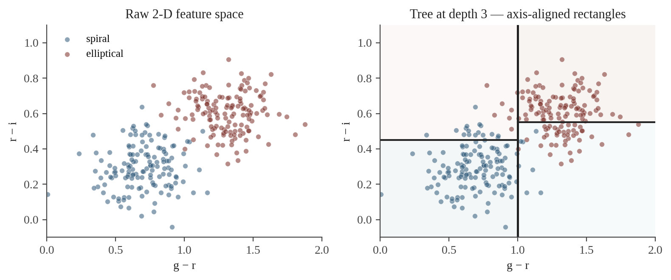
Regression Trees — Partitioning Feature Space
1. Partition the feature space into J distinct, non-overlapping regions R₁, R₂, …, R_J.
2. In each region, predict the mean of the training responses that fall there.
3. For simplicity choose rectangular regions (axis-aligned splits).
4. Pick the splits to minimize mean-square-error inside every region.
CosmicAI Summer School
5
Notes:
This is the heart of decision trees. Note that the objective is intuitive: minimize squared error by carving the feature space into rectangular boxes. The trick is that finding the optimal partition is NP-hard. So we use a greedy heuristic — recursive binary splitting. Next slide.

Slide 6
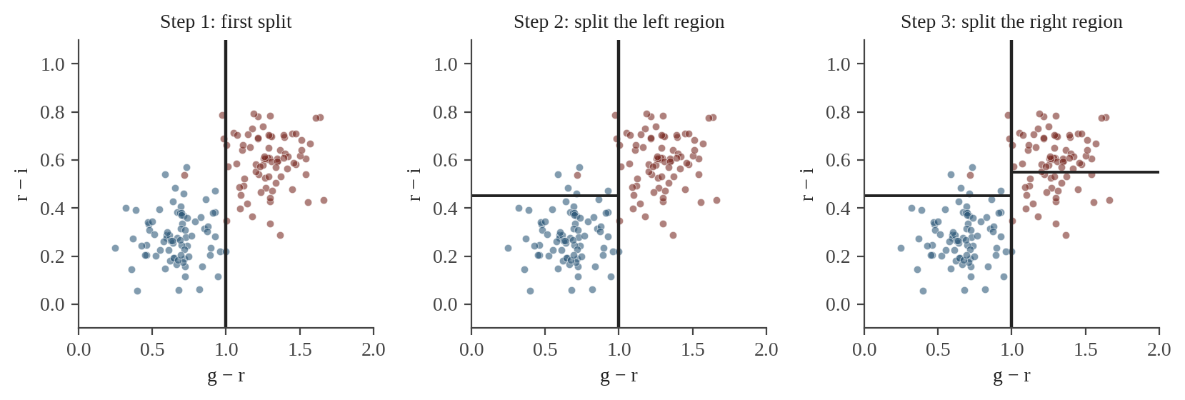
Recursive Binary Splitting
Top-down
Recursive
Greedy
Start at the root with all data, then split into smaller regions step by step.
Each split creates two children, and the same procedure runs on each child.
Pick the locally best split at every step. Don't search ahead — practical, but suboptimal.
CosmicAI Summer School
6
Notes:
Walk left-to-right through the figure. First split takes all data, finds the best (feature, threshold) by minimizing MSE — that's the vertical line at g-r=1.0. Then we apply the same procedure RECURSIVELY to the left region (horizontal split) and then to the right region. This is THE decision-tree algorithm. Note 'greedy' is the price of tractability: we never undo a split.

Slide 7
Splitting Criteria — Gini & Entropy
For classification, MSE no longer makes sense. We need a measure of node impurity.
Gini impurity
G = 1 − Σ_k p_k²
p_k = proportion of class k in the node. Default in sklearn.
Entropy
H = − Σ_k p_k log p_k
Roots in information theory.
Split quality: minimize the weighted-average impurity of the two child nodes. In practice Gini ≈ Entropy — either works.
CosmicAI Summer School
7
Notes:
Both are zero when the node is pure (all one class) and maximal at p=0.5 (perfect mixture). Gini is the default because it's slightly cheaper. The choice rarely matters — what matters is that we have ANY impurity measure. The split that maximizes the impurity DECREASE is selected.

Slide 8
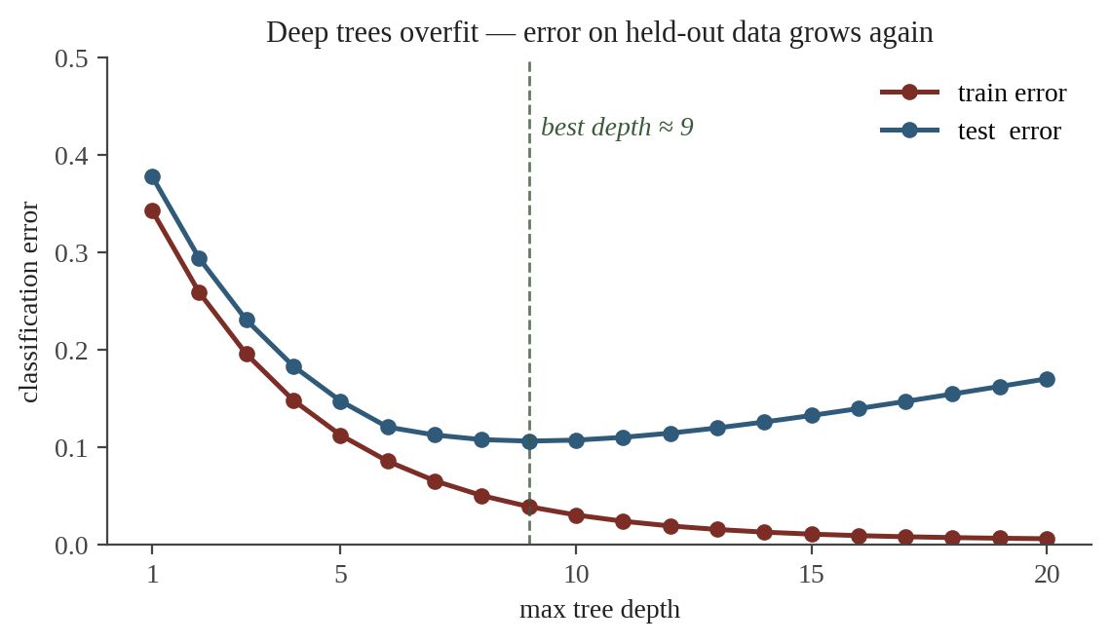
Pruning — Why?
A large tree can fit any training set perfectly:
just keep splitting until every leaf has one example.
But the model has memorized noise:
train error → 0, test error climbs.
Recall Lec 3a: the test set is the only honest judge.
Two cures:
Pre-pruning: stop splitting when the tree gets deep enough.
Post-pruning: grow fully, then chop branches that don't help on validation.
Pre-pruning hyperparameters in sklearn:
max_depth, min_samples_split, min_samples_leaf, max_leaf_nodes.
CosmicAI Summer School
11
Notes:
The U-shape on the right is the canonical overfitting curve. Train error monotonically drops; test error has a sweet spot. Pre-pruning sets a maximum depth (or leaf count) upfront — you choose that via CV from Lec 3a. Post-pruning grows fully then prunes back — next slide.

Slide 9
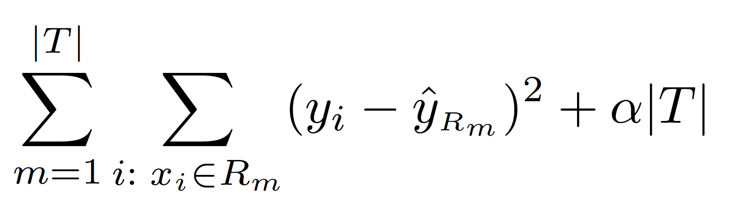
Pruning — Cost-Complexity (post-pruning)
Grow the tree to full depth, then remove the weakest branches.
minimize
What the symbols mean:
|T| total number of leaves in the (sub-)tree.
α hyperparameter trading off fit vs size.
How to pick α:
α = 0: no penalty → full tree.
α large: tiny tree, even just the root.
Sweet spot: minimize error on the validation set.
sklearn: DecisionTreeClassifier(ccp_alpha=α) — scan α with cross-validation.
CosmicAI Summer School
12
Notes:
This is the cost-complexity (CCP) formulation by Breiman. The α·|T| term is exactly like ridge or lasso regularization — it just penalizes model complexity in the appropriate way for trees. Walk through what happens at α=0 (full tree) and α=∞ (only the root).

Slide 10
Predicting from a Classification Tree
Once trained, prediction is mechanical:
Route the new example down the tree until it lands in a leaf.
Predict the most frequent class (majority vote) among the training examples in that leaf.
Also report class proportions in the leaf as a probability-like score:
P̂(spiral | x) ≈ n_spiral / n_total in leaf
Worked example
A new galaxy with g − r = 0.9, r − i = 0.30:
1. g − r < 1.0? → yes, go left.
2. r − i < 0.45? → yes, go left.
3. Leaf has n = 178 examples:
170 spiral, 6 elliptical, 2 irregular.
Prediction: spiral with P̂ = 170 / 178 = 0.96
CosmicAI Summer School
10
Notes:
Important: that probability is just an empirical proportion in a leaf, not a calibrated probability. For science applications (galaxy survey purity / completeness) you may need to recalibrate.

Slide 11
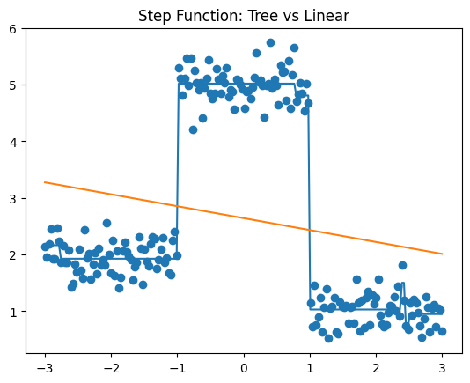
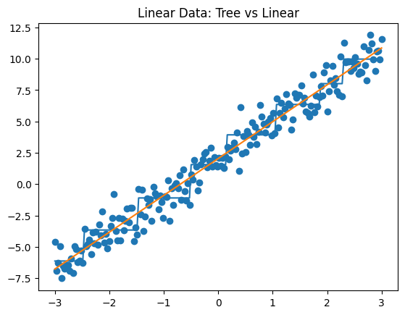
Strengths & Weaknesses of Single Trees
Strengths
Intuitive: easy to draw, explain, modify.
No scaling needed: trees are invariant to transforms.
Mixed feature types: numerical and categorical handled together.
Captures non-linear, non-monotonic structure (the partition).
Built-in feature importance.
Fast inference O(depth).
Weaknesses
High variance: small data change → very different tree.
Trees can underperform on some simple linear tasks.
Very easy to overfit.
CosmicAI Summer School
13
Notes:
High variance is the key sin we are about to fix. Trees are intuitive and powerful but unstable. Bagging is the cure: average many noisy trees together and the variance collapses.

Slide 12
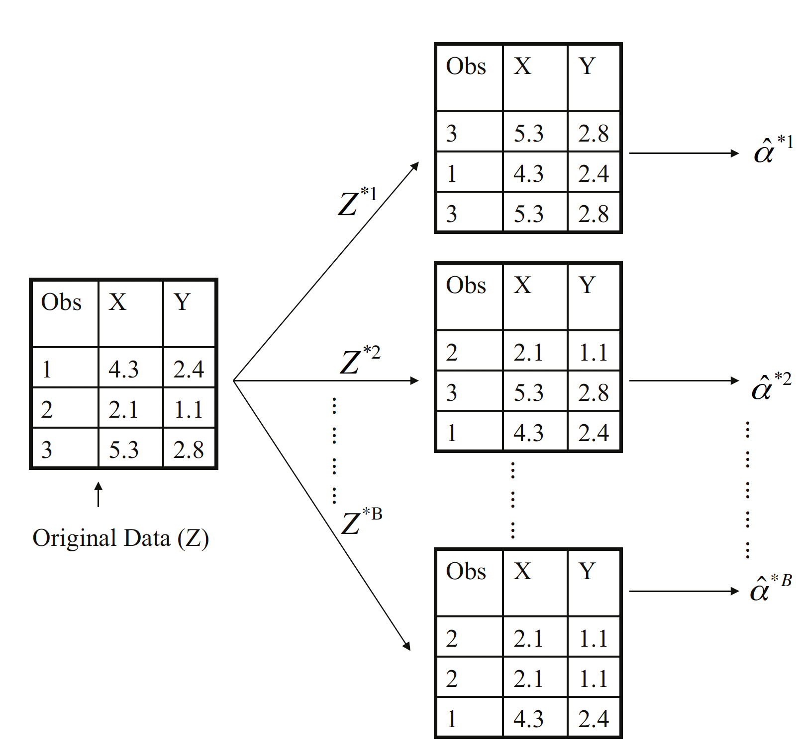
Bootstrap
CosmicAI Summer School
13

Slide 13
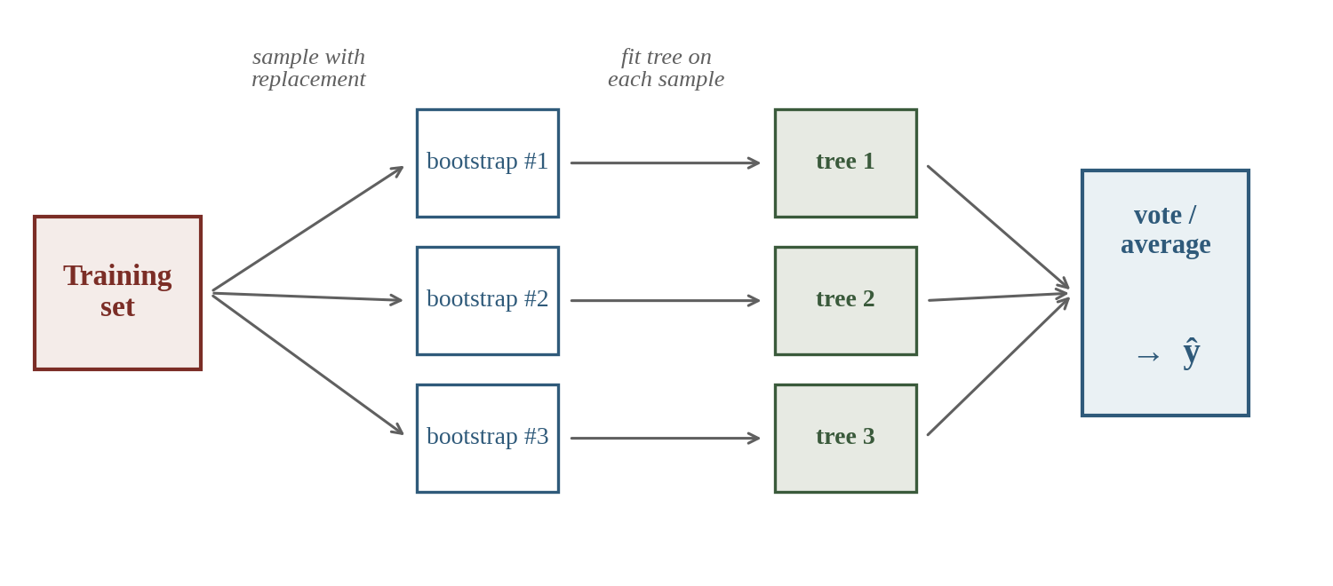
From One Tree to Many — Bagging
Bagging = Bootstrap + Aggregating.
1. Draw B bootstrap samples (with replacement).
2. Train one tree per sample.
3. Aggregate: mean for regression, vote for classification.
Why this helps:
Each tree is trained on a different bootstrap, so averaging cancels the noise (variance ↓).
Bias stays the same (trees are fully grown).
CosmicAI Summer School
14
Notes:
A bootstrap sample is drawn WITH REPLACEMENT, so it has the same size as the original training set but ~37% of original examples are missing (and ~63% appear, some multiple times). The missing ones are 'out-of-bag' — useful for estimating generalization (slide 14).

Slide 14
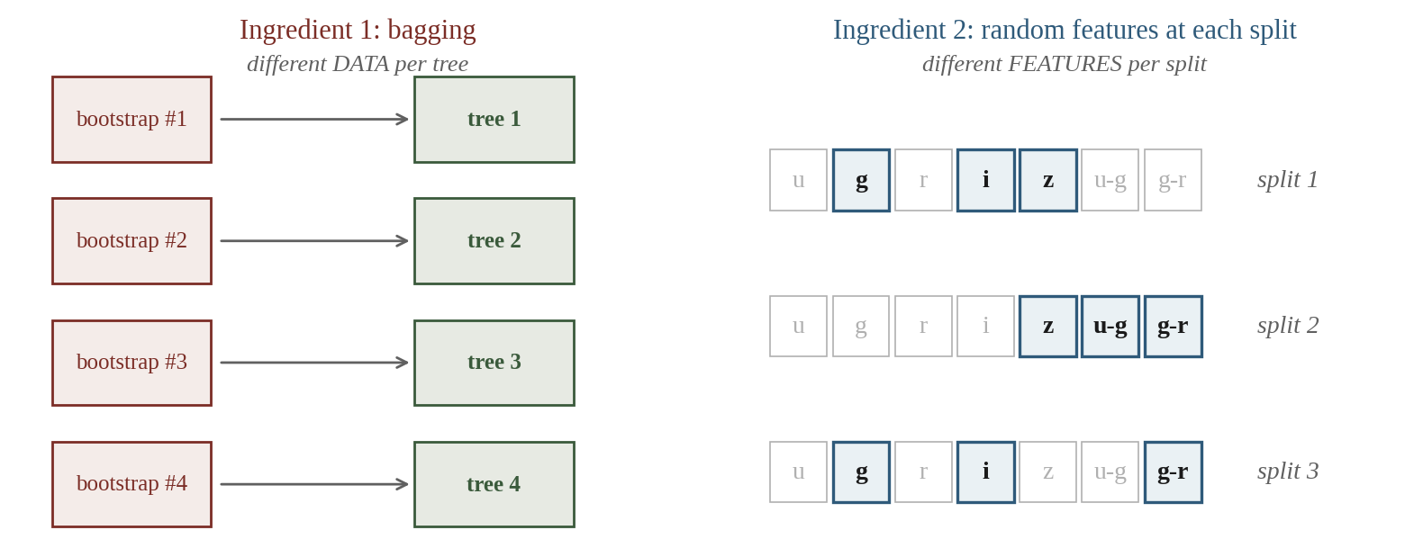
Random Forests — Two Ingredients
1. Bagging (data randomness):
different bootstrap sample per tree → different data.
2. Feature subsampling (feature randomness):
at every split, only a random subset of features is considered.
CosmicAI Summer School
15
Notes:
Bagging by itself reduces variance only modestly because every tree still picks the same dominant feature for the first split — bagged trees are CORRELATED. Random feature subsampling at each split forces trees to use different features → trees become decorrelated → averaging is much more effective. This is THE insight of Random Forests (Breiman 2001).

Slide 15
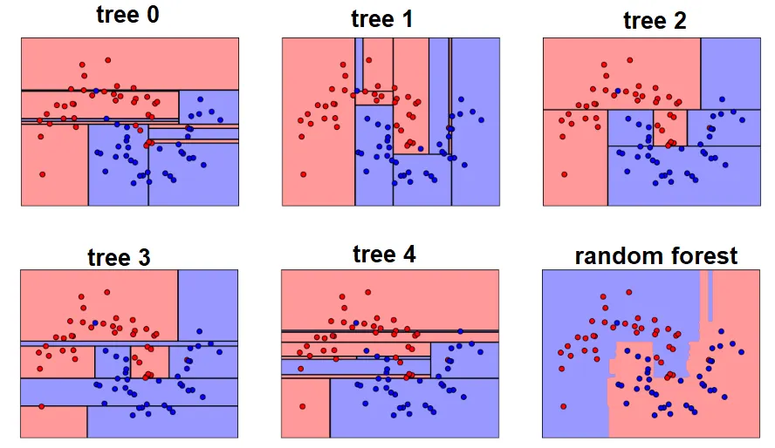
Random Forest on Spiral Data
CosmicAI Summer School
13

Slide 16
Quick Check 1
QUIZ
What single property distinguishes a Random Forest from plain bagged decision trees?
RF uses many trees;
bagging uses just one
RF uses bootstrap sampling;
bagging does not
A
B
RF also samples FEATURES
at each split
RF is more interpretable
than bagged trees
C
D
Pick A, B, C, or D — then advance.
CosmicAI Summer School
16
Notes:
Common confusion: students remember 'bagging = many trees' and pick A. The point of this question is to crystallize that BOTH techniques use many trees and bootstrap sampling — but ONLY Random Forests add the feature-subsampling layer at every split.

Slide 17
Quick Check 1 — Answer
ANSWER
A
Many trees vs one
B
Bootstrap vs not
Both use many trees — the difference is structural.
Both use bootstrap sampling (bagging).
RF samples FEATURES too
C
✓
D
RF more interpretable
At each split, only √d features are considered.
Forests are less interpretable than a single tree.
Why this matters: feature subsampling forces different trees to use different features → the trees become decorrelated. Averaging decorrelated noisy predictions is far more powerful than averaging correlated ones.
CosmicAI Summer School
17
Notes:
If time allows, do the math heuristic: variance of the mean of N iid variables = σ²/N. If they're correlated with average ρ, the variance is σ² × (ρ + (1-ρ)/N). So if ρ → 1, no improvement from adding trees. Feature subsampling drives ρ down, and the bound tightens.

Slide 18
Aggregating Predictions & OOB Score
Aggregation
Out-Of-Bag (OOB) score
Regression: average the B tree predictions.
ŷ = (1/B) · Σ_b ŷ_b(x)
Classification: majority vote, or average the class probabilities and then argmax.
Why it works: variance of the mean = variance of one / B (if the trees were independent).
A free held-out estimate, no separate validation set needed.
For each training example x_i:
average the predictions from only those trees that DID NOT see x_i in their bootstrap.
sklearn: RandomForestClassifier(oob_score=True).oob_score_
CosmicAI Summer School
18
Notes:
OOB is one of the unsung joys of random forests. You get a near-free estimate of generalization, no extra split, no extra fit. Tell students: when prototyping, this saves real time.

Slide 19
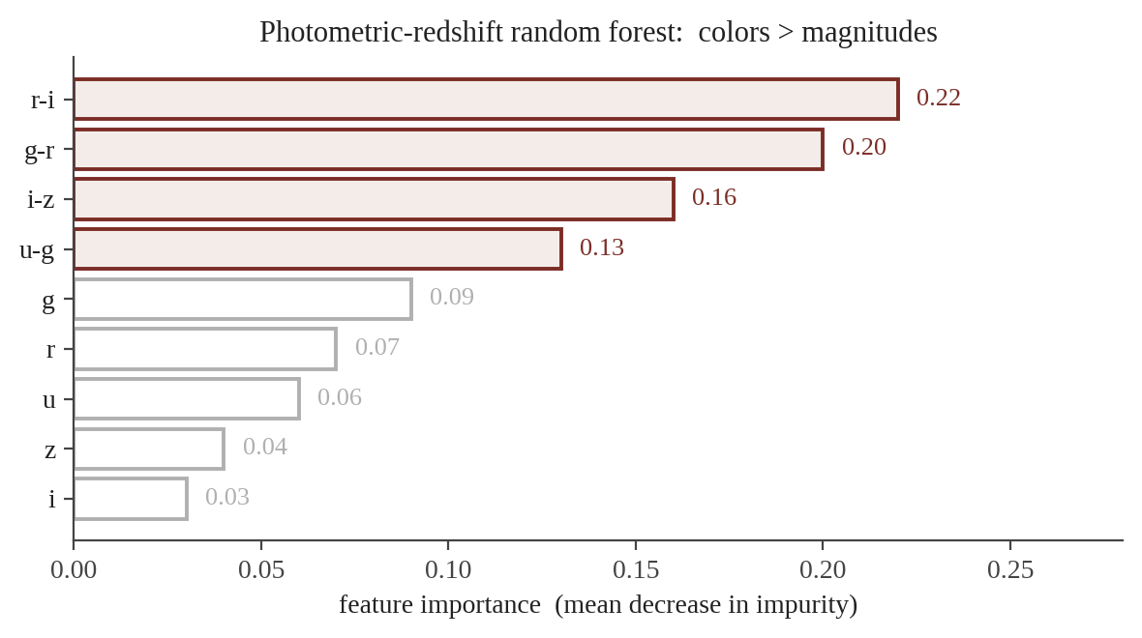
Feature Importance
How important is each feature? Two common definitions.
Mean Decrease in Impurity (MDI):
at each split, record the impurity drop times the number of samples; sum across all splits and all trees that use that feature; normalize.
Permutation importance:
for each feature, shuffle its values across rows and measure how much the OOB / test score drops.
CosmicAI Summer School
21
Notes:
Real story for students: feature importance is the cheapest 'why does the model work' diagnostic you can run. For papers, prefer permutation importance because MDI inflates the score of features with many possible values (e.g., continuous over binary).

Slide 20
Code — Random Forest in sklearn
Plugs straight into the Pipeline / CV scaffolding from Lec 2 & 3a.
from sklearn.ensemble import RandomForestClassifier
rf = RandomForestClassifier(
n_estimators=500, # how many trees
max_depth=None, # fully grown (forest will average out)
max_features="sqrt", # max features set to sqrt(n_features)
min_samples_leaf=5, # lightweight pre-pruning
oob_score=True, # free held-out estimate
n_jobs=-1, random_state=42,
)
rf.fit(X_train, y_train)
print("OOB score:", rf.oob_score_)
# Feature importance ranking
import pandas as pd
pd.Series(rf.feature_importances_, index=X_train.columns).sort_values()
CosmicAI Summer School
24
Notes:
Notes for live coding: (1) n_estimators=500 is generous; even 100 is usually fine. More trees never hurt accuracy but cost compute. (2) max_features='sqrt' is the classic Breiman default for classification; 'log2' or floats also work. (3) min_samples_leaf=5 is a soft anti-overfitting knob; tune via CV. (4) n_jobs=-1 uses all CPU cores.

Slide 21
Recap — Trees and Forests
1
Decision tree
Recursive binary splitting of feature space; predict per leaf.
2
Splitting criteria
MSE for regression; Gini or Entropy for classification.
3
Pruning
Pre-pruning (max_depth, min_samples_leaf) or cost-complexity post-pruning.
4
Bagging
Average B bootstrap-trained trees → drops variance.
5
Random Forest
Bagging + feature subsampling at each split → decorrelated trees.
6
Free goodies
OOB score, feature importance, fast inference.
Next → Lecture 4: putting it all together — photometric-redshift case study with scikit-learn.
CosmicAI Summer School
25
Notes:
Wrap up: a decision tree is a simple, interpretable building block. A random forest is a robust, high-performance model with virtually no tuning needed. Lec 4 will use a random forest as our workhorse for the photometric redshift case study.

