Slide 1

Lecture 4:
Practical Implementation of Random Forest
The ML framework, common pitfalls, and a worked photo-z case study
Omkar Bait (CosmicAI Fellow)
NRAO, Charlottesville
CosmicAI Summer School
1
Notes:
We've now seen all the pieces — task framing (1b), preprocessing (2), evaluation (3a), and random forests (3b). Today we put them together into a complete recipe and then walk through a real photometric-redshift project end to end. By the end, students should be able to follow the notebook and adapt it to their own thesis data.

Slide 2
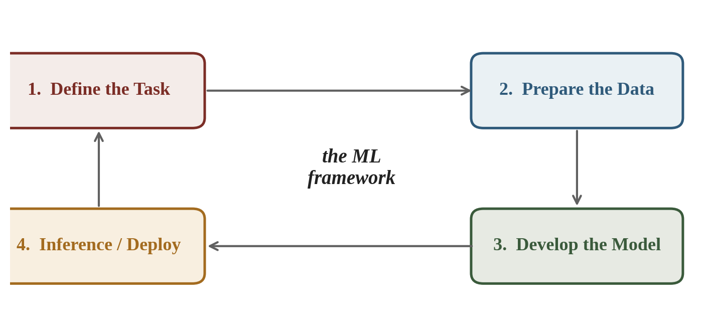
The ML Framework — One Picture
Every supervised-ML project follows the same four steps. Skipping any leads to trouble.
Today: we revisit each step briefly, then walk through a complete real-world example.
CosmicAI Summer School
2
Notes:
This loop is universal — it doesn't depend on what model you use. In practice you iterate: deploy → notice failure → reframe → re-prepare → retrain. Tell students that real ML projects spend ≥ 70% of effort in steps 1 and 2.

Slide 3
Step-by-Step Recap of the Course
1
Define the Task (Lec 1b)
What is X? What is y? Classification or regression? What does success mean (RMSE, accuracy)?
2
Prepare the Data (Lec 2)
EDA → missing values → outliers → scaling → encoding → split into train / val / test.
3
Develop the Model (Lec 3a + 3b)
Pick a model → beat a baseline → cross-validate → tune hyperparameters → guard against leakage.
4
Inference / Deploy (Lec 4)
Final evaluation on test set → uncertainty quantification → apply to unseen real data.
CosmicAI Summer School
3
Notes:
This single slide is the spine of the whole course. Put it on the wall of your office. Every project you do will move through these four boxes — and 90% of debugging happens by going back to a previous step.

Slide 4
scikit-learn — Your Toolbox
Open-source, BSD-licensed, the de-facto standard for ML in Python.
Datasets & loading
Preprocessing
fetch_openml, load_iris, load_digits, plus the I/O helpers in pandas.
SimpleImputer, KNNImputer, StandardScaler, MinMaxScaler, OneHotEncoder, PCA.
Models
Pipelines & evaluation
LinearRegression, DecisionTreeClassifier, RandomForestClassifier, GradientBoosting, SVM, MLP.
Pipeline, ColumnTransformer, train_test_split, StratifiedKFold, GridSearchCV, cross_val_score.
All-in-one install: pip install numpy pandas scikit-learn matplotlib jupyter
CosmicAI Summer School
4
Notes:
Stress: sklearn's API is uniform — every model has fit() and predict(). That uniformity is what makes Pipeline + GridSearchCV so powerful. The same line of code that wires up a LinearRegression model wires up a 100-tree random forest.

Slide 5
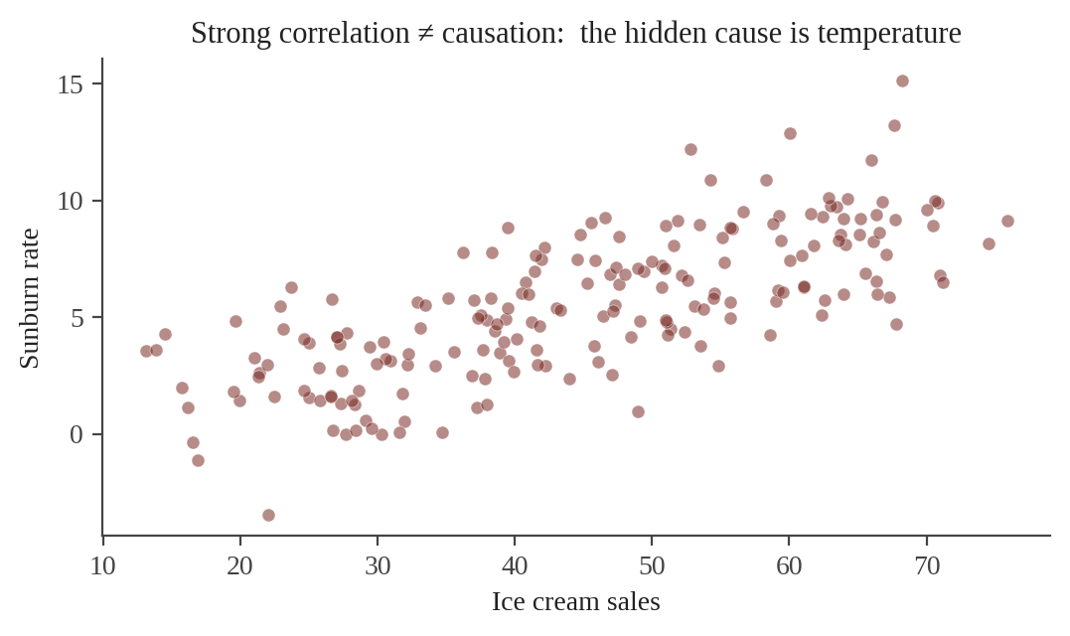
Pitfall 1 — Causation vs Correlation
ML finds patterns. It does not know why the pattern exists.
Classic example:
Ice cream sales and sunburn rates are strongly correlated.
But eating ice cream doesn't cause sunburn.
Both are driven by a hidden cause: temperature.
In astronomy: galaxy color correlates with redshift (and we'll exploit that today). But color does not cause redshift.
Don't extrapolate beyond the training range.
CosmicAI Summer School
5
Notes:
This is the most subtle pitfall. The model can be very accurate on data drawn from the same distribution and yet completely wrong when used 'mechanistically'. For science, this matters: if you discover a new correlation, the model can confirm it exists but cannot tell you it's causal.

Slide 6
Pitfall 2 — Overfitting
A model with too much capacity can memorize the training set noise.
How to spot it
How to fix it
Training metric → near-perfect.
Validation / test metric → much worse.
Predictions look noisy or wildly variable on small data perturbations.
Feature importances dominated by a single feature.
Get more training data.
Reduce model complexity (max_depth, fewer features).
Add regularization (ccp_alpha, weight decay).
Cross-validate (Lec 3a) — never trust a single split.
Use ensembles (bagging, RF) — average out the noise.
Mantra: always report two numbers: training metric and test metric. The gap is the diagnostic.
CosmicAI Summer School
6
Notes:
Connect back to Lec 3b — random forests are intrinsically robust to overfitting because bagging averages out the high variance of individual trees. But you still need to be careful with min_samples_leaf and max_depth for very small datasets.

Slide 7
Pitfall 3 — Bias in the Training Data
The model can only learn what is in your training set. Holes in coverage become silent failures.
Selection bias
Label bias
Training sample isn't a random draw from the deployment population.
The labels reflect human / pipeline choices, not the underlying truth.
→ Spectroscopic samples are biased toward bright nearby galaxies.
→ Citizen-science galaxy morphology has inter-rater disagreement.
Measurement bias
Representation bias
Survey or instrument systematics that change with sky position or epoch.
Rare but important sub-populations are under-represented.
→ Different filter calibrations between SDSS and DES create offsets.
→ AGN, lensed quasars, ultra-faint dwarfs — easy to miss.
Diagnostic: compare distributions of train vs deploy features (Lec 1b slide on distribution shift).
CosmicAI Summer School
7
Notes:
Photo-z is the canonical example of selection bias in astronomy: the spec-z training sample is preferentially bright/nearby, but you deploy on the much fainter, more distant photometric set. Fixing this is an active research area — reweighting, importance-sampling, semi-supervised methods.

Slide 8
Pitfall 4 — Generalizability
Will your model still work tomorrow, on data it has never seen?
Domain (covariate) shift
Concept shift
Adversarial / OOD
New data is drawn from a different feature distribution (e.g. fainter galaxies, new sky region).
The target relationship itself changes (e.g. K-correction at high z that wasn't in training).
Outliers and rare events the model has never met (catastrophic photo-z failures).
Defenses: (1) always estimate uncertainty alongside predictions; (2) monitor input distributions in deployment; (3) flag low-confidence predictions for human review.
CosmicAI Summer School
8
Notes:
Generalizability is what separates a paper plot from a deployed catalog. Tell students: the random-forest per-object sigma we compute later (from the spread of trees) is one of the cheapest and most valuable uncertainty estimates you can attach to predictions.

Slide 9
Part 2 · Case Study
Photometric Redshift Estimation with Random Forest
10 000 SDSS DR6 galaxies · 4 colors · scikit-learn
Reference: Carliles et al. 2010
CosmicAI Summer School
9
Notes:
Briefly tell the students they'll follow along in the notebook. We will literally walk every step of the ML framework on a real astronomy problem.

Slide 10
Why Photometric Redshifts?
Spectroscopy is the gold standard. But it's slow and expensive.
Spectroscopic z (truth)
Photometric z (estimate)
Disperse light through a grating, identify emission/absorption lines, measure shifts.
Accurate to ~10⁻⁴.
Slow: hours per galaxy on big telescopes.
Expensive — pre-LSST surveys ≈ 10⁶ spec-z.
Use the brightness through a small set of broad filters (u, g, r, i, z).
Lower accuracy (σ ≈ 0.02–0.05).
Fast: one image gives 10⁶+ galaxies at once.
Cheap — LSST will deliver ~ 10¹⁰ photo-z.
CosmicAI Summer School
10
Notes:
Selling point: this is one of the highest-impact ML applications in astronomy. Photo-z catalogs underpin cosmology, weak lensing, large-scale structure, and galaxy evolution. LSST/Rubin will depend on photo-z for almost everything.

Slide 11
Step 1 — Define the Task
Type
Supervised · regression (target is a continuous scalar).
Inputs (X)
4 colors: uberColorU, uberColorG, uberColorR, uberColorI. (Pre-computed from ugriz magnitudes.)
Target (y)
zSpec — spectroscopic redshift in the range [0.002, 0.38] (low-z galaxy sample).
Success metric
RMSE on z, plus bias Δz = ⟨zPhot − zSpec⟩ and outlier fraction |Δz| / (1+z) > 0.15.
Why colors instead of raw magnitudes? colors are scale-free (insensitive to overall brightness) → cleaner physics.
CosmicAI Summer School
11
Notes:
Tie back to Lec 3b slide 15: feature importance showed colors dominate over magnitudes. The dataset designers (Carrasco-Kind & Brunner et al., 2009) explicitly used 'uber-colors' that are calibrated and extinction-corrected — that's why we don't need to apply our own scaling or extinction correction in this notebook.

Slide 12
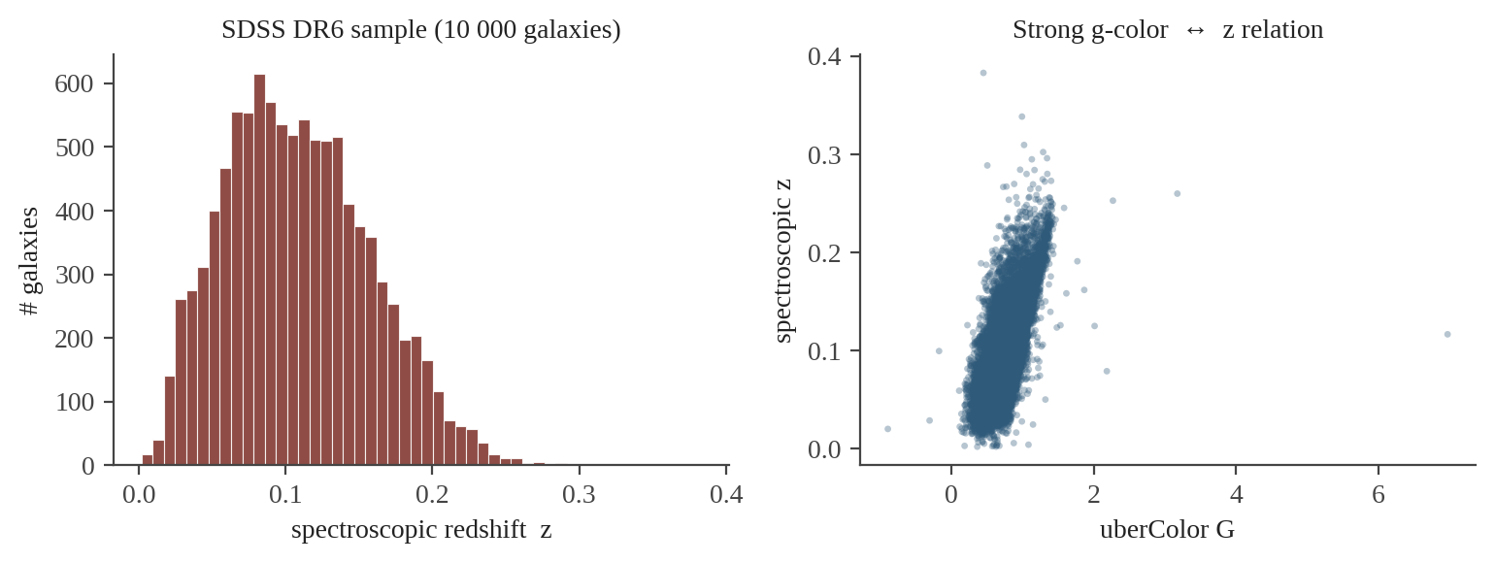
The Dataset — SDSS DR6 Galaxies
10 000 + 10 000 galaxies (train + test).
Drawn uniformly at random from the SDSS DR6 main galaxy sample.
Files we will use:
trainColors10k.txt (n × 4 features)
trainzSpec10k.txt (n × 1 target)
testColors10k.txt (n × 4 features)
testzSpec10k.txt (n × 1 target)
Features
uberColorU u − g (extinction-corrected)
uberColorG g − r
uberColorR r − i
uberColorI i − z
Note: the split was done by the dataset authors — already i.i.d. and we treat it as our test holdout.
CosmicAI Summer School
12
Notes:
The dataset is from the Carrasco-Kind & Brunner photo-z benchmark suite. The 'uber colors' are calibrated colors that have already absorbed the band corrections, so we don't need to do extinction correction or scaling — that's exceptional, in general you must. Stress that the redshift range is LOW (mostly z < 0.3) — the model would not extrapolate to z=2.

Slide 13
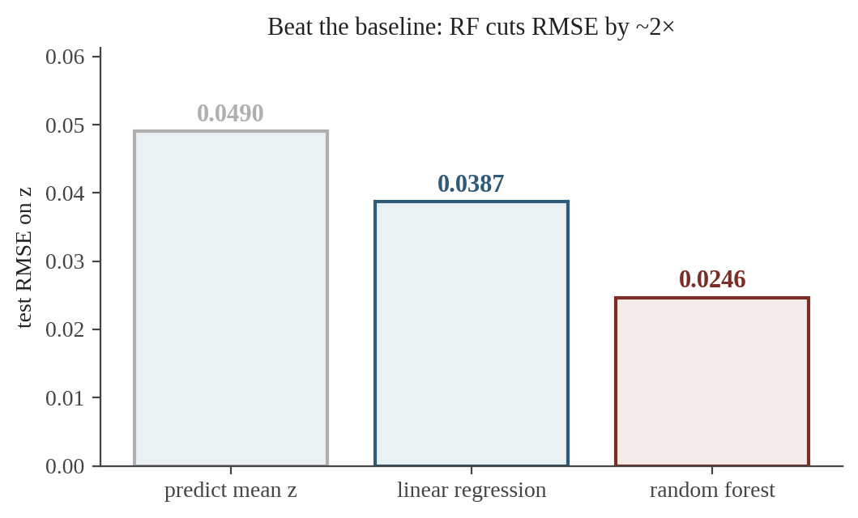
Step 2 — EDA & Baselines
Sanity checks (Lec 1b–2):
shape (10 000 × 4).
no missing values.
redshift distribution skewed to small z.
colors strongly correlated with z (good).
Two baselines to beat:
predict the training mean ⟨z⟩.
fit a simple LinearRegression on the 4 colors.
Takeaway: the RF cuts the error of linear regression by ~36% and of the mean baseline by ~50%.
CosmicAI Summer School
13
Notes:
Never report a fancy model without a baseline. Mean-prediction RMSE is the 'do nothing' floor; linear regression is the 'least effort' baseline. If your model can't beat both, it isn't worth shipping. RF clears both convincingly here.

Slide 14
Step 3 — Train the Random Forest
Default RF hyperparameters work surprisingly well here — but it's worth knowing what each knob does.
from sklearn.ensemble import RandomForestRegressor
rf = RandomForestRegressor(
n_estimators=50, # # of trees
max_features="sqrt", # decorrelate trees
min_samples_leaf=5, # soft pre-pruning
n_jobs=-1, random_state=0,
)
rf.fit(train_colors, train_zspec)
z_phot = rf.predict(test_colors)
Tune by cross-validation:
n_estimators: 50 → 500. Beyond ~200 the gain on this dataset is tiny.
max_features: with only 4 features, sqrt(4) = 2 is reasonable.
min_samples_leaf: leaves with only 1 sample tend to over-predict locally; keep ≥ 5.
Test result: RMSE = 0.0246, bias = +0.0001, outlier frac < 0.05%.
CosmicAI Summer School
14
Notes:
The original R script used ntree=50 — we keep that to reproduce. Stress: this is a small forest. For production, 500-1000 trees is more typical. We use sqrt features mostly out of convention; with only 4 features, the effect is small but still useful for tree decorrelation.

Slide 15
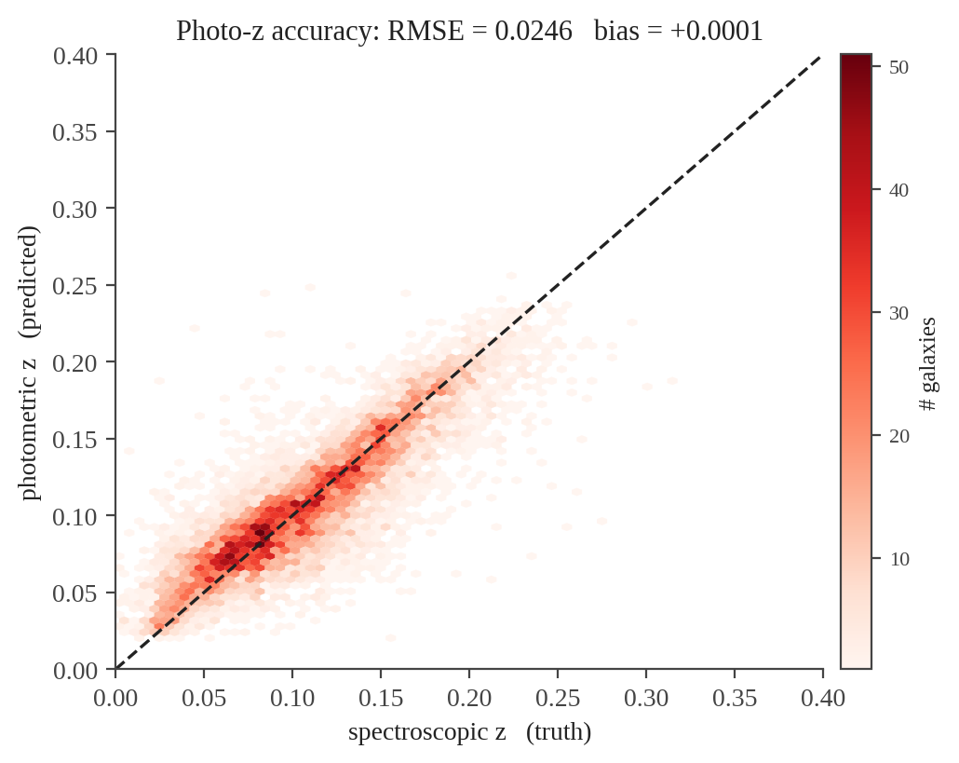
Result — zPhot vs zSpec
Headline metrics
RMSE 0.0246
Bias ⟨zPhot − zSpec⟩ +0.0001
MAD |Δz| / (1+z) 0.012
Outlier frac > 0.15(1+z) 0.02%
Comfortably under the LSST DESC requirement (σ < 0.05).
CosmicAI Summer School
15
Notes:
Point out the cloud hugs the 1:1 line tightly. The slight downward bend at high z is the well-known photo-z 'compression' — the model under-predicts at the high-z edge because training examples become sparse. This is a hint that the training sample's z distribution matters: see Lec 1b distribution-shift slide.

Slide 16
Per-Object Uncertainty
A random forest gives you free uncertainty: the spread of its trees.
σ(x) = sqrt( mean_b [ ( ẑ_b(x) − ẑ_forest(x) )² ] )
# Aggregate prediction from the forest
z_phot = rf.predict(X_test)
# Individual tree predictions (n_trees, n_samples)
indiv = np.vstack([t.predict(X_test) for t in rf.estimators_])
sigma = np.sqrt(((indiv - z_phot[None,:])**2).mean(axis=0))
On this test set: mean σ = 0.021, somewhat smaller than the actual scatter (RMSE 0.025) → mildly under-estimated.
CosmicAI Summer School
16
Notes:
This is the magic of ensembles — you don't have to derive a probabilistic model, the bootstrap naturally gives you a per-prediction uncertainty. Caveats: this is a model-uncertainty estimate, NOT the photometric measurement error. For science use you typically need to add the two in quadrature.

Slide 17
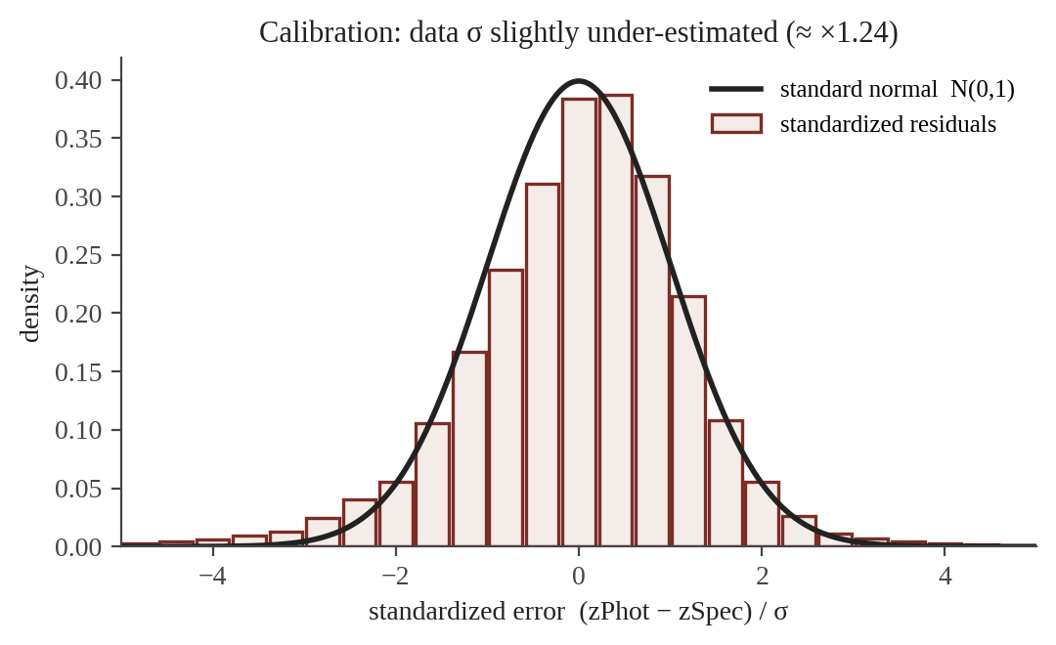
Calibration — Are Our σ's Honest?
If σ's were perfectly calibrated, the standardized residuals
(zPhot − zSpec) / σ
would follow N(0, 1).
What we find: the empirical std is 1.24, not 1.0.
Interpretation: the model under-estimates its uncertainty by ~24%. Multiply σ by 1.24 for honest reporting.
CosmicAI Summer School
17
Notes:
Excellent diagnostic. The tails of our histogram are slightly heavier than N(0,1) — that's why the std is 1.24 instead of 1. In a paper you'd report this and either inflate σ post-hoc or switch to a quantile-regression forest. Tie back to Lec 2's z-score teaching.

Slide 18
Wrap-Up & Hand-Off to the Notebook
1
Define
supervised regression · colors → z · RMSE / bias / outlier frac
2
Prepare
10 000 SDSS galaxies, clean (uber-colors), no missing values
3
Model
RF (50 trees, sqrt-features) beats linear regression by 36% RMSE
4
Inference
RMSE 0.0246 · bias near zero · per-object σ from the ensemble
5
Caveats
σ under-estimated by ~24% · extrapolation beyond z < 0.4 unsafe
Now open RFPhotoZ_full.ipynb and walk through it cell by cell. Each section maps to one box of the ML framework — try the suggested extensions at the end.
CosmicAI Summer School
18
Notes:
End the lecture by literally opening the notebook on the projector and running the first few cells. The remaining time can be used for a coding-along session. Set expectations: students should be able to adapt this template to their own thesis data.

