Slide 1
Lab Meeting 2019-01-03
Nick Gregory

Slide 2
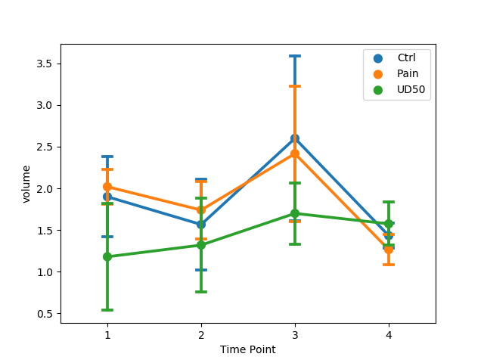
Sucrose Consumption

Slide 3
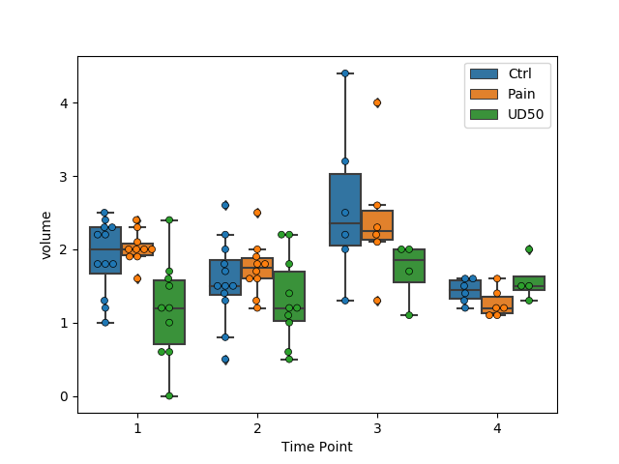
Sucrose Consumption

Slide 4
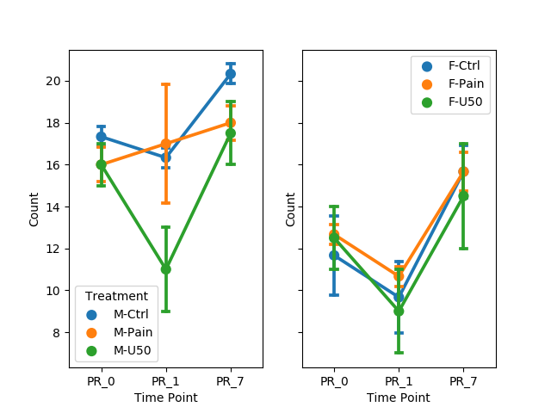
Self Admin

Slide 5
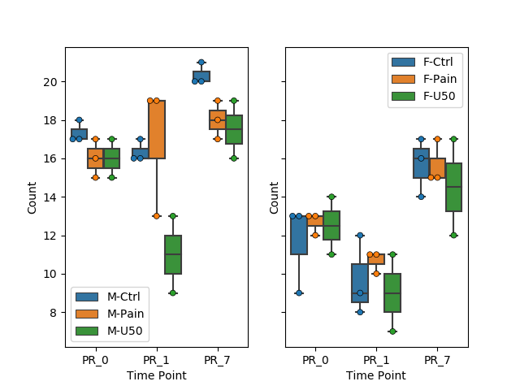
Self Admin

