Slide 1



Minor project iII
Final Review
02/12/2024

Slide 2
Title: low noise CLASS-D AMPLIFIER using pcb design
GUIDED BY,
Mrs B.Neeththi Aadithiya

Slide 3
TEAM MEMBERS
JAINISHAANTH N S [927622BEC079]
MADHESWARAN S [927622BEC104]
MUTHUKUMAR S [927622BEC126]
NANDHAKUMAR M [927622BEC128]

Slide 4
OBJECTIVE
To Design a PCB for a Class D Audio Amplifier that
Manages compact thermal considerations
Minimizes noise
Electromagnetic interference
With optimize performance and audio quality for diverse applications.

Slide 5
INTRODUCTION
A Class D Amplifier is a type of amplifier which provides about 100% efficiency Theoretically.
It uses a switching circuit to produce those kinds of efficiency.
However, most of the Class D Amplifiers generates noise overtime.
This project focusses on Designing a PCB design which reduces the noise and the Electromagnetic Interference produced in the circuit.

Slide 6
PROBLEM STATEMENT
Most of the Class D Amplifiers are generating noise even though they are good in efficiency.
Its also important that the design must be done in a way which does not have a Electromagnetic Interference.
So the Design of the PCB should be in a way that has low Signal to Noise Ratio(SNR).

Slide 7
EXISTING SYSTEM
The existing system for the PCB design of a Class D Audio Amplifier [1] prioritizes efficient power delivery through optimized component placement and trace routing.
It incorporates robust thermal management strategies, utilizing thermal vias and strategically positioned heat sinks to mitigate heat buildup during amplifier operation.
Additionally, the system employs dedicated noise mitigation techniques, including filtering components and proper grounding, to ensure a clean and interference-free audio signal.

Slide 8
PROPOSED SYSTEM
The proposed system for PCB design of a Class D amplifier aims to optimize performance, minimize size, and reduce interference(NOISE).
By strategically selecting components, implementing efficient layout designs, and incorporating noise-reduction techniques, the system seeks to enhance the overall efficiency and reliability of the amplifier.
Additionally, emphasis will be placed on thermal management strategies to ensure optimal operation and longevity of the amplifier in various audio applications.

Slide 9
METHODOLOGY
Class D amplifier is divided into three sub-parts
Triangular wave Generator
Comparator/Switching circuit
Low-Pass Filter
Audio Signal
Amplified PWM Signal
PWM Signal
Amplified Signal

Slide 10
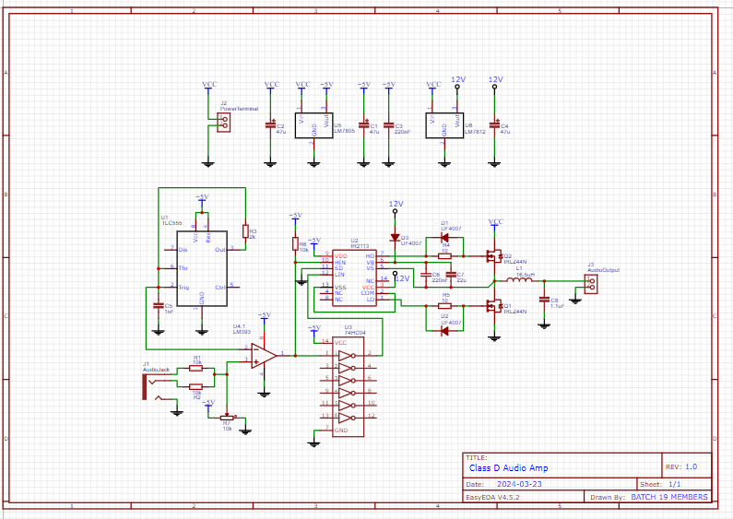
SCHEMATIC DIAGRAM

Slide 11
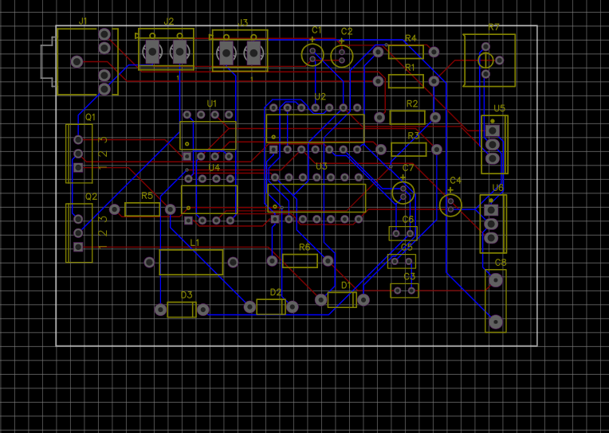
LAYOUT DESIGN

Slide 12
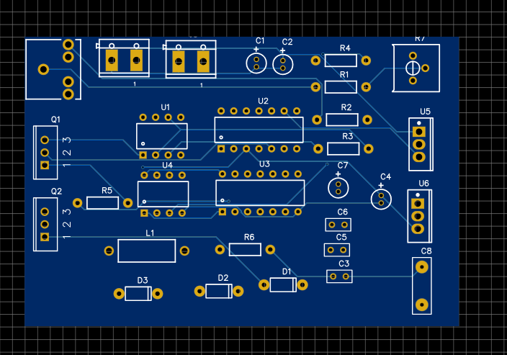
2D VIEW

Slide 13
REFERENCES
[1] M. Berkhout, "An integrated 400-W class-D audio amplifier," in IEEE Journal of Solid-State Circuits, vol. 38, no. 7, pp. 1198-1206, July 2003, doi: 10.1109/JSSC.2003.813238.
[2] Honda, Jun, Manuel Rodríguez, and Wenduo Liu. "25W-500W scalable output power class D audio power amplifier reference design using the IRS2092 protected digital audio driver.” Acesso em 9 (2008).
[3] Mei, S.; Hu, Y.; Xu, H.; Wen, H. The Class D Audio Power Amplifier: A Review. Electronics 2022, 11, 3244.

Slide 14
Thank you

