Slide 1
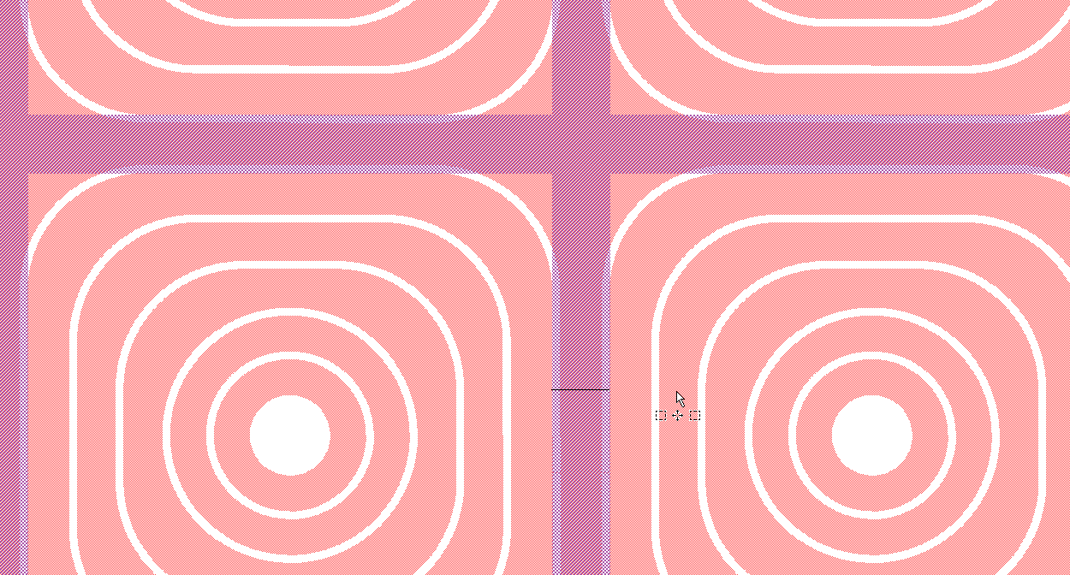
100um
Metal lines on back are 100um wide
Cathode (or 6th ring, ☺ ) on the front is 70um wide, then there are 15um of not-implanted region before 5th ring

Slide 2
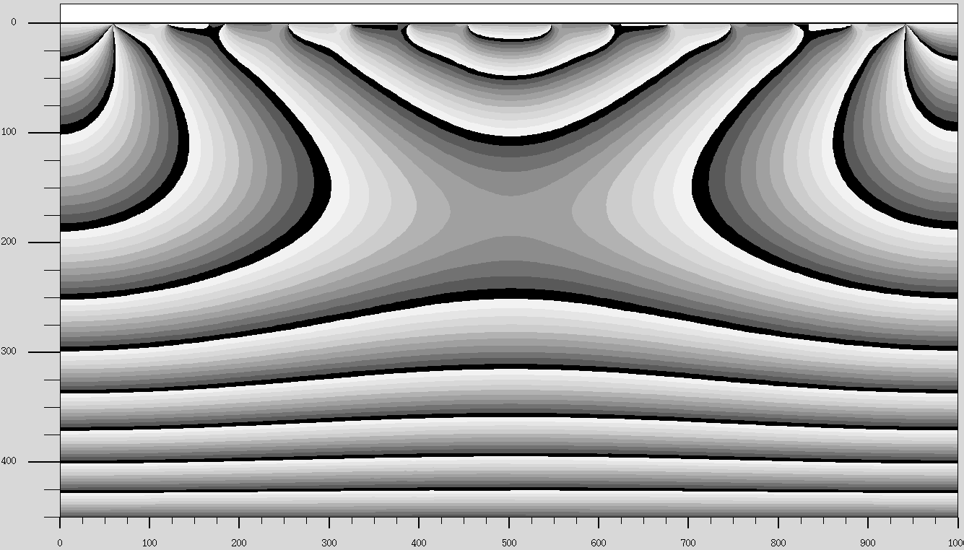
Charge sharing between adjacent pixels - short edge: SDDMAIA3_2double.str
Points of interaction: X=400, 410, …470 Y=420-430

Slide 3
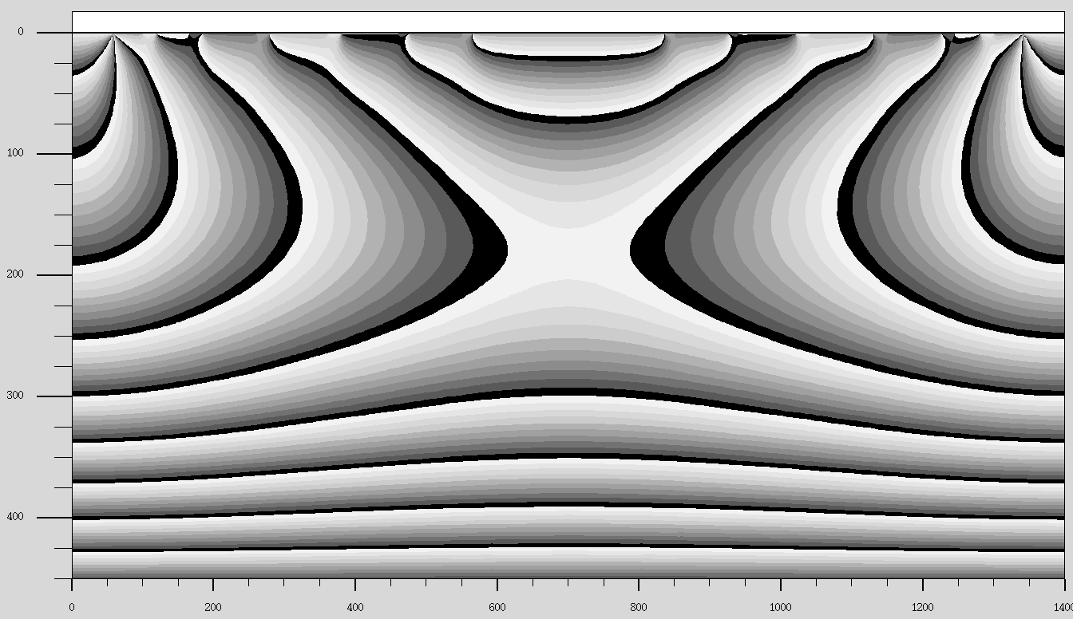
Charge sharing between adjacent pixels - short edge: SDDMAIA3_2diagonaldouble.str
Points of interaction: X=600, 610, …660 Y=420-430

Slide 4
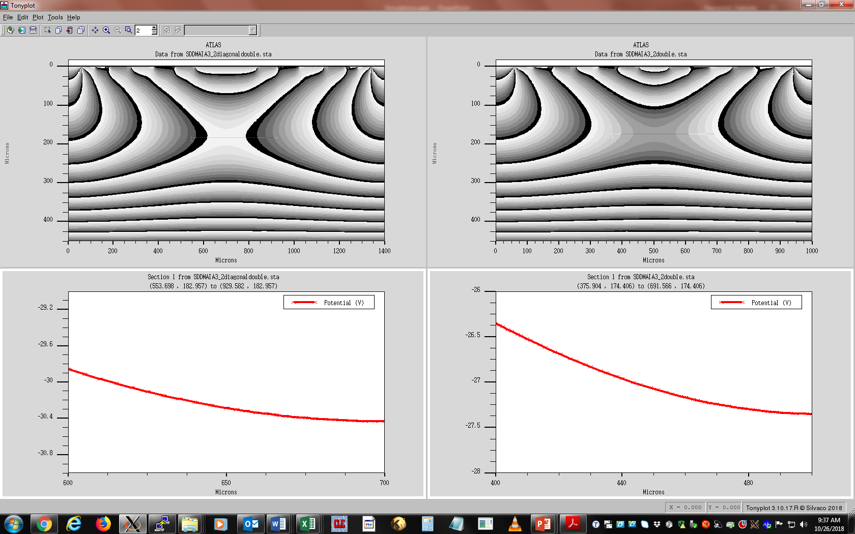
Horizontal Cutline at the saddle point (lowest electric fields)
~ 0.3 V
~ 0.3 V
Electrons generated at the left go 100% to anode
Electrons generated at the left go 100% to anode
Essentially, a Molybdenum shield 100um wide at the edge of the cell (like in the present MAIA) is OK. No need of larger one at the curvature

Slide 5
