Slide 1
NSLS-II Storage Ring Commissioning
S. Krinsky
NSLS-II ASD Retreat
May 13, 2010

Slide 2
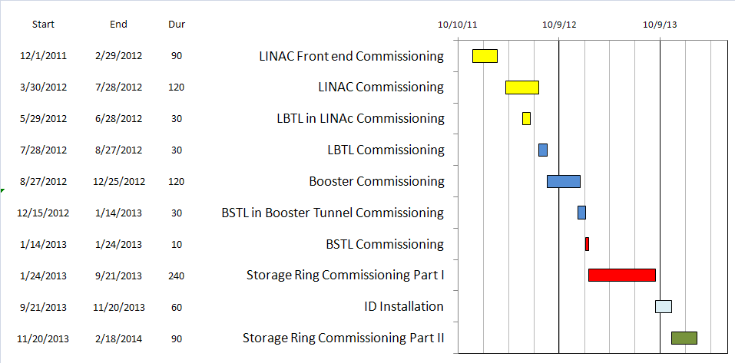
Commissioning Schedule

Slide 3
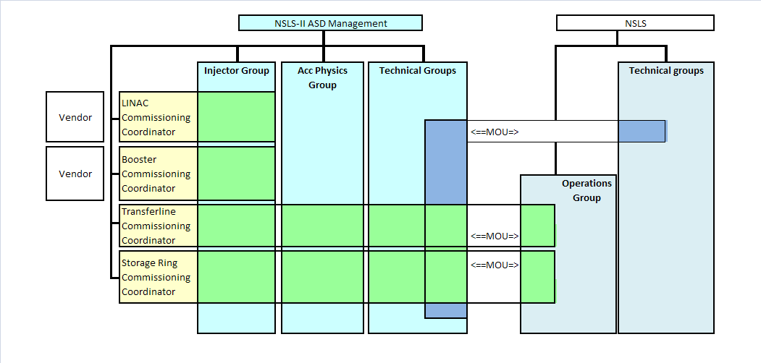
Commissioning Organization

Slide 4
Commissioning Task Forces
Commissioning work organized in task forces
Task Force leaders report to ASD division director
Task Force leader assisted by Run Coordinators
On shift, commissioning crew reports to Run Coordinators
who report to Task Force leader
Commissioning organization structure orthogonal to ASD
group structure
Group members delegated to commissioning task forces
and report in this function to Task Force leaders

Slide 5
Magnetic Field Measurement and Modeling
Measure magnets to determine field quality
Determine calibration
Develop lattice model using measured fields
  Linear optics
  Nonlinear optics

Slide 6
Wakefield Modeling and Tracking Studies
Develop model for impedance and wakefields
  calculation
  measurement
Estimate instability thresholds
Simulate bunch-by-bunch feedback with realistic
bunches and wakefields

Slide 7
Pre-Beam Commissioning Tests
Inspect radiation shielding
Test personnel protection system
Test loss control monitoring system
Prepare, review, sign safety documentation
Complete staff training
Verify that named devices in control system
control proper hardware
Check polarity of all magnets
Complete survey of magnetic elements
Test diagnostic equipment without beam

Slide 8
Phase 1—Without IDs
Commission BTS transport line
  Obtain good transmission through septum and good
  transverse phase space match
  Set timing of pulsed magnets
Obtain first turn in storage ring using single kicker
  Center beam in single downstream kicker
  Adjust kicker strength to place beam on design orbit
  Use single turn BPMs to steer beam trajectory around
  ring and estimate linear optics and tune
  Use flag to obtain beam size information at injection
  point and after one turn

Slide 9
Phase 1—Without IDs
Look for magnet errors that may have been missed in testing
Achieve additional turns around ring
Achieve circulating beam ~ hundreds of turns
Measure and improve orbit and tune
Achieve RF capture ~ lifetime seconds to minutes
Measure and improve orbit and tune
Obtain circulating beam using four kicker magnets to make
local injection bump
Achieve 1-Hz accumulation of injected bunches into ring
Commission Loss Control Monitoring System

Slide 10
Phase 1—Without IDs
Use visible synchrotron light monitor to study transverse
beam profile and disturbance due to kickers
Improve injection efficiency and RF capture
Reduce beam loss due to kicker excitation
Improve orbit and tune
Improve lifetime
Use pinhole camera to determine transverse profile
and energy spread
Measure Orbit Response Matrix
Use LOCO to characterize linear optics
Reduce beta beat

Slide 11
Phase 1—Without IDs
Condition vacuum chamber with beam
Achieve 25 mA stored beam
Study Lifetime & Vacuum Pressure vs Amp-hrs
Correct coupling using skew quadrupoles
Measure dependence of lifetime on vertical beam size
using pinhole camera—estimate Touschek lifetime
Measure dependence of lifetime on position of beam scrapers
to get information on physical and dynamic aperture
Refine LOCO characterization of linear optics
Carry out beam based alignment of BPMs
Test fast orbit feedback system

Slide 12
Phase 1—Without IDs
Characterize nonlinear optics
  Determine nonlinear dispersion and chromaticity
  Use Pinger to measure tune shift with amplitude,
  dynamic aperture and characterize sextupole distribution
Increase current
  Study instability thresholds
  Commission transverse bunch-by-bunch feedback
  Measure variation of coherent tune with current
  Characterize ring impedance using beam
  Study increasing chromaticity from +2/+2 to +5/+5
Compare optics and wakefield models with measurements
Update models

Slide 13
Phase 2—With IDs
Insertion device commissioning
  Bake beamline equipment
  Survey front end fiducial marks on the ID beamline
  Commission undulator gap control in control room
  Establish and save reference orbit (low current ~5mA)
  ID front end radiation survey at low current (gap open)
  ID front end radiation survey opening mask and valve
  ID front end radiation survey increasing current (gap open)
  ID front end radiation survey at intervals during vacuum
  conditioning of safety shutter
  Establish ID elevation

Slide 14
Phase 2—With IDs
Calibration/testing of Equipment Protection Interlock System
  Center photon beam in exit slot
  Verify gap open/close status is properly reported to
  interlock system
  Measure interlock BPM offset and scale factors
  Adjust the hardware trip points on the local logic chassis
  Verify beam is dumped at the specified position offsets
  Set the values in the interlock test file
  Set the values in the micro
  Verify the proper operation of the interlock test

Slide 15
Phase 2—With IDs
  ID front end radiation survey with gap closed
  (low current ~5mA)
  When necessary, compensate linear optics for ID
  Radiation survey with closed gap at progressively
  higher current—check for component heating
  Observe orbit and tune shift vs gap
  Measure lifetime vs gap
  Observe beam stability vs current
  Measure change in impedance due to ID chamber

Slide 16
Phase 2—With IDs
  Prepare look-up tables for feed forward orbit correction coils
  Measure effect on tune shift with amplitude, chromaticity
  and emittance coupling
  Measure impedance vs gap for IVUs
  Commission undulator gap control for users
  Measure undulator spectra vs gap
  Measure flux and brightness

Slide 17
Top-Off Injection
  Check position of apertures in ring and beamline
  Test interlocks
  Radiation survey with shutters open
  Characterize injection transient on transverse orbit
    Contribution from septum
    Contribution from kickers
  Test transverse feedback with injection transient

Slide 18
Concerns
Accuracy of magnet calibration-two types of dipoles
Magnetic field quality--do we measure all magnets?
Pinger is not in baseline budget
Should carry out bench measurements of some key
impedance elements-IVUs, IR-chambers,…
Calibration of Equipment Protection Interlock
  Need to coordinate with XFD to observe x-rays
  Develop approach to center beam in IVU
Effect of injection transient on Equipment Protection
Interlock
Radiation damage of IDs

