Slide 1
ChannelFinder
Kunal Shroff
Group Meeting 4/12/2011
BNL

Slide 2
Motivation and Objectives
A flat name space restricts seriously:
  Clients need to know all channel names beforehand
  Portable generic clients must be simple
  Apps need full configuration or framework supplied service
Develop a Directory Service
  Generic
    No dependency on installation and local conventions
  Simple and fast (enough)
    Use standards wherever possible
  Provides “query-by-functionality”

Slide 3
ChannelFinder
REST style web service
  URI specifies the data element to operate on
  HTTP method specifies the operation
  Payload (XML, JSON) contains object representation
RDB
  Contains directory data
Use LDAP to query user-group relations

Slide 4
Directory Data
Set of Channels (unique names)
Each Channel has an arbitrary number of
Properties (name/value pairs) and
Tags (names)
Each Channel, Property, or Tag has an Owner (group) to allow basic access control
All names and values are strings

Slide 5
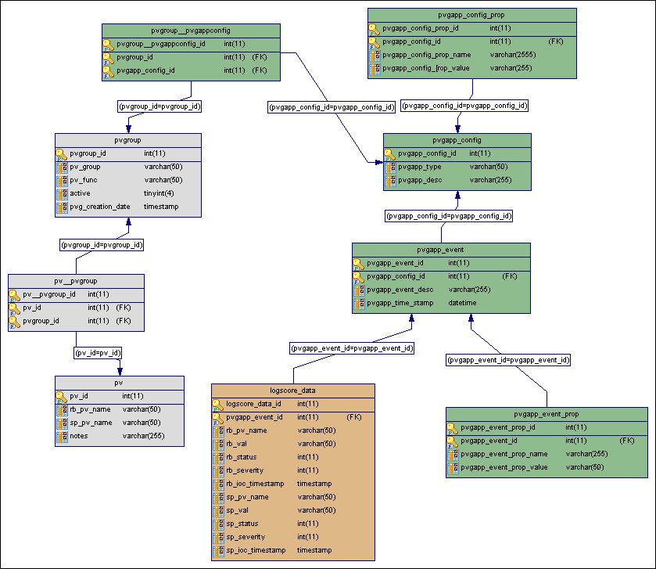
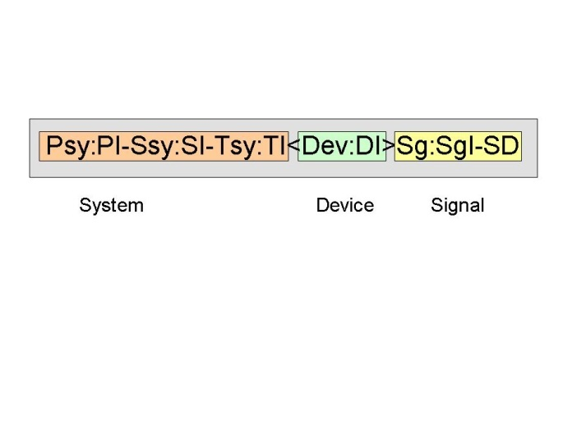
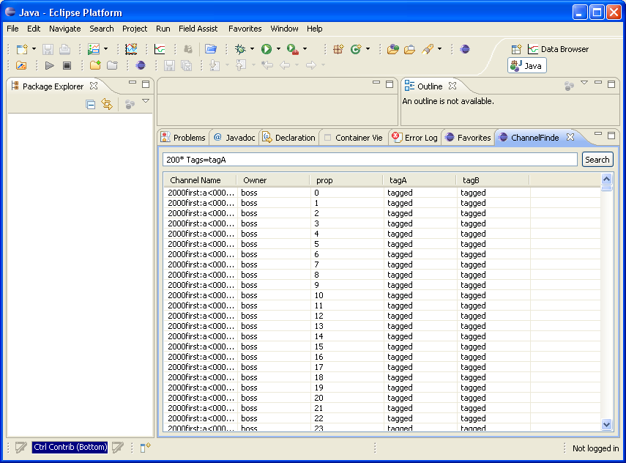
Directory Data Sources
IRMIS or other RDB systems
Geographical, hierarchical,
engineering, physics data
DB file parser (PV names, attributes)
Requires a good naming convention
Control room applications
”Joe’s favorite channels”

Slide 6
Java ChannelFinderAPI
http://channelfinder.sourceforge.net/
Pure Java API library
  Query
  Add/Remove channels, Properties, Tags
  Set/Update channels, Properties, Tags
RESTful web service client - Jersey
Test Driven Development
  Junit
  corbertura

Slide 7
Java ChannelFinderAPI
DataType
  Channel
    String Name, Owner
    Collection<Tag>
    Collection<Properties>
  Tag
    String Name, Owner
  Property
    String Name, Owner, Value

Slide 8
Java ChannelFinderAPI
Operations
  Add/Create
  Set
  Query
  Remove

Slide 9
Java ChannelFinderAPI
Fluent API
  Creating objects
    channel("ChannelName").owner("ChannelOwner")
    .with(tag("TagName", "TagOwner"))
    .with(property("PropertyName", "propValue").owner("PropOwner"))
  Calling client operations
    client.add(testChannel.with(testTag1));
    client.updateChannel(testChannel.with(testTag2));

Slide 10
Java ChannelFinderAPI
Channel Util
  getAllTagNames(Collection<Channel> channels):
    Return a union of tag names associated with channels
  getChannelNames(Collection<Channel> channels)
    Returns all the channel Names
  getPropertyNames(Channel channel)
    Return a list of property names associated with this channel
  getPropertyNames(Collection<Channel> channels)
    Return a union of property names associated with channels
  getTagNames(Channel channel)
    Return a list of tag names associated with this channel

Slide 11
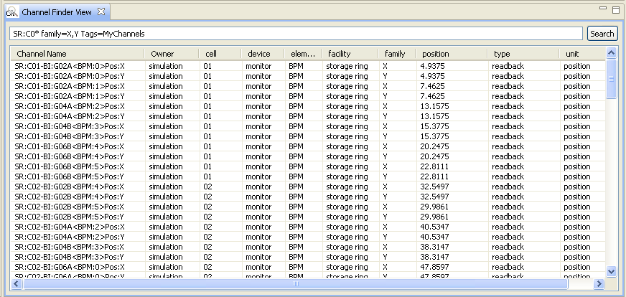
ChannelFinder Viewer
CSS → Display → ChannelFinderViewer
Searching
  Name, Property value, Tags
  Regular Expressions using “*”, “?”
  prop=val1, val2 is equivalent to prop=val1 OR prop=val2
  prop=val1 tag=myTag is equivalent to prop=val1 AND tag=myTag

Slide 12
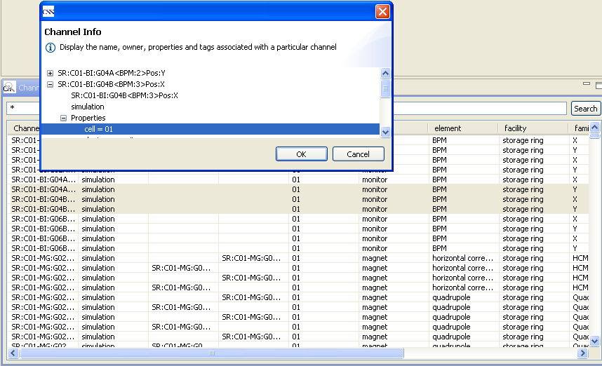
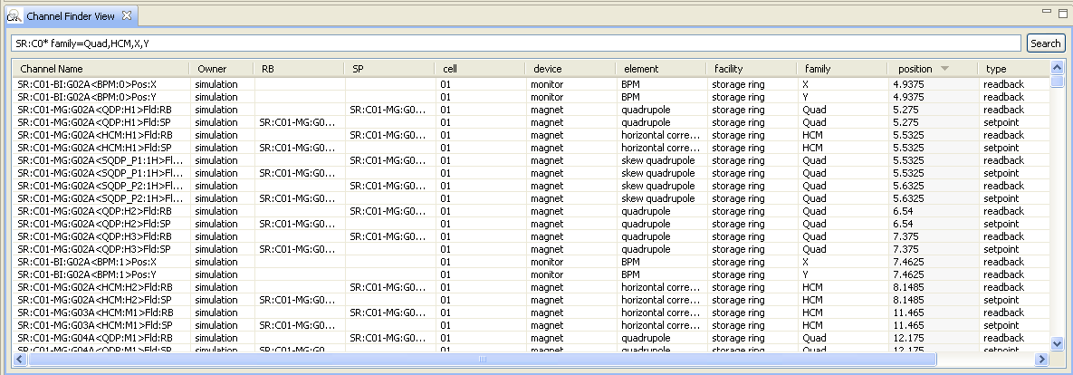
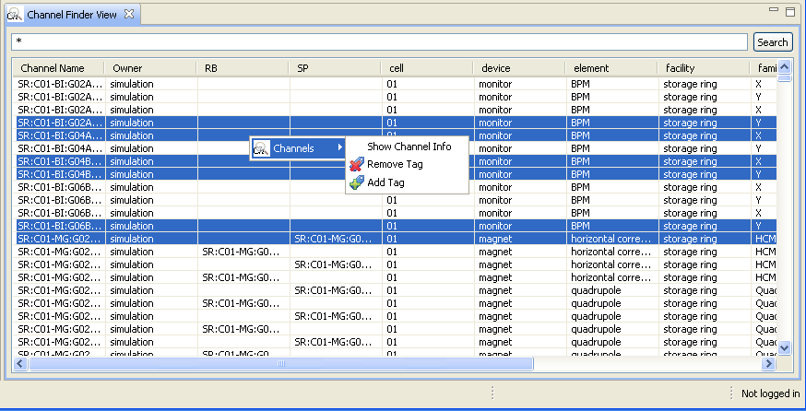
ChannelFinder Viewer

Slide 13
Python ChannelFinderAPI
http://channelfinder.hg.sourceforge.net/hgweb/channelfinder/python.channelfinder.api
Installation
  Requires python 2.6 or greater
  Python setup.py install
DataTypes
  Channel
    String Name, Owner
    list[Tag], list[Properties]
  Tag
    String Name, Owner
  Property
    String Name, Owner, Value

Slide 14
Python ChannelFinderAPI
Operations
  Add
  Update
  Query
  Remove
cf-update-ioc-list Application
  create/update channels in the database with
    Hostname
    IOCname

Slide 15
TODO
Operations
  Clean up the create/add/update/set interface
Expand the utility class
Sorting support
Feature request

