Slide 1
Updated on Nov. 20, 2020
Installation
Get the folder “sixcircle_ver1.3alpha_xxxxxxxx”.
It includes:
The program relies on python3, numpy, and scipy.
pip install numpy
pip install scipy
Start up
Get into the folder “sixcircle_ver1.4alpha_xxxxxxxx” and enter python3 shell.
import sixcircle
from sixcircle import *
For users at BL43LXU, add:
from sixcircle_rqd import *
sixcircle.py
scbasic.py
ini.conf
sixcircle_rqd.py
BL43XU_CONST.mac
BL35XU_CONST.mac
The main program.
A required module of six-circle calculation. If necessary, users can develop their own six-circle program based on scbasic.py.
A configuration file essential for initialization
An optional module specially for BL43LXU and BL35XU at SPring-8. It is also an example to show how users can develop their own toolkits based on sixcircle.py
A configuration file including constants in BL43LXU, SPring8, required by sixcircle_rqd.py
A configuration file including constants in BL35XU, SPring8, required by sixcircle_rqd.py

Slide 2
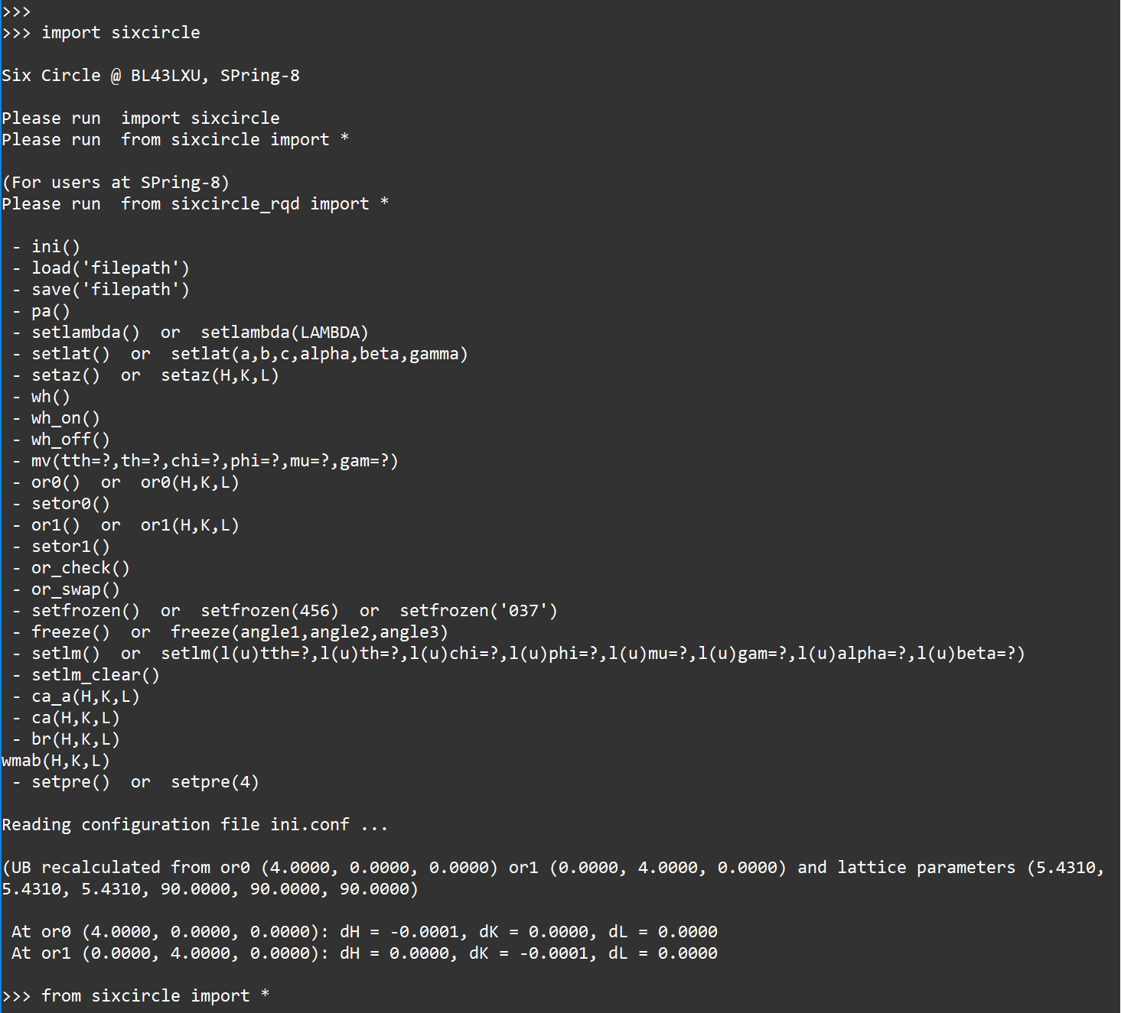
Definition of motors
mu: right-hand rotation angle of incident beam with respect to x-axis.
gam: right-hand rotation angle of deflected beam with respect to x-axis.
sa: scattering angle
omega: difference from tth/2 to th

Slide 3
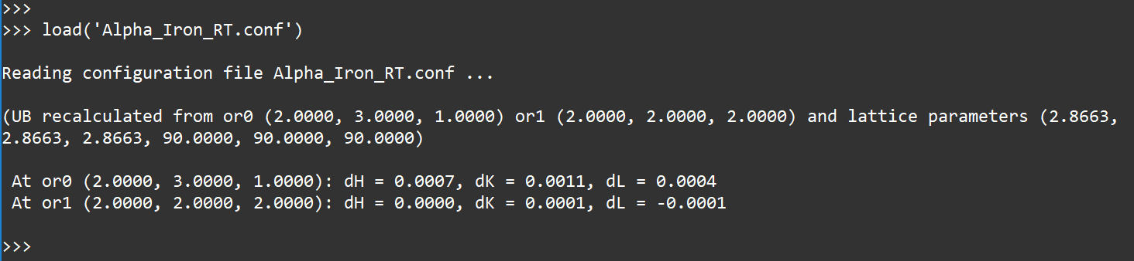
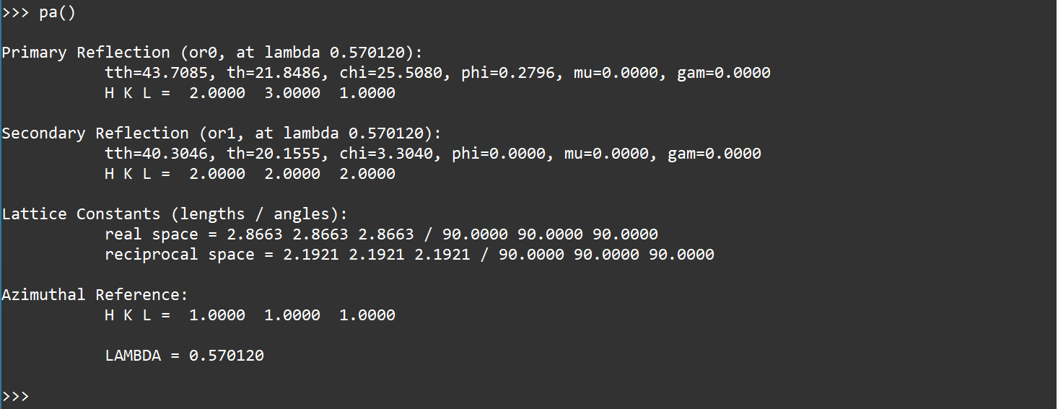
load(‘filepath’)
Load a configuration file
save(‘filepath’)
Save to a configuration file
pa()
Check current parameters

Slide 4
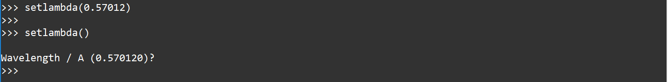
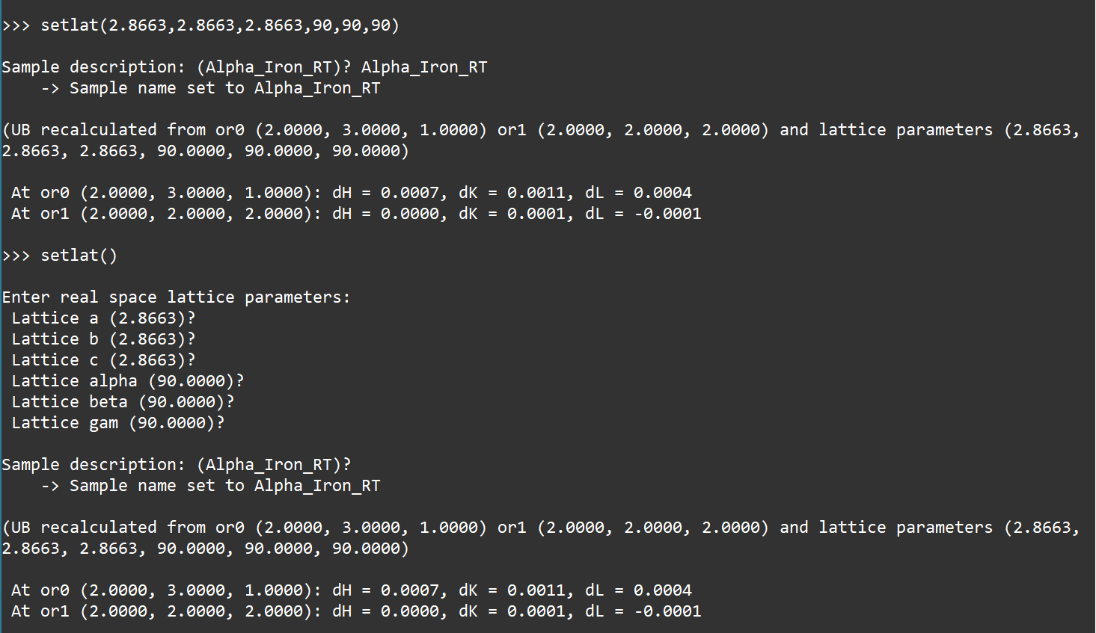
setlambda()
setlambda(LAMBDA)
Set wavelength
setlat()
setlat(a,b,c,alpha,beta,gamma)
Set lattice parameters

Slide 5
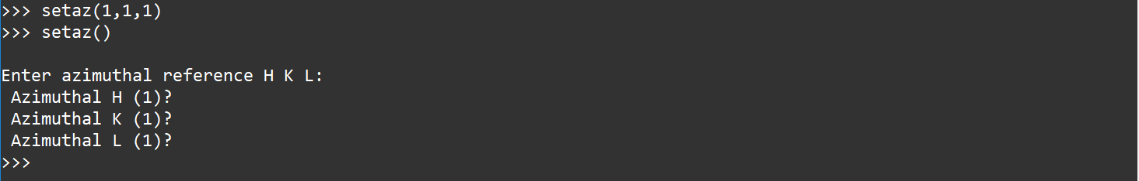
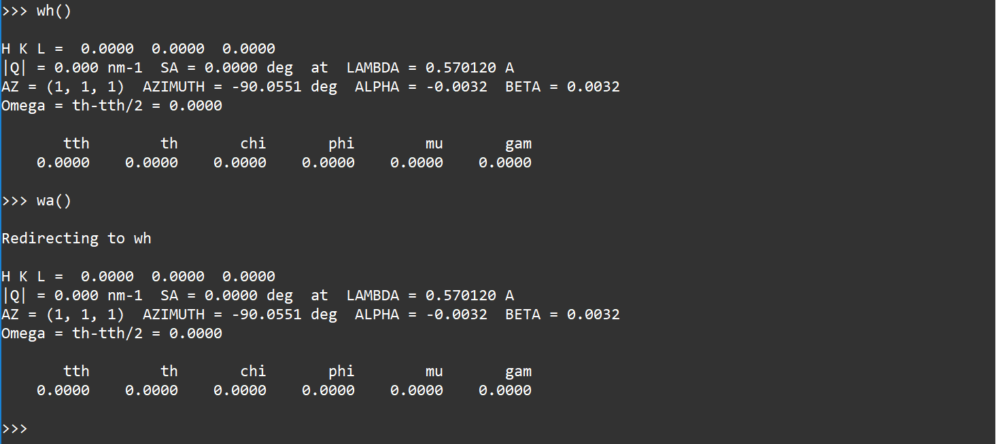
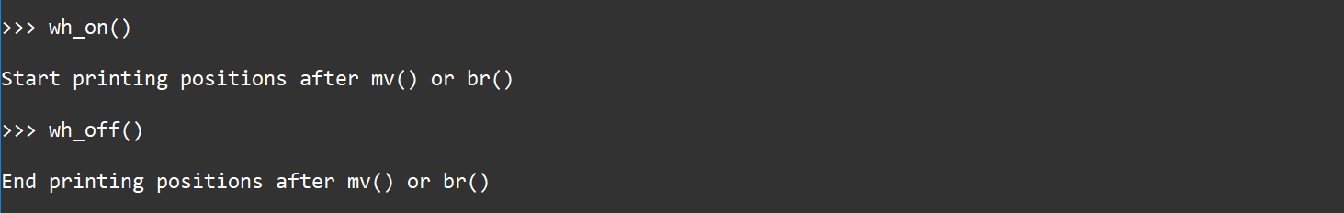
setaz()
setaz(H, K, L)
Set the reference vector HKL
wh()
wa()
Check all current positions
wh_on()
wh_off()
Start (end) printing positions after mv() or br()

Slide 6
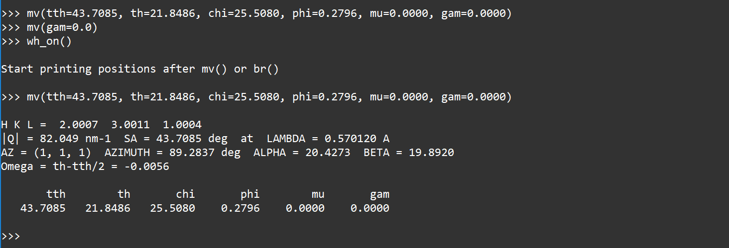
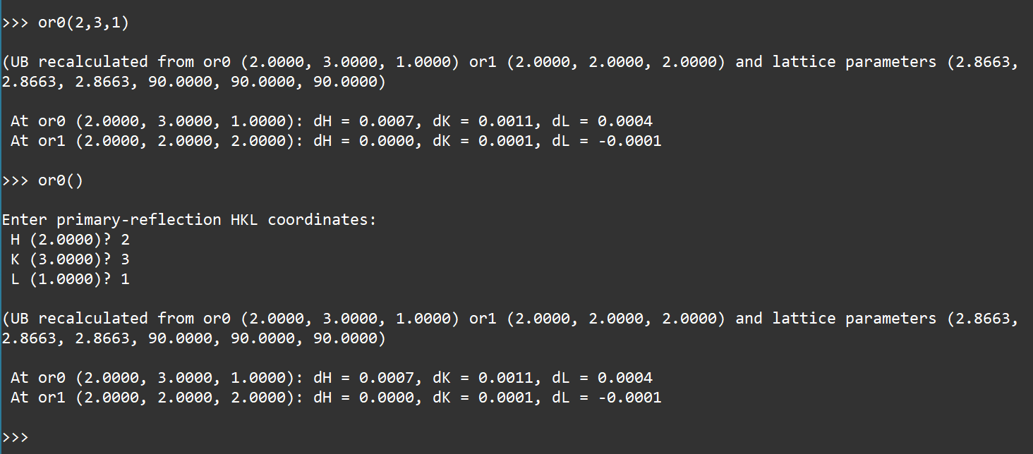
mv(tth=?, th=?, chi=?, phi=?, mu=?, gam=?)
Move motors positions.
or0()
or0(H,K,L)
or1()
or1(H,K,L)
Set the HKL of the primary (secondary) reflection based on current motors positions.

Slide 7
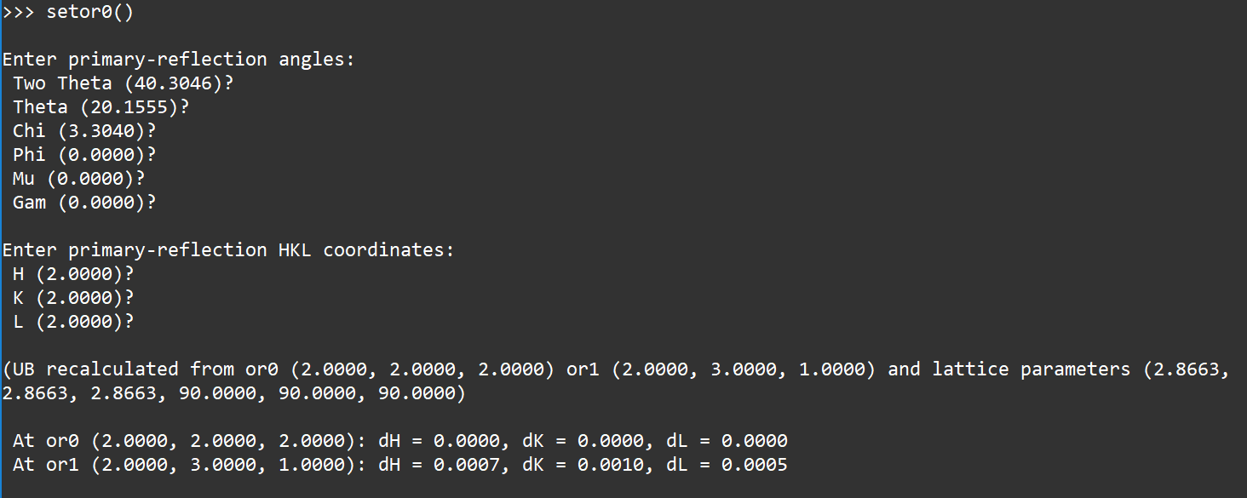
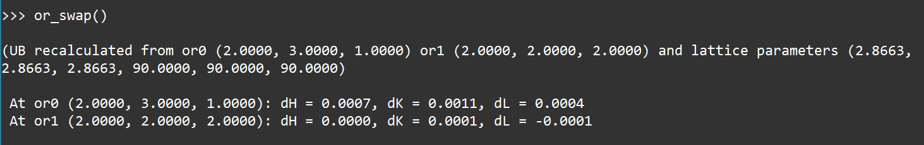
setor0()
setor1()
Set the HKL of the primary (secondary) reflection and corresponding motors positions.
or_check()
Check consistency at the primary and the secondary reflections.
or_swap()
Swap the primary reflection and the secondary reflection.

Slide 8
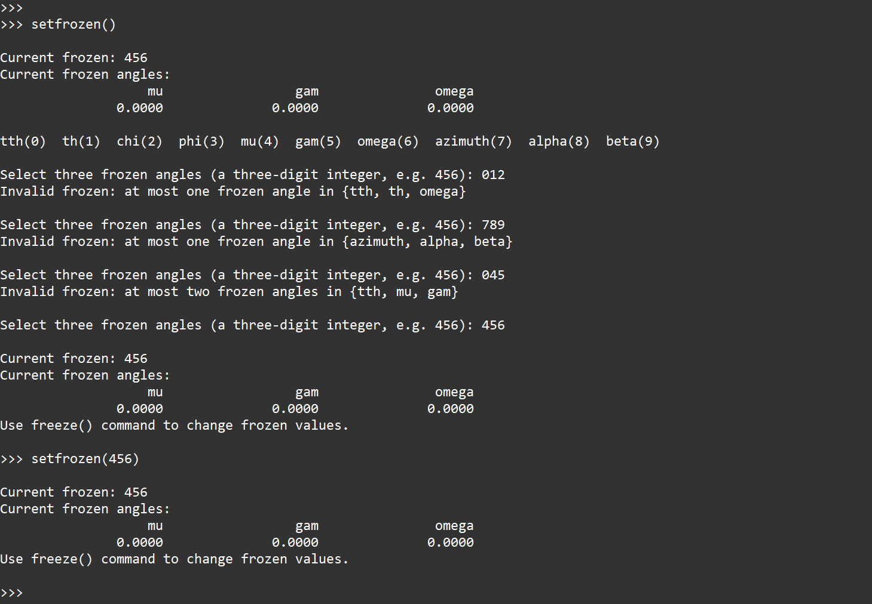
setfrozen()
setfrozen(456)
setfrozen(‘037’)
setmode()
‘Frozen’ (abc) is a string of a three-digit number.
Choose three angles to freeze: tth (0), th (1), chi (2), phi (3), mu(4), gam (5), omega (6), azimuth (7), alpha (8), beta (9)
Default mode is 456: freeze mu, gam, omega
It is possible to choose one or two angles in {tth, mu, gam}
It is possible to choose zero or one angle in {azimuth, alpha, beta}
It is possible to choose zero or one angle in {tth, th, omega}

Slide 9
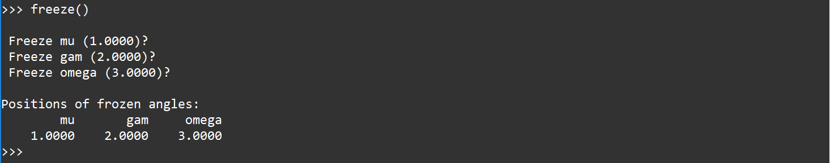
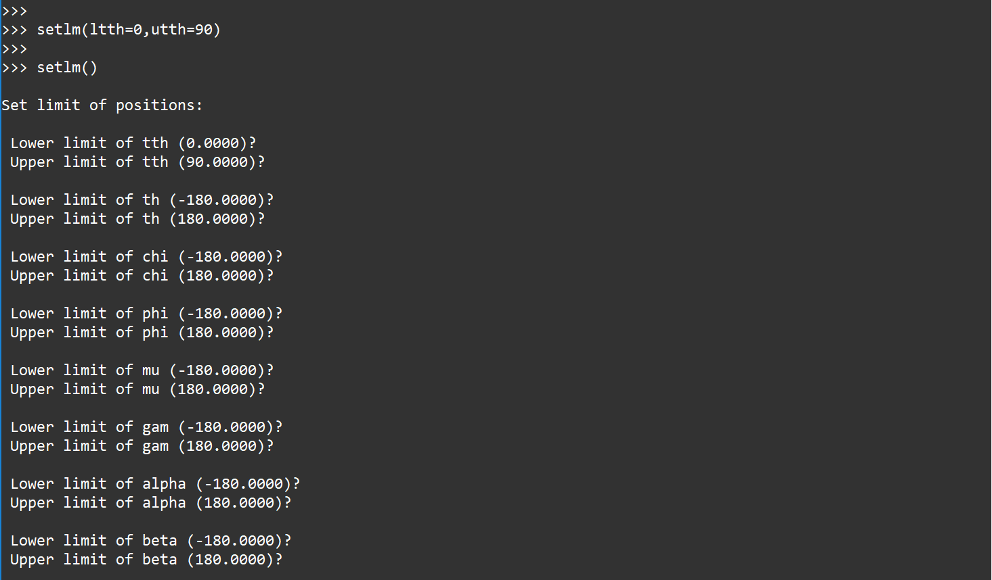
freeze()
freeze(position1,position2,position3)
Set positions of three frozen angles.
setlm()
setlm(ltth=?,utth=?,…)
Set limits of positions. This will be applied to selecting calculated positions.
Valid keyword: l(u)tth, l(u)th, l(u)chi, l(u)phi, l(u)mu, l(u)gam, l(u)alpha, l(u)beta

Slide 10
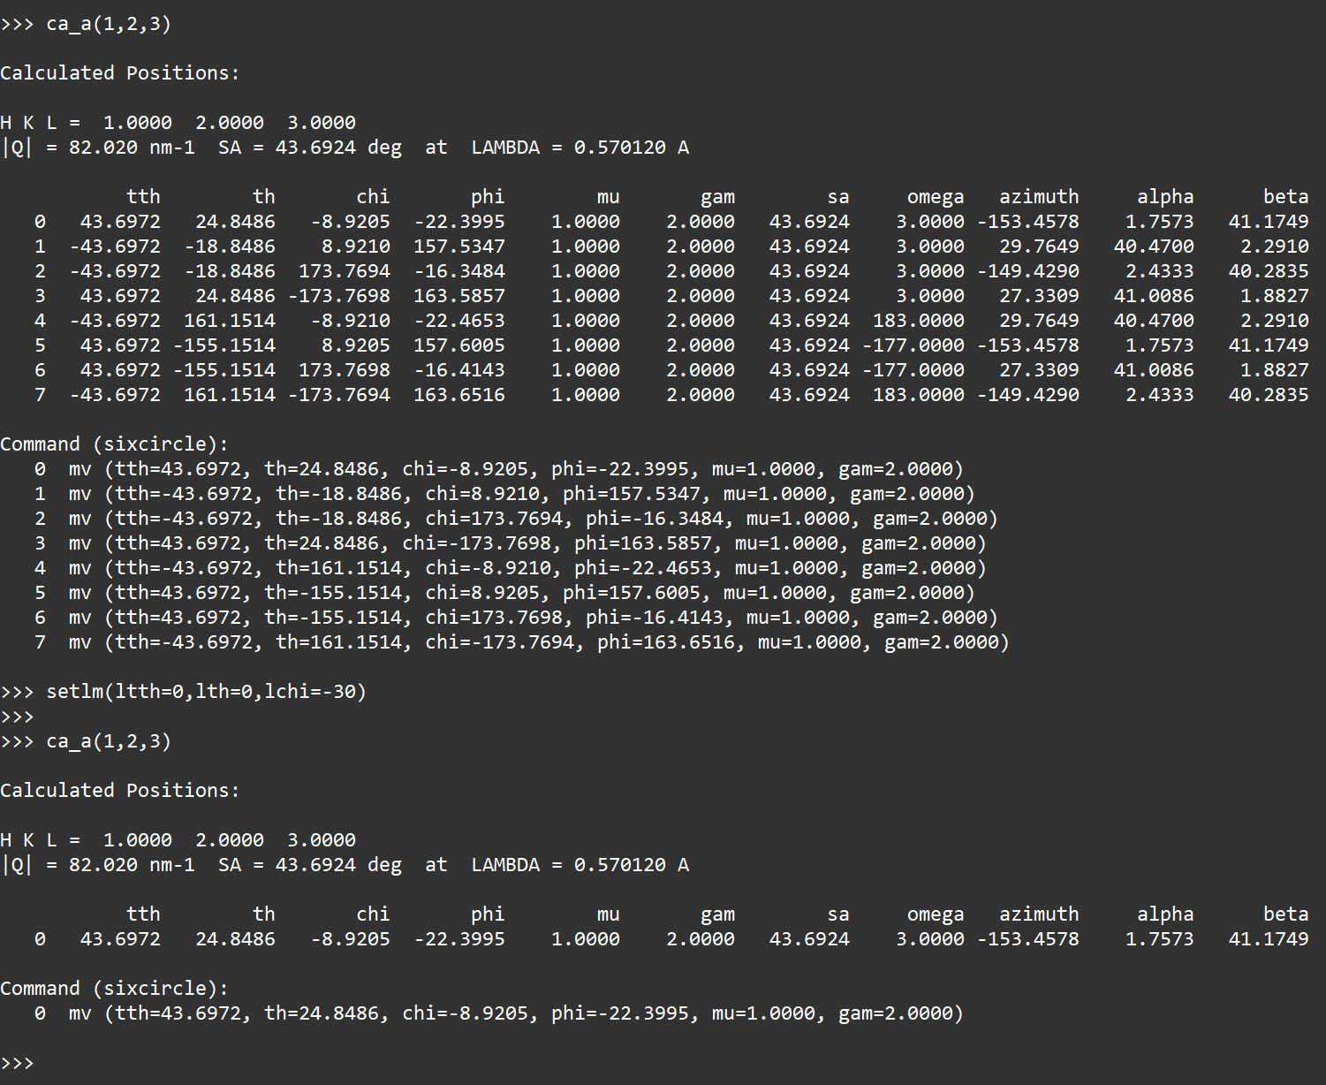
setlm_clear()
Set all limits to -180 to 180
ca_a(H,K,L)
Find all positions for H, K, L.
All sets of positions within preset limits in preset mode are displayed.
To select one set, use setlm.

Slide 11
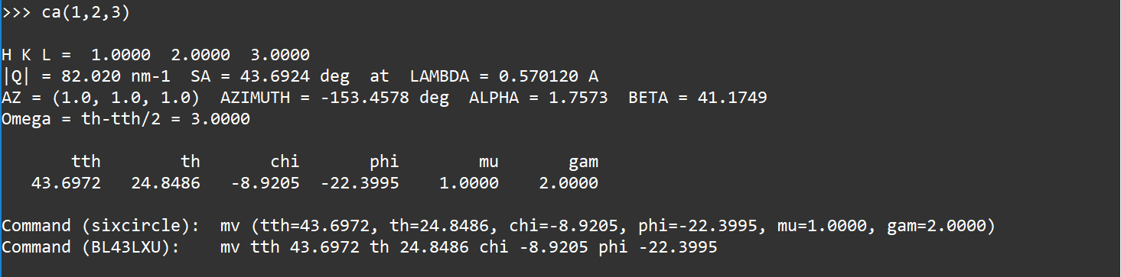
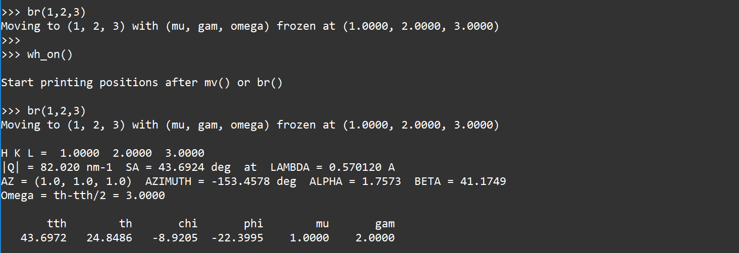
ca(H,K,L)
Find positions for H, K, L.
Only the first set of positions is displayed.
br(H,K,L)
Move to positions for H, K, L.
The first set of positions is used.

Slide 12
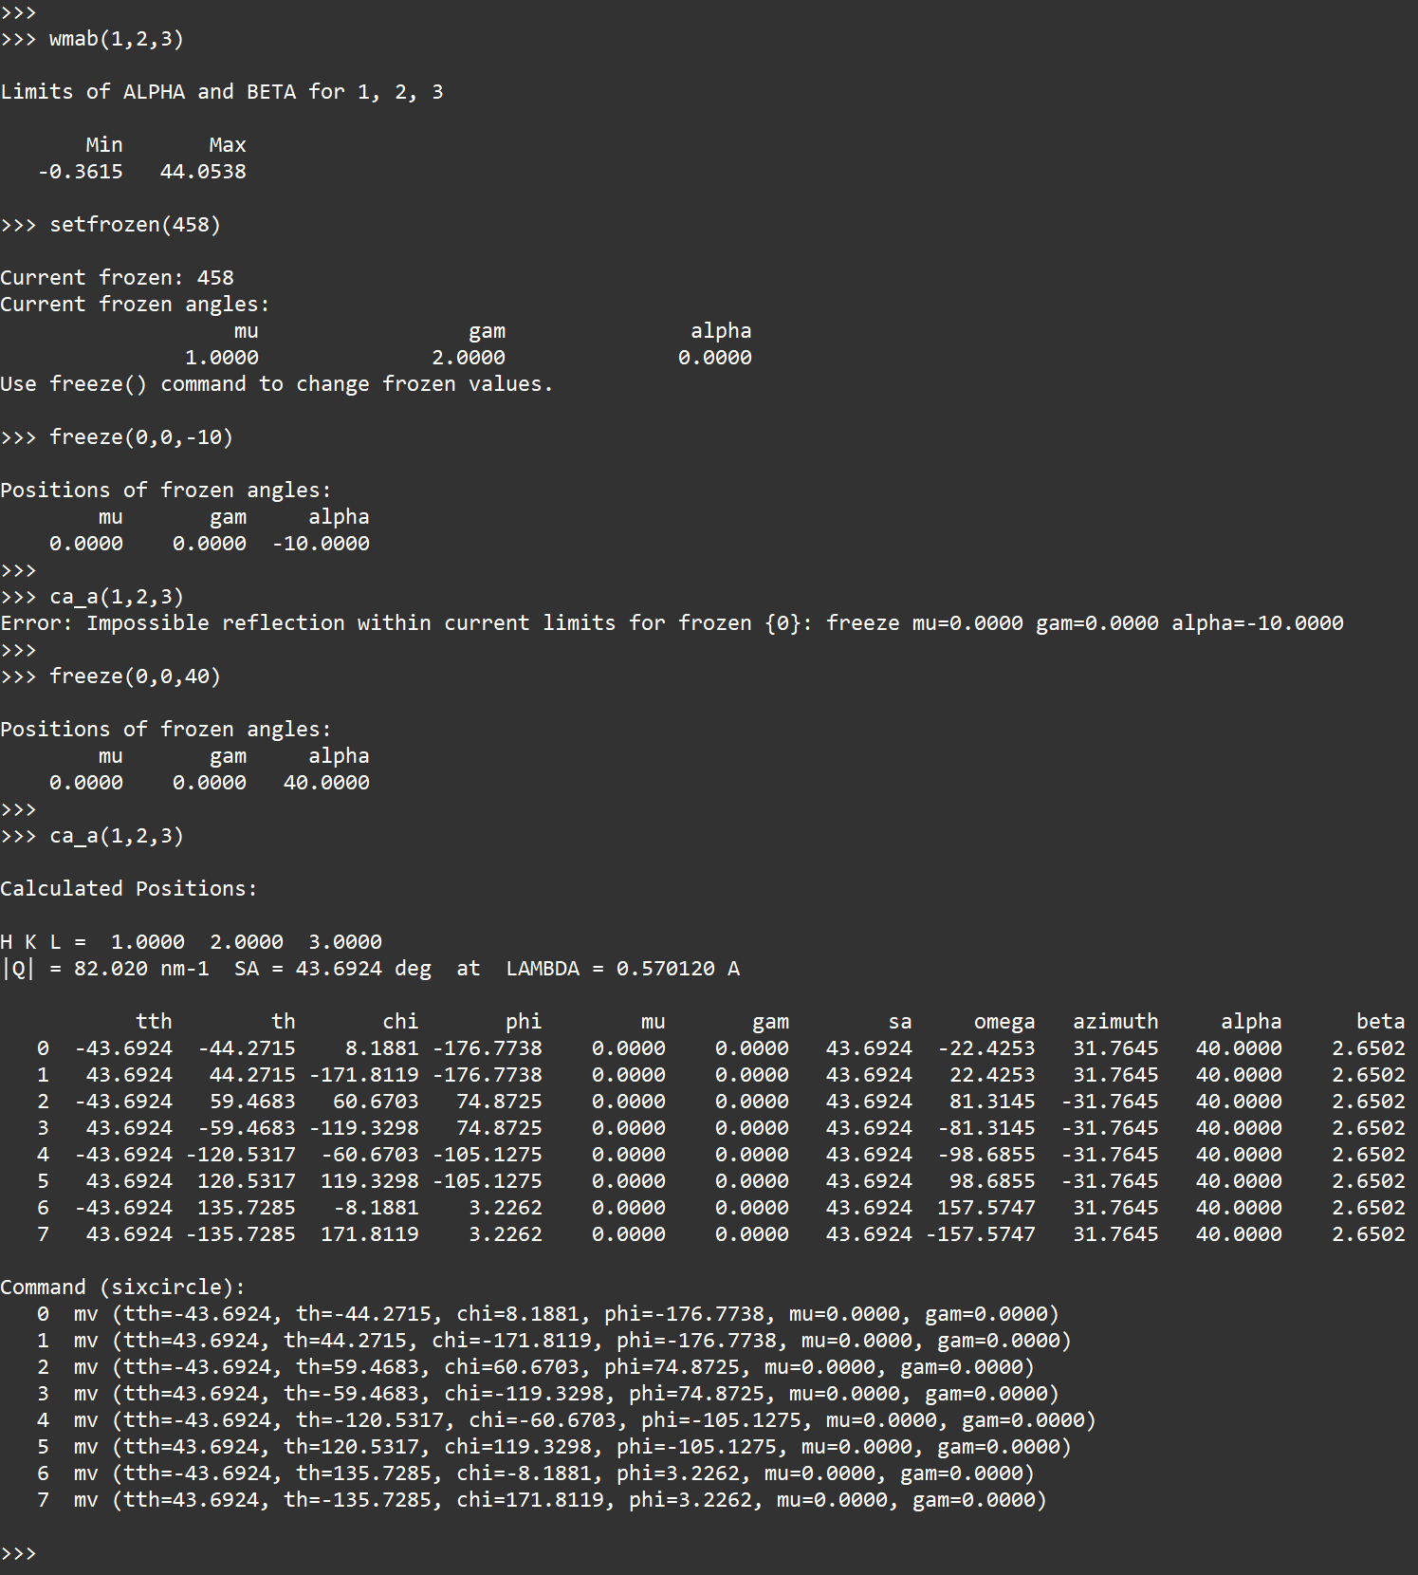
wmab(H, K, L)
Check the limits of alpha and beta for H, K, L.
This is simply determined by the deflection angle of (HKL) and the angle from (HKL) to the reference vector.

Slide 13
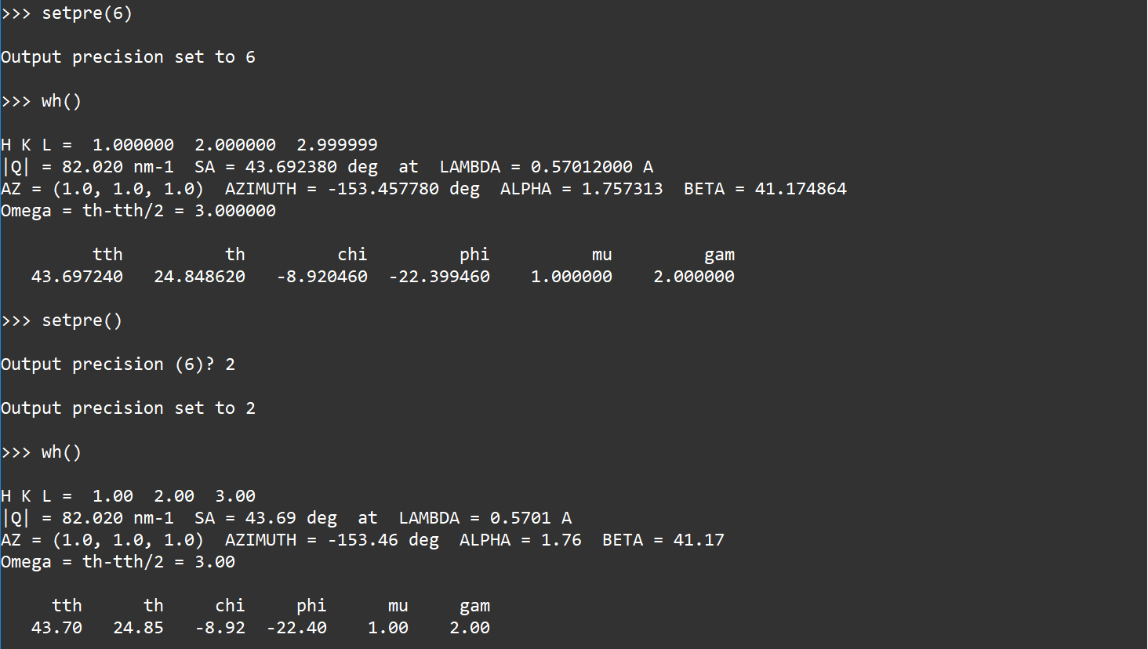
setpre()
setpre(4)
Set the number of digits in output.

Slide 14
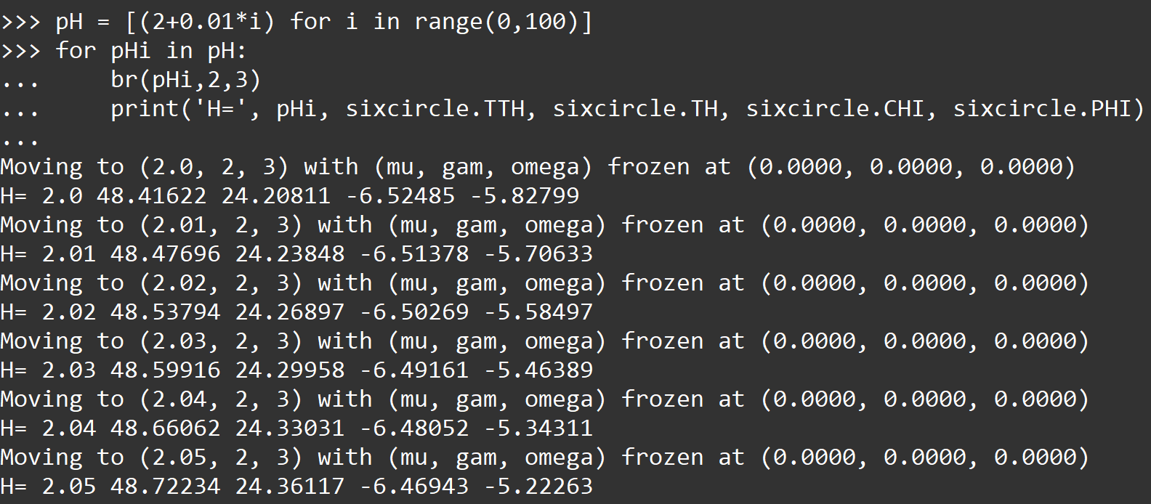
Discussion on multiple sets of positions
There are numerous sets of positions for one HKL vector. When freezing three angles, the number of sets becomes finite, generally 2, 4, 6, 8, or more, depending on frozen angles and corresponding positions. Please note these sets are different from the eight sectors in FOURC (https://certif.com/spec_manual/fourc_4_6.html), and, when mu or gamma is nonzero, the eight sectors in FOURC are invalid in SIXC geometry.
Sets of positions are arranged in a simple order: Firstly compare the distance from tth to zero, then compare the th, then chi, phi, mu, gamma. It is necessary to arrange them in a better order.
Loops and branches in python shell
Users can run some simple loops and branches directly in python shell.
For example:

Slide 15
To prepare user’s own toolkit
Users can also prepare their own toolkit using sixcircle.py.
One example is sixcircle_rqd.py
Put the toolkit.py in the same directory with sixc.py.
import sixcircle; from sixcircle import *, so that it can visit functions and global variables in sixcircle.py.
After preparing the toolkit, enter from toolkit import * in python shell after starting sixcircle.
List of global variables:
# Current positions
TTH, TH, OMEGA, CHI, PHI, OMEGA, MU, GAM, SA, ABSQ
# Current H, K, L, alpha, beta, azimuth
H, K, L, ALPHA, BETA, AZIMUTH
# frozen mode
g_frozen
# Frozen positions of angles:
F_TTH, F_TH, F_CHI, F_PHI, F_MU, F_GAM, F_AZIMUTH, F_OMEGA, F_ALPHA, F_BETA
# Sample description
g_sample
# Azimuth reference vector H, K, L
g_haz, g_kaz, g_laz
# Lattice parameters: a, b, c, alpha, beta, gamma
g_aa, g_bb, g_cc, g_al, g_be, g_ga
# Primary reflection: H, K, L, wavelength
g_h0, g_k0, g_l0, g_lambda0

Slide 16
To prepare user’s own toolkit
# Primary reflection: positions of tth, th, chi, phi, mu, gam
g_u00, g_u01, g_u02, g_u03, g_u04, g_u05
# Secondary reflections: H, K, L
g_h1, g_k1, g_l1, g_lambda1
# Secondary reflection: positions of tth, th, chi, phi, mu, gam
g_u10, g_u11, g_u12, g_u13, g_u14, g_u15
# Wavelength in current calculation
LAMBDA
# Output precision
PRE
# Flag of wa_on or wa_off
FLAG_WA
To visit one global variable, for example, sixcircle.g_frozen, other than g_frozen.
It is not recommended to modify global variables directly.
Two additional functions are also available in preparing toolkit:
flag, pos = ca_s(H, K, L)
Calculate positions in specified mode
‘_s’: silent, calculation in background
flag: True (False) when calculation is successful (failed: no solution)
pos: N set of positions, [[mu1, gam1, tth1, th1, chi1, phi1, sa1, azimuth1, alpha1, beta1, omega1],[mu2,...],...,[muN,...]]
flag, min, max = wmab_s(H, K, L)
Check where the limits of alpha and beta are for H, K, L
‘_s’: silent, calculation in background
flag: True (False) when calculation is successful (failed: impossible HKL reflection)

Slide 17
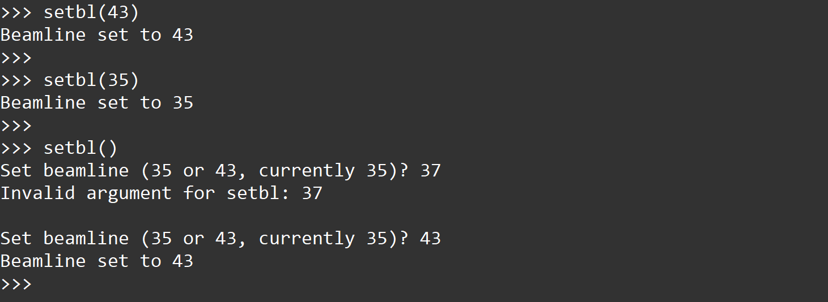
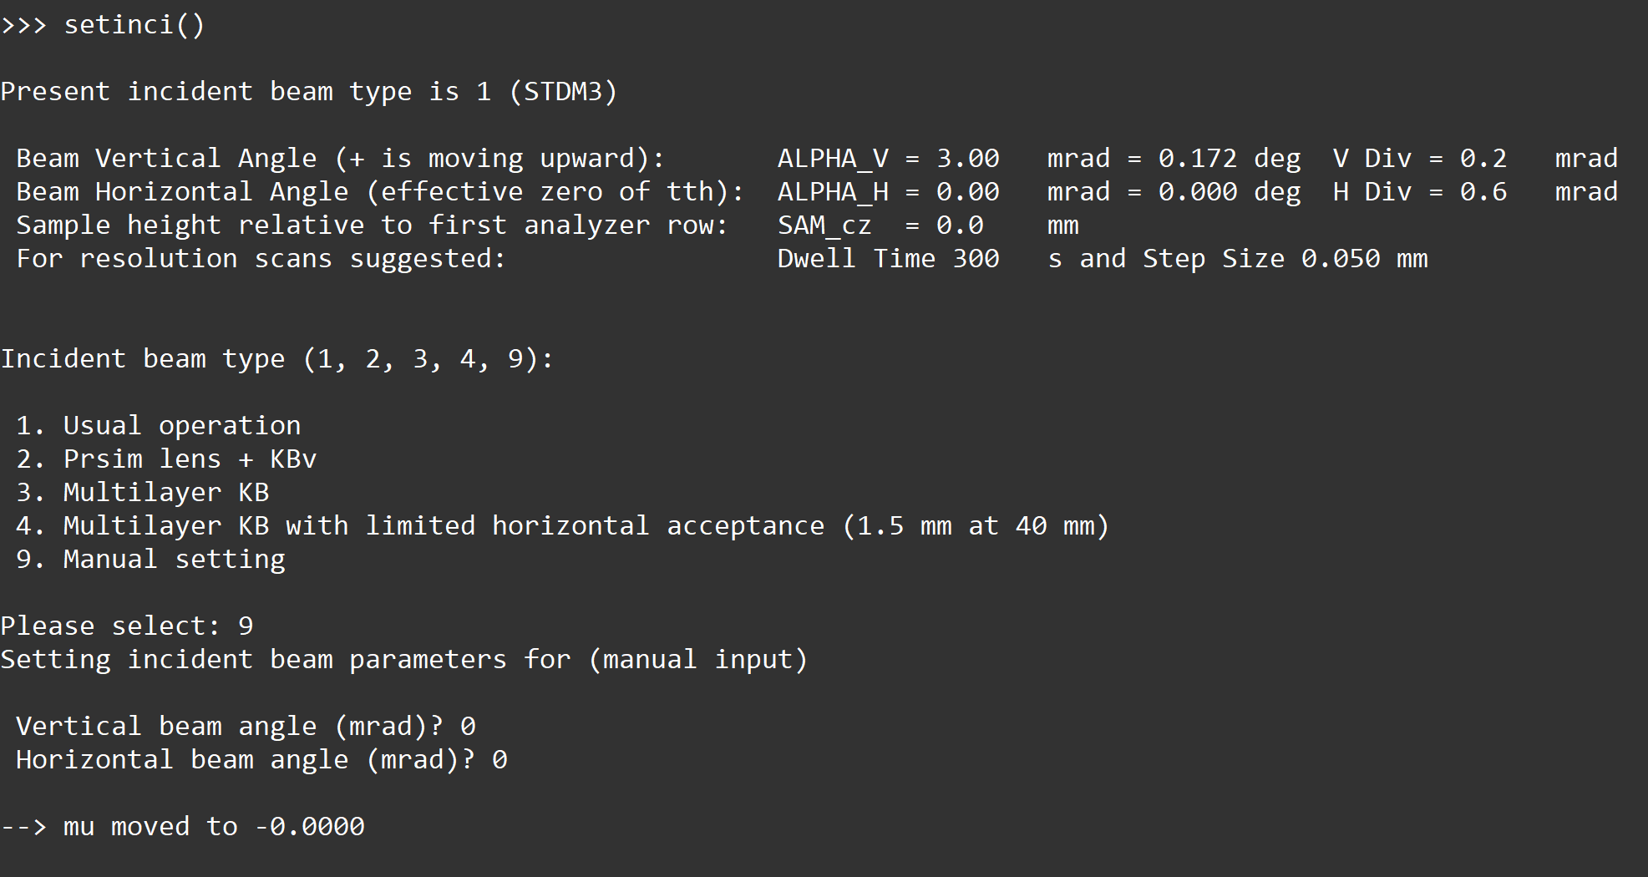
About sixcircle_rqd
setbl()
setbl(43) or setbl(35)
setinci()
setinci(1)

Slide 18
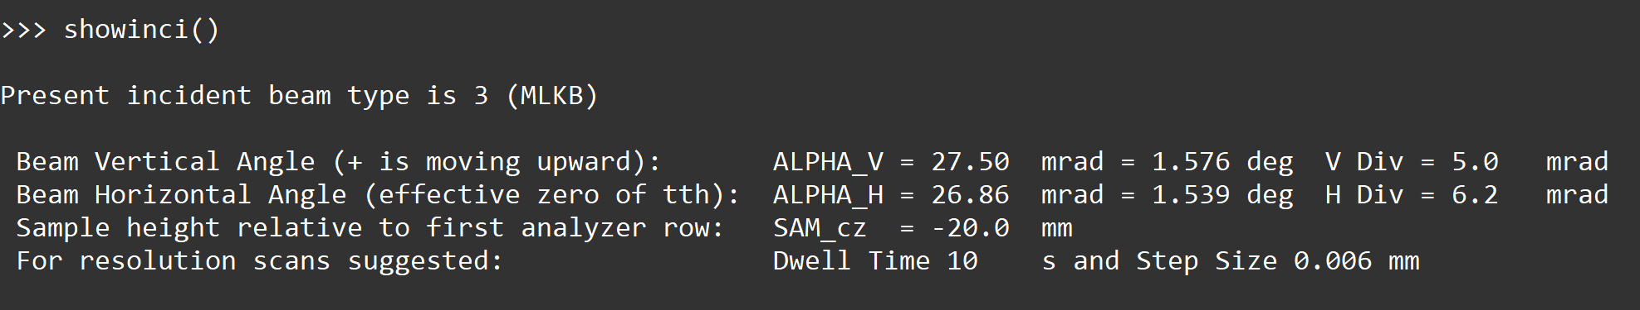
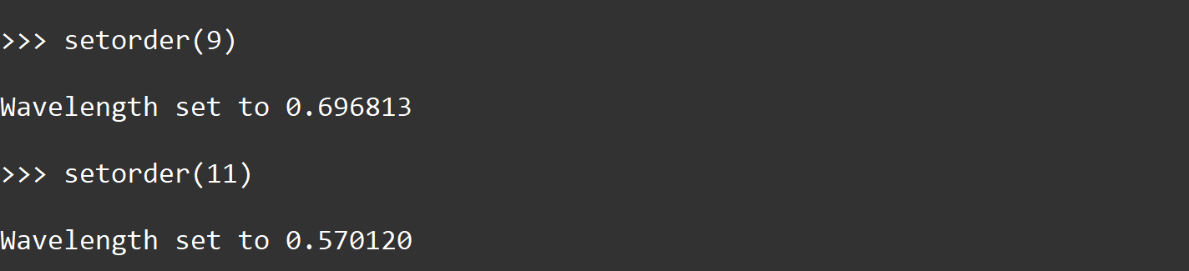
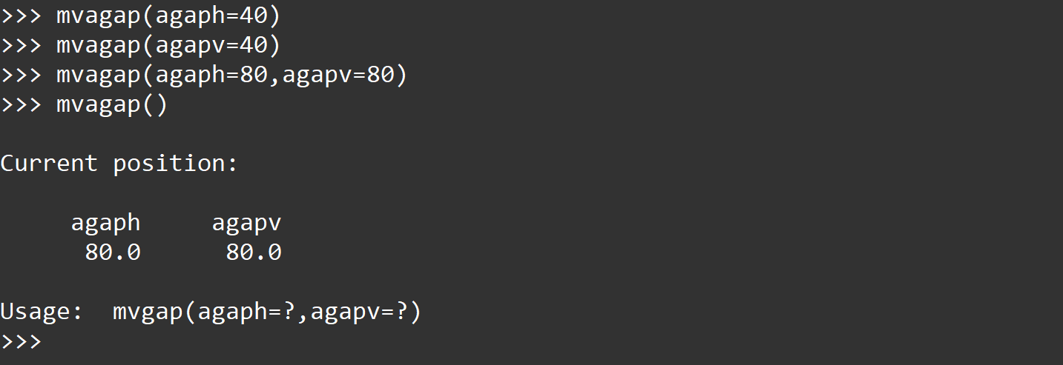
About sixcircle_rqd
showinci()
setorder()
setorder(11)
mvagap()
Check agaph, agapv
mvagap(agaph=?, agapv=?)
Move agaph, agapv

Slide 19
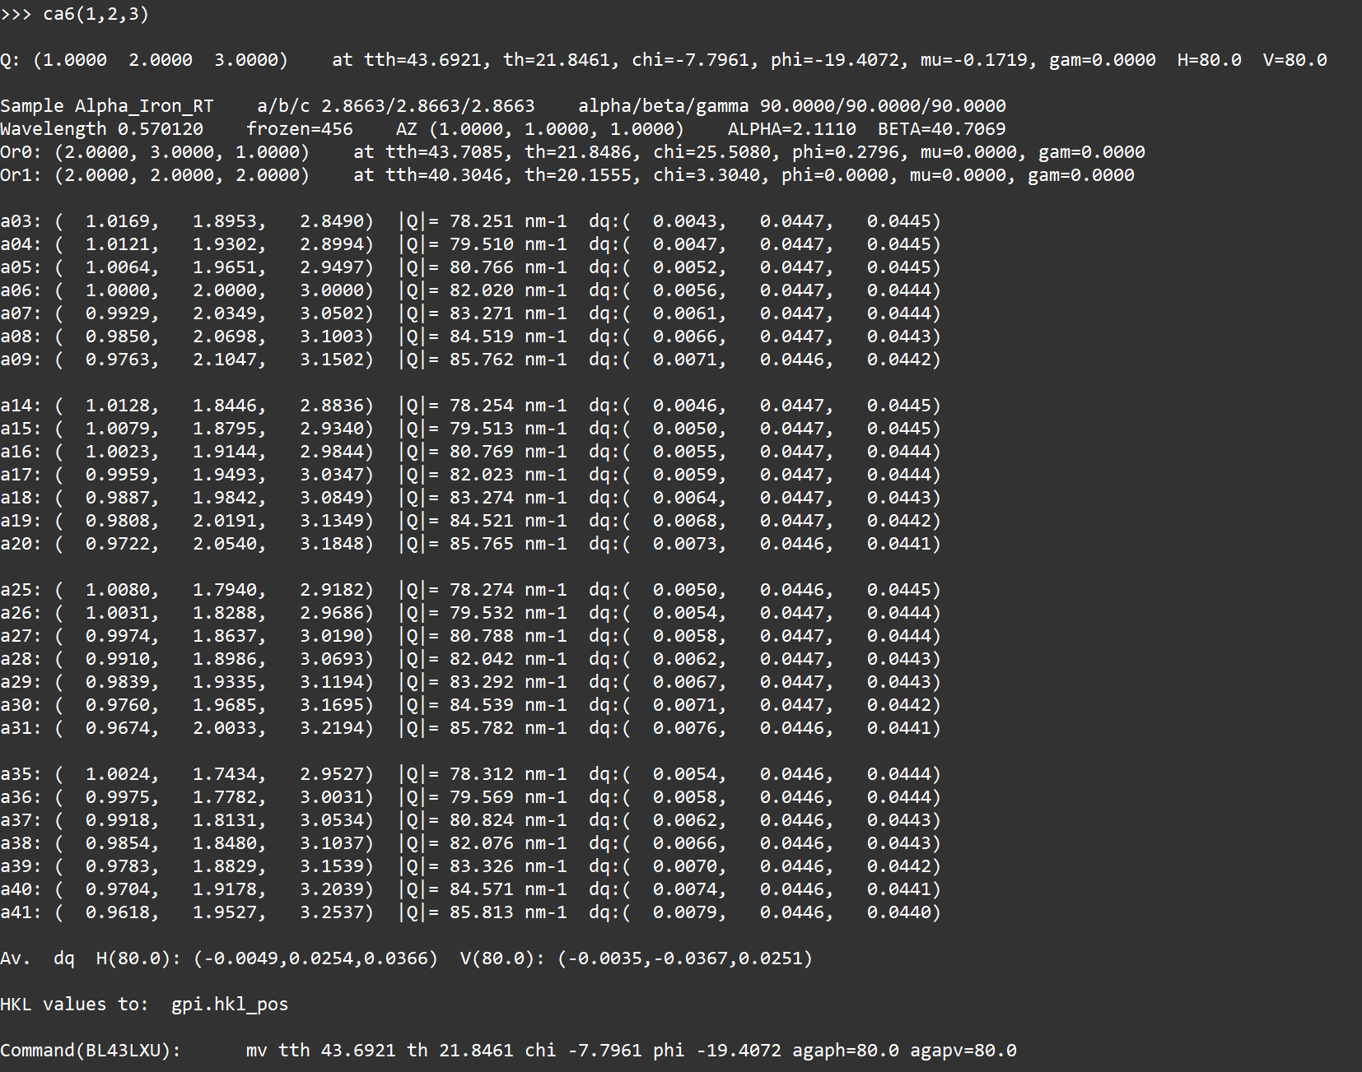
ca6(H, K, L)
ca6(H, K, L, tH, tK, tL)
Calculate reflection of every analyzer when A06 is put to H, K, L.
Optional vector tau=(tH, tK, tL) represents the reference reciprocal lattice point.
Do calculation for the first set of positions. File “gpi.hkl_pos” will be created.
For bl43lxu:

Slide 20
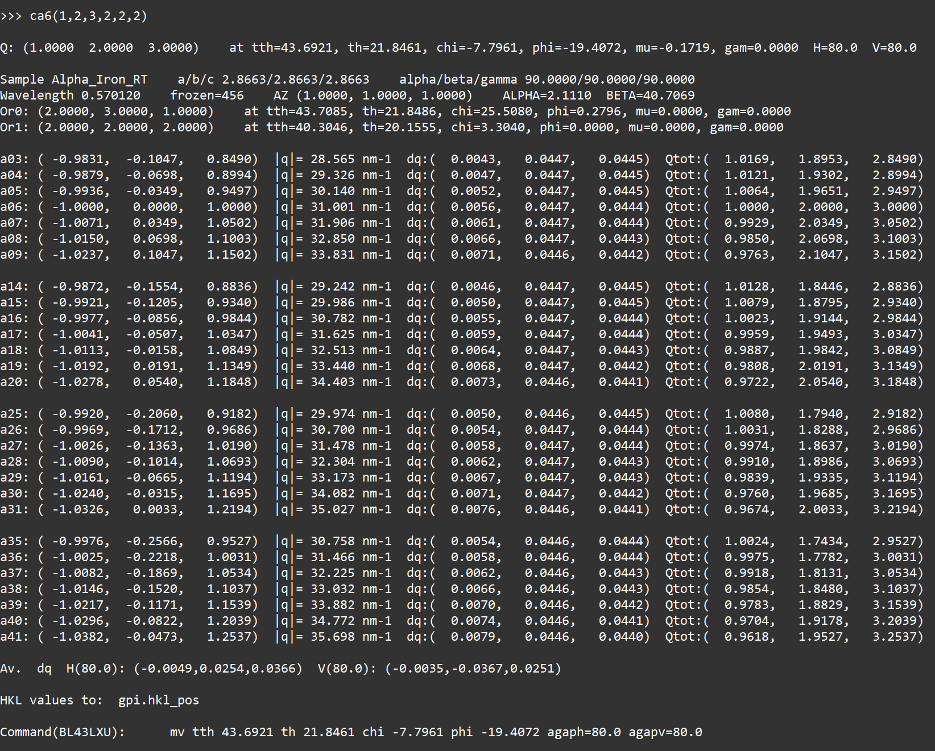
ca6(H, K, L)
ca6(H, K, L, tH, tK, tL)
Calculate reflection of every analyzer when A06 is put to H, K, L.
Optional vector tau=(tH, tK, tL) represents the reference reciprocal lattice point.
Do calculation for the first set of positions. File “gpi.hkl_pos” will be created.
For bl43lxu:

Slide 21
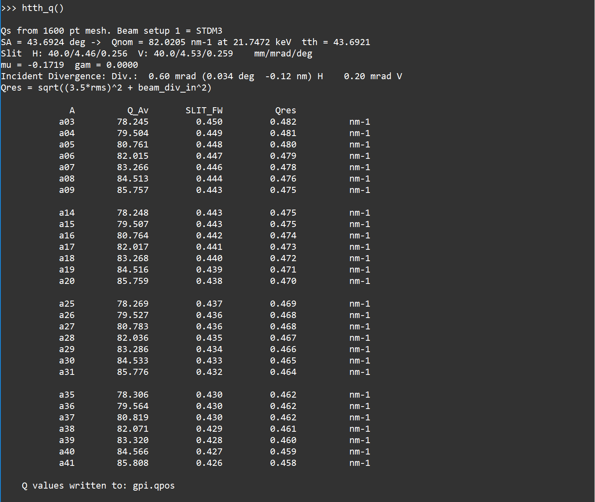
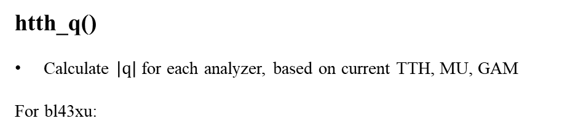
htth_q()
Calculate $\left|q\right|$ for each analyzer, based on current TTH, MU, GAM
For bl43xu:

