Slide 1
Sample preparation and sample environments
Eli Stavitski, ISS Lead beamline scientist
Fundamentals of XAS Data Analysis: A Hands-on Tutorial, BNL , October 10–12, 2023

Slide 2
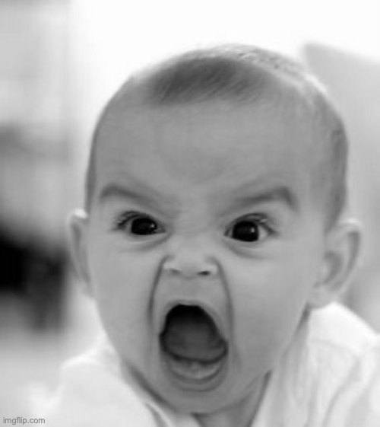
Why talking about sample preparation?
Over a half of lost time during synchrotron beamtime is due to the sample quality deficiencies
If you do not recognize how sample quality affects the XAS data, you will collect and potentially publish misleading results
This presentation does not include math: see, e.g., http://gbxafs.iit.edu/training/XAFS_sample_prep.pdf for more quantitative explanation of the underlying phenomena

Slide 3
Best approach
Speak with beamline staff!

Slide 4
Sample preparation – victim of XAS popularity
XAS is versatile: almost anything can be measured (solids, liquids, gases, soil, dust, batteries, fuel cells, meteorites, wastewater, colloidal suspensions, protein solutions etc)
Your specimen must be transformed into a sample!
What are the characteristics of a good sample?
Concentration compatible with one of the common detection methods
Doesn’t introduce spectra distortion
Can be handled ☺
Oftentimes, the samples are just what they are…

Slide 5
Detection methods: transmission vs. fluorescence
Transmission: photon flux detected upstream of the sample and downstream of the sample
Fluorescence: emitted photons are collected by the detector placed on the side of the sample
For transmission absorbance (per Beer-Lambert law) is µ = -log(I_{t} /I₀ )
For fluorescence, in thin dilute sample approximation, intensity is proportional to µ
Sample
Detector I_{t} (ion chamber)
Detector I₀ (ion chamber)
Side note: we often put a corresponding metal foil and another detector for energy calibration
Side note: mind this distance: air absorbs photons
Fluorescence detector

Slide 6
Sample size
Considerations:
Beam size at a specific beamline
ISS: 1 mm (H) x 1 mm(V) or 50-100 µm (FWHM).
QAS: 10 mm(H) 1.5 mm(V) x 10 mm(H), or ~0.5 mm (FWHM),
BMM: 8 mm (H) by 1 mm (V) or 300 µm (FWHM).
Standard holder
Ease of handling

Slide 7
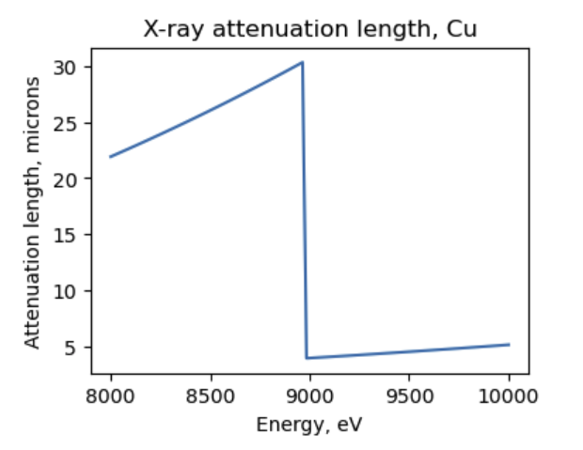
Uniformity is the key!!
Basic rule of sample preparation: sample shall be made homogenous so that every X-ray photon interacts identically no matter what area on the sample it hits.
Attenuation Length: The depth into the material measured along the beam where the X-ray flux falls to 1/e of its value at the surface.
To be homogenous enough means particles shall be smaller than the attenuation length
Disclaimer: sometimes you cannot make smaller particles, e.g., certain sieve fraction of a catalyst to prevent gas flow blockage.

Slide 8
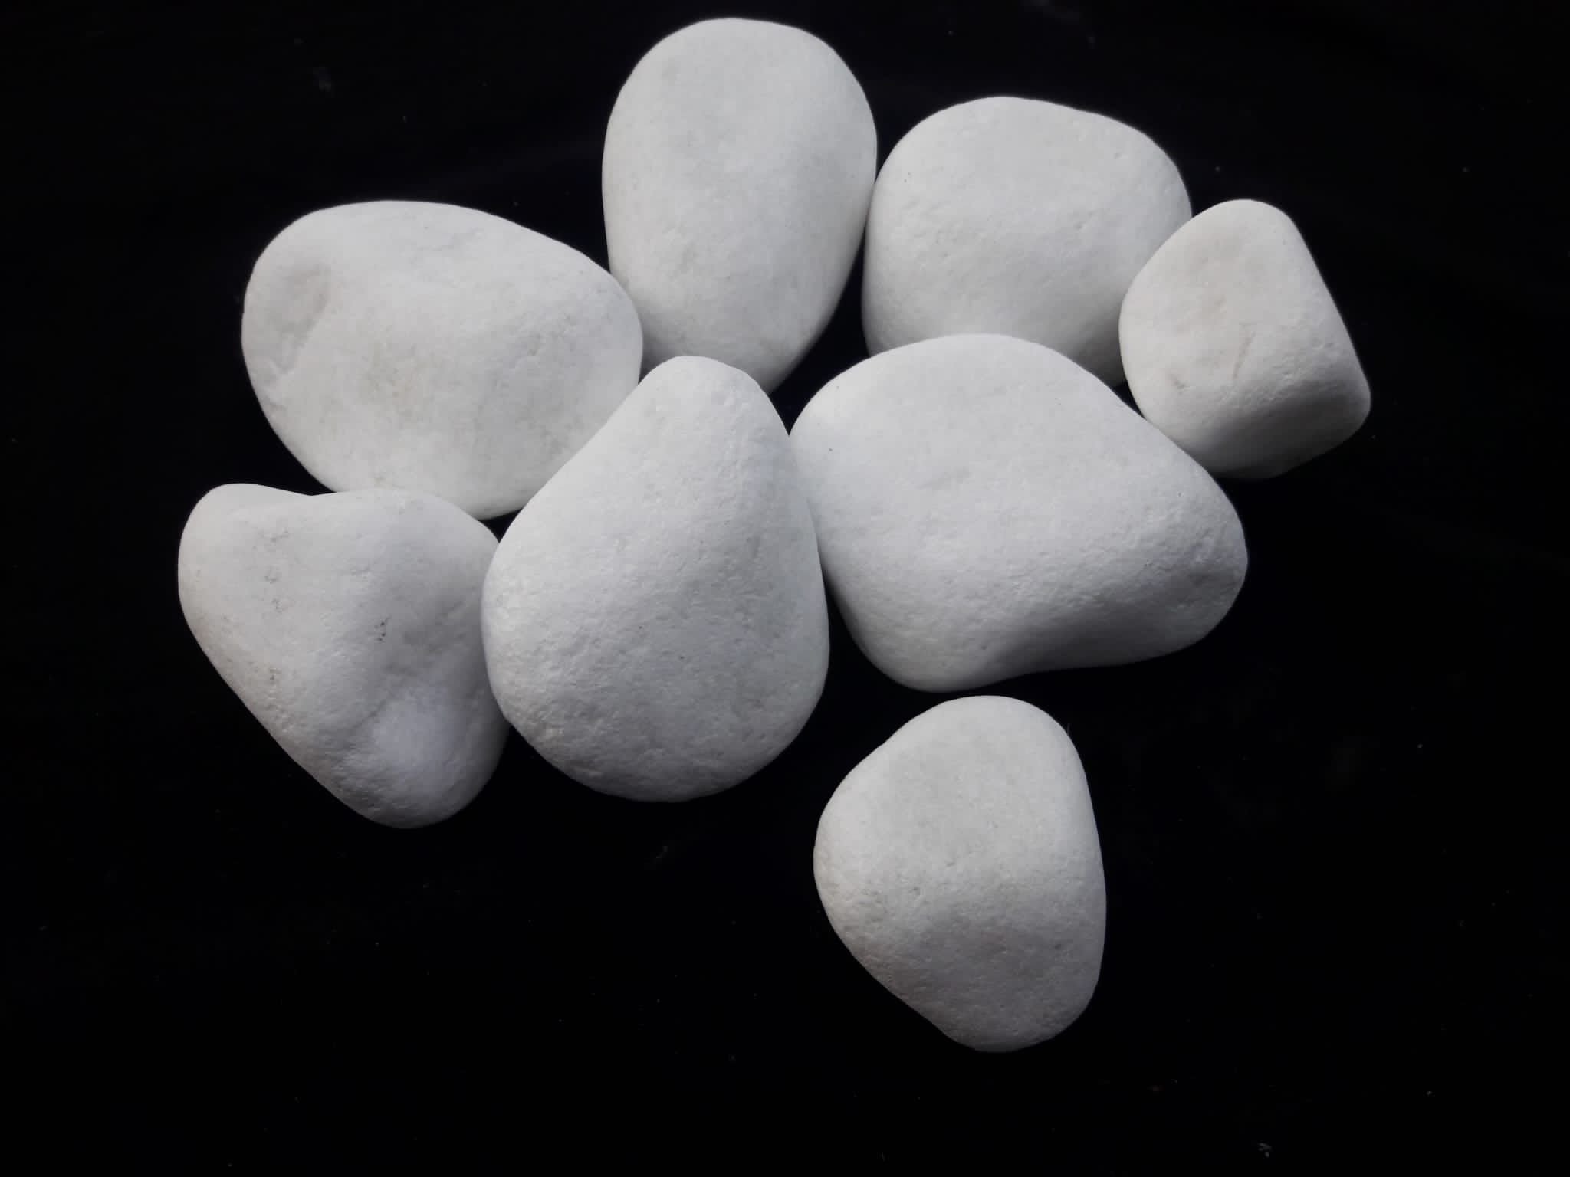
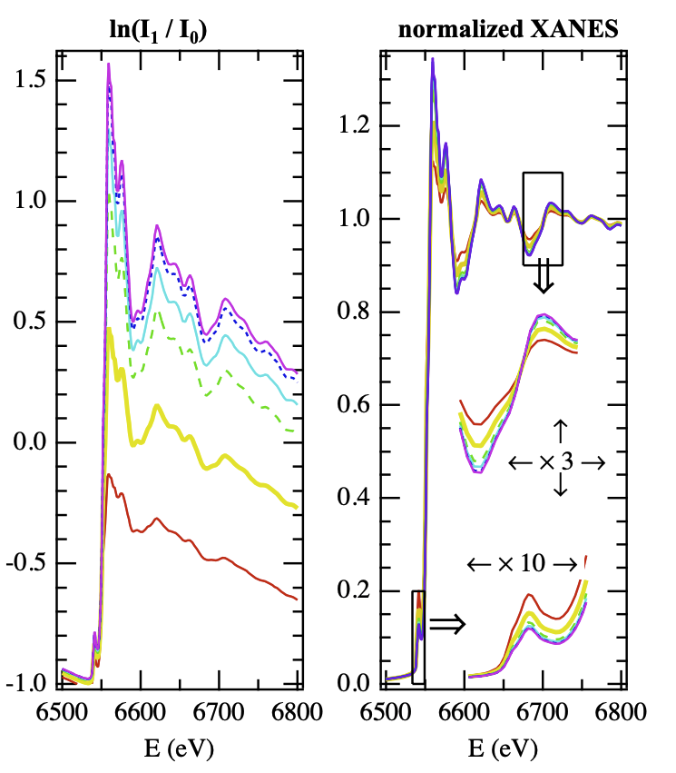
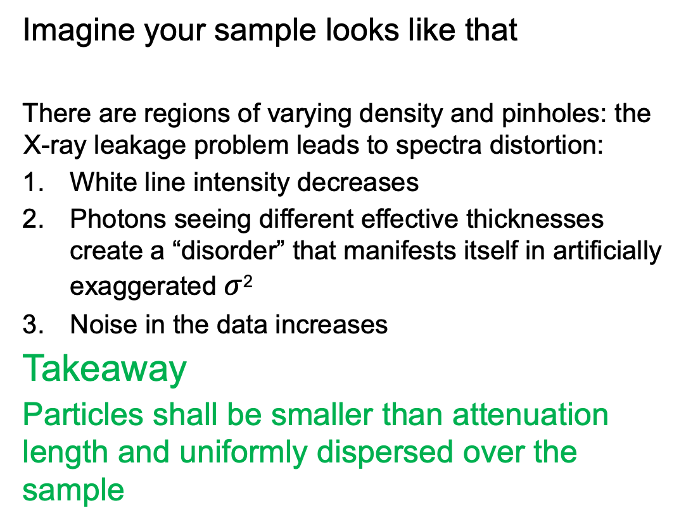
Uniformity is the key!! (cont.)
Imagine your sample looks like that
There are regions of varying density and pinholes: the X-ray leakage problem leads to spectra distortion:
White line intensity decreases
Photons seeing different effective thicknesses create a “disorder” that manifests itself in artificially exaggerated $σ$²
Noise in the data increases
Takeaway
Particles shall be smaller than attenuation length and uniformly dispersed over the sample
Simulated spectra for particle sizes from 30 um to 0.3 um
Notes:
Particles f

Slide 9
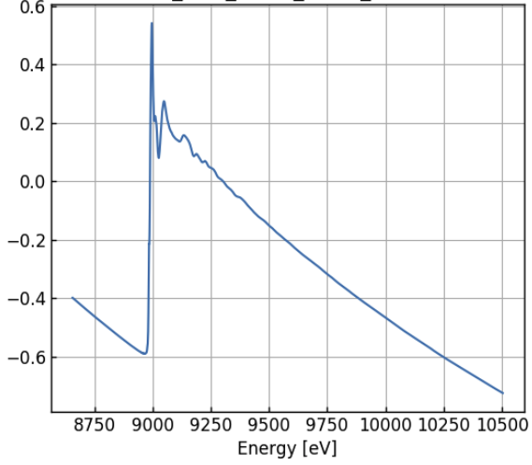
Sample preparation for transmission experiments
It is recommended that the sample for transmission measurements has an edge step of 1-1.5 (however, 0.1-1 can be acceptable if the sample is of good quality)
Edge jump of ~0.65

Slide 10
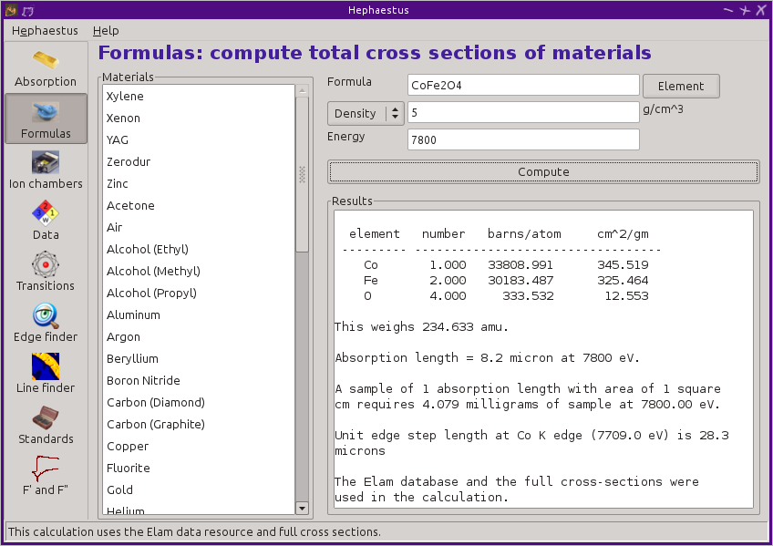
Sample preparation for transmission experiment
Finding right amount of sample with Hephaestus
Chemical formula
Density
List of typical materials
Energy (100 eV above the edge energy)
Absorption length
Amount of material/cm² for the edge jump of 1

Slide 11
Making pellets
Most reliable ex situ sample preparation method is making pellets made using a hydraulic (or hand) press (similar to IR pellets)
Inert binder/dilutant may be added to maintain correct concentration
Rule-of-thumb 1 Total amount of sample+binder >100 mg (for ease of handling)
Rule of thumb 2 Grind as long as you can… and then some
Rule of thumb 3 Sample+binder mixture color shall be uniform
Note on binders
BN, cellulose, zeolite, polyethylene glycol (Inert is a relative term: BN catalyzed methane oxidation, zeolites are catalysts, PEG polymerizes under pressure…)

Slide 12
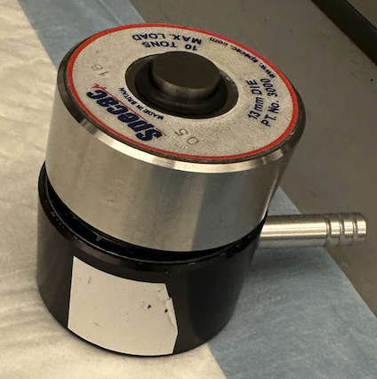
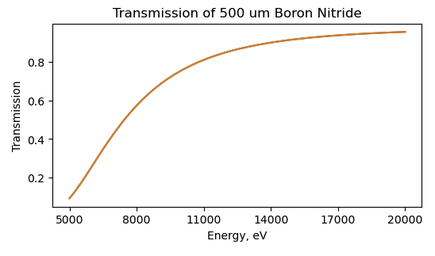
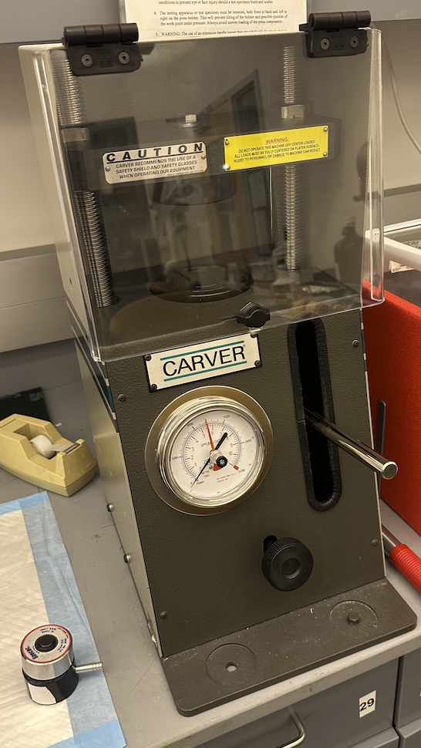
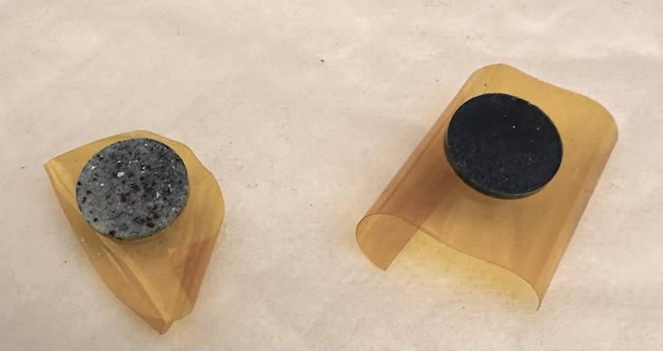
Making pellets
Mind binder absorption
Equipment
Ugly pellet
Nice pellet

Slide 13
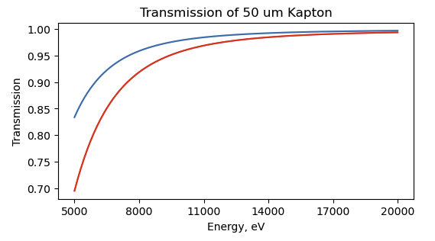
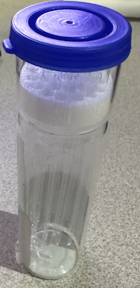
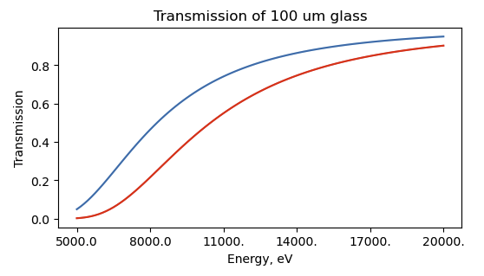
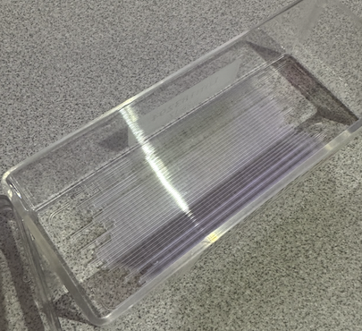
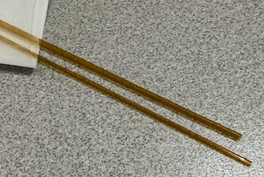
Other sample prep methods
Capillaries
Typical materials – borosilicate glass, quartz, Kapton
Mind the wall thickness: attenuation can be strong
Even though in situ comes later:
If heating is involved:
Glass – up to 600 ºC
Quartz – up to ~ 1300 ºC (becomes brittle)
Kapton – up to 300 ºC
Capillaries can be sealed with epoxy, quartz wool or wax

Slide 14
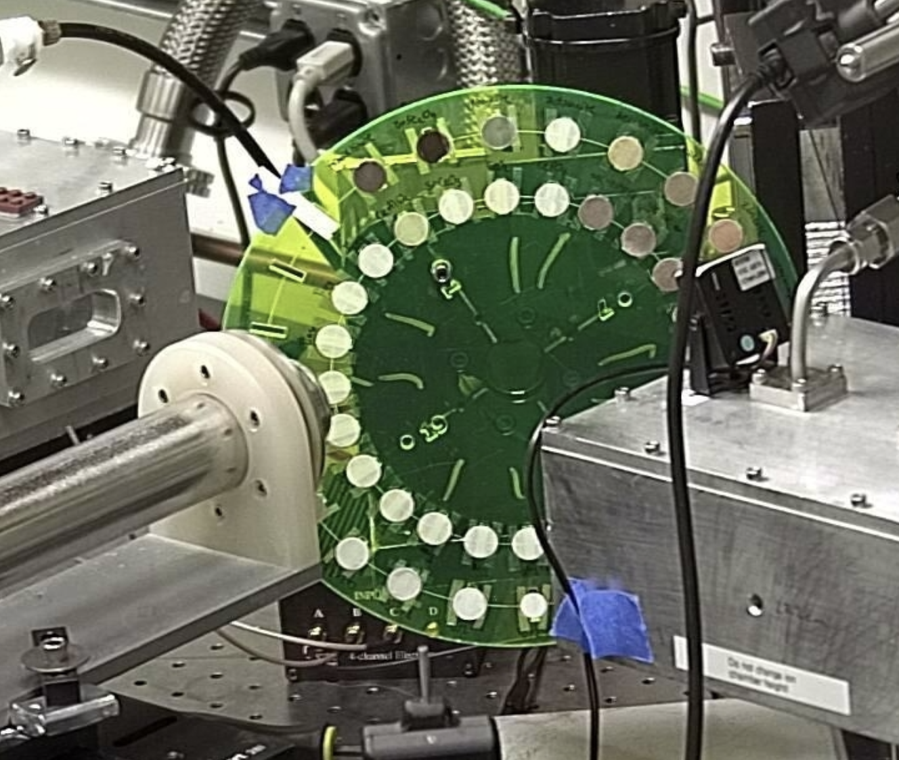

Other powder sample prep methods
Fill the wells in the sample holder with powder
Sample on adhesive tape
My personal opinion: It shall not be done
If you have absolutely no choice, the powder shall be ground and spread as thin as possible, and the tape folded
Always take the spectrum of the tape – you might be surprised
Mind the absorption of the tape - may be critical at lower side of the spectra

Slide 15
When to measure in fluorescence
Sample has low loading yielding edge jump of 0.1 or less
Sample is supported on opaque substrate (thin film on Si wafer)
It is undesirable or impossible to manipulate the sample (art object, meteorite etc.).
Low energy edges cannot be measured in transmission
A good fluorescence sample:
Homogenous – while effects of leakage and non-uniformity are not as severe as in transmission, it is still desirable.

Slide 16
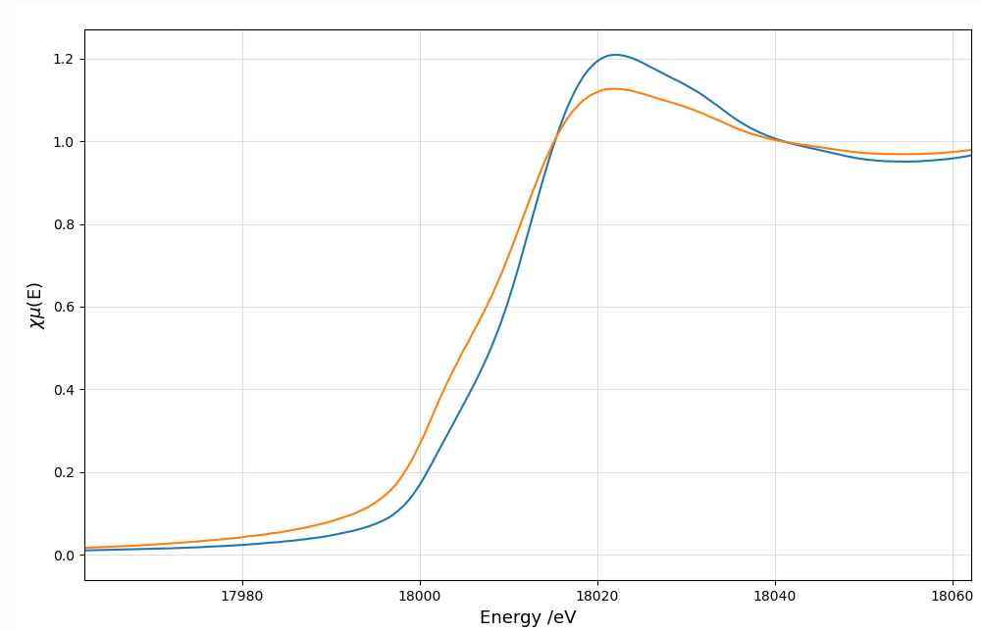
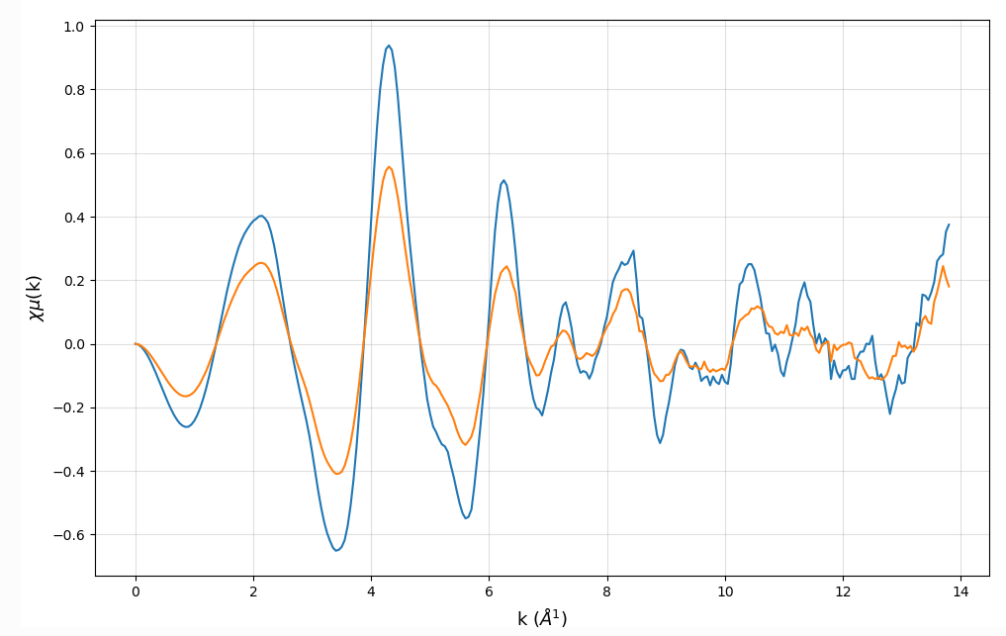
Self-absorption in fluorescence measurement
Spectral distortion (reduced white line and EXAFS wiggles) is the result of changing penetration depth of X-ray beam when scanning through the edge
No
absorption
Strong
absorption
Varying
absorption
Sample

Slide 17
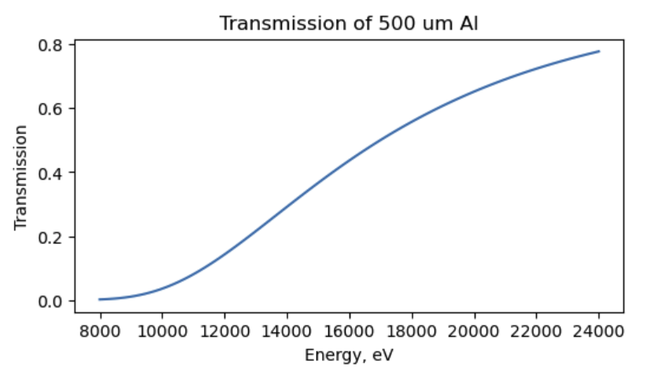
Fluorescence measurements best practices
This is particularly important for dilute sample
Avoid sample holders/sample environments made of same or neighbor elements (and mind overlap between 3d K edges and 4f and 5d L edges )
Check windows/tapes/capillary sealing materials for the element of interests (very low levels of Mn, Zn in Mylar, Fe in Kapton have been found)
Avoid fluorescence from in-line calibration foil getting fluorescence detector. Use apertures upstream of the reference foil.
When compounds containing lighter elements are used to support heavier elements (e.g., Pd/CuO), non resonance fluorescence from the support obscures the signal from the element of interest (energy discriminating detector is not always a solution). Use Al foil for reducing lower energy signal.
In the past lead tape was used extensively for ad hoc shielding. It’s banned now due to health and safety reasons. Tin foil ca be used instead – not as blocking but as pliable.

Slide 18
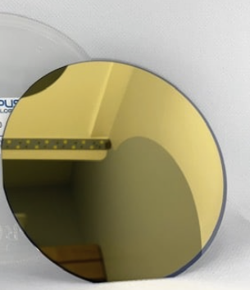
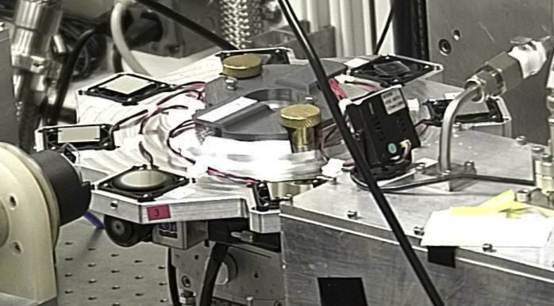
Thin films
Thin films are supported on a substrate
Measured in fluorescence mode
Films are positioned at grazing or near-grazing incidence angle to the beam to spread the beam over a larger surface and increase surface sensitivity
Substrate and films are often crystalline, leading to Bragg peaks hitting the detector.
We often spin the samples to “smear” Bragg peaks

Slide 19
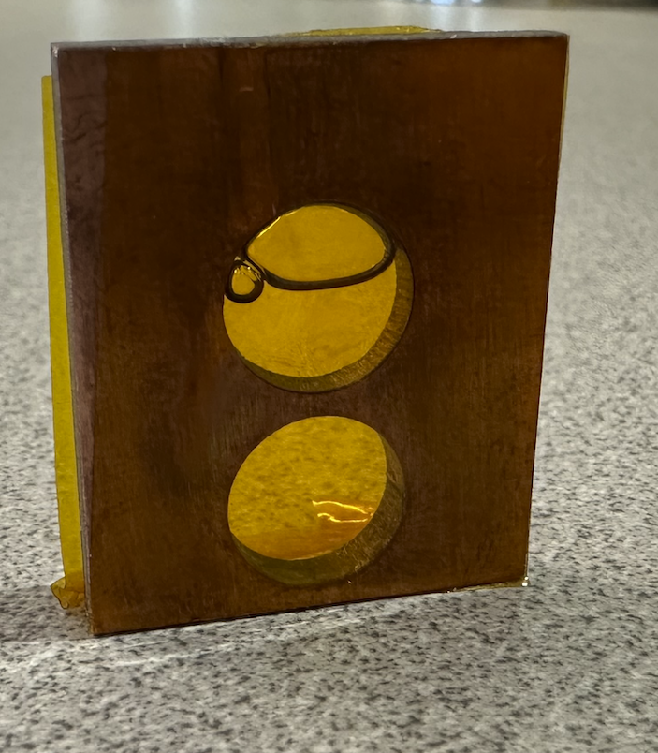
Liquid samples
Naturally homogenous (unless they are suspensions)
Appropriate containment
Capillaries sample
Sample holders with wells or holes sealed with adhesive tape
Beware of beam damage (more on it later)

Slide 20
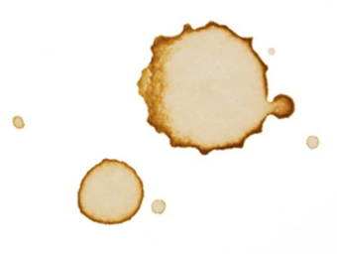
Drop casting
A method to deposit catalyst slurry onto a porous flat substrate, e.g., carbon paper.
Common in electrocatalysis/fuel cells
Usually produces highly inhomogeneous samples due to ”coffee stain” effect
Lower concentration = weak spectra
High concentration gradient = noisy spectra

Slide 21
Sample environments
What we want to expose the sample to:
Temperature
Reactive gases /pressure
Reactive liquids
Pressure
Voltage/current
Magnetic field
We also want to keep the sample intact (limit exposure to X-rays/minimize X-ray beam damage

Slide 22
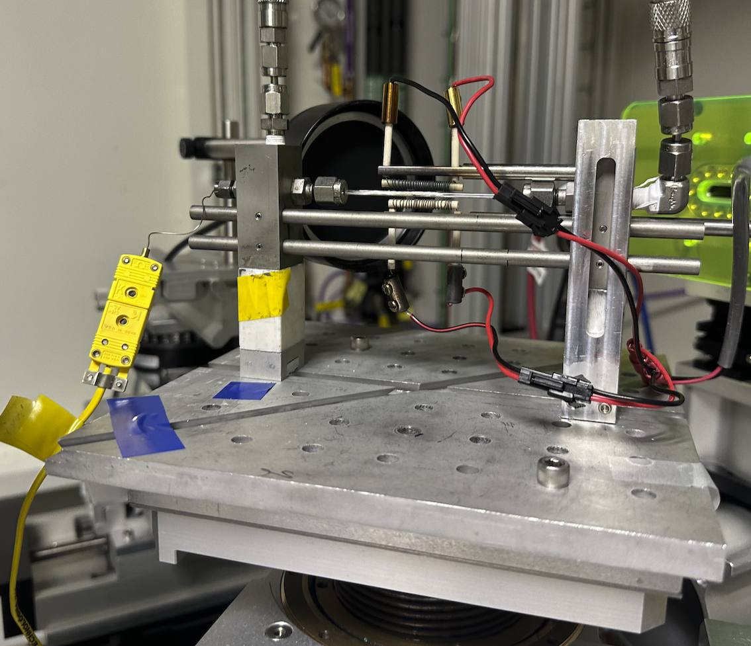
Klausen (capillary) flow cell
Advantages:
Compatible with different capillaries
True plug flow catalytic reactor
Fast cooldown
Disadvantages
Hard to do operando - low catalysis amount, and low gas flow rates are needed to observe conversion
Temperature profile is poorly defined

Slide 23
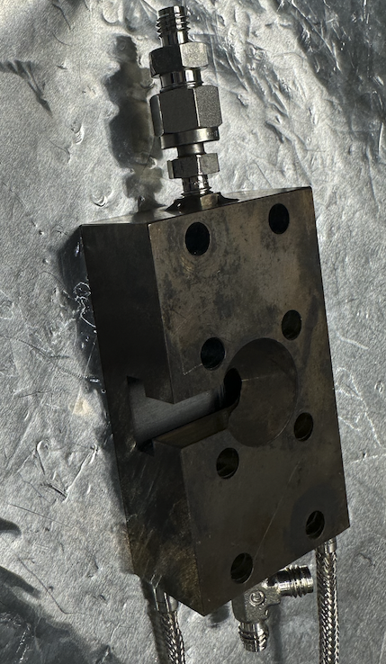
Another capillary flow cell
Advantages:
Compatible with different capillaries
True plug flow catalytic reactor
Better temperature stability
Fast cooldown
Disadvantages
Hard to do operando - low catalysis amount, and low gas flow rates are needed to observe conversion
Temperature profile is poorly defined

Slide 24
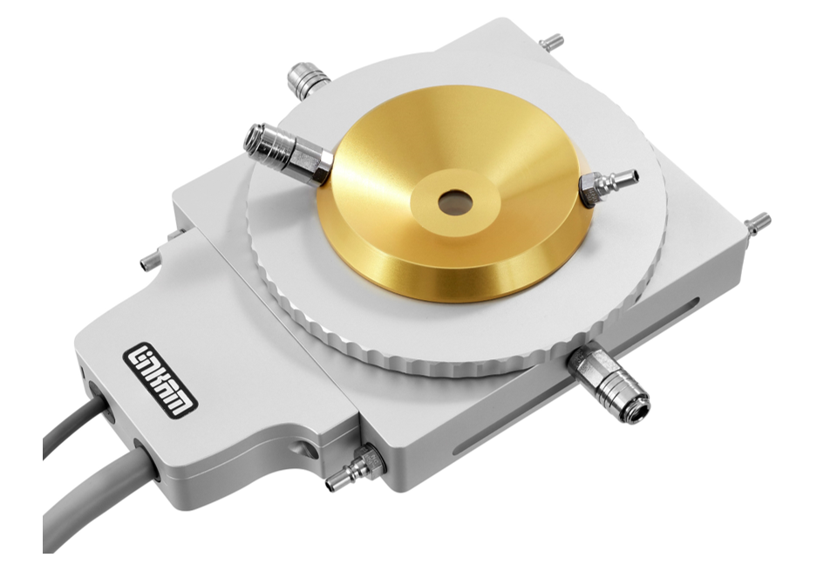
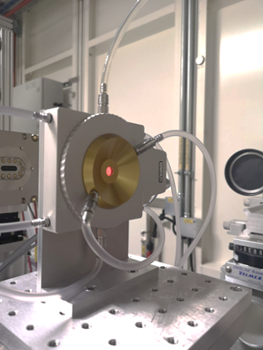
Other temperature cells (commercial)
Commercial designs originally for optical microscopy
Temperatures up to 1500 C
Some design allow cooling
While OK for gas treatment, not suitable for catalysis due to large dead volume.
Some design allow cooling to -195 C

Slide 25
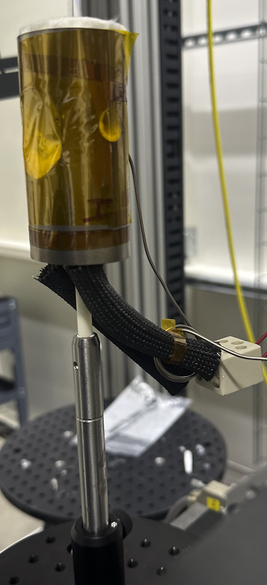
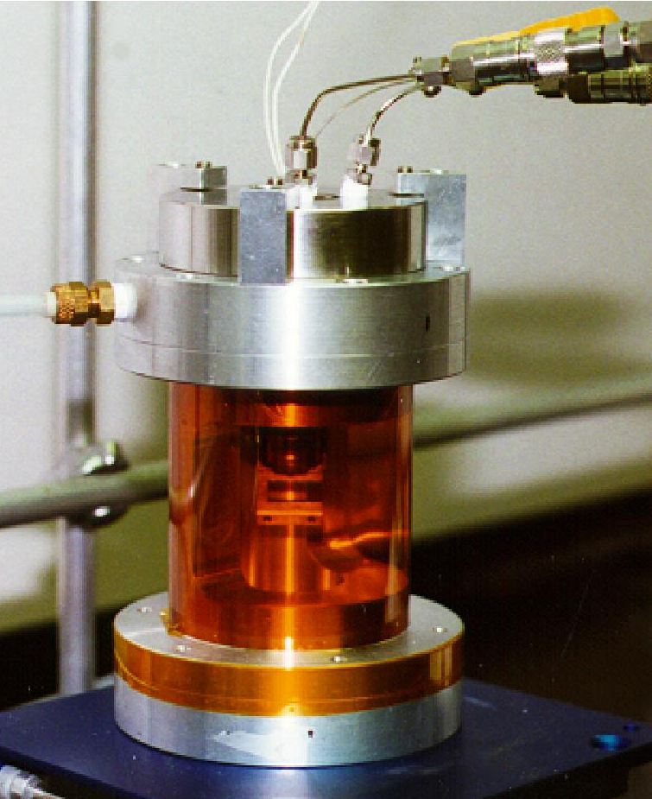
Other temperature cell
Users are allowed to design their own cells, as long as they are safe and have windows/openings for the all/preferred detection methods.

Slide 26
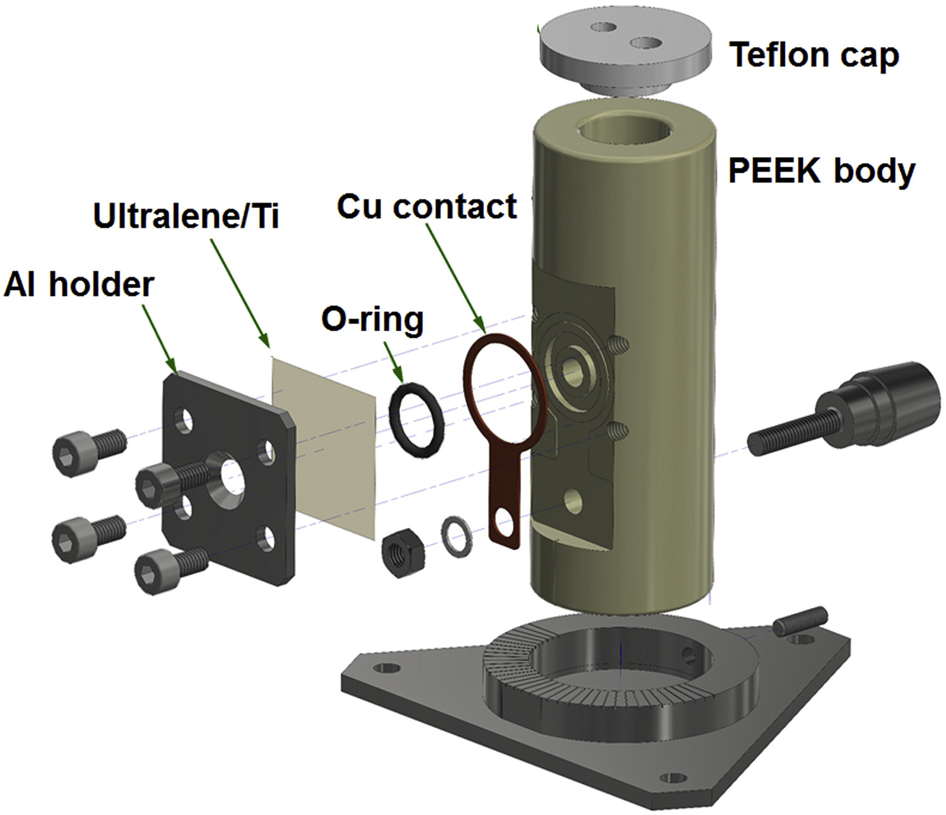
Electrochemical cells
Typically user designed:
Accommodate variable number of electrodes
Location of electrode being investigated is important (due to electrolyte absorption)
Bubble formation is sometimes inevitable
These cells leak!!
Electrochem. Comm., 94, 2018, 14-17

Slide 27
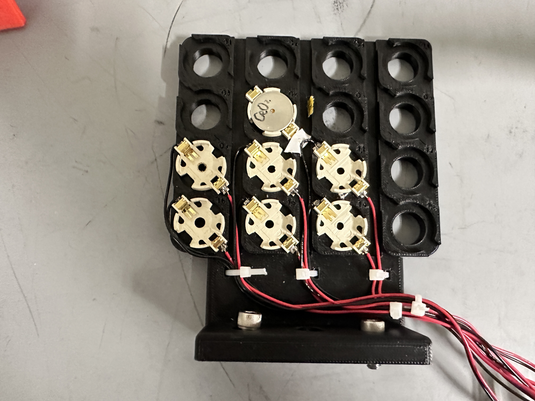
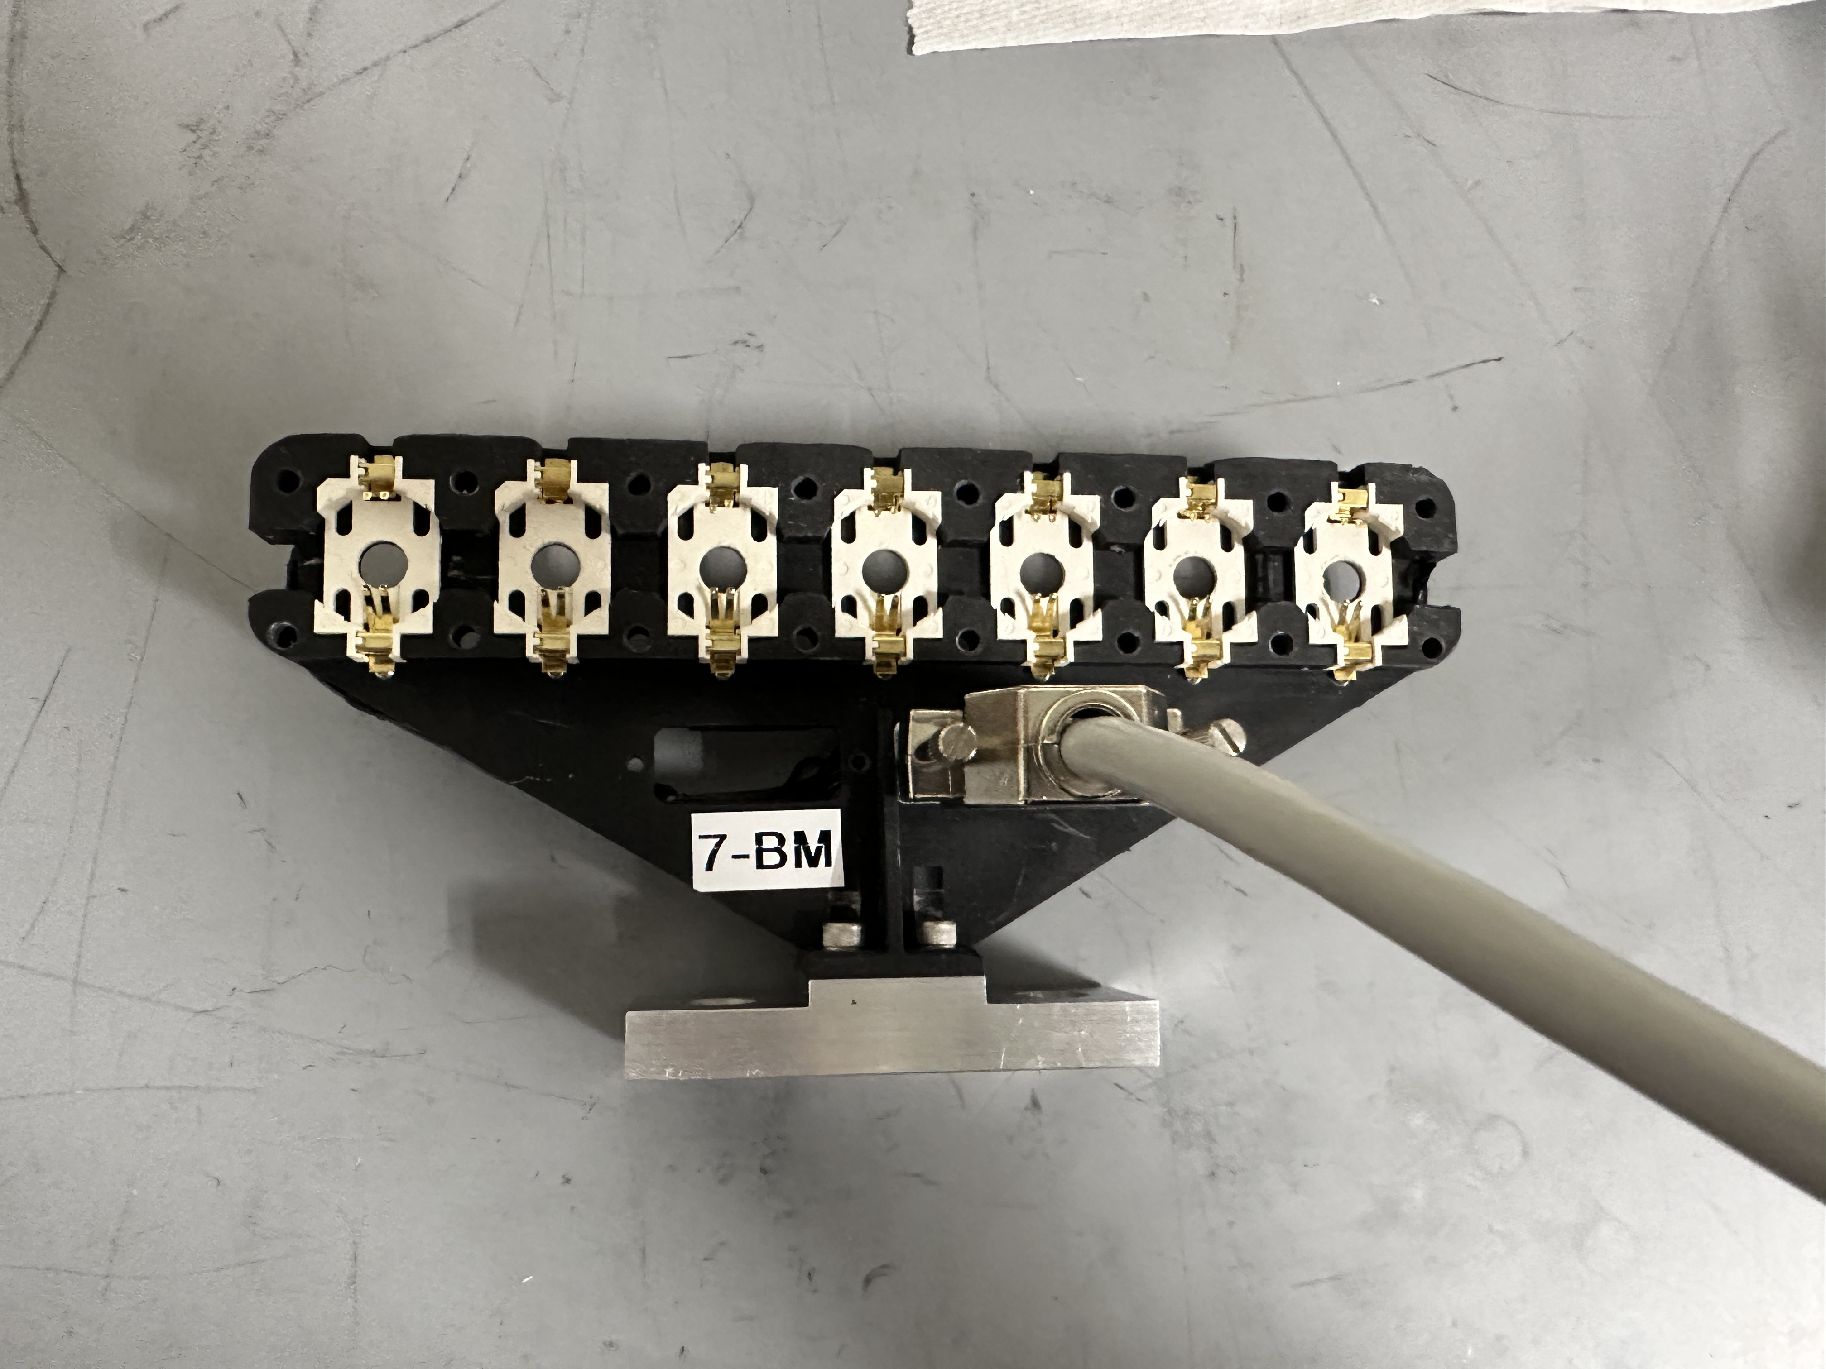
Battery holders
While not sample environments by themselves, they make battery cells handling much easier.
Allow for high throughput measurements
Side note: adding X-ray transparent windows to a coin cell may change field distribution and chemistry

Slide 28
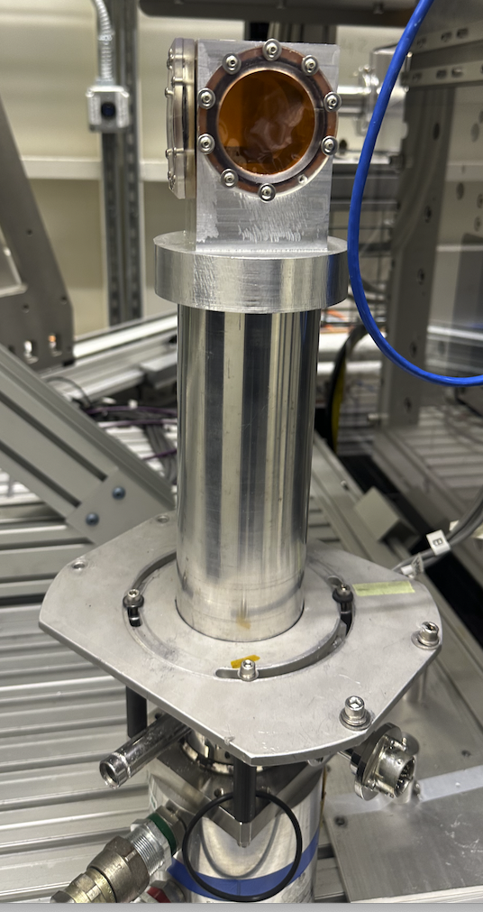
Cryostats
Allow for low temperature measurements down to a few K
Thermal motion decreases, and EXAFS can be recorded up to higher k.
Improves sample radiation sensitivity
Cooling is slow (can be >1h)
Sample handling is difficult, especially if samples need to be mounted frozen

Slide 29
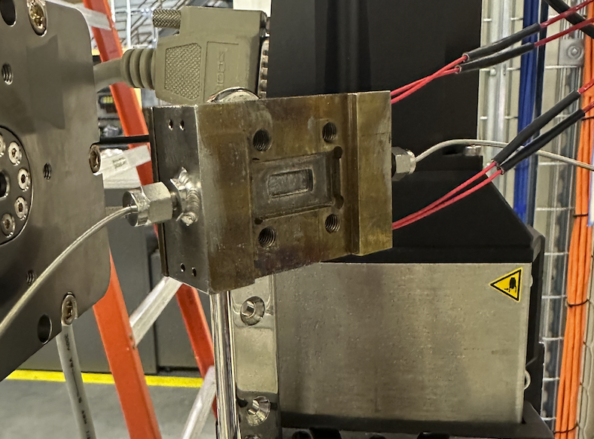
High pressure gas and liquid cells
When catalytic (or other) experiment requires reactant pressures above ambient, custom cell are required.

Slide 30
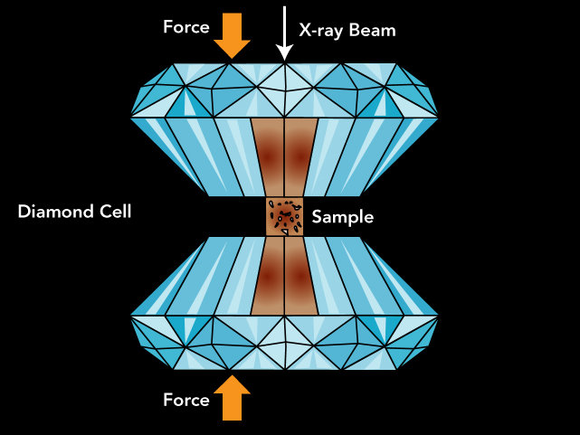
Really high pressure cell
Diamond anvil cells allow to create pressures up to 700 Gpa (usually below 200 Gpa)
Recreate the pressure existing deep inside planets and to synthesize materials and phases not observed under normal ambient conditions.
Diffraction from diamonds can (and does) lead to very intense spikes in the spectra

Slide 31
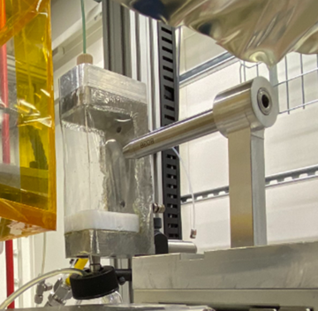
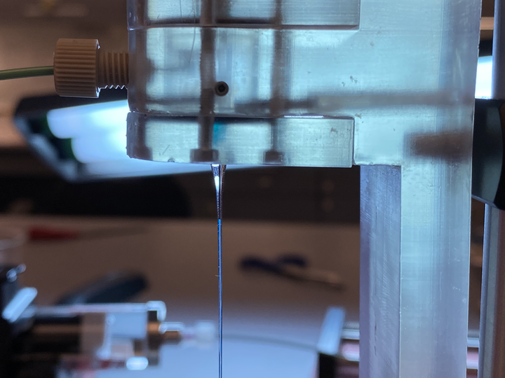
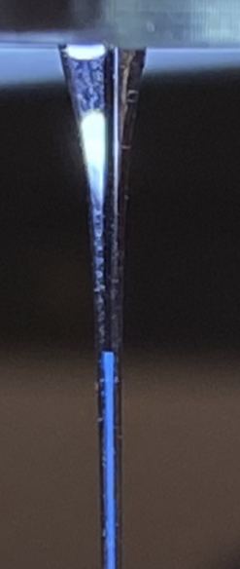
Liquid jet
To prevent sample damage in liquids, the sample needs to be constantly exchanged.
The liquid is pumped with syringe or/peristaltic pump through a nozzle
One can protect air sensitive liquids by enclosing it within another fluid in a “coaxial” jet

Slide 32
Conclusions
Sample preparation should be considered in the early stages of experiment planning
Discuss detection method(s) with beamline staff and tailor the samples and sample environment(s) to them.
Discuss how to mount the sample environment if you bring your own.

Slide 33
Best approach
Speak with beamline staff!

