Slide 1
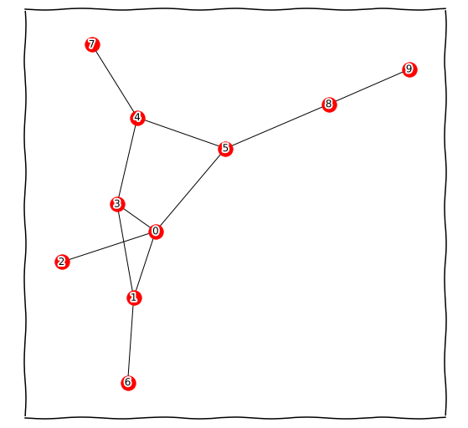
Practice 1: Drawing this undirected graphs in NetworkX

Slide 2
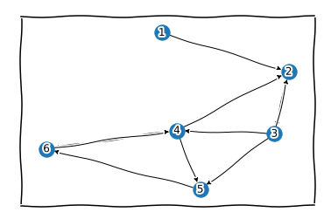
Practice 2: Drawing this directed graphs in NetworkX

Slide 3
Practice 3: Drawing this directed graphs in NetworkX
A undirected graph has 10 nodes: 0,1,2,3,4,5,6,7,8,9 and edges:
(0, 1), (0, 5), (1, 3), (1, 6), (3, 4), (4, 5), (4, 7), (5, 8).
Draw the network

Slide 4
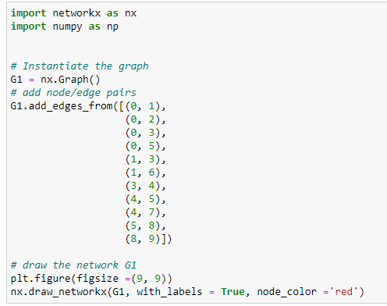
Practice 1: Solutions

Slide 5
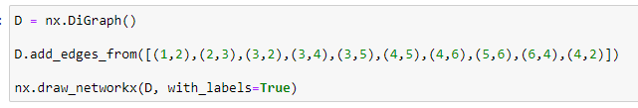
Practice 2: Solutions

Slide 6
Practice 3: Solutions
import networkx as nx
import numpy as np
import matplotlib.pyplot as plt
# Instantiate the graph
G1 = nx.Graph()
# add node/edge pairs
G1.add_edges_from([(0, 1),
(0, 2),
(0, 3),
(0, 5),
(1, 3),
(1, 6),
(3, 4),
(4, 5),
(4, 7),
(5, 8),
(8, 9)])
print("Total number of nodes: ", int(G.number_of_nodes()))
print("Total number of edges: ", int(G.number_of_edges()))
print("List of all nodes: ", list(G.nodes()))
print("List of all edges: ", list(G.edges(data = True)))
# draw the network G1
plt.figure(figsize =(9, 9))
nx.draw_networkx(G1, with_labels = True, node_color ='red')

