Slide 1
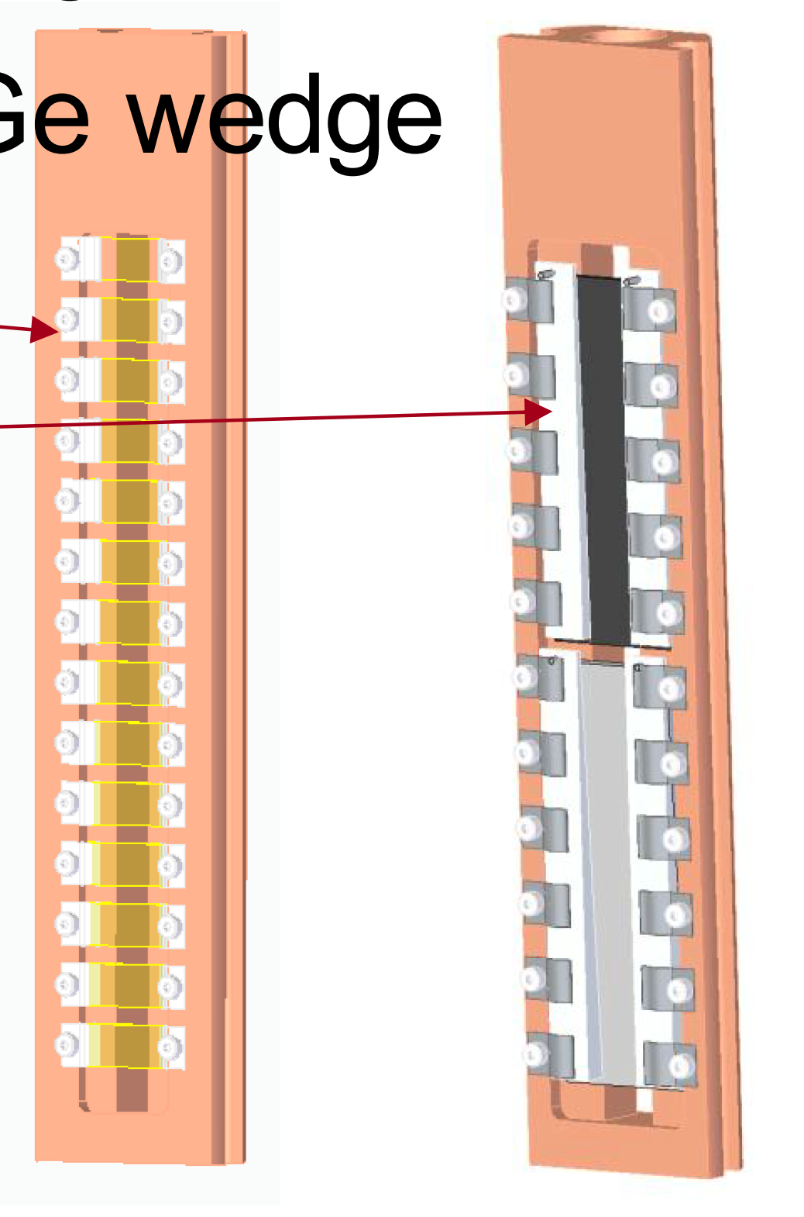
Ceiling Rounding Mode
Not possible?
P = 0
P = 0
Floor Rounding Mode
1
Filter Config
2
3
1
Requested Attenuation
Position in mm for each holder
Total Tranmission
2
User Request
14

Slide 2
Spare
T4
T2
Total transmission = T1 * T2 * T3 * T4
T3
Total attenuation = 1 - Total transmission
T1

