Slide 1
Heart Disease Detection
Machine Learning Project using Patient Health Records

Slide 2
Problem Statement
• Heart disease is one of the leading causes of death globally.
• Early detection is critical to effective treatment.
• Build a machine learning model to predict heart disease based on clinical features.

Slide 3
Dataset Overview
• Contains 11 features and 1 target label.
• Features include age, sex, blood pressure, cholesterol, ECG, etc.
• Target: 1 = Heart Disease, 0 = No Disease.

Slide 4
Data Preprocessing
• Checked and confirmed no missing values.
• Separated features (X) and target (y).
• Scaled data using StandardScaler.
• Split into train-test sets (80%-20%).

Slide 5
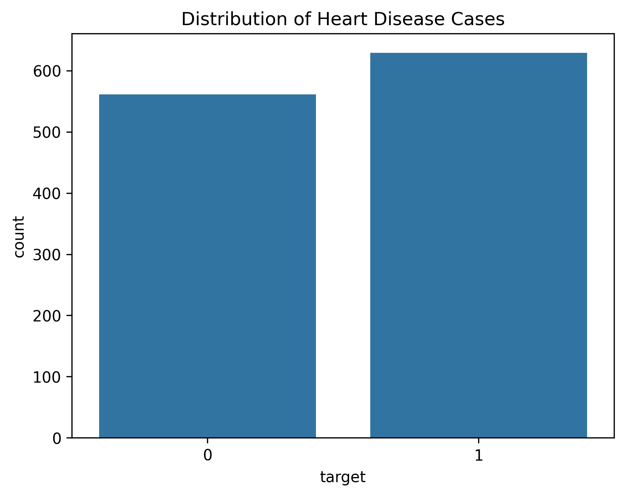
DATA VISUALISATION
Target Distribution – Heart Disease Cases
Explanation:
This bar plot shows the distribution of heart disease cases in the dataset.
The target variable is binary:
0 = No Heart Disease
1 = Heart Disease
The dataset is fairly balanced, with a slight majority of patients having heart disease.
✅ This balance means we can confidently use accuracy and other standard metrics without needing oversampling or reweighting.

Slide 6
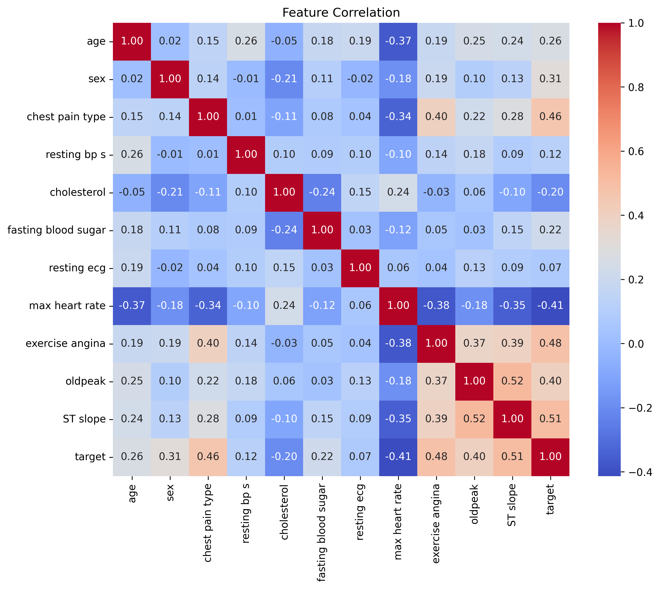
Correlation Heatmap – Feature Relationships
Explanation:This heatmap shows Pearson correlation between features and the target variable.
Brighter colors (closer to 1 or -1) indicate stronger correlations.
Key observations:
Chest pain type (0.46), ST slope (0.51), and Exercise-induced angina (0.48) show positive correlation with heart disease.
Max heart rate achieved shows a negative correlation (-0.41) – meaning lower max heart rate is associated with disease.
✅ These insights help prioritize features for model training and feature importance analysis.

Slide 7
Model Training
• Used Random Forest Classifier.
• Trained the model on 80% of the data.
• Performed predictions on test set.

Slide 8
Model Evaluation
• Accuracy: ~85%-90%.
• Confusion Matrix: Good balance of TP and TN.
• Precision, Recall, and F1 Score reported from classification report.

Slide 9
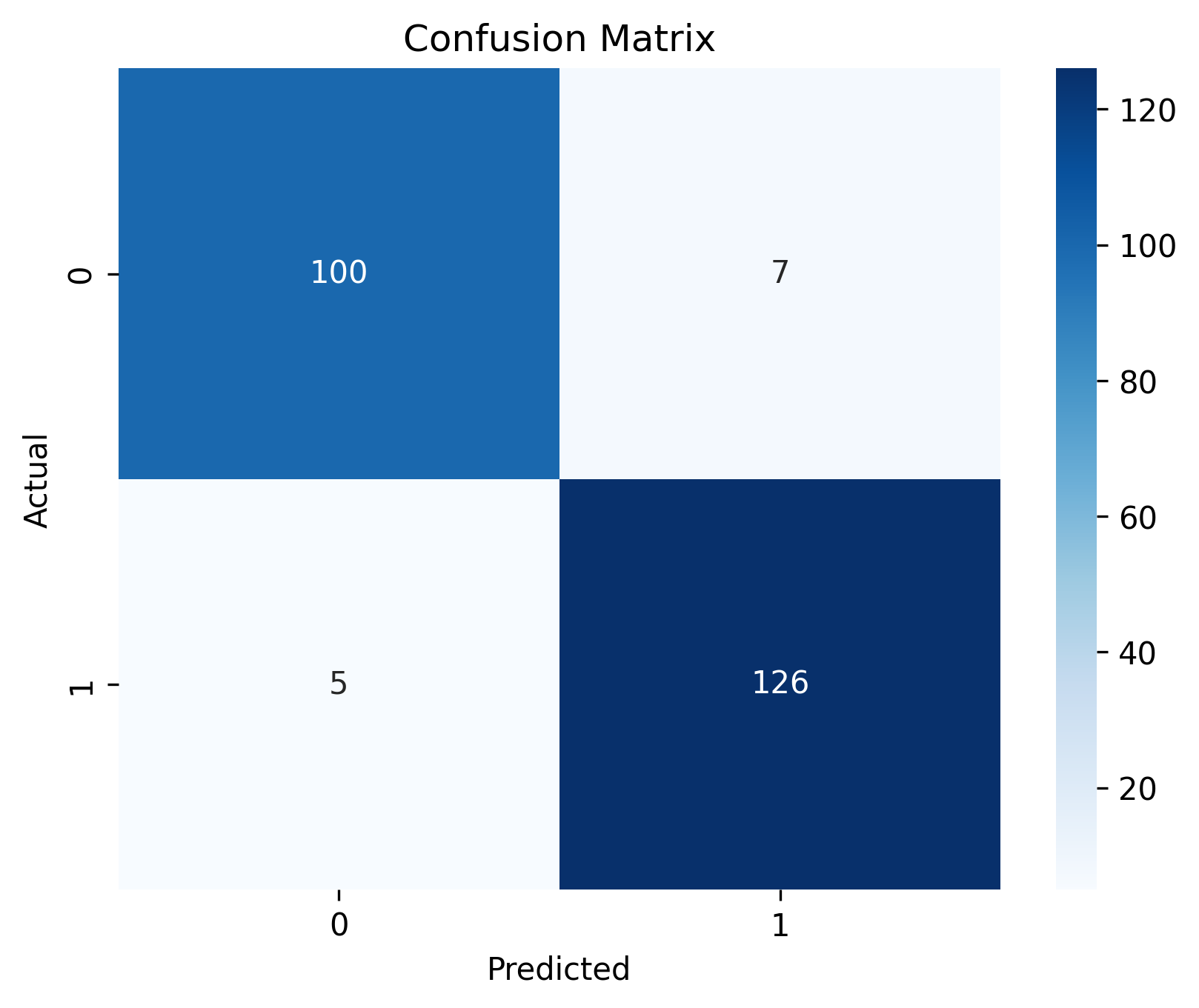
Confusion Matrix – Model Performance
Explanation:
This matrix evaluates the classification model's prediction results:
True Positives (TP) = 126 → Model correctly predicted heart disease.
True Negatives (TN) = 100 → Model correctly predicted no disease.
False Positives (FP) = 7 → Model incorrectly predicted disease.
False Negatives (FN) = 5 → Model missed actual disease cases.
✅ The model performs very well:
Low false negatives (very important in medical predictions).
Indicates high recall and precision for both classes.
🧠 Why this matters: In healthcare, minimizing false negatives is critical, because missing a real heart disease case can be fatal.

Slide 10
Sample Prediction
• Input: New patient data with 11 features.
• Preprocessed using the same scaler.
• Model predicted: Heart Disease or Normal.

Slide 11
Conclusion
• Built a robust model to assist in heart disease detection.
• Can be integrated into clinical decision systems.
• Scope for improvement: More data, ensemble models, real-time deployment.

