Slide 1
Mobile Price Range Prediction
Presented by Neha

Slide 2
Objective
Build a classification system that predicts the price range of mobile phones based on
their technical specifications. The target variable
price_range has four classes:
0: Low cost
1: Medium cost
2: High cost
3: Very high cost

Slide 3
Dataset Overview
The dataset includes 21 features describing a mobile phone’s specifications
(battery power, RAM, internal memory, camera megapixels, resolution, etc.) and one target variable
price_range.
Key Features:
Numerical: battery_power, ram, px_height, px_width, int_memory, pc, fc
Binary: blue, dual_sim, four_g, three_g, wifi, touch_screen

Slide 4
Exploratory Data Analysis (EDA)
RAM is the most influential feature with a clear increasing trend across price categories.
Pixel resolution (width & height) and battery power also strongly impact pricing.
Correlation heatmaps and feature importance from Random Forest confirmed these insights.
Class distribution is balanced, allowing fair comparison across all categories.

Slide 5
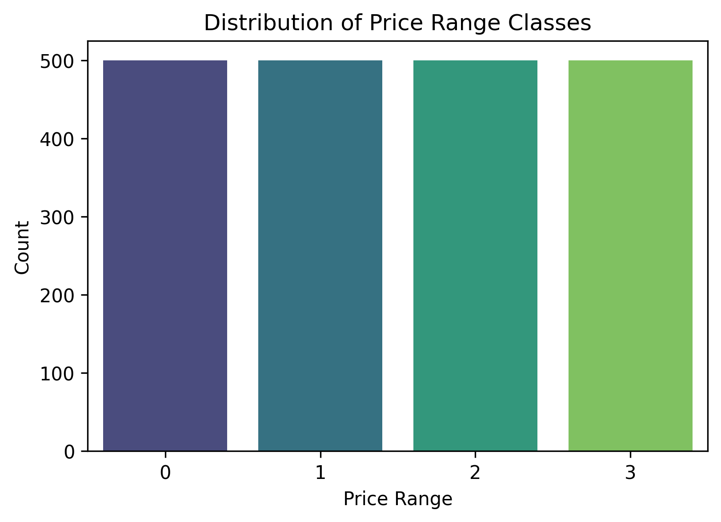
Price Range Distribution
1. Price Range Distribution
All four classes (0, 1, 2, 3) are evenly distributed, meaning the dataset is balanced.
This is ideal for classification tasks as it avoids bias toward any particular class.

Slide 6
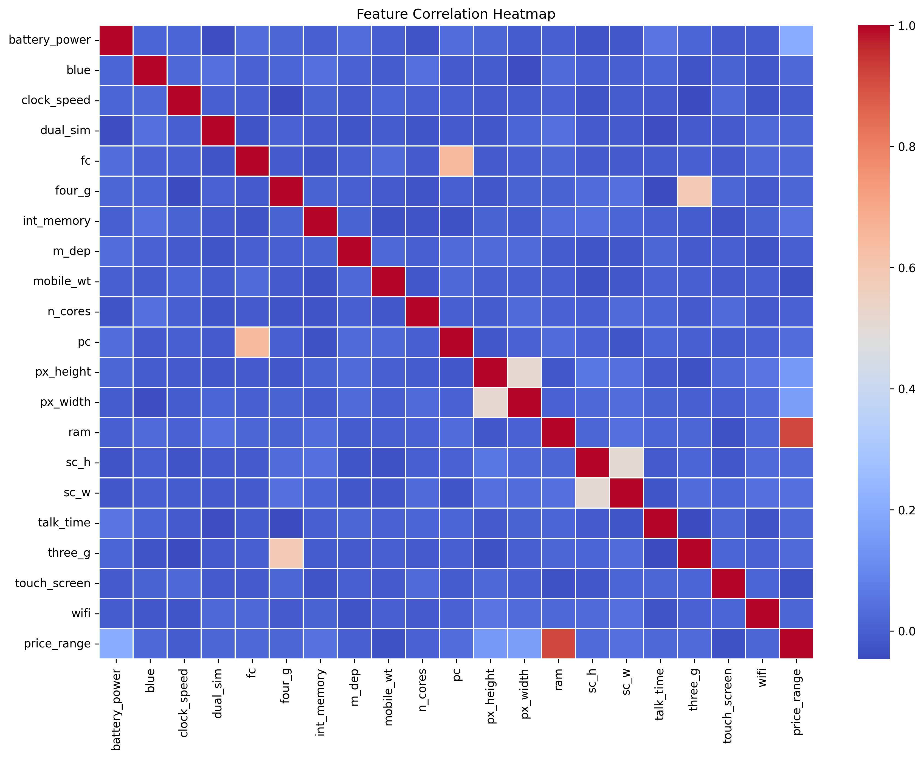
Correlation Heatmap
Key insights:
Ram has a very strong positive correlation with price_range — likely the most predictive feature.
px_height and px_width are also moderately correlated with price.
Features like talk_time, mobile_wt, m_dep, and sc_w show low correlation with price.

Slide 7
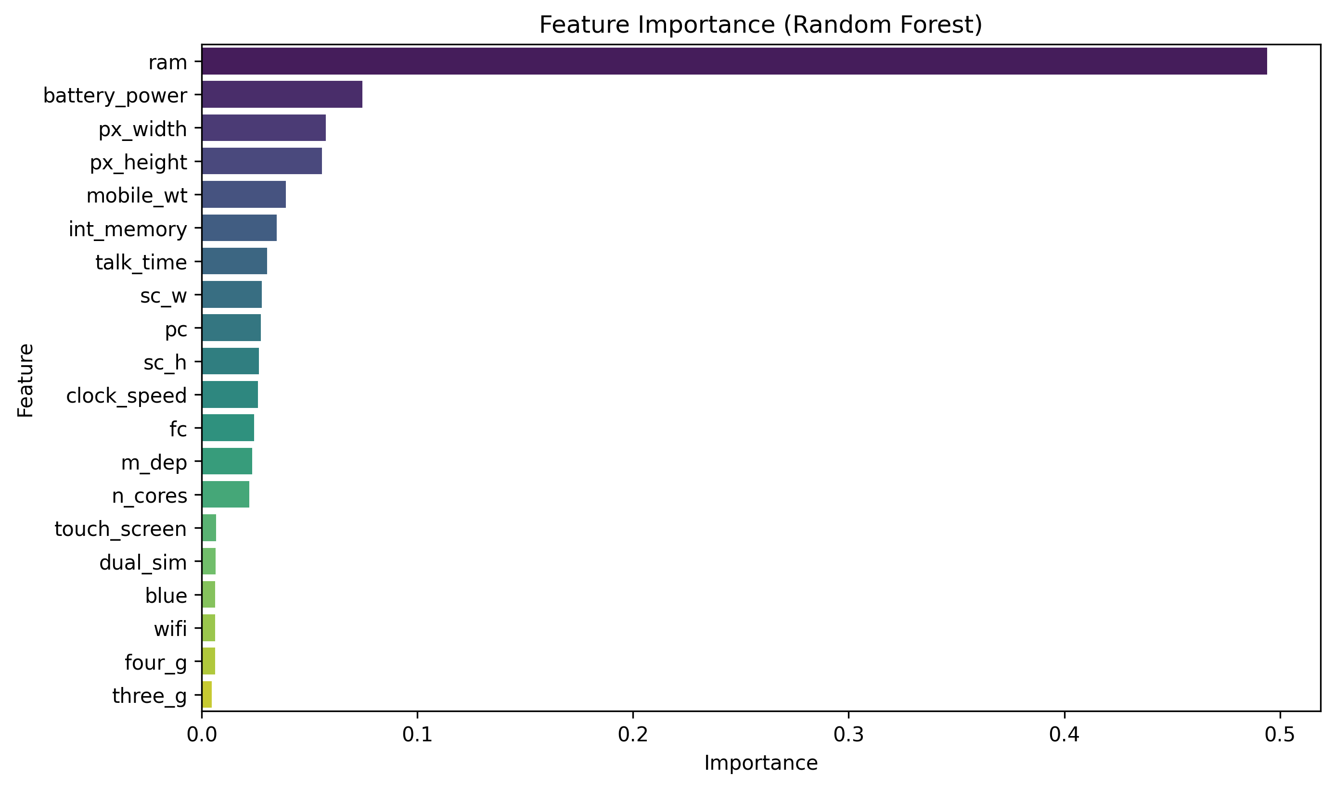
Feature Importance (Random Forest)
Feature Importance (Random Forest):
Top features influencing price prediction:
ram (most dominant)
px_width, px_height
battery_power, int_memory, pc (primary camera)
Binary features like wifi, touch_screen, three_g have lower importance.

Slide 8
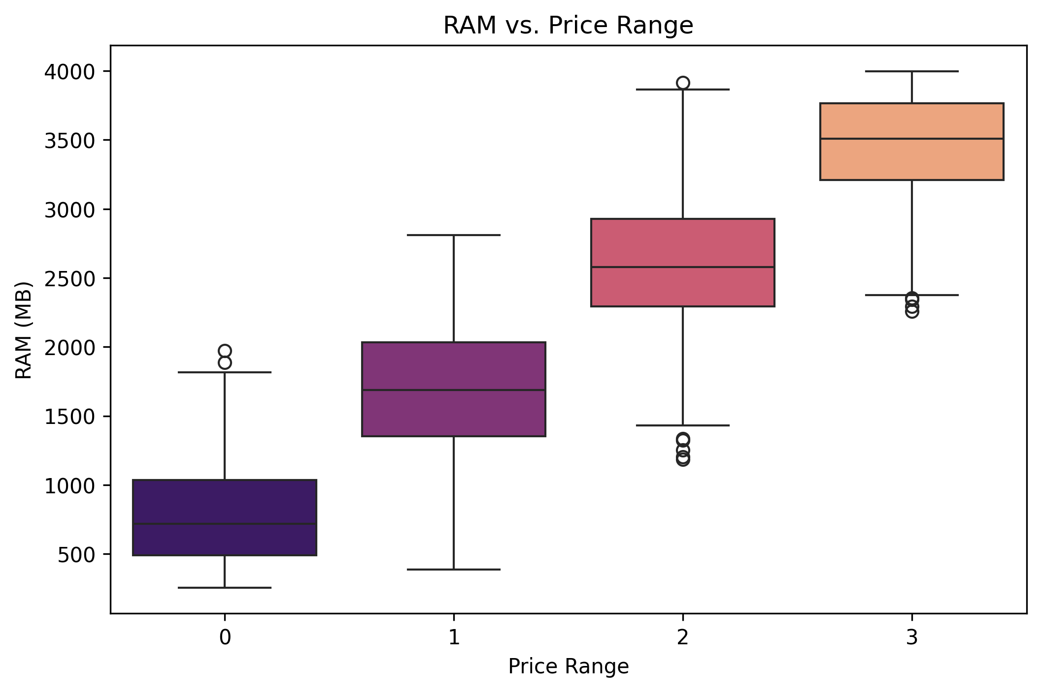
Box Plot of RAM vs. Price Range
Box Plot of RAM vs. Price Range :
Higher RAM consistently aligns with higher price categories.

Slide 9
Model Building & Evaluation
Models Used:
Logistic Regression (Linear Classifier)
Random Forest (Ensemble Tree-Based Classifier)
📊 Performance Comparison
Model | Accuracy | Strengths | Weaknesses
Logistic Regression | 96.5% | High performance on all classes | Might underfit complex data
Random Forest | 88.0% | Good for non-linear data | Lower precision/recall for classes 1 & 2

Slide 10
Classification Reports (Highlights)
Logistic Regression:
Class | Precision | Recall | F1-Score
0 | 0.99 | 0.98 | 0.98
1 | 0.96 | 0.96 | 0.96
2 | 0.95 | 0.94 | 0.94
3 | 0.96 | 0.98 | 0.97
Random Forest:
Class | Precision | Recall | F1-Score
0 | 0.95 | 0.96 | 0.96
1 | 0.83 | 0.83 | 0.83
2 | 0.81 | 0.80 | 0.80
3 | 0.93 | 0.93 | 0.93

Slide 11
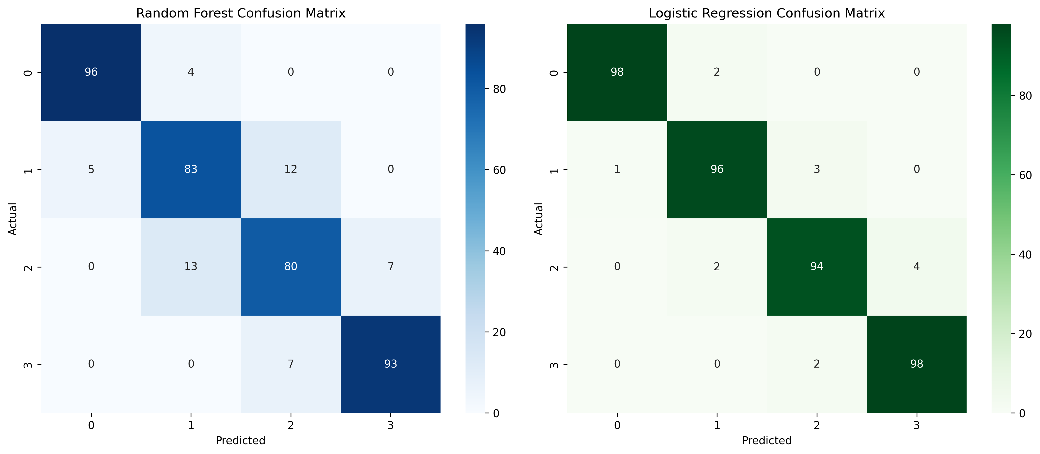
Confusion metrics

Slide 12
Analysis
Logistic Regression significantly outperforms Random Forest in this case.
The high performance of Logistic Regression suggests that the relationship between features and pricing is well-separated and linear, especially due to powerful features like RAM, pixel resolution, and battery_power.
Random Forest underperforms slightly, likely due to:
Not being hyperparameter tuned.
Overfitting noise in mid-range classes (1 and 2).
Features such as wifi, touch_screen, and dual_sim had low importance, indicating they contribute little to pricing decisions.

Slide 13
Best Evaluation Metric
Accuracy is reliable due to balanced class distribution.
F1-score is important to ensure that no class is being predicted poorly.
Macro Avg F1 confirms consistently high performance across all categories for Logistic Regression.

Slide 14
Conclusion
Logistic Regression is the best model for this problem:
Simpler, more interpretable
Highest accuracy (96.5%)
Strong generalization to all classes

