Slide 1
Tc/BSD Basics

Slide 2
Wi-Fi:Beckhoff_Messe
Password: EngMeeting2023!
Files:https://github.com/NSMelius/TcBSD_Files

Slide 3
Tc/BSD Basics
Brief Recap of Basics
Changes to Networking
Using tcbsd-upgrade
TF1200
ZFS
Creating a local Repository

Slide 4
Essential Commands and Files
ifconfig - interface for nic ports. Used as is, it behaves like ipconfig in Windows.
/etc/rc.conf - configuration file with variable for some daemons at start up. This is where the IP address can be set.
doas - “Do As Administrator” used to run a command at a heightened user level with higher permissions. (This is how we “Right-Click and Run As Administrator”)
ee - Easy Editor. A simple text editor for Linux.
TcSysExe.exe – The Tc/BSD equivalent to the TwinCAT Icon in the Windows System Tray. It can be used to check the current mode of TwinCAT, restart in Run Mode or Config Mode, check the TwinCAT version, etc.
TwinCAT directory - /usr/local/etc/TwinCAT/

Slide 5
Tc/BSD Basics
Brief Recap of Basics
Changes to Networking
Using tcbsd-upgrade
TE1210 UI Client
ZFS
Creating a local Repository

Slide 6
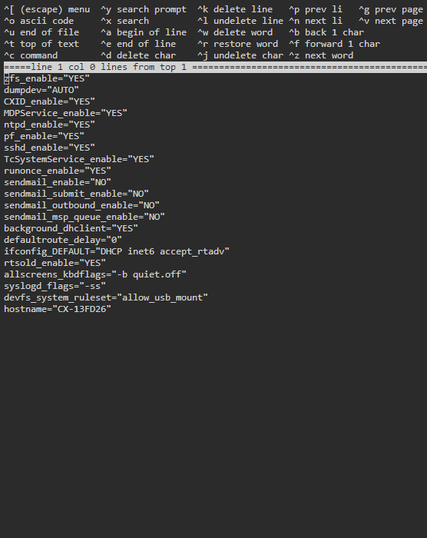
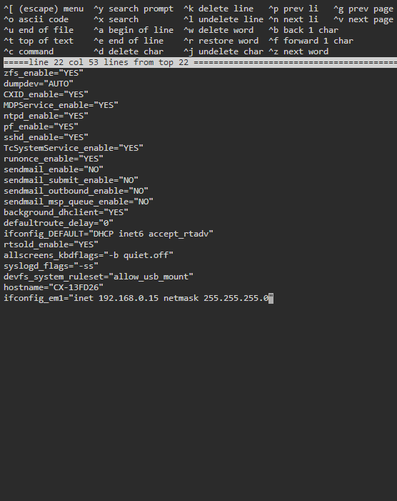
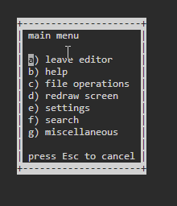
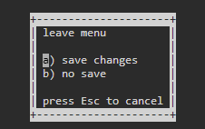
Changing the IP address (Older Versions)
Use ifconfig to check the name of your nic interface.
It should be named em1 or em0.
Check which port does NOT have an ip address.
Edit the rc.conf file using easy editor.
Use the command: doas ee /etc/rc.conf
Create a new line and enter
ifconfig_<nic>=“inet 192.168.0.16 netmask 255.255.255.0”
(i.e. ifconfig_em0...)
Press Esc and then press a to leave and then a again to save changes.
Notes:
Make sure to include the doas command first, otherwise we can only read the file, not write to it.
This file is also where we can change the host name of the CX.

Slide 7
Changing the IP Address (Older Versions cont.)
Enter the command doas service netif restart
This will restart the network interface service. When it restarts, the service will read the new variables added to rc.conf.
You should get a new output with the nic port using the static IP address chosen.

Slide 8
DHCPcd
The previous DHCP client has reached the end of its life and is not receiving updates.
The new default DHCP client in Tc/BSD as of version 13.2.0.6
Can be installed on older versions using pkg manager
doas pkg install dhcpcd
Offers faster boot times and IP address assignment.
Setting static IP addresses for network interfaces requires a few extra steps

Slide 9
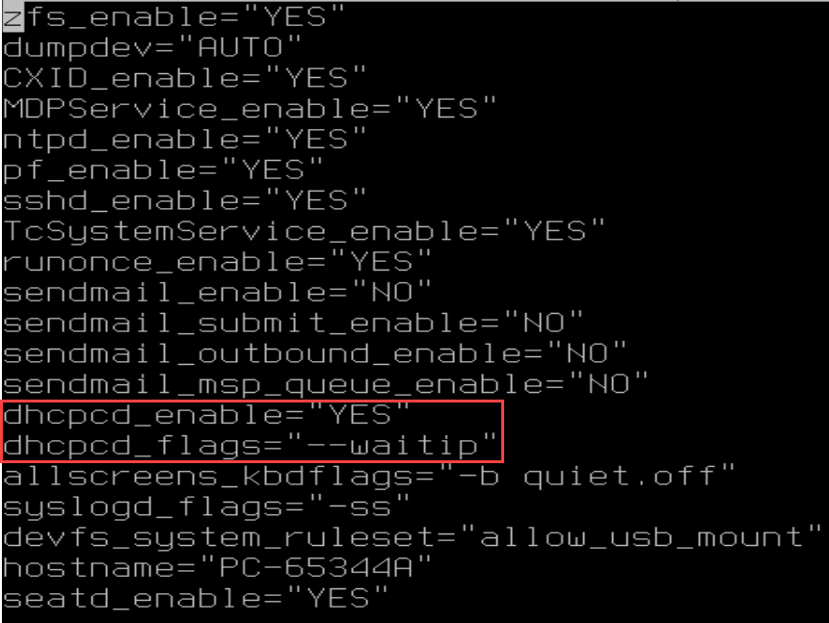
Setting a Static IP with DHCPd
Additional variables for new DHCP client.
Setting a static ip is the same ifconfig_<nic>=“inet 192.168.0.16 netmask 255.255.255.0”
Now requires additional change to dhcp_flags variable: dhcpcd_flags="--denyinterfaces <nic>“
doas service netif restart && doas service dhcpcd restart

Slide 10
Tc/BSD Basics
Recap of Basics
Changes to Networking
Using tcbsd-upgrade
TF1200 UI Client
ZFS
Creating a Local Repository

Slide 11
Tc/BSD Versions
Tc/BSD 12 is for legacy systems only. If a customer is using Tc/BSD 12, and needs a replacement image, we can provide the older .iso in Support.
XAR version = 4024.22.
The version 12 repository still exists for these cases, new version of those packages are not being released. Some functions have not been updated since 2022.
Tc/BSD 13/14 will have new features added in the future, such as Hypervisor and TF1200 HMI client.

Slide 12
Tcbsd-upgrade
For customer’s still using Tc/BSD 12 or 13, the only option to upgrade to Tc/BSD 14 without a reimage is using the tcbsd-upgrade package.
Simply changing the remote repository URL to the 14 version will not be enough for a proper upgrade of Tc/BSD.
The application can also be used for minor updates where only OS and TwinCAT XAR packages are upgraded.
doas tcbsd-upgrade --major
Upgrade from Tc/BSD 12 to Tc/BSD 14
doas tcbsd-upgrade --minor
Upgrade “core” OS packages( i.e. 13.0 -> 13.2) and TcXAR

Slide 13
Tc/BSD Basics
Changes to Networking
Using tcbsd-upgrade
TF1200 UI Client
ZFS
Creating a local Repository

Slide 14
TF1200 Installation
Like all other functions, installation begins with the package manager:
doas pkg install TF1200-UI-Client
Once downloaded, we need to run a script to set up the GUI and web server. The script is in the Function’s directory /usr/local/etc/TwinCAT/Functions/TF1200-UI-Client/scripts/
We will change our directory to that and then call the full setup script:
doas setup-full --user=HMI --autologin --autostart
After the installation is finished, a reboot is necessary. If everything was entered correctly, the IPC should boot, login into the HMI user, and start the UI Client.

Slide 15
Configuring The UI Client
By default, the UI client should load a blank page. For an HMI, that is not ideal, so we will need to change the page that is loaded on startup. To do so, we need to edit the configuration file at /home/HMI/.config/TF1200-UI-Client/config.json
If you used a different name for your user than HMI, the directory path will need to reflect that
In the Config file there is a line for starting chromium with a set url. We just need to edit the URL to one we want:
TF1800: "startUrl": http://localhost/Tc3PlcHmiWeb/Port_851/Visu/webvisu.htm
TF200: "startUrl": "http://localhost:1010"

Slide 16
TF1200 – A Simpler way
Matt Kleven took the time to make this even simpler for you! Instead of performing the downloads and installation and configurations yourselves, he’s written a script that will do it for you!
It can be downloaded from the Applications Common website at: https://azdevops01.beckhoff.com/ApplicationCommon/ipc-os
The command to run it is: doas ./install_and_configure_tf1200.sh –webserver TF2000 –password TOUR_PASSWORD

Slide 17
Tc/BSD Basics
Changes to Networking
Using tcbsd-upgrade
TF1200 UI Client Demo
ZFS
TwinCAT directory contents
Using an external drive
Setting up automounting for external drives
Creating mirrors
Creating a local Repository

Slide 18
TwinCAT License Files
Once inside the TwinCAT directory, the layout is nearly identical to Windows.
The process of activating a license is no different than with a Windows CX. TwinCAT XAE will direct the files to the correct directory when the “License Response File…” or
“7 Days Trial License” button is pressed.
If you need to copy the files outside of TwinCAT, the licenses are stored in: usr/local/etc/TwinCAT/3.1/Target/License/

Slide 19
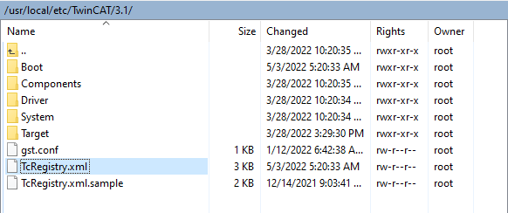

Changing the AMS Net Id
The Ams Net Id is stored as a “reg key” similar to Windows.
In Tc/BSD, calls for registry keys are routed to read from an xml file in the TwinCAT folder:
/usr/local/etc/TwinCAT/3.1/TcRegistry.xml
The format of the reg key is very similar to the Windows version

Slide 20
The Beckhoff Write Filter
TcBSD comes with the BWF already installed. The filter can be toggled on and off with a simple command.
doas service bwf enable will enable the write filter
doas service bwf disable will disable the write filter
Toggling the write filter requires a reboot of the system, which can be down using doas shutdown –r now

Slide 21
Pkg
Pkg is used to manage all packages. It includes many sub functions for specific tasks
pkg update: updates the local repository from the source repo.
pkg info: provides a summary of an installed package(version, dependencies, etc.)
pkg search: search the repository for a package with a matching name.
pkg install: install any packages included with the command.
pkg upgrade: checks for updates for a specific package, or every package if one is not included as part of the command.
pkg delete: deletes the provided package from the machine.

Slide 22
How to Find if a TwinCAT Function is Supported
All available functions for TcBSD are included in the TcBSD Package server.
You can look up what Functions are supported on Tc/BSD here: https://www.beckhoff.com/en-us/products/automation/product-finder-twincat/
You can look up what functions are available as packages here: https://tcbsd.beckhoff.com/TCBSD/14/stable/packages/All/
Some functions are listed as supported, but do not have a package. These functions only need to be installed on the XAE side, or are installed with the XAR.
Installing these packages requires the pkg command.
TcBSD does not currently support ports in addition to packages.

Slide 23
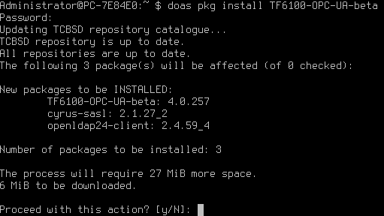
Installing Functions from the Pkg Repository
Use doas pkg install <package name>
For example: doas pkg install TF6100-OPC-UA-beta commands pkg to find the package from the repository with the matching name, and then prompt the user if the package is what they want to install. A response with “y” will trigger the download and installation of the package.

Slide 24
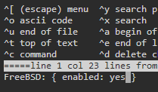
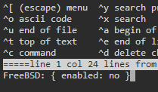
Changing the Target Package Repository
Pkg can be set to target either the Tc/BSD repository, or the FreeBSD repository.
To switch between the two repositories, we just need to edit a single file and change an option from “No” to “Yes”
File path: /usr/local/etc/pkg/repos/FreeBSD.conf
The next time pkg is called, it will update from the set repository

Slide 25
Installing Functions from an Independent Package File
In situations where the controller may not have internet access, you can download a package from the package server in a browser and transfer the file to the Tc/BSD system. From there you can use pkg to install from that package.
Transferring the package to the IPC can then be done using either STFP through WinSCP, or copied to a USB Thumb Drive

Slide 26
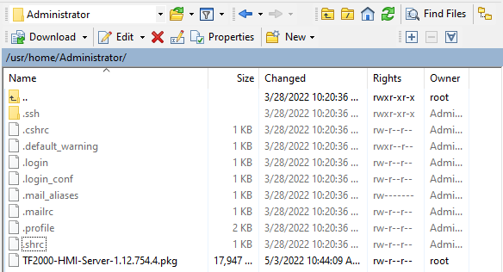
Example
Story: I have a TwinCAT HMI package that I want to use for testing. It is not in the stable branch of the package repository for my version of Tc/BSD. Instead, I downloaded it from here: https://tcbsd.beckhoff.com/TCBSD/14/testing/packages/All/
Using WinSCP I have transferred the file to my CX in my user directory.

Slide 27
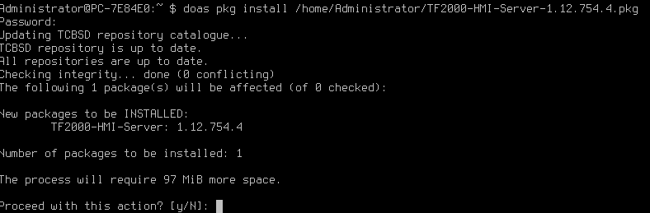
Example Cont.
From here, I can install the package using pkg install with the file path:

Slide 28
Changing the Ams NetId Cont.
The AMS NetId is stored in hexadecimal format.
Each byte represents a pip of the NetId.
In this example the AMS Net ID is:
0513FD260101 = 05.13.FD.26.01.01 = 5.19.253.38.1.1
So, if we need to change the Net Id, we need to translate to Hex first.
Once the file has been edited and saved, TwinCAT will need to be restarted.

Slide 29


Creating Backups
TcBSD comes with the tool “restorepoint” already installed.
Restorepoint can be used to create backup snapshots, restore to a previous snapshot, and delete snapshots.
To create a new backup, use the command doas restorepoint create <backup>, where <backup> is the name of the snapshot you are making.
If no name is given, a backup will be created with a timestamp as its name.
You can use restorepoint status to check what backups are available.
These do not help if a drive fails, for backup image files, use the Backup utility of the Installer

Slide 30
On Drives
Attached devices will have a device files created in /dev
In terminals a list of these files can be seen with ls
Drives have a naming scheme, just like Windows
ada0-n: ATA Direct Access devices. Our internal drives show up as this.
da0-n: SCSI Direct Access devices. USB drives will show up as this.
p#: Partition number of drive. i.e. ada0p1 is the first partition of the first ada device.

Slide 31
On USB Drives
Unlike Windows, external USB drives are not automatically added to the filesystem by default.
Instead mounting a new drive is a manual process where we have to tell the system what the device we want to mount is named, and what directory the drive’s filesystem should be attached at.
It is possibly to set Tc/BSD to automatically mount a new drive when it is detected.

Slide 32
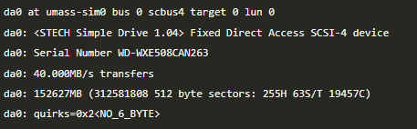
Mounting a USB Drive
Tc/BSD uses the Zetabyte File System, which is not supported by Windows. However, ZFS has support for the FAT32 format. So if you need to transfer a file from a Windows PC to a controller running Tc/BSD via USB, make sure the thumb drive is formatted to FAT 32 before adding the files to it.
Once inserted, you can use the command dmesg to be sure the device was recognized. It should show up with the device name “da0”:

Slide 33
Mounting a USB Drive Cont.
Now that the USB device is recognized by Tc/BSD, we need to mount it to the file system in order to access its contents.
The command mount is used to add the device to the file system. In order to use it, we need to provide; the file format, the device we want to add, and the directory we want to mount the device to.
Tc/BSD has a directory set up for mounting devices name /mnt additional directories can be added using the mkdir command. Example: mkdir /mnt/usb/ will create a new folder named “usb” in /mnt.
All devices have a file created when they are connected in the /dev directory, our USB device should have multiple files starting with “da0”, we need to be sure “da0s1” in that directory.

Slide 34
Mounting a USB Drive Cont.
We have the device location, and the mounting location. For the format, we can check the mount man page using man mount.
For FAT 32, the value we need is msdosfs.
So, to mount the USB drive to the system, use the command
doas mount –t msdosfs /dev/da0s1 /mnt/usb/
The files on the USB drive should now be viewable under /mnt/usb/

Slide 35
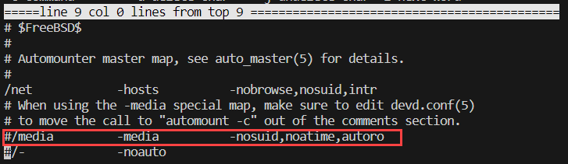
Setting Up Automounting of USB Drives
Automounting is set up in a few steps.
With Automounting any attached USB drives will be mounted to /media/ as a directory named after the filesystem label, or the device node.
Step 1: open /etc/auto_master in a text editor
doas ee /etc/auto_master
Uncomment line 8:

Slide 36
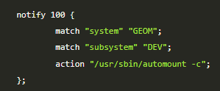
Setting Up Automounting of USB Drives
Step 2: open /etc/devd.conf in a text editor
doas ee /etc/devd.conf
Add the following to the file

Slide 37

Setting Up Automounting of USB Drives
Step 3: enable autofs service in the rc.conf
Can be done using a text editor like with IP addresses, or can be done using a command: doas sysrc autofs_enable=“YES”
The output:
Automounting is now enabled, the services for it just need to be started or restarted.

Slide 38
Setting Up Automounting of USB Drives
To start the service for automount: doas service automount start doas service automountd start doas service autounmountd start doas service devd restart
Unlike with mounting manually, we do not add a directory to the /mnt/ folder, instead automount adds them to the /media/ folder.

Slide 39
Tc/BSD Basics
Changes to Networking
Using tcbsd-upgrade
TF1200 UI Client Demo
ZFS
Creating a Local Repository

Slide 40
About Older Versions of Packages
We do not maintain a directory of old Packages. If a package is updated/removed from the Tc/BSD Repository, there is no other place to download said older version.
We don’t want to maintain these older versions. i.e. security updates.
We cannot expect stability with a mix of old package version and new package version.
If a customer wants to create their own “golden image” of Tc/BSD and packages, they will have to take steps to ensure that they have said repository versions stored somewhere

Slide 41
Creating A Local repository.
First step is to download all packages from the Tc/BSD repository
In Tc/BSD, the customer can use wget to download every package: doas wget --recursive --timestamping --level=inf --no-cache --no-parent --no-cookies --no-host-directories --relative --directory-prefix /tmp/mirror https://tcbsd.beckhoff.com/TCBSD/14/stable/packages/
If the IPC does not have Internet access, then a tool was created and uploaded to the Beckhoff GitHub: https://github.com/Beckhoff/twincatbsd-tools/tree/master/Backup-TCBSDRepo
This is a PowerShell script that will download every package and save them to the directory of your choice.
From there, you can move the directory to a USB drive to be transferred to the Tc/BSD system.

Slide 42
Creating a Local Repository
The USB drive then needs to be mounted to the filesystem of the IPC.
Follow the same steps as before.
doas mkdir /mnt/usb
ls /dev/da0*
doas mount_msdosfs /dev/da0s1 /mnt/usb
Check that the packages files are listed. ls /mnt/usb/tcbsd/repository/packages
Set pkg to use the directory for its repository instead of the Tc/BSD repository doas sh /usr/local/share/examples/bhf/pkgrepo-set.sh file:///mnt/usb/tcbsd/repository/packages

Slide 43
Wrap-Up
THANK YOU!

Slide 46
Beckhoff Automation [legal form]
[Address details 1]
[Address details 2]
[Address details 3]
[Address details 4]
Phone: +[country code] [number] E-mail: [account]@beckhoff.[domain] Web: www.beckhoff.[domain]

