Slide 1


MCP Healthcare Tech Assessment
Noelle Fleury
February 27, 2026

Slide 2
Contents
1
Approach & Background
2
Salesforce API Requirements
3
Scope & Requirements
4
Objectives & Capabilities
5
Implementation with Salesforce
6
Technical Decisions & Trade-offs

Slide 3
Approach & Background

Slide 4






Objectives
Active’s six technical assessment objectives.
Install and use Claude Code to understand MCP capabilities firsthand.
Establish clear objectives for what capabilities the MCP will enable.
Research Salesforce API requirements and authentication patterns.
Implement core MCP functionality with at least 3 Salesforce functions.
Define requirements and scope for my MCP server implementation for Healthcare clients and use cases.
Document your technical decisions and trade-offs.

Slide 5



Background Knowledge & Learning
Assessing Claude’s performance and user experience.
Claude’s Answers
UX/UI Interface
Can it break down a complex problem step by step?
Does it ask clarifying questions?
Does it provide examples and/or analogies?
How detailed are the explanations compared to other AI?
How does it differ from other AI tools?
How easy is it to upload and work alongside documents?
Can it handle multi-step conversations?
How does it structure long outputs?
Does it encourage more detailed prompts?
Natural Language Communication
Does it adapt to the tone of the user?
Can it simplify complex concepts without losing meaning?
How natural does the conversation style feel?

Slide 6
Objectives
Active’s six technical assessment objectives.
Install and use Claude Code to understand MCP capabilities firsthand.
Establish clear objectives for what capabilities the MCP will enable.
Research Salesforce API requirements and authentication patterns.
Implement core MCP functionality with at least 3 Salesforce functions.
Define requirements and scope for my MCP server implementation for Healthcare clients and use cases.
Document your technical decisions and trade-offs.

Slide 7
Understanding Claude’s Model Context Protocol (MCP)
From technical terms to tangible ideas.
MCP is like asking your neighbor for a cup of sugar.
I knock on their door and ask for a sugar. They retrieve the sugar from inside their home and deliver it. I stay on their porch and remain outside without access to their home, kitchen, or other belongings. Similarly, MCP enables Claude to request specific information from a system without direct access to the entire environment.
Claude makes a request to MCP server
MCP server receives the request and knows how to handle it
MCP server checks for valid access and authentication
MCP makes API call to Salesforce on Claude’s behalf
Salesforce returns materials
MCP server formats the response
Claude delivers the answer
Technical
Knock on neighbor’s door
Neighbor answers door
Stay on neighbor’s porch
Neighbor goes to kitchen
Neighbor brings back only sugar
Sugar is in an appropriate container
Receives cup of sugar
Analogy

Slide 8
Salesforce Requirements

Slide 9
Objectives
Active’s six technical assessment objectives.
Install and use Claude Code to understand MCP capabilities firsthand.
Establish clear objectives for what capabilities the MCP will enable.
Research Salesforce API requirements and authentication patterns.
Implement core MCP functionality with at least 3 Salesforce functions.
Define requirements and scope for my MCP server implementation for Healthcare clients and use cases.
Document your technical decisions and trade-offs.

Slide 10




Salesforce API Requirements & Authentication
Understanding versioning, limits, SOQL, and authentication.
API Versioning
Salesforce Query Language
Salesforce releases updates three times a year.
Version their API accordingly.
Different types of API (REST, SOAP, etc.)
Engineer: Use the latest version.
Consultant: Develop a versioning strategy.
Salesforce’s own query language – SOQL.
This can affect how queries usually look compared to other programming languages.
Engineer: Use the query language responsibly.
Consultant: Consider how SOQL behaves at scale.
API Call Limits
Authentication
Salesforce limits how many API calls an organization can make per day.
Typical enterprise gets around 100,000 calls per day.
Engineer: Limit chatty calls and use bulk APIs.
Consultant: Estimate project API volume during design phase and utilize governance strategy.
Need permission to call Salesforce (OAuth 2.0).
Create a Connected App to register MCP with Salesforce.
Different flows for demo vs prod.
Engineer: Ensure correct flow usage of demo vs. prod.
Consultant: Escalate any authorization limitations engineers experience.
For the purpose of this technical assessment, it is best to use REST API, Username-Password flow, and ensure that authentication uses OAuth 2.0 via a Connected App.

Slide 11
Scope & Requirements

Slide 12
Objectives
Active’s six technical assessment objectives.
Install and use Claude Code to understand MCP capabilities firsthand.
Establish clear objectives for what capabilities the MCP will enable.
Research Salesforce API requirements and authentication patterns.
Implement core MCP functionality with at least 3 Salesforce functions.
Define requirements and scope for my MCP server implementation for Healthcare clients and use cases.
Document your technical decisions and trade-offs.

Slide 13
Consultant Mindset & Healthcare Background
How to approach the healthcare industry as a consultant.
Who are we working with?
Prioritize relationship building.
What do we know about our clients?
What are we currently working on?
What are current projects happening in the industry?
What are common ad hoc requests?
What are the future opportunities?
What is their next-gen vision?
What are pain points now that can be mitigated in the future?
Background
Healthcare organizations rely heavily on Salesforce as their primary CRM and operational platform.
Staff across these organizations spend significant time manually navigating Salesforce to look up account information, log service issues, and track business development activity.
This results in friction, slow response times, and consultants spending time on data retrieval instead of delivering value.

Slide 14
User Personas
Who is using this MCP?
Healthcare Client
Consultant
Primary user.
Individuals employed within a health system, hospital network, or med tech company who use Salesforce as part of their daily workflow.
These are not technical users but rather coordinators, liaisons, etc., who need answers fast.
Example: Someone in med tech sales who needs to know they’re calling the right person about the right product.
Secondary user.
A consultant who is supporting healthcare clients.
Needs visibility into client Salesforce environments to manage requests effectively.
Example: A consultant supporting their healthcare client with data analytics for upcoming contract renewals.
The dual-persona scope is an intentional design choice, not scope creep. In practice, a consulting firm would deploy separate instances with different permission scopes

Slide 15
Scope
Tying scope into 3 Salesforce functions for the client and the consultant.
Who are we working with?
What are we currently working on?
What are the future opportunities?
Consultant Mindset
Salesforce Function
Query account and contact Records
Create and update cases
Query opportunities
A physician liaison at a regional health system needs to pull up a referring physician group before an outreach call.
A patient services coordinator needs to log a provider escalation a billing dispute, flagged as high priority.
A business development manager wants a status check on all active partnership opportunities with med tech vendors.
Healthcare Client Use Case
A consultant preparing for a quarterly business review pulls the client account overview before the meeting.
A consultant managing a client implementation identifies a new issue mid-engagement and logs it directly through Claude.
A consultant wants visibility into where their client stands on an upcoming renewal before advising on contract strategy.
Consultant Use Case

Slide 16
Scope
Tying scope into 3 Salesforce functions for the client and the consultant.
Who are we working with?
What are we currently working on?
What are the future opportunities?
Consultant Mindset
Salesforce Function
Query account and contact Records
Create and update cases
Query opportunities
A physician liaison at a regional health system needs to pull up a referring physician group before an outreach call.
A patient services coordinator needs to log a provider escalation a billing dispute, flagged as high priority.
A business development manager wants a status check on all active partnership opportunities with med tech vendors.
Healthcare Client Use Case
A consultant preparing for a quarterly business review pulls the client account overview before the meeting.
A consultant managing a client implementation identifies a new issue mid-engagement and logs it directly through Claude.
A consultant wants visibility into where their client stands on an upcoming renewal before advising on contract strategy.
Consultant Use Case

Slide 17
Objectives & Capabilities

Slide 18
Objectives
Active’s six technical assessment objectives.
Install and use Claude Code to understand MCP capabilities firsthand.
Establish clear objectives for what capabilities the MCP will enable.
Research Salesforce API requirements and authentication patterns.
Implement core MCP functionality with at least 3 Salesforce functions.
Define requirements and scope for my MCP server implementation for Healthcare clients and use cases.
Document your technical decisions and trade-offs.

Slide 19
MCP Objectives & Capabilities
Clear objectives for what capabilities the MCP will enable.
Capability | Example Interaction | Claude’s Actions | Business Case
Natural Language Account and Contact Look Up | "Pull up the account for Midwest Cardiology Associates" | Claude returns account name, associated contacts, industry, account status, and last activity date. | Replaces manual Salesforce navigation, ad hoc data requests to admins, pre-meeting prep time spent searching the CRM.
Conversational Case Creation and Updates | "Open a new case for Dr. Patel at Northwestern. Billing dispute, high priority" | Claude creates the Case with Account, Contact, Subject, Priority, and Status fields populated. | Replaces manual case entry, routing through a Salesforce admin, delayed logging of time-sensitive issues.
Pipeline and Opportunity Visibility | "What are our open opportunities with device vendors right now?" | Claude returns a list of opportunities with name, stage, expected value, and associated account. | Replaces manual pipeline reviews, Salesforce report generation, waiting on a manager or analyst to pull deal status.

Slide 20
Implementation with Salesforce

Slide 21
Objectives
Active’s six technical assessment objectives.
Install and use Claude Code to understand MCP capabilities firsthand.
Establish clear objectives for what capabilities the MCP will enable.
Research Salesforce API requirements and authentication patterns.
Implement core MCP functionality with at least 3 Salesforce functions.
Define requirements and scope for my MCP server implementation for Healthcare clients and use cases.
Document your technical decisions and trade-offs.

Slide 22
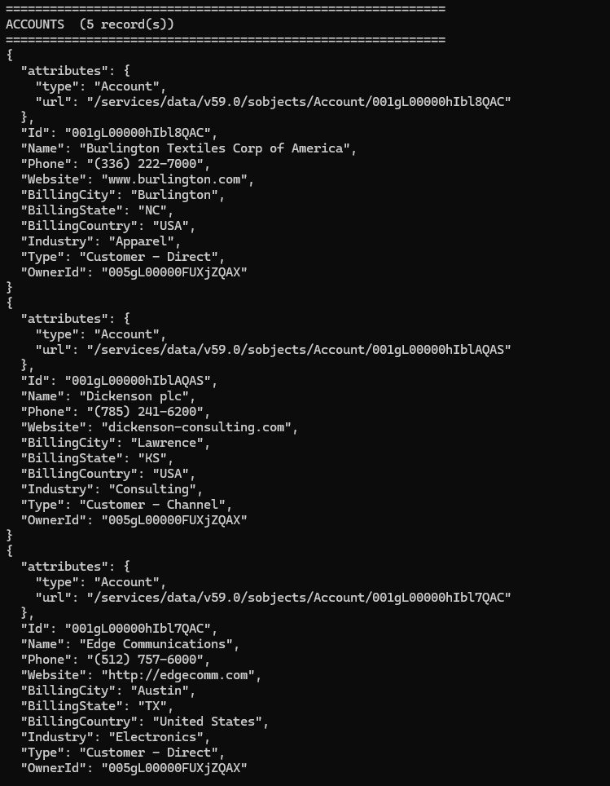
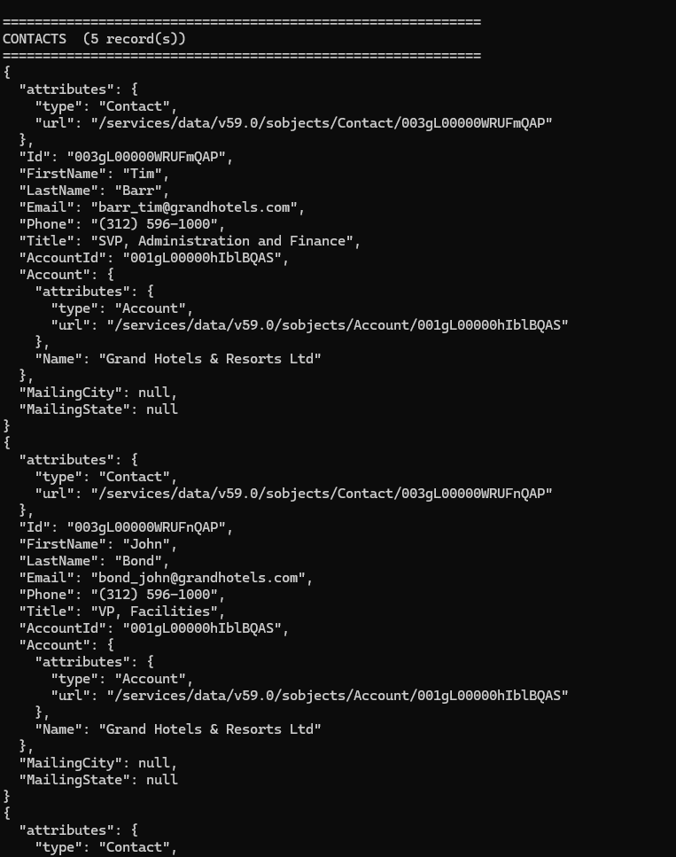
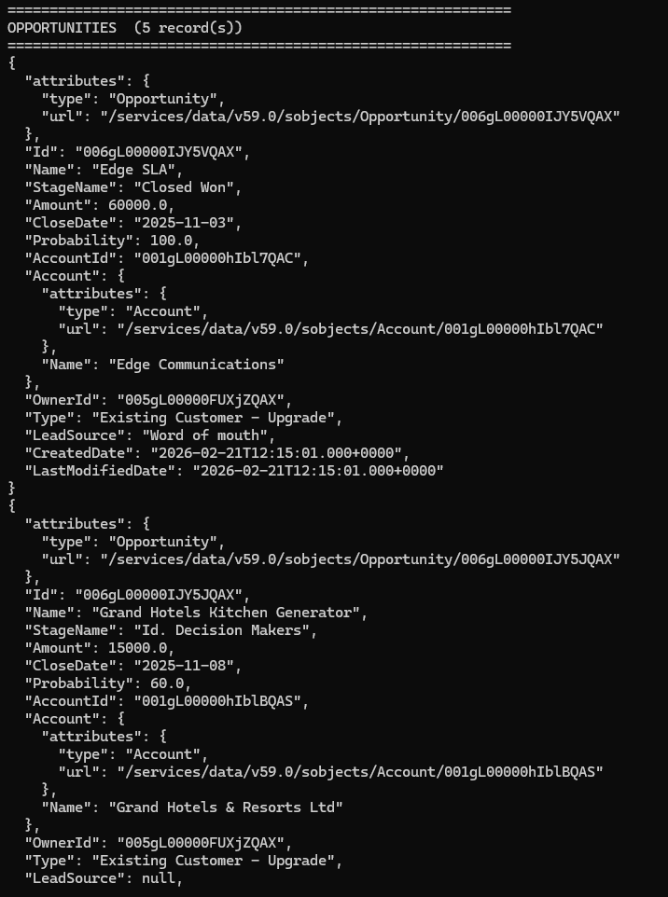
MCP Connection to Salesforce
MCP server successful connection to a live Salesforce org and data retrieval.
MCP server queried Salesforce and returned 5 account records.
MCP server queried Salesforce and returned 5 contact records.
MCP server queried Salesforce and returned 5 opportunity records.

Slide 23
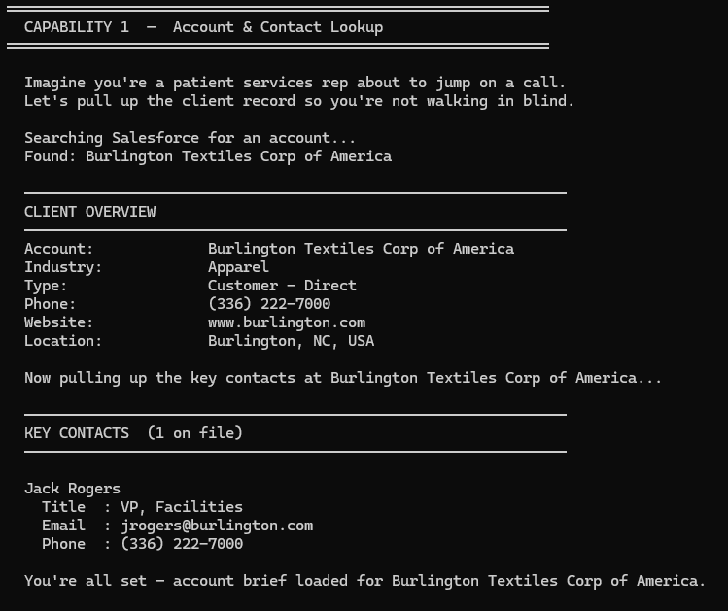
Capability 1 - Query Account and Contact Records
Who am I working with?
Asked Claude to pull up account information.
Provided client overview and key contact information.
Essential for when you’re about to hop on a call and don’t want to walk in blind.

Slide 24
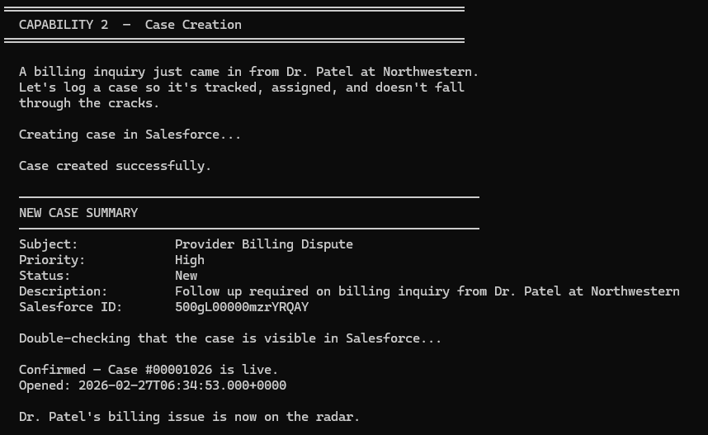
Capability 2 – Create and Update Cases
What are we currently working on?
Asked Claude to pull up create a case in Salesforce due to an ad hoc request.
Saved time from manually entering data and logging information in excel trackers.

Slide 25
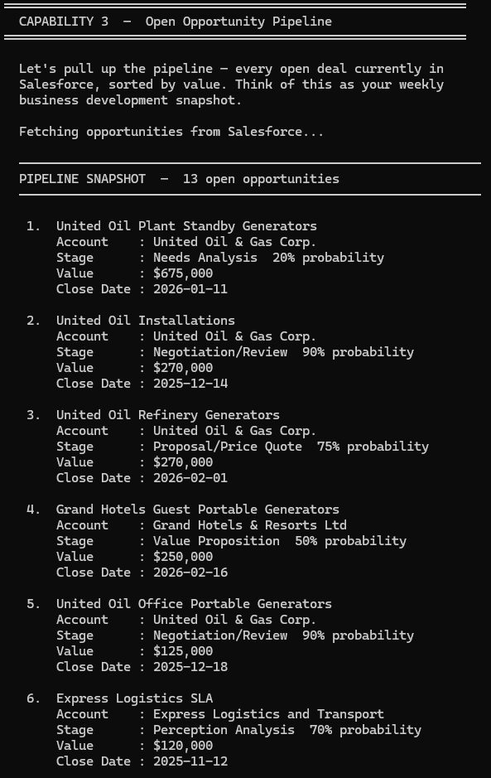
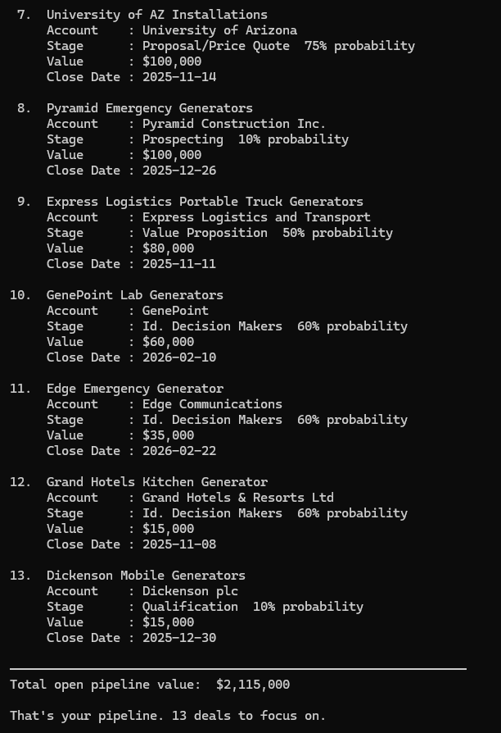
Capability 3 – Query Opportunities
What are the future opportunities?
Looking down the pipeline at every open deal currently in Salesforce.
Automatically sorted it by value.
Provided total pipeline value.
Good overview of leads to pursue.

Slide 26
Technical Decisions & Trade-offs

Slide 27
Objectives
Active’s six technical assessment objectives.
Install and use Claude Code to understand MCP capabilities firsthand.
Establish clear objectives for what capabilities the MCP will enable.
Research Salesforce API requirements and authentication patterns.
Implement core MCP functionality with at least 3 Salesforce functions.
Define requirements and scope for my MCP server implementation for Healthcare clients and use cases.
Document your technical decisions and trade-offs.

Slide 28
Technical Decisions
Technical justification for decisions made during my execution of Active’s technical assessment.
Username-Password OAuth Flow
Scoping Universal Salesforce Objects
PHI Exclusion
REST API
1
2
3
4
Multiple API types.
RST API is modern and widely documented
SOAP API is older.
Bulk API is design for mass operations.
Used during sandbox.
JWT Bearer does not expose user credentials.
JWT Bearer Flow is used in production.
My selections are present in almost every Salesforce org.
Makes MCP server portable across client environments.
Excluded Protected Health Information.
Both technical and risk management decision.

Slide 29
Thank you!

