Slide 1

SOLVING RIEMANN INTEGRABLE FUNCTIONS
Andrew Owen & Michael MacCallum

Slide 2
Wat
Riemann Sums

Slide 3
What is a Riemann Sum?
Numerical method for approximating integrals
Found by summing the area of N rectangles or trapezoids below a function
Function must be integrable

Slide 4
Four Methods to Calculate Riemann Sums
Left
Right
Middle
Trapezoidal

Slide 5
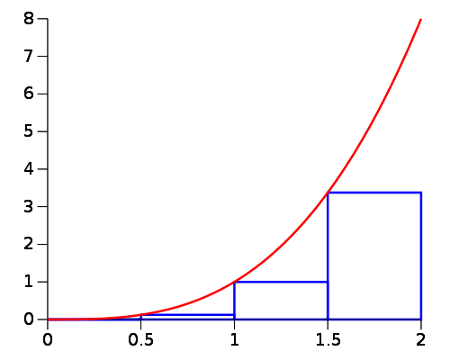
Left Sum

Slide 6
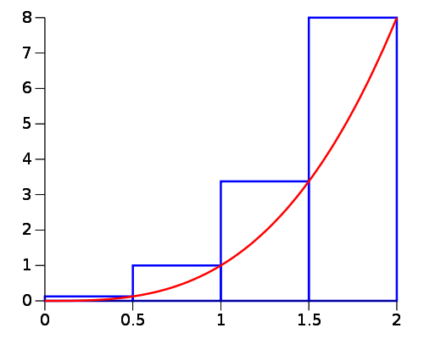
Right Sum

Slide 7
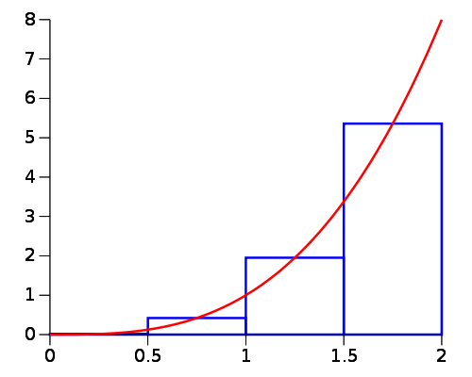
Middle Sum

Slide 8
Trapezoid Method

