Slide 1
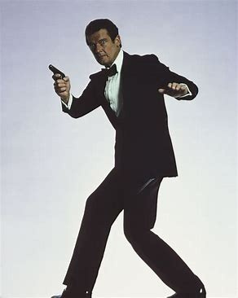


APP TRADER
REVIEW
EDDIE KINNARD
CHIEDOZIE UHUEGBU
CALEB LUCAS
RUSHI CHOKSHI

Slide 2
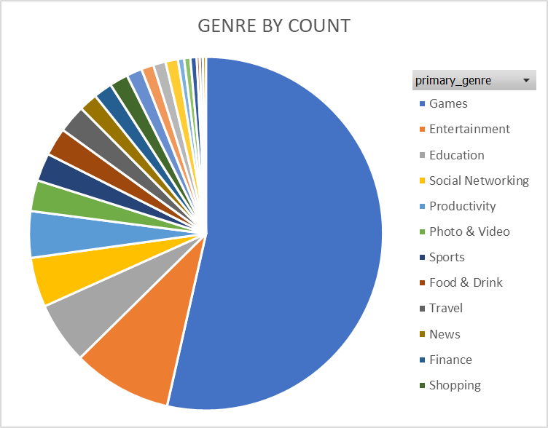
Pitch Deck
THYNK UNLIMITED
PROBLEM
MARKET SATURATION
GAME HEAVY MARKET
Productivity has highest average profitability.
Far more games over both app stores than other genres.
Genre | Average Estimated Profitability | Count of App Name
Productivity | 454000 | 15
Games | 451861 | 189
Book | 450100 | 1
Health & Fitness | 450050 | 4
Reference | 446000 | 2

Slide 3

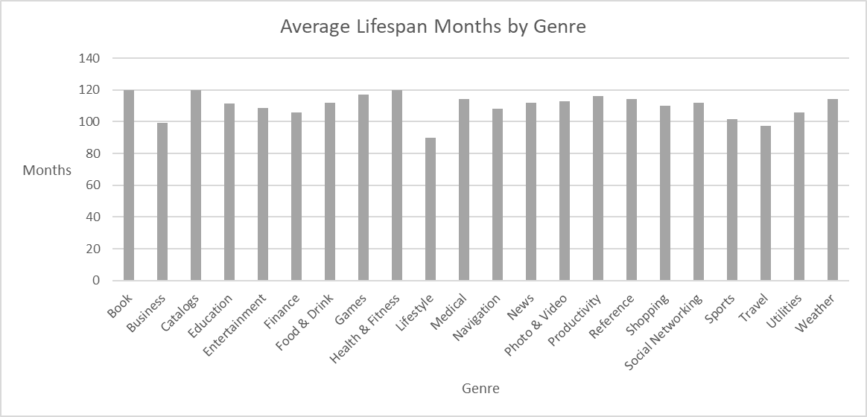
AVERAGE LIFESPAN BY GENRE OF APPS IN BOTH STORES
Pitch Deck
THYNK UNLIMITED

Slide 4
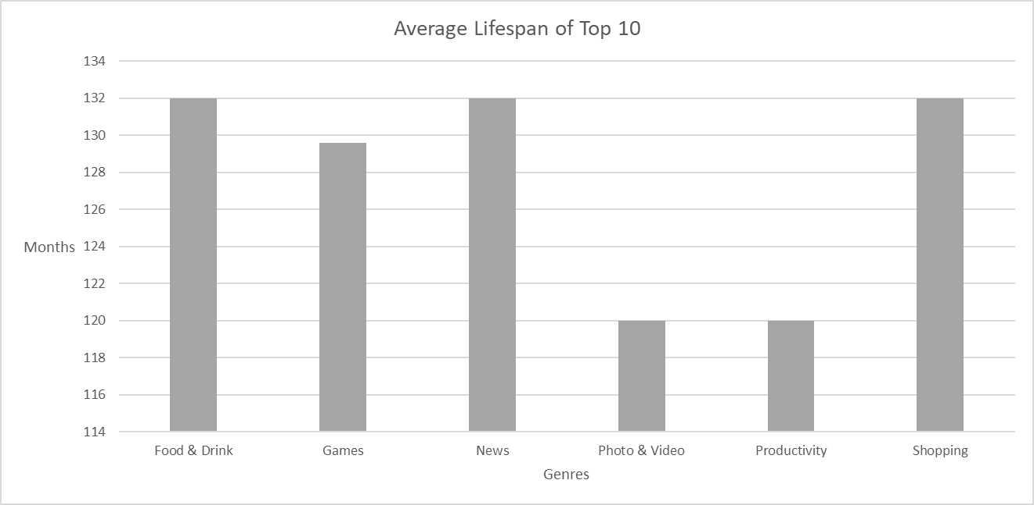
AVERAGE LIFESPAN OF TOP 10 BY GENRE OF APPS IN BOTH STORES
Pitch Deck
THYNK UNLIMITED

Slide 5
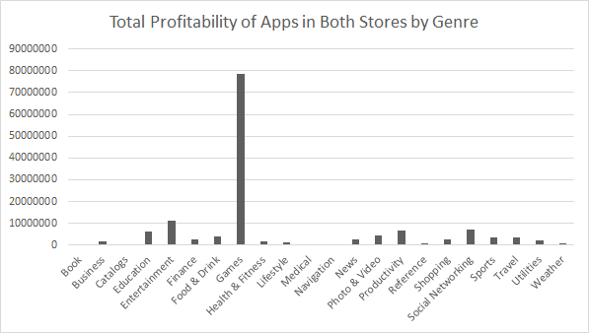
DISTRIBUTION OF PROFITABILITY VS. NUMBER OF APPS
Pitch Deck
THYNK UNLIMITED
Total of 353 apps in both app stores
Combined profitability of $143,131,800

Slide 6
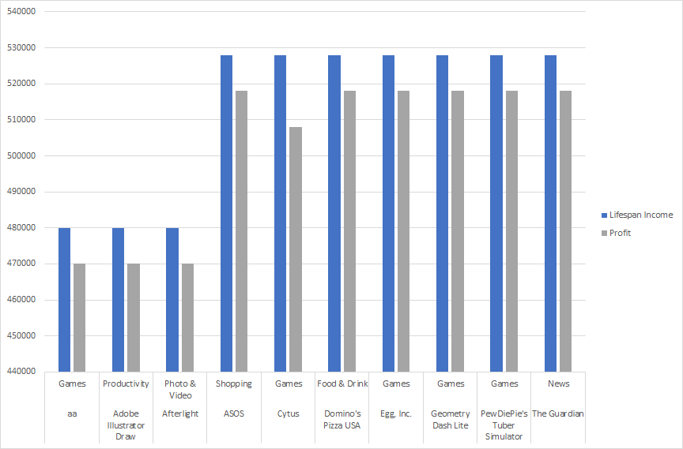
Top Ten Apps Profitablity Margin

Slide 7
Pitch Deck
TOO_MUCH_PANTLEG
PROBLEM
APP CHOICES AND
PROFITABILITY RANKINGS
Total Profitability - High app rating leads to longevity and longevity leads to higher income
Selected apps have high average rating and longer lifespan
Focus on apps in both stores to save on marketing costs
App Name | Category | Average App Rating | Estimated Profitability
ASOS | SHOPPING | 5 | $518,000.00
Domino's Pizza USA | FOOD_AND_DRINK | 5 | $518,000.00
Egg, Inc. | FAMILY | 5 | $518,000.00
Geometry Dash Lite | GAME | 5 | $518,000.00
PewDiePie's Tuber Simulator | FAMILY | 5 | $518,000.00
The Guardian | NEWS_AND_MAGAZINES | 5 | $518,000.00
Cytus | GAME | 5 | $508,100.00
aa | FAMILY | 4.5 | $470,000.00
Adobe Illustrator Draw | PHOTOGRAPHY | 4.5 | $470,000.00
Afterlight | PHOTOGRAPHY | 4.5 | $470,000.00

