Slide 1
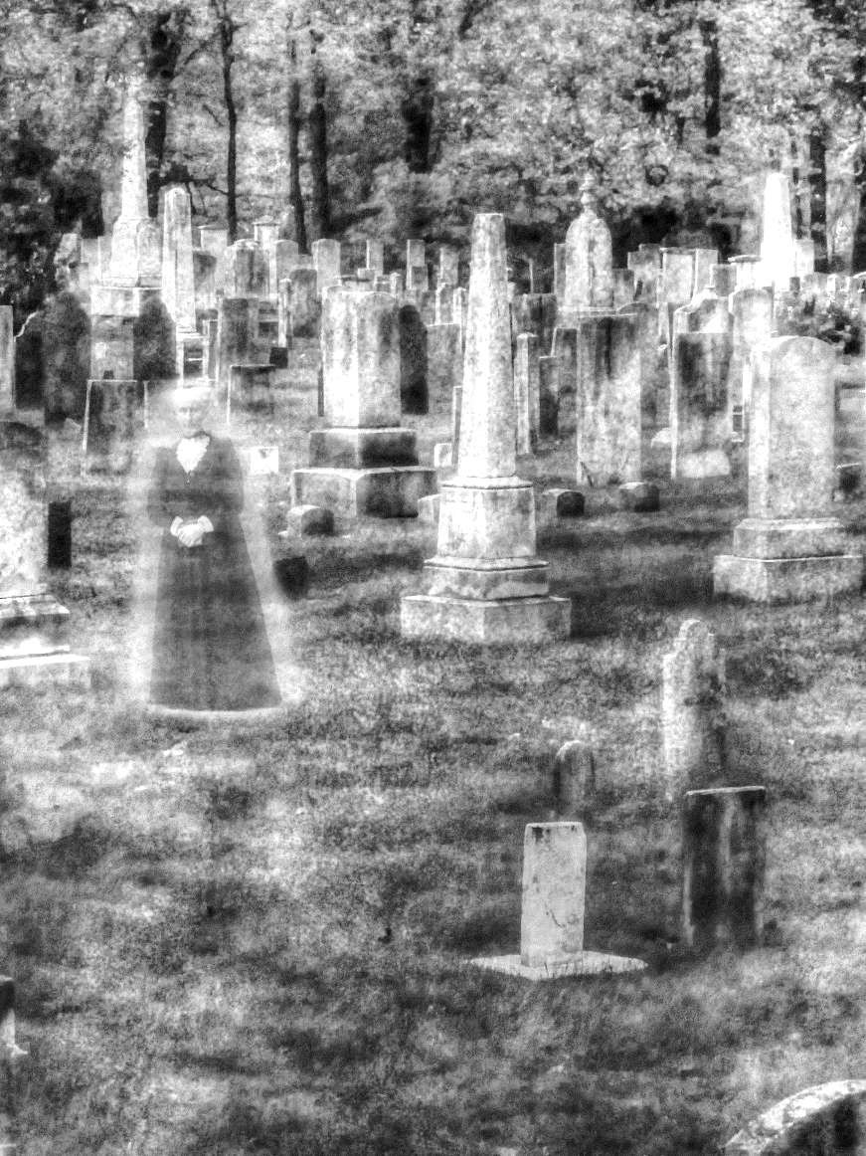
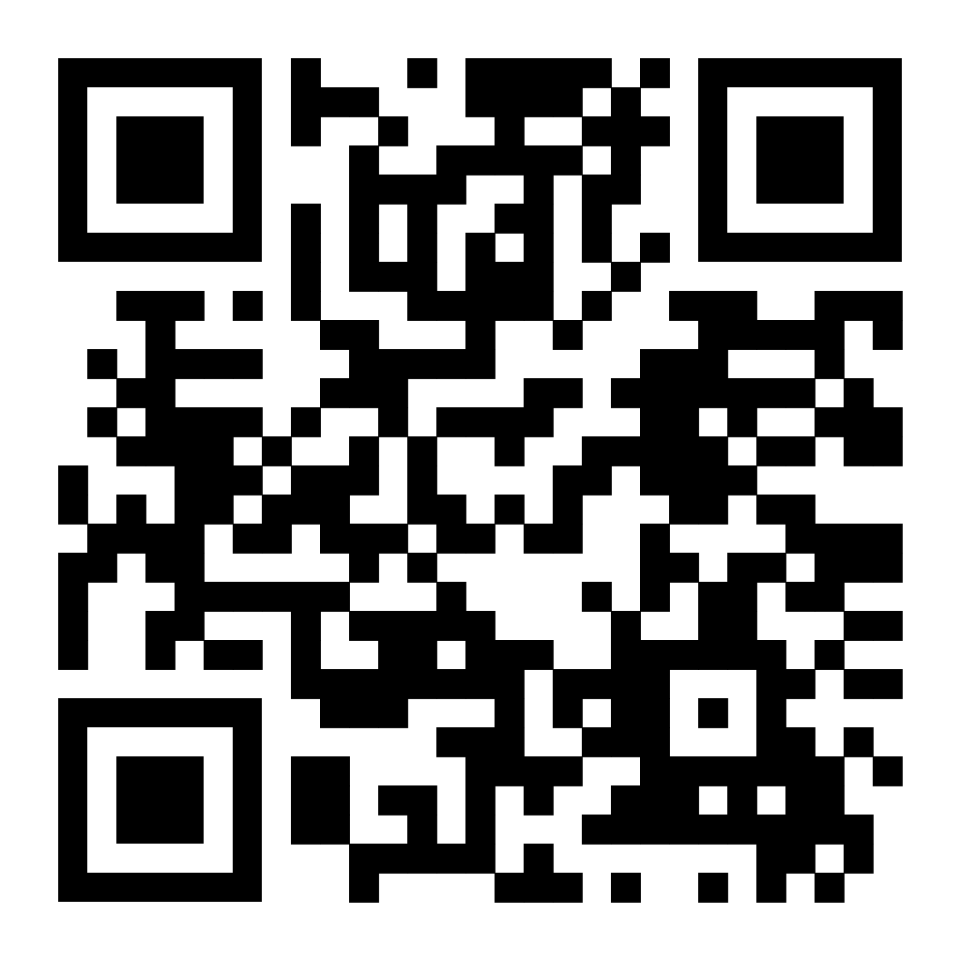
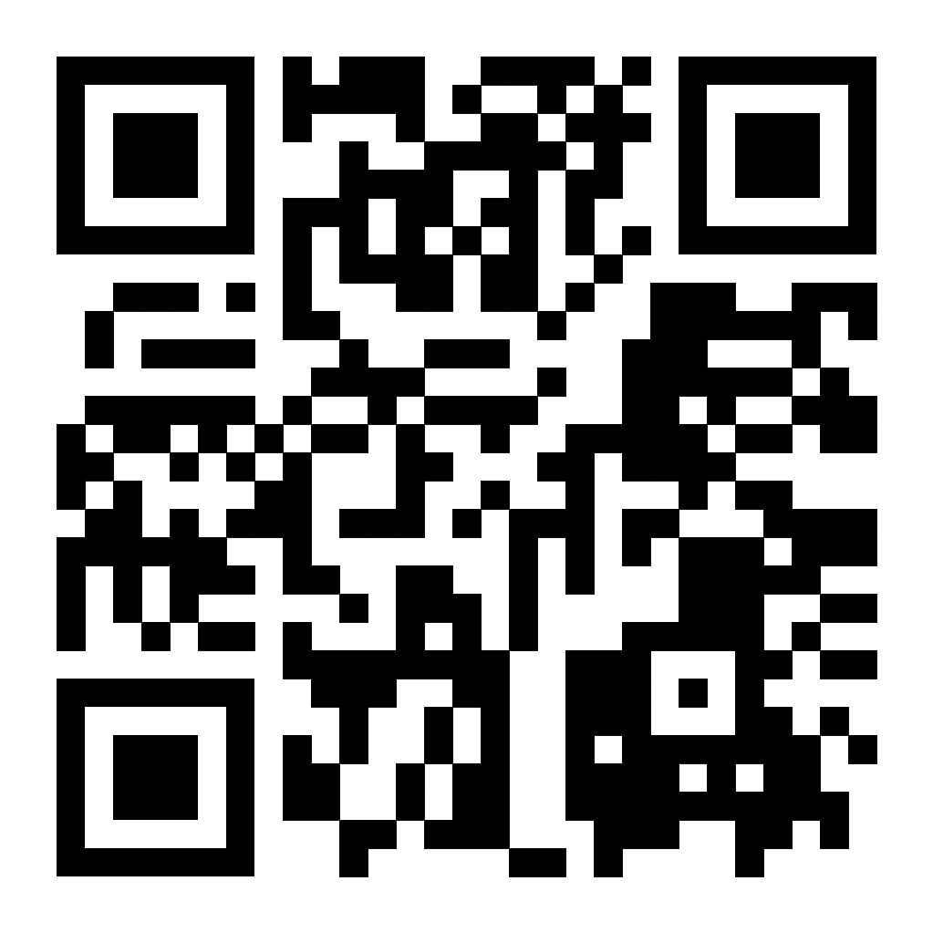
Nashville City Cemetery
Visit Nashville’s oldest public cemetery – home of 20000 souls from the past. Nashville City Cemetery is the final resting place of many individuals who have shaped Nashville – including the founders of Nashville, mayors, public education pioneers and one of the original Fisk Jubilee singers.
Tours are self-guided through our app that’s available on the App Store and Google Play. We also have events throughout the year that you and your family will enjoy including scavenger hunts to murder mystery tours. For more information, please visit our website via the QR code at the bottom along with a few trivia questions about our cemetery. We hope to see you soon!
Our Website
NCC Trivia
.

