Slide 1

Lift Every Voice & Sing
During Black History Month, please join us for our Celebration of Life of Nashville’s prominent Black community members.
Please join us every Saturday in February from 12p-3p

Slide 2
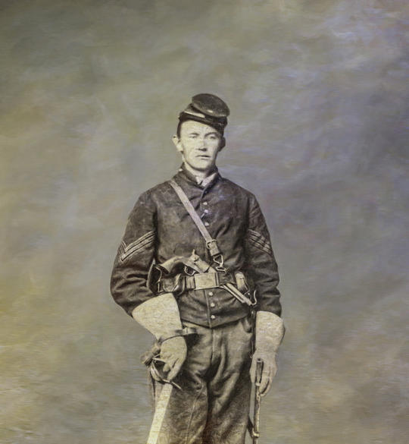
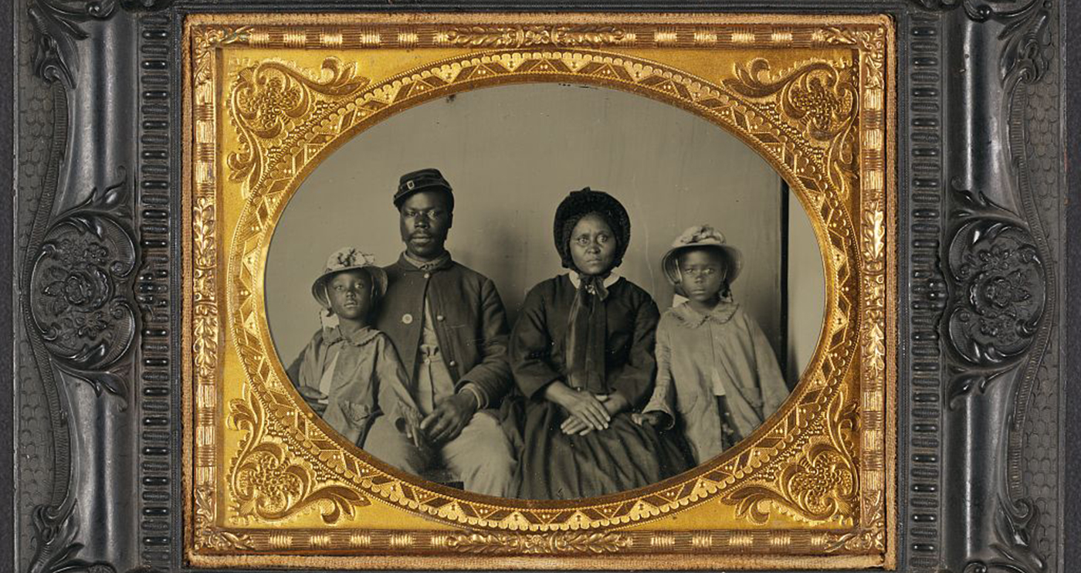

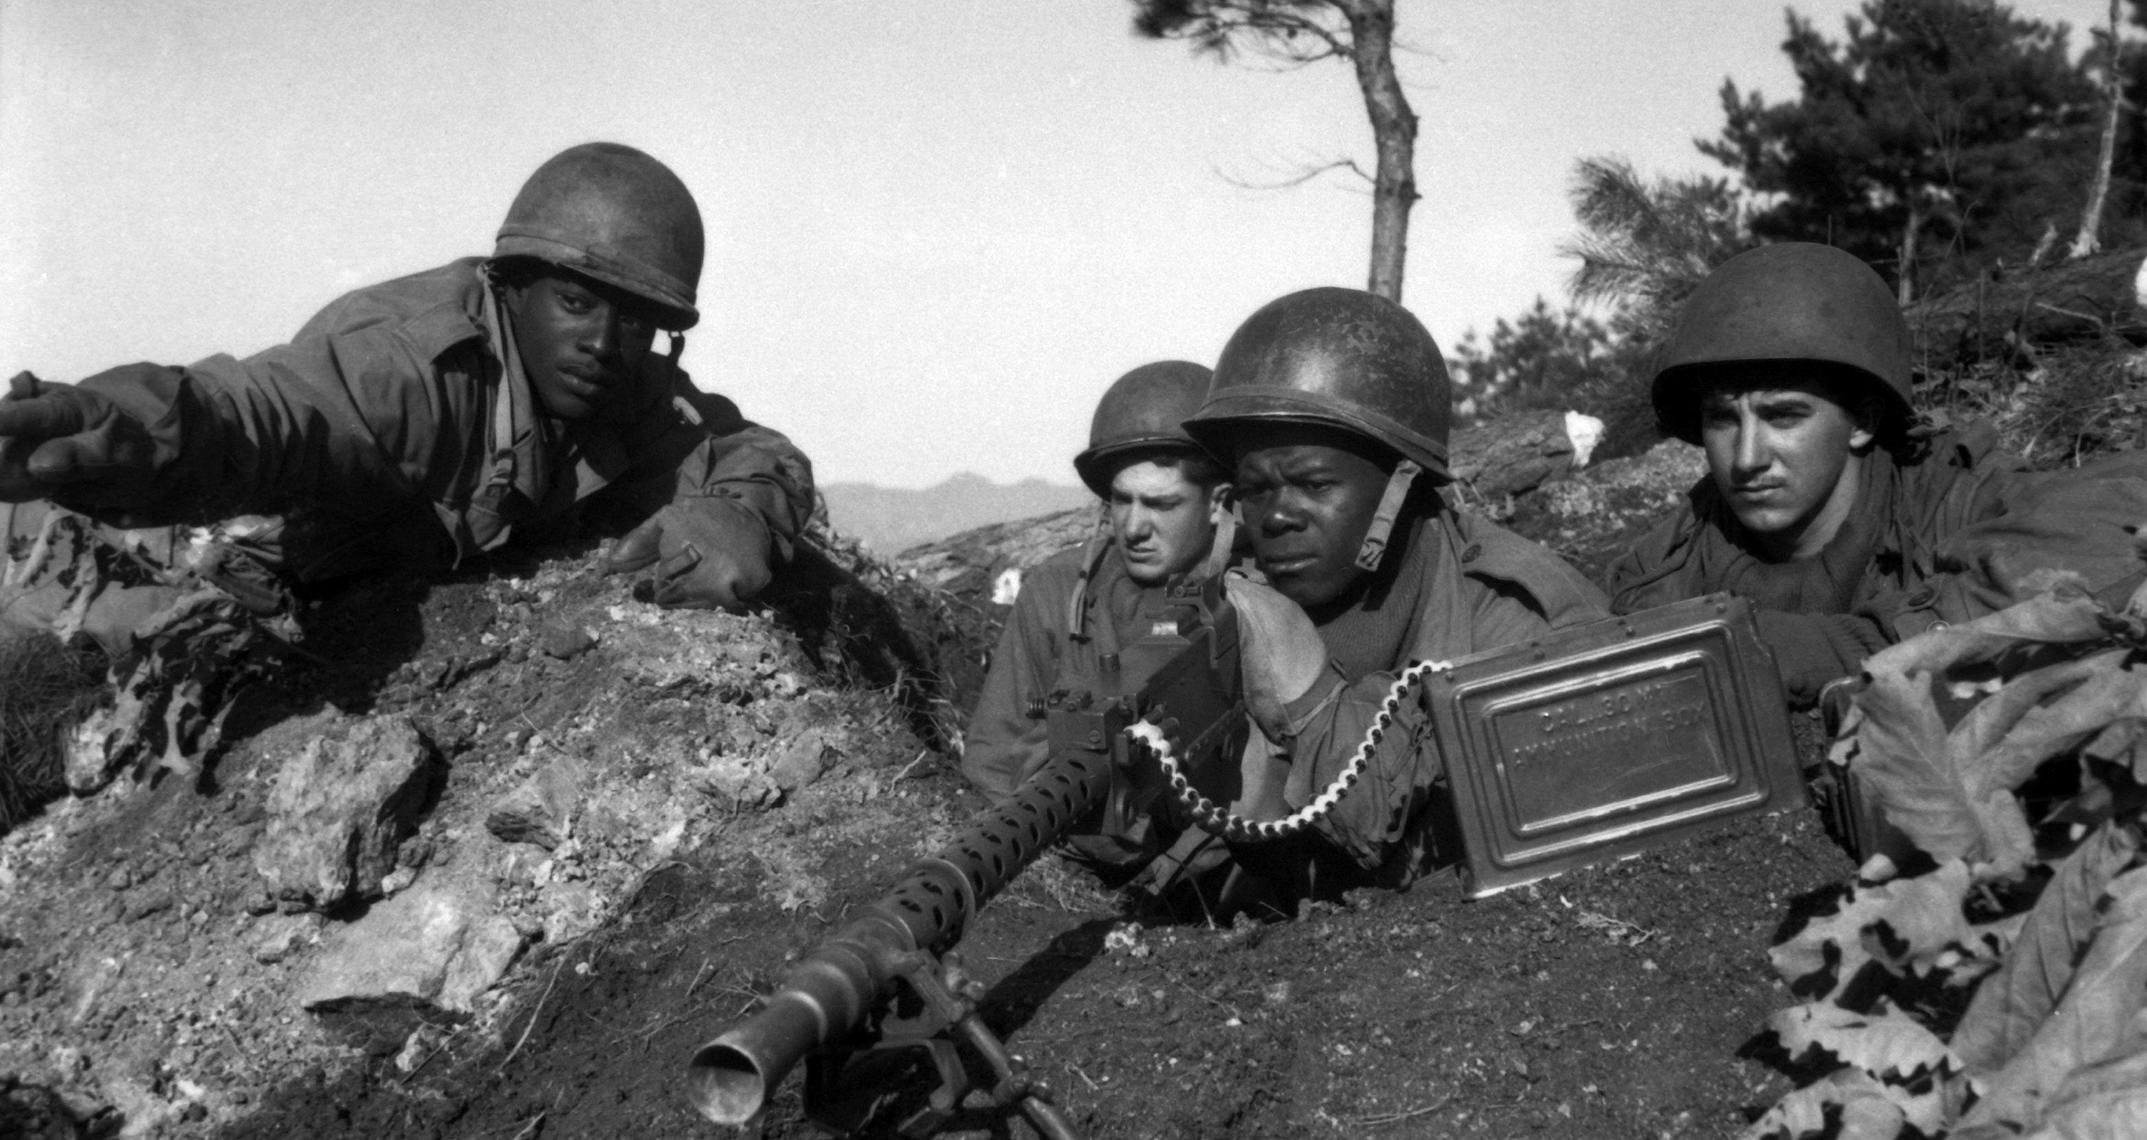

Monday, May 27, 2024
Please join us as we honor and mourn our local heroes

Slide 3

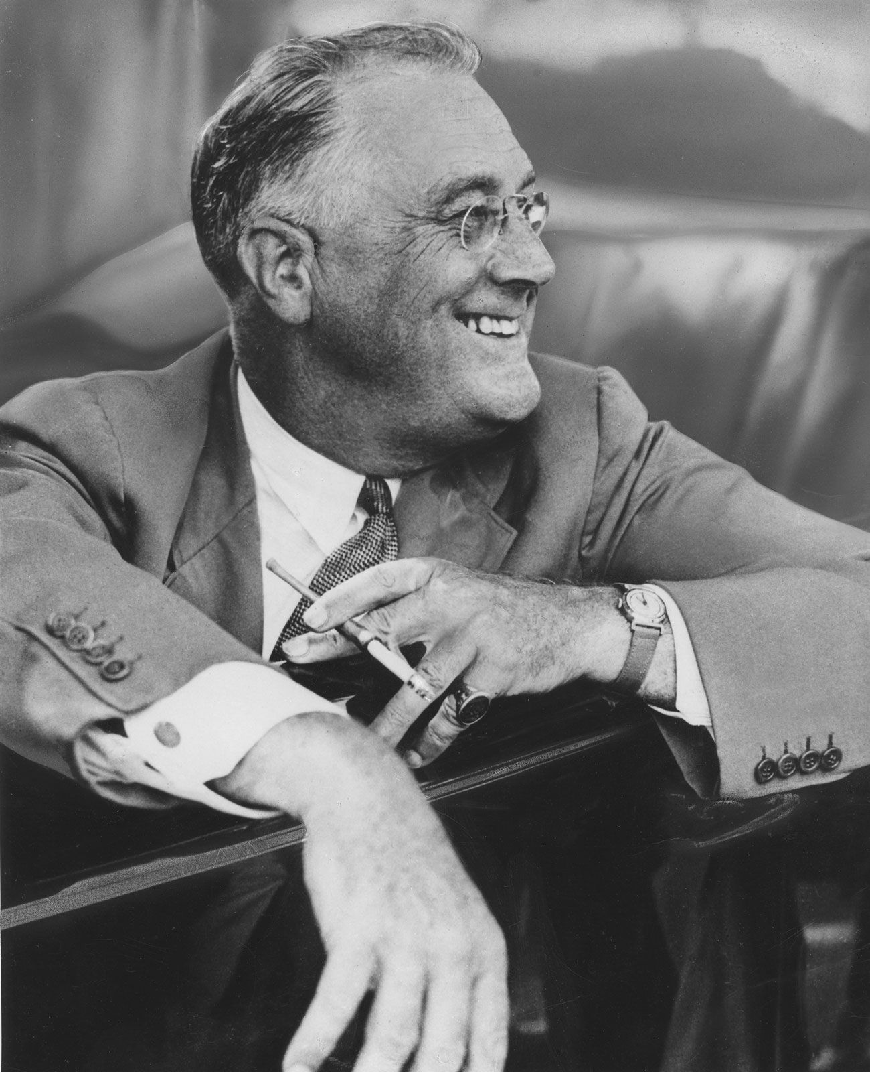


March 11, 2024
Please join us as we honor and mourn our local heroes

