Slide 1
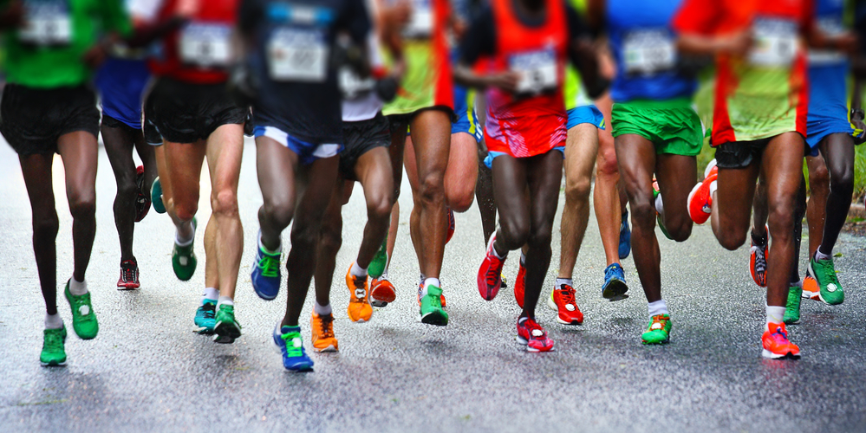
Nashville Rock-and-Roll
Marathon and Half-Marathon
Race Results from 2016-2019

Slide 2
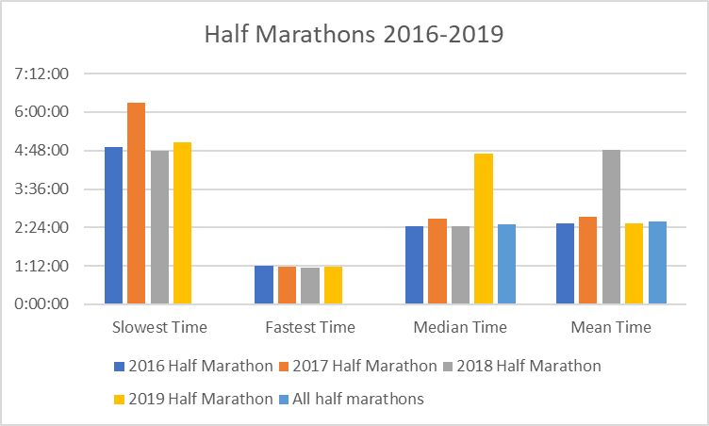
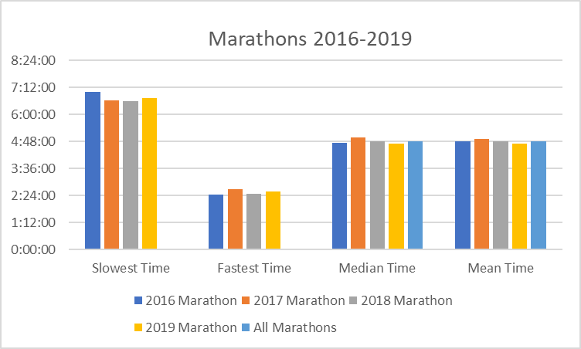
Marathon & Half-Marathon Times
2016-2019

Slide 3
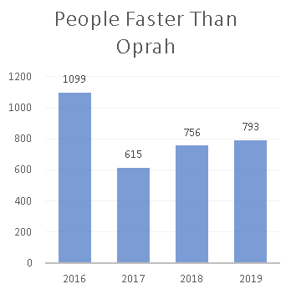

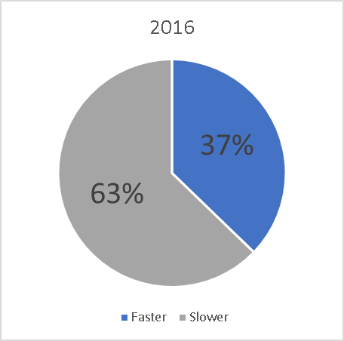
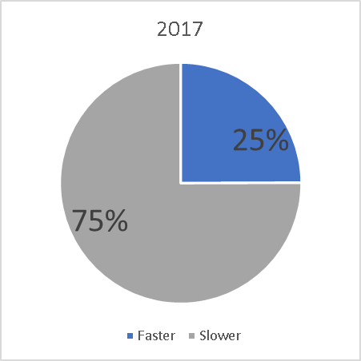
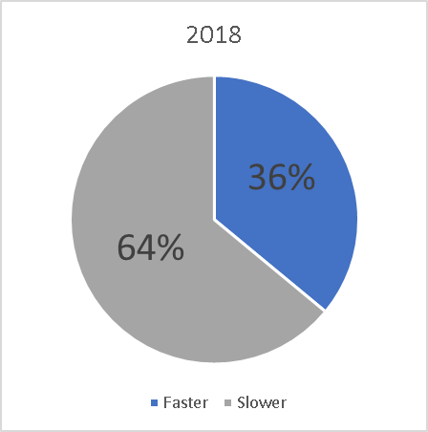
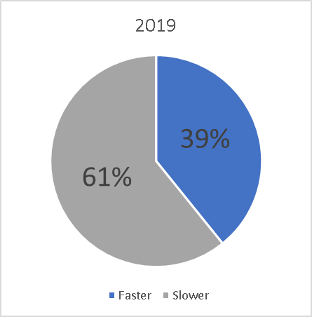
Are you Faster Than Oprah?
4:29:20
How many runners each year beat Oprah’s time?
What percentage of runners in each of the 4 marathons beat Oprah’s time?

Slide 4
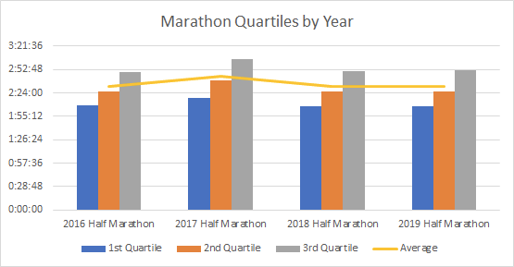
Find the Values that Define the First, Second, and Third Quartiles for Each Half-Marathon

Slide 5
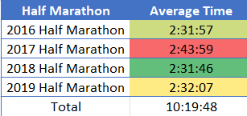
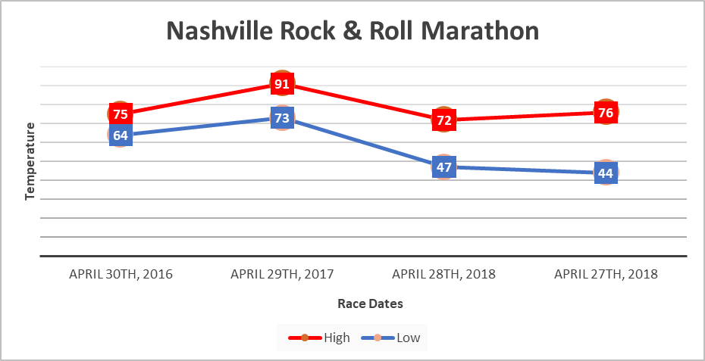
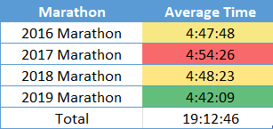
Is There a Year in Which Runners Seem Slower or Faster?

Slide 6
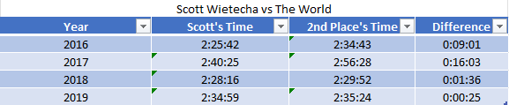
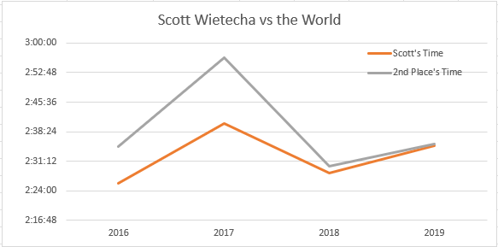
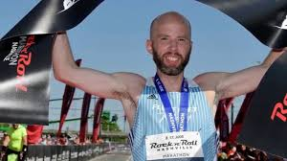
Scott’s Time Vs. The Next Fastest Runners
2016-2019
Scott’s fastest year was 2016
The biggest difference in times was in 2017
The smallest difference in times was in 2018

