Slide 1
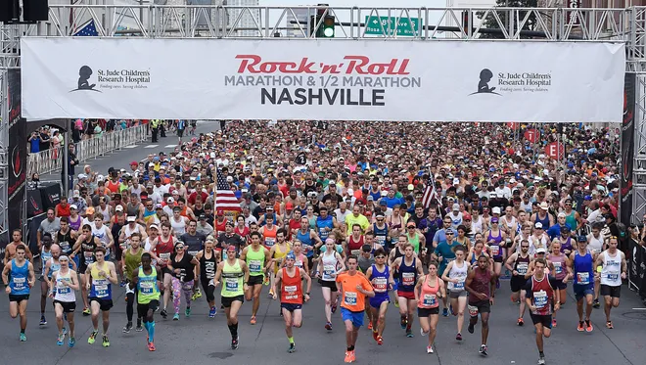
2016 - 2019
Analytical case study with key insight
Distance Marathon: 26.1 miles HM: 13.1 miles
Presented By: Team SoundGarden, Sep 14 2024
Date: April
Previously known as the Country Music Marathon

Slide 2
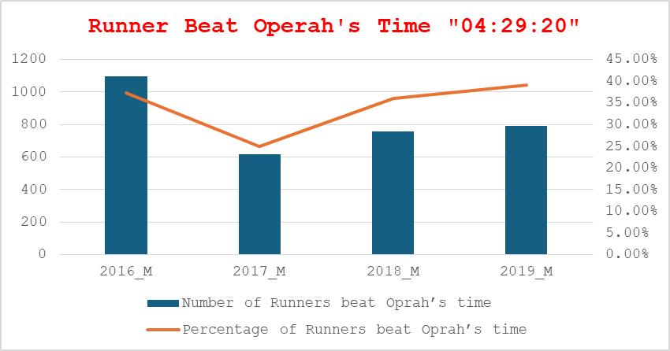
TV host Oprah Winfrey's Marine Corps Marathon time of four hours 29 minutes 20 seconds. which she achieved, aged 40, in 1994.

Slide 3
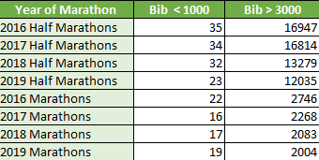
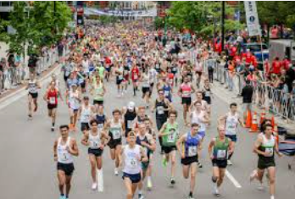
Popular Bib number of marathon runners!

Slide 4
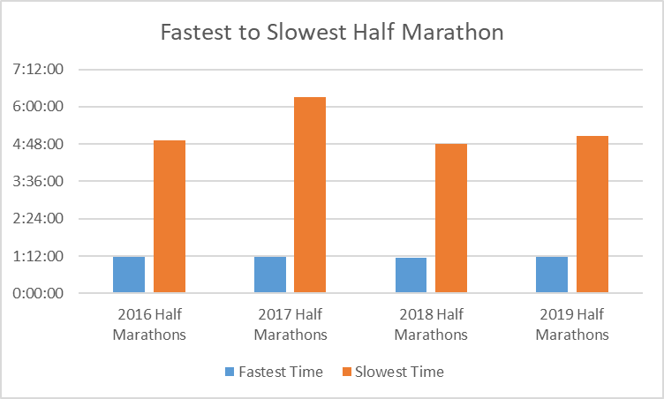
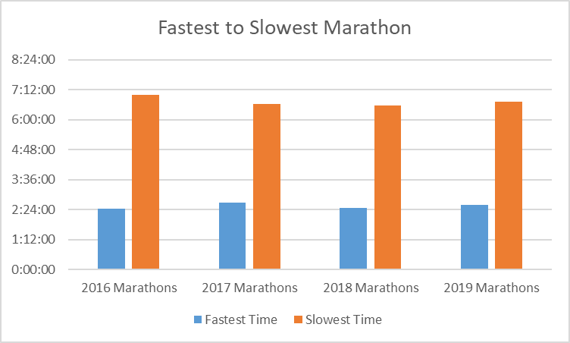
Fastest to Slowest Marathon Time

Slide 5

Dibran Rexhepi VS 2016HM April 30, 2016
1st Quartile | 2:08:18
Time 2:08:35 Rank # 4592/18151
Fastest | Slowest | Median | Mean
1:11:15 | 4:54:41 | 2:26:18 | 2:31:57

Slide 6
Median Time and Mean Time
Median Time Half_Marathon
2016 2:26:18 AM
2017 2:39:34 AM
2018 2:25:32 AM
2019 2:26:07 AM
Median Time Full_Marathon
2016 2:26:18
2017 2:39:34
2018 2:25:32
2019 2:26:07
Half Marathon
Fastest 2018 Duration 1:09:25
Slowest 2017 duration: 6:18:24

Slide 7
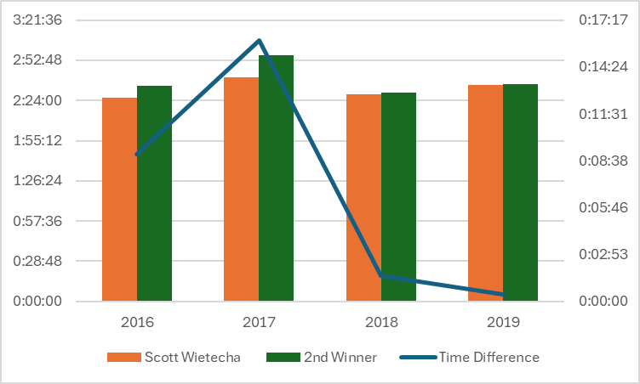
Scott Wietecha’s Journey of Marathon Wins

