Slide 1
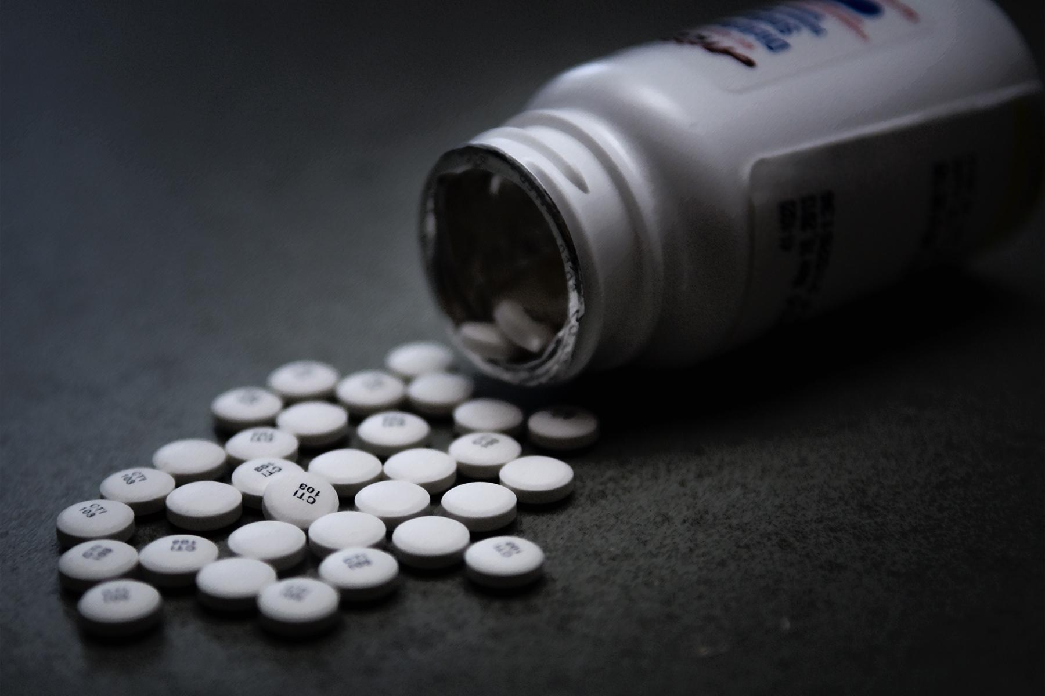
Scrooges!!
Tennessee Opioid Crisis
Presented by The Scrooges:
Jesse Crawford
Zia Rahman
Narendra Kharel
Ebuka Ajagu

Slide 2

Agenda/Clinical Analysis : Tennessee Opioid Crisis
Investigating which county had a disproportionately high number of opioid prescriptions
Top Opioid prescribers in the state
Trend in overdose deaths due to opiods from 2015 - 2018
Associations between rates of opioid prescription and overdose death by county
Associations between specific opioids + long-lasting vs normal opioids and overdose deaths.

Slide 3
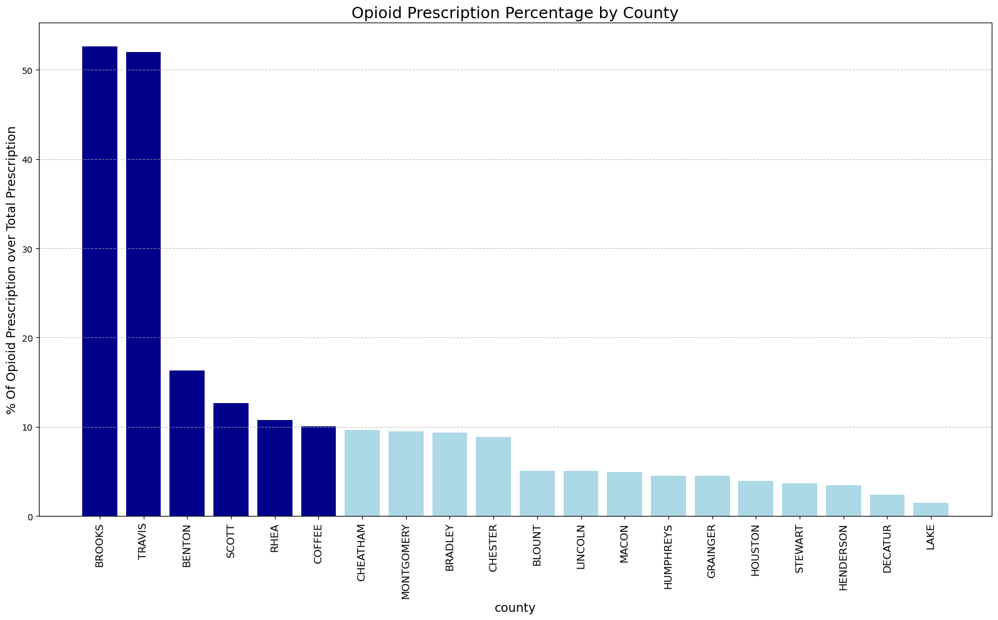
Which Tennessee counties had a disproportionately high number of opioid prescriptions?
Top two has less significance because of smaller size of prescription..
Bar with dark blue has more than 10% Opioid prescription over Total prescription.
County | Total Number of Claim | Total No. of Opioid Claim | % of Opioid Prescription
BROOKS | 38 | 20 | 52.63
TRAVIS | 77 | 40 | 51.95
BENTON | 73935 | 12046 | 16.29
SCOTT | 206112 | 26159 | 12.69
RHEA | 196808 | 21238 | 10.79
COFFEE | 463381 | 46571 | 10.05

Slide 4
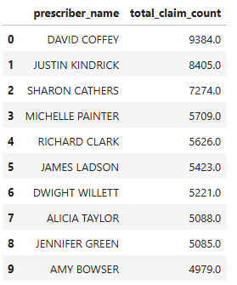
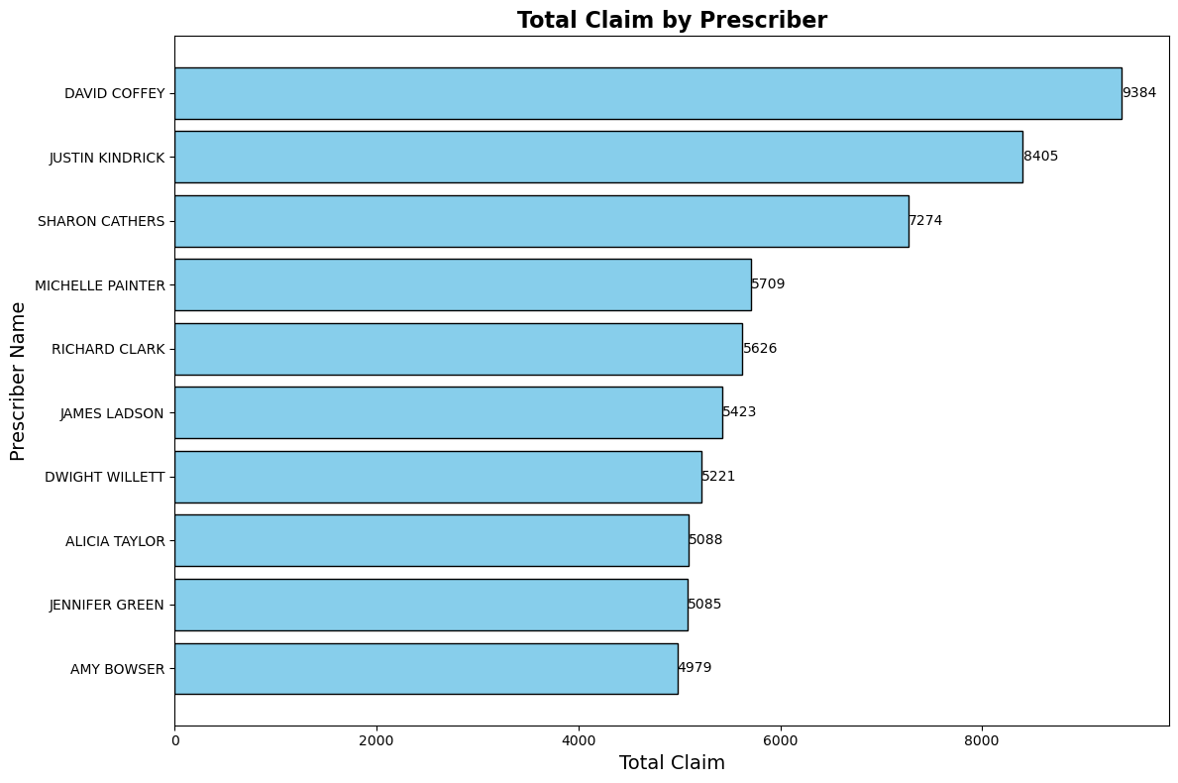
Top 10 Opioid Prescribers in Tennessee
Prescriber Total Claim

Slide 5
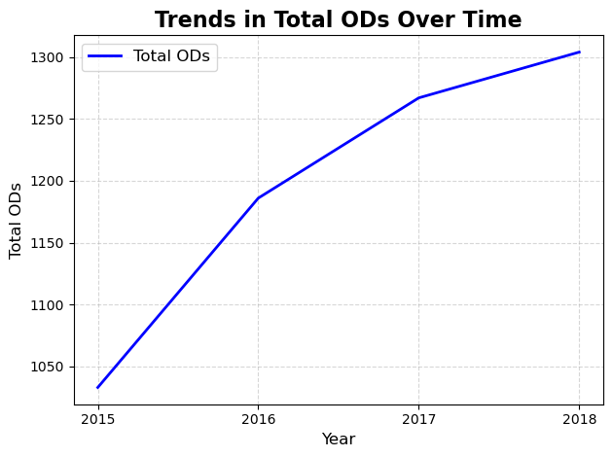
YEAR | DEATHS
2015 | 1033
2016 | 1186
2017 | 1267
2018 | 1304
Overdoses up ~26% within this 4 year span.

Slide 6
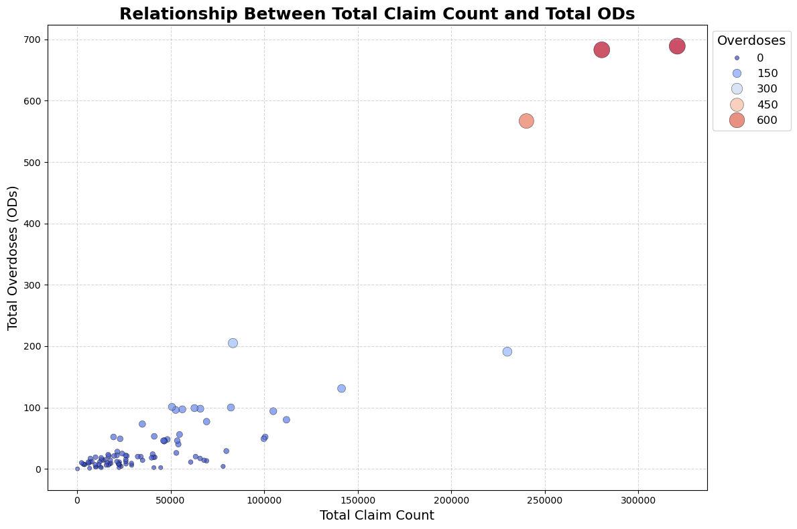
Upward trend indicates positive correlation
As total claims approach 250k, overdoses skyrocket.
Rutherford County, 205

Slide 7
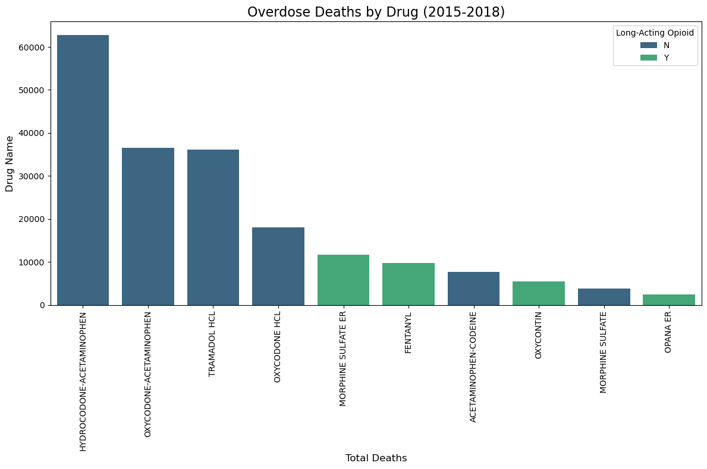
Which Opioids Are Doing the Most Damage?
Hydrocodone-Acetaminophen and Oxycodone-Acetaminophen are associated with the highest number of overdose deaths.
Most of the top contributors to overdose deaths are not classified as long-acting opioids.But they are still significant contributors.
Overdoses
•Pain that isn't relieved by non-opioid pain medications alone
•Severe, chronic pain in people who are opioid tolerant
Drug Name

Slide 8
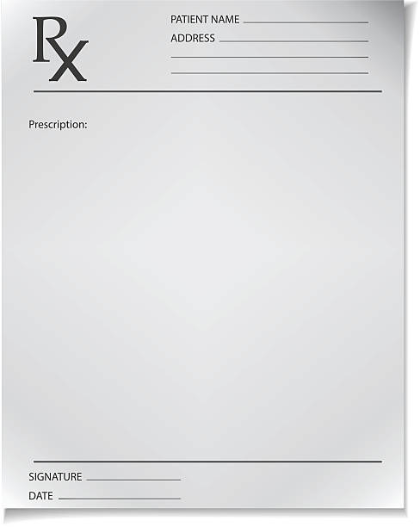
In Conclusion…
In conclusion
Rural counties seem to have the highest ratio of opioid prescriptions
The top 10 prescribers account for over 62k claims in the timeframe.
Opioid overdoses increase year after year in the timeframe.
The more opioids prescribed, the higher the rate of overdoses.
Top 3 deadly opioids are : Hydrocodone, Oxycodone, and Tramadol.

