Slide 1
Tennessee opioid prescriptions and overdose deaths
Presented by:
Brenda
Janvi
Richard

Slide 2
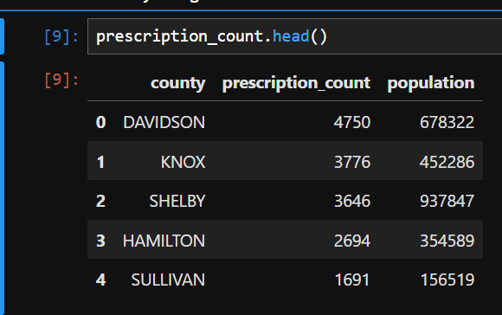
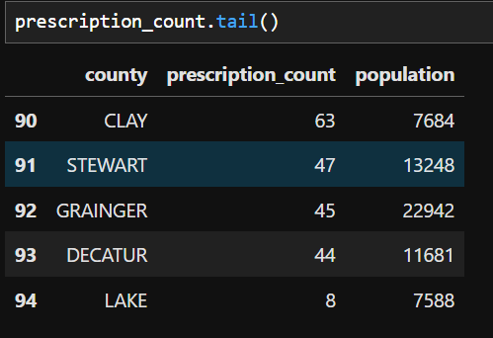
Top 5 Tennessee counties with high number of opioid prescriptions
Davidson county has the highest number of opioid prescription which is 4750, followed by Knox and Shelby counties with more than 3500.
The lowest prescription is in Lake County with total count of 8.

Slide 3
Top opioid prescribers for the state of Tennessee

Slide 4
Trend in overdose deaths due to opioids
Year | Total Overdose Deaths
2015 | 1033
2016 | 1186
2017 | 1267
2018 | 1304
Deaths in Tennessee due to overdose has increased over the years.
About 300 more deaths were recorded in 2018 than 2015.

Slide 5
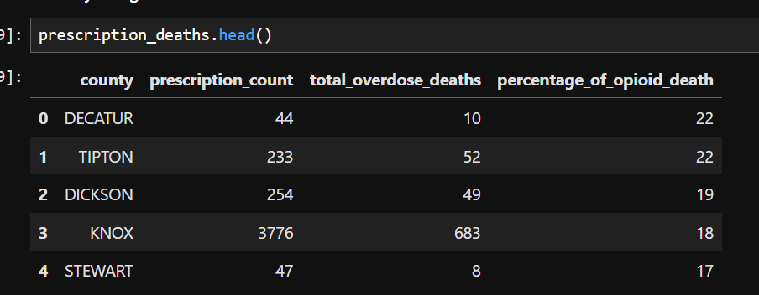
Opioid prescriptions and overdose deaths by county
The count of overdose deaths is definitely high where the prescription count is high like KNOX county with 3776 prescription and 683 deaths; however,
If we look at the percentage of deaths as compared to prescription count, then DECATUR county has the highest percentage of overdose deaths.
So, there is no correlation with overdose deaths and high prescription count.

Slide 6
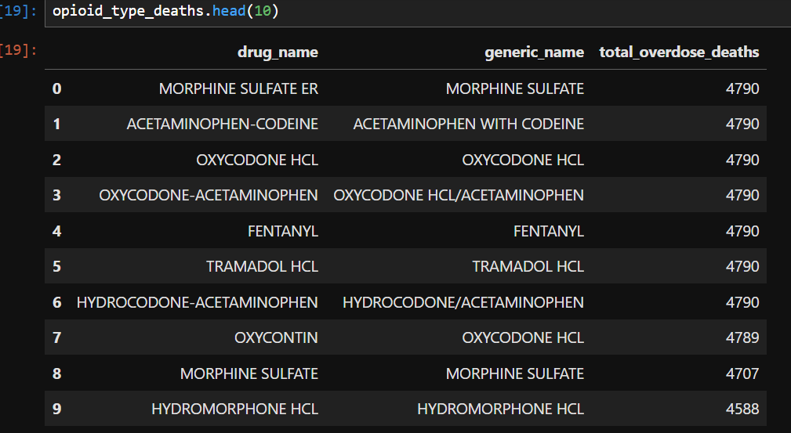
Association between a particular type of opioid and number of overdose deaths
Since, there is no Unique key to directly join the tables, this is the closest we got. Multiple counties are appearing for the same zip and multiple zip for same county. So we cannot derive the accurate results from the available data.
If we can have the drug name in overdose_deaths/ zip_fips/ fipscounty table it would be easier to answer.
All type and kind of opioids have high number of overdose deaths.
They all are harmful, so need less prescription and less usage to save the world.
Natural opiates
Morphine
Codeine
Semi- synthetic opioids
Oxycodone
Hydrocodone
Fully synthetic opioids
Fentanyl
Tramodol
Hydromorphone

Slide 7
Questions???

