Slide 1

BASEBalllll
IT’s HARD
?

Slide 2
Batting Averages

Slide 3
“In Major League Baseball, the 50 home run club is an informal term applied to the group of players who have hit 50 or more home runs in a single season. The 50 Home Run Club was "founded" by Babe Ruth in 1920…” –baseball.fandom.com

Slide 4
Increase in averages and head count in 50 Home Run Club after 1950

Slide 5
So, what happened in the 50’s and 60’s?
Professional athletes began misusing anabolic steroids during the 1954 Olympics, when Russian weightlifters were given testosterone.
DRUGS
Widely used in baseball, even encouraged and some cases players were forced to use them.

Slide 6
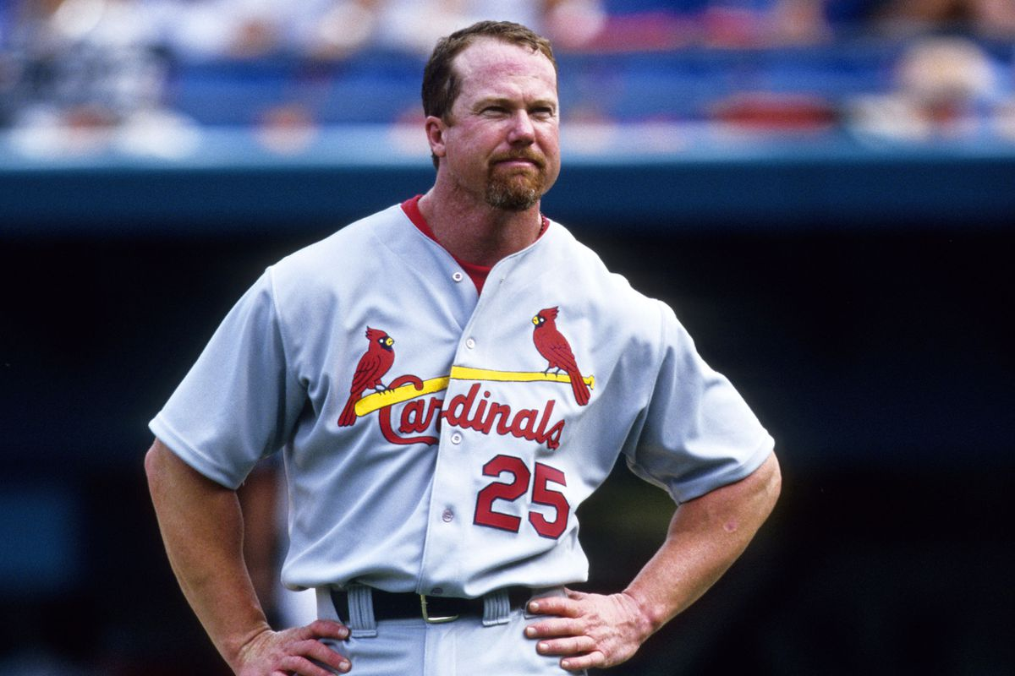
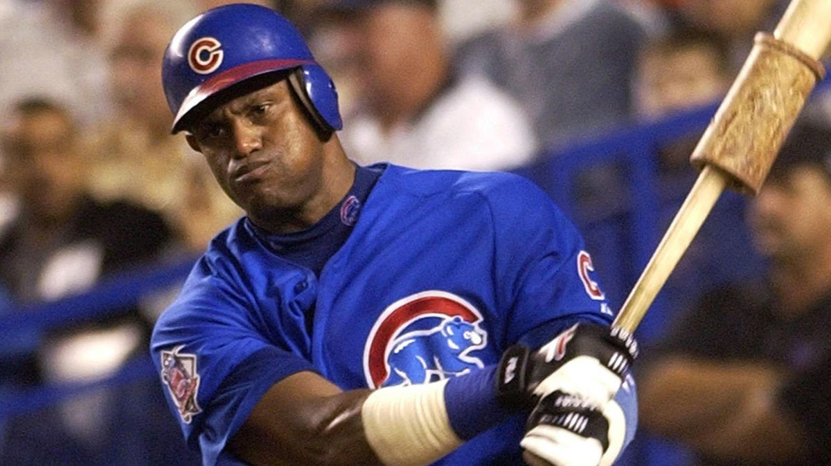
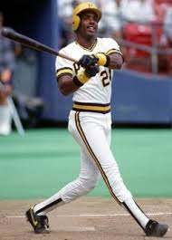
“Steroids era” strongest from 80’s -2000’s, resulting in increased offensive output . PED’s banned in ‘91 but no testing until 2003 Uptick in mid 90’s with Mcgwire, Sousa and Bonds Peaked public interest in League after previous strike

Slide 7
Numbers called into question after all 3 players were linked to PED’s
60% of 500 Home Run Club linked to PED’s
Steroids not restricted to baseball but very effective in increasing power in a semi-lazy sport ☺

