Slide 1
Salary and Success
A Brief Examination of Athletic Careers in the Major Leagues By College

Slide 2

How do we measure Success?
In college sports vs. MLB
Stats vs. Salary
Salary as a metric of success (why this is important)
Shows player merit
What they bring to the table for the brand
Win capability
Indicates assumed longevity

Slide 3
Some Salary Statistics
Constraints
Only player counts over 70
Lowest Average Salary Creighton University with $384276.86
Mean Salary for this metric is $1783058.52
Highest Average Salary University of California, Santa Barbara with $5039623.53

Slide 4
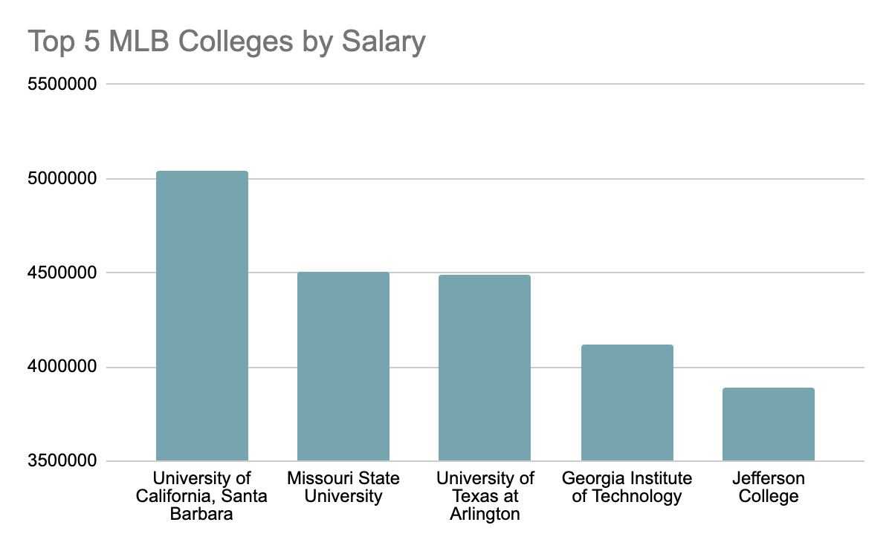
Top 5 schools in Mlb

Slide 5
What makes these schools successful?

